Slide 1
MonetDB/DataCell: Online Analytics in a Streaming Column-Store
Erietta Liarou et al.
VLDB Endowment `12
Hyun Geun Soo
2016 12 26

Slide 2
Goal
DataCell on top of an DataBase Kernel
Exploit database techniques, query optimization and operators
Provide full language functionalities (SQL`03)
Multi-query processing/scheduling
Real-time processing

Slide 3
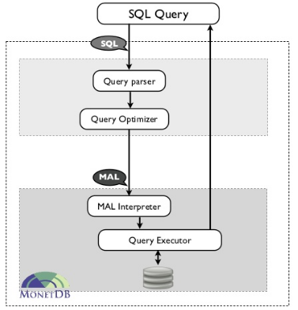
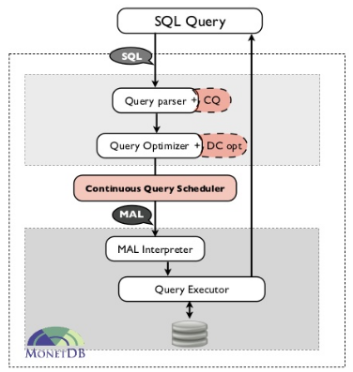

Slide 4
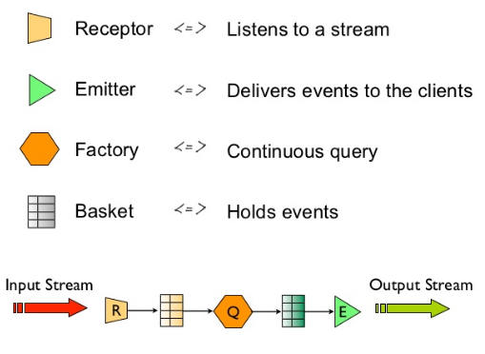

Slide 5
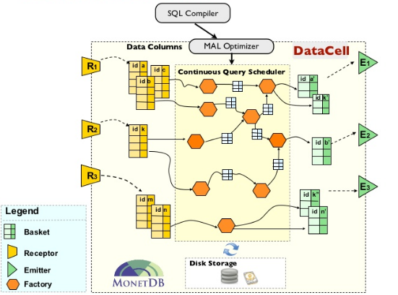

Slide 6
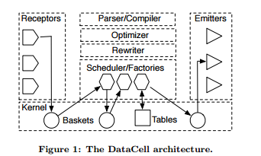
Architecture

Slide 7
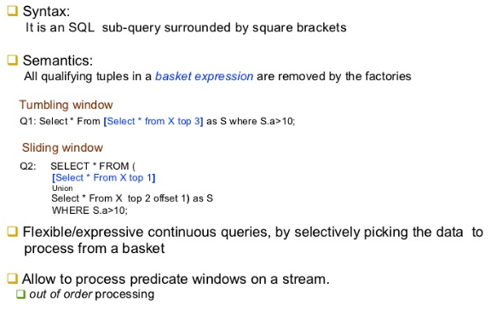
Basket Expression

Slide 8
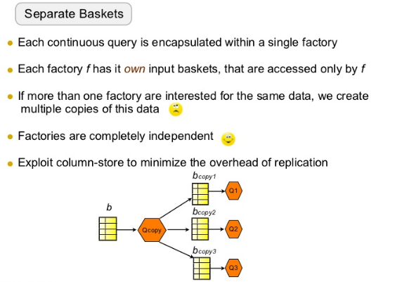
Query processing strategies

Slide 9
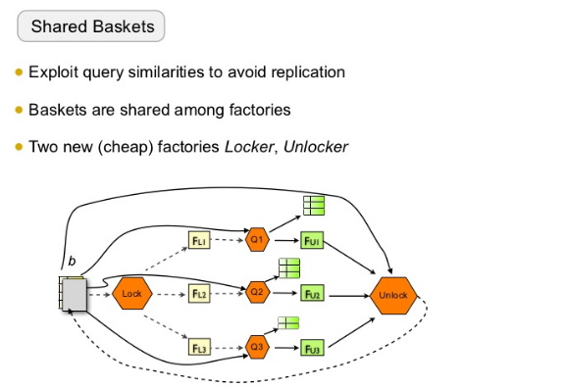
Query processing strategies

