Slide 1
XML Applications
The ubiquitous XML(5)
© copyright 2001 SNU OOPSLA Lab.

Slide 2
contents
As Meta-mark-up language
1. Meta-mark-up언어로서의 application
2. XML for XML : XML을 위한 XML application
3. Data exchange applications

Slide 3
Xml application (1) application as meta_mark_up language
As Meta-mark-up language
특정 각 분야를 위한 mark up 설계
분야별 DTD design

Slide 4
Xml application (1) application as meta_mark_up language
As Meta-mark-up language
MathML
MusicML
NewsML
PML
SpeechML
UIML
Xforms
WebML
SMIL
MPEG-7
XSA
JavaML

Slide 5
MathML
As Meta-mark-up language
x² + 4x+ 4 = 0
Presentation
Semantic
<mrow>
<mrow>
<msup> <mi>x</mi> <mn>2</mn> </msup> <mo>+</mo>
<mrow>
<mn>4</mn>
<mo>&invisibletimes;</mo>
<mi>x</mi>
</mrow>
<mo>+</mo>
<mn>4</mn>
</mrow>
<mo>=</mo>
<mn>0</mn>
</mrow>
<apply>
<plus/>
<apply>
<power/>
<ci>x</ci>
<cn>2</cn>
</apply>
<apply>
<times/>
<cn>4</cn>
<ci>x</ci>
</apply>
<cn>4</cn>
</apply>
Notes:
MathML(Mathematical Markup Languages)
수학방정식을 위한 XML 애플리케이션
약간의 제약사항이 있지만 거의 모든 수식 표현가능
웹에 수식표현 또는 수식 교환을 위한 표준으로 사용가능

Slide 6
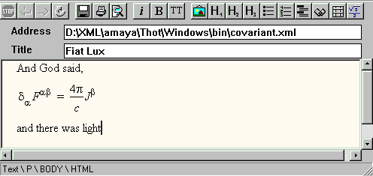
Amaya - MathML Editor
As Meta-mark-up language
Notes:
Amaya 브라우저가 MathML로 작성된 맥스웰의 방정식을 표시하고 있다.
Amaya 브라우저는 약간의 Math16을 지원한다
현재 대부분의 웹 브라우저에서 아직 지원하고 있지 않는다.

Slide 7
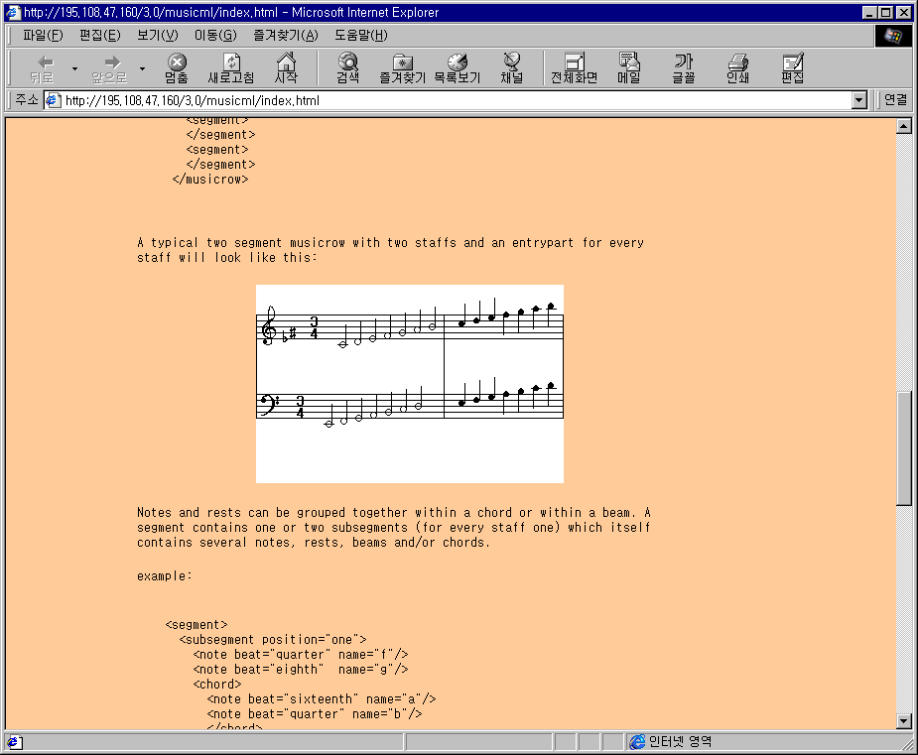
MusicML : example
As Meta-mark-up language
Notes:
MusicML
Cennection Factory사가 악보를 위해 만든 XML 어플리케이션
음표, 박자, 음자리표, 리듬, 쉼표, 코드 등을 포함
웹 상에 악보를 표현 가능
기보 프로그램간의 악보 교환 목적으로도 사용 가능

Slide 8
NewsML (1/2)
As Meta-mark-up language
[November 15, 1999] International Press Telecommunications Council
XML-based standard for all aspects of news creation, storage and delivery
[October 11, 2000] NewsML Version 1.0 DTD
Notes:
NewsML
특정 사건 내용을 text, audio, video등으로 입체적으로 기술하고
이들 간의 관계와 사건 간의 관계를 정의하면
사건(event) 정보를 교환하기 용이하고
특정 목적에 맞는 표현이 가능하다.
한번 기술해 놓은 자료를 이용하여 TV방송, 자막 방송, 신문기사, 웹 뉴스 등
필요한 형식에 맞추어 display가 가능함

Slide 9
NewsML (2/2)
As Meta-mark-up language
Features
  All formats and media types recognized equally
  Facilitates the development of news items
  Collections of news items
  Named relationships between news items
  Structure consisting of parts and named relationships between parts
  Alternative representations of the same part

Slide 10
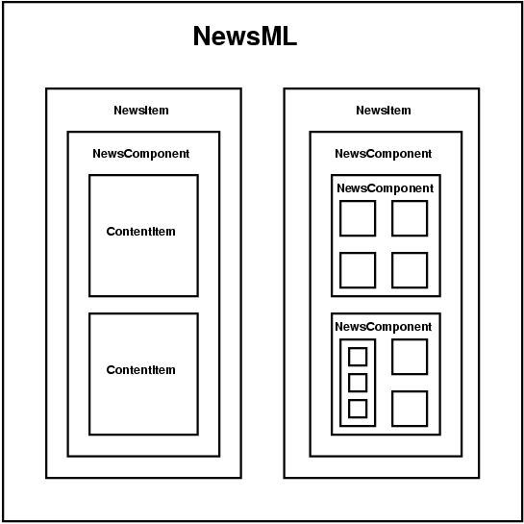

As Meta-mark-up language
structure of a typical object tree
SNU
OOPSLA Lab.
Notes:
NewML DTD구조에 따른 Content description 구조의 한 예

Slide 11
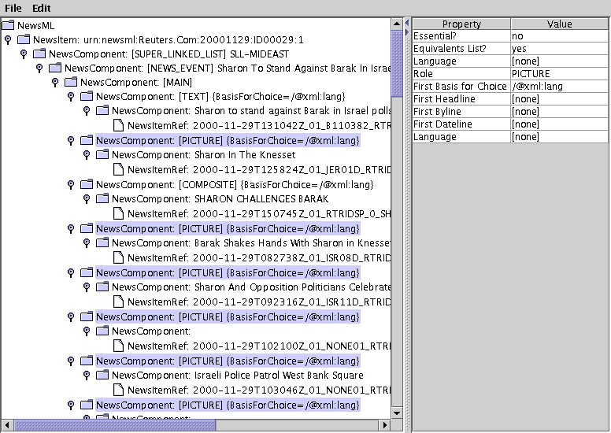
As Meta-mark-up language
NewsML Explorer
SNU
OOPSLA Lab.
Notes:
전용 브라우저로 NewsML Content를 브라우징 하는 모습

Slide 12
Portal Markup Language (PML)
As Meta-mark-up language
DataChannel's submission to XML.org
Inter-portal communication by providing an XML-based description of portal-related data and metadata
Allow portals of the same or of different manufacturers to exchange information about the information objects, users, groups, access controls subscriptions and notifications
http://www.datachannel.com

Slide 13
SpeechML
As Meta-mark-up language
Builds distributed network-based conversational applications
The text-to-speech synthesis using the Java Speech Markup Language (JSML)
http://www.alphawoks.ibm.com
Notes:
SpeechML
웹 사이트와 사용자간의 interaction하는 수단으로 음성으로 명령하고
지정된 음성, 음악, 또는 합성된 소리로 응답을 받는 것을 목적으로 한 Markup Language
전화를 이용한 Web기반 서비스 가능
시력에 문제가 있거나 손과 눈을 다른데 사용하면서 웹에 대한 접근을 필요로 하는 사람들에게 유용
마우스나 키보드가 없거나 불편한 경우 display되는 Web content와 효율적인 interaction이 가능하게 함
현재 IBM의 SpeechML, Motorola VoxML, AT&T의 PML등이 통합되어 VoiceXML 또는 VXML로 W3C에서 표준화 활동중

Slide 14
User Interface Markup Language (UIML)
As Meta-mark-up language
XML language for defining user interfaces
  Defines the actual interface elements
  Defines the location, and design of controls
  Defines actions to take when certain events take place
Advantage
  Describe a rich set of interfaces and reduces the work in porting the user interface to another platform
Notes:
UIML
An XML language for defining user interfaces
The buttons, menus, lists and other controls allow a program to function in a graphical interface like Windows or Motif
UIML is used to define the location, and design of controls. It also defines actions to take when certain events take place
Users create events when they interact with the interface by typing a key on the keyboard or moving and clicking the mouse
UIML 2.0 spec이 01/17/2000에 발표됨

Slide 15
Xforms (1/3)
As Meta-mark-up language
Xforms
  specification of Web forms that can be used with a wide variety of platforms including desktop computers, hand helds, information appliances, and even paper

Slide 16
Xforms (2/3)
As Meta-mark-up language
Goals
  Support for handheld, television, and desktop browsers, plus printers and scanners
  Richer user interface to meet the needs of business, consumer and device control applications
  Decoupled data, logic and presentation
  Improved internationalization
  Support for structured form data
  Advanced forms logic
  Multiple forms per page, and pages per form
  Suspend and Resume support
  Seamless integration with other XML tag sets

Slide 17
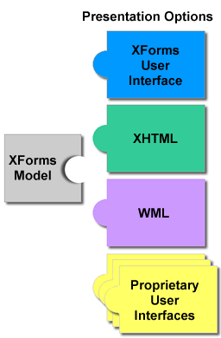
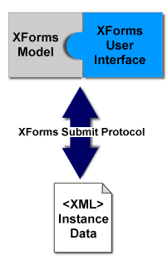
As Meta-mark-up language
Xforms (3/3)
XForms Model

Slide 18
Web Modeling Language (WebML)
As Meta-mark-up language
Notation for specifying complex Web sites at the conceptual level
Model-driven approach to Web site development
  Data content [structural model]
  Pages that compose it [composition model]
  Topology of links between pages [navigation model]
  Layout and graphic requirements for page rendering [presentation model],
  Customization features for one-to-one content delivery [personalization model]
Notes:
WebML
Designer가 특정 site의 핵심 feature를 high level로 기술할 수 있도록 하는 Notation의 집합
관점에 따른 4가지 모델이 존재
Structural Model
site의 data content를 표현하기 위한 모델
관련 있는 entity와 그들 간의 관계에 의해서 기술
E/R model, ODMG OO model, UML class diagram과 호환가능
Hypertext Model
하나 또는 그 이상의 hypertext들을 기술함.
Site-view라고도 하며 다음 두 모델로 구성됨
Composition Model
page를 구성하는 content unit들과 어느page hypertext를 포함하는지를 기술
Navigation Model
어떻게 페이지와 content unit들이 연결되어 hypertext를 구성하는 지를 표현
Presentation Model
XML syntax로 출력 장치나 언어에 무관하게 page의 layout과 그래픽 형태를 표현
Personalization Model
특정 사용자들이나 사용자 그룹에 특화

Slide 19
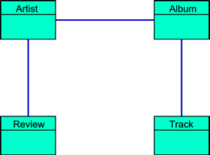
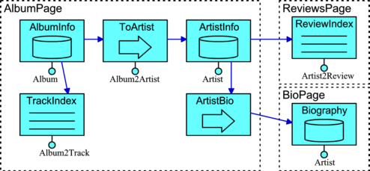
As Meta-mark-up language
structure schema
WebML composition and navigation specification
SNU
OOPSLA Lab.
Notes:
예) CDNow Site의 WebML modeling 예(출처 : http://xerox.elet.polimi.it/webml/readings/webmlnutshell.html)
Structure schema(Structural Model)
Album과 artist에 대한 간단한 structure schema를 보여줌
Atritst는 biographic information, track들로 구성된 publish albums, 그리고 review를 포함하고 있다.
이런 정보를 Web에 표현하기 위해서 페이지가 어떻게 구성되고 naviation 할 것인지에 대한 기술이 필요
=> site view(hypertext model)
A site view defined in WebML(Hypertext Model)
AlbumPage는 AblumInfo data unit과 album에 대한 trackIndex
그리고 AlbumInfo와 data unit인 ArtistInfo를 연결시켜주는 ToArtist direct unit으로 구성되어 있고
ArtistInfo data unit은 BioPage에 대한 direct unit인 ArtistBio와 ReviewsPage에 대한 링크로 구성 된다.
여기서 direct unit은 문법적인 편의를 위한 것으로 ArtistInfo와 BioPage간에 1:1관계를 항상 가진다는 것을 나타낸다.

Slide 20
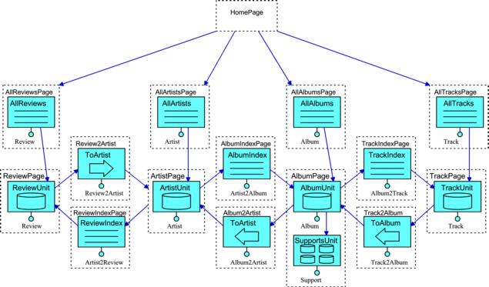
As Meta-mark-up language
A default site view
SNU
OOPSLA Lab.
Notes:
CDNow site의 site view

Slide 21
SMIL
As Meta-mark-up language
Synchronized Multimedia Integration Language
  describing interactive synchronized multimedia distributed on the Web
  SMIL lets Web builders specify such actions as "play audio file A five seconds after video file B starts and then show image file C."
  Easily-defined basic timing relationships
  Fine-tuned synchronization
  Direct inclusion of non-text and non-image media
  Hyperlink support for time-based media
  Adaptiveness to varying user and system characteristics
Notes:
SMIL(smile이라고 읽는다, “스밀이 아님”)
SMIL 목표
①인터랙티브한 멀티미디어 프리젠테이션을 제작하는데 쓰이는 XML 기반 언어를 정의한다.
멀티미디어 프리젠테이션의 temporal behavior를 표현
스크린 상에 프리젠테이션의 레이아웃을 표현
각 미디어 객체에 링크를 건다.
② 다른 XML 기반 언어에서 스마일 구문(syntax)과 의미체계(semantics)의 재사용을 가능케 한다.
-특히 타이밍과 동기화를 필요로 하는 언어에서
예) SMIL 2.0 컴포넌트는 XHTML
현재 SMIL 2.0 version이 W3C working draft로 2001년 3월에 제출됨

Slide 22
SMIL : Example
As Meta-mark-up language
<SMIL>
<HEAD>
<META NAME="title" CONTENT="WebReview Demo"/>
<META NAME="author" CONTENT="jrule@ruleweb.com"/>
<META NAME="copyright" CONTENT="©1999"/>
<LAYOUT TYPE="text/smil-basic-layout">
<REGION ID="PixChannel" TITLE="PixChannel" LEFT="0" TOP="0" HEIGHT="120"
WIDTH="160" BACKGROUND-COLOR="#888888" FIT="fill"/>
<REGION ID="VideoChannel" TITLE="VideoChannel" LEFT="160" TOP="0" HEIGHT="120"
WIDTH="160" BACKGROUND-COLOR="#888888" FIT="fill"/>
<REGION ID="TextChannel" TITLE="TextChannel" LEFT="0" TOP="120" HEIGHT="50"
WIDTH="320" BACKGROUND-COLOR="#888888" FIT="hidden"/>
</LAYOUT>
</HEAD>
<BODY>
<PAR TITLE="multiplexor">
<VIDEO SRC="webreview.rm" ID="Video" REGION="VideoChannel" TITLE="Video"/>
<IMG SRC="webreview.rp" ID="Headline Pix" REGION="PixChannel" TITLE="Headline Pix"/>
<TEXT SRC="webreview.rt" ID="Ticker" REGION="TextChannel" TITLE="Ticker"/>
</PAR>
</BODY>
</SMIL>
Notes:
Title, author, copyright들에 대한 기술과 3가지 layout을 정의하고 각 layout의 내용을 body안에서 기술하고 있다.

Slide 23
MPEG-7 Standard (1/6)
As Meta-mark-up language
MPEC : Moving Picture Experts Group
'Multimedia Content Description Interface' standard
Focuses on representing information about the content, not the content itself
Provide a simple, flexible, interoperable solution to the problems of indexing, searching and retrieving multimedia resources
Notes:
MPEG-7
Multimedia content에 대한 정보검색을 목적으로 어떻게 content에 대한 정보를 기술할 것인가에 관한 표준
Multimedia content에 대한 정보를 표현하는 언어로서 XML을 사용

Slide 24
MPEG-7 Standard (2/6)
As Meta-mark-up language
The Description Definition Language (DDL)
  Creates MPEG-7 Description Schemes and Descriptors
  Expresses spatial, temporal, structural, and conceptual relationships between the elements of a DS, and between DSs
Applications
  Digital libraries (image catalog, musical dictionary,...)
  Multimedia directory services (e.g. yellow pages)
Notes:
DDL
The language allows the creation of MPEG-7 Description Schemes and Descriptors
A DDL schema specifies the constraints
XML Schema Language as the DDL
The DDL AHG decided to add multimedia content descriptions require specific features to XML Schema Language

Slide 25
MPEG-7 Standard (3/6)
As Meta-mark-up language
  Broadcast media selection (radio channel, TV channel,...)
  Multimedia editing (personalized electronic news service, media authoring)
http://www.darmstadt.gmd.de/mobile/MPEG7/index.html
Notes:
Application
상기 이외
• Education,
• Journalism (e.g. searching speeches of a certain politician using his name, his voice or his face),
• Tourist information,
• Cultural services (history museums, art galleries, etc.),
• Entertainment (e.g. searching a game, karaoke),
• Investigation services (human characteristics recognition, forensics),
• Geographical information systems,
• Remote sensing (cartography, ecology, natural resources management, etc.),
• Surveillance (traffic control, surface transportation, non-destructive testing in hostile environments, etc.),
• Bio-medical applications,
• Shopping (e.g. searching for clothes that you like),
• Architecture, real estate, and interior design,
• Social (e.g. dating services), and
• Film, Video and Radio archives.

Slide 26
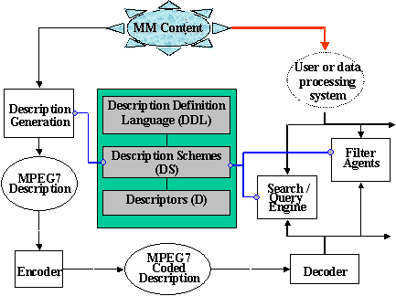
MPEG-7 Standard (4/6)
As Meta-mark-up language
An abstract representation of possible applications using MPEG-7
SNU
OOPSLA Lab.
Notes:
A hypothetical MPEG-7 chain in practice
The circular box : depict tools that are doing things(such as encoding or decoding)
The square boxes : represent static elements(such as a description)
The dotted boxes : the normative elements of the MPEG-7 standard

Slide 27
MPEG-7 Standard (5/6)
As Meta-mark-up language
Query examples
  Music
    Play a few notes on a keyboard and get in return a list of musical pieces containing (or close to) the required tune or images somehow matching the notes, e.g. in terms of emotions.
  Graphics
    Draw a few lines on a screen and get in return a set of images containing similar graphics, logos, ideograms,...
  Image
    Define objects, including color patches or textures and get in return examples among which you select the interesting objects to compose your image.

Slide 28
MPEG-7 Standard (6/6)
As Meta-mark-up language
  Movement
    On a given set of objects, describe movements and relations between objects and get in return a list of animations fulfilling the described temporal and spatial relations.
  Scenario
    On a given content, describe actions and get a list of scenarios where similar actions happen.
  Voice
    Using an excerpt of Pavarotti’s voice, and getting a list of Pavarotti’s records, video clips where Pavarotti is singing or video clips where Pavarotti is present.

Slide 29
JavaML
As Meta-mark-up language
Java Markup Language
  JavaML provides a complete self-describing representation of Java source code
  JavaML reflects the structure of the software artifact directly in the nesting of elements in the XML-based syntax
  represents extra edges in the program graph using the id and idref
Notes:
Because JavaML is an XML application, it is easy to parse, and all existing tools for working with XML can be applied to Java source code in its JavaML representation
JavaML tools can leverage the existing infrastructure and exploit the canonical representation to improve their inter-operability

Slide 30
JavaML : Example (1/2)
As Meta-mark-up language
<java-source-program>
<import-declaration>import java.applet.*; </import-declaration>
<import-declaration>import java.awt.*; </import-declaration>
<class-declaration>
<modifiers>public</modifiers> class
<class-name>FirstApplet</class-name> extends
<superclass>Applet</superclass> {
<method-definition>
<modifiers>public</modifiers>
<return-type>void</return-type>
<method-name>paint</method-name>
(<formal-arguments> <type>Graphics</type>
<name>g</name> </formal-arguments>)
<statements>{ g.drawString("FirstApplet", 25, 50); } </statements>
</method-definition> }
</class-declaration>
</java-source-program>
Java Source
import java.applet.*;
import java.awt.*;
public class FirstApplet extends Applet {
public void paint(Graphics g) {
g.drawString("FirstApplet", 25, 50); }
}
JavaML
Notes:
Java source code를 JavaML을 이용하여 나타낸 모습

Slide 31
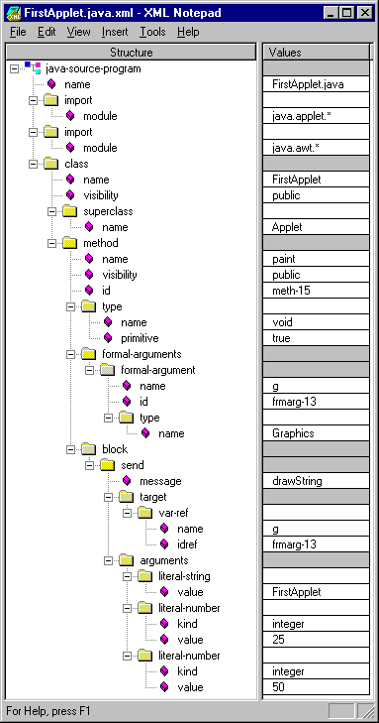
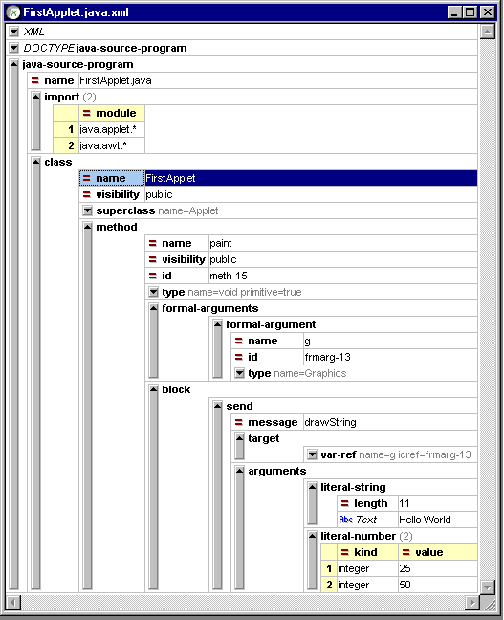
JavaML : Example (2/2)
As Meta-mark-up language
SNU
OOPSLA Lab.
Notes:
JavaML을 XML notepad(left)와 XML Spy를 이용하여 본 모습

Slide 32
contents
XML for XML
1. Meta-mark-up언어로서의 application
2. XML for XML : XML을 위한 XML application
3. Data exchange applications

Slide 33
XML for XML
Xml application (2)
XML을 위한 XML application
XML 자체의 개선을 위한 application
Document publishing applications
  XSL stylesheet
  XLL link-language
  DCD(Document Content Description)
Notes:
XML은 텍스트 데이터를 위한 일반적 목적의 포맷
이들 중 일부의 사용되는 목적은 XML 자체의 개선을 위해서임
이것은 XSL, XLL, DCD을 포함한다.

Slide 34
XSL
XML for XML
eXtensible Style Language
  style-sheet for XML document
  a kind of XML application
XSL is composed of
  transformation language
  - XML 문서를 another format 의 문서로 전환
  formatting language
  -content를 어떻게 보여 줄 것인가

Slide 35
XSL 의 실제 (1)
XML for XML
<?xml version=“1.0”?>
<xsl:stylesheet xmlns:xsl=“http://www.w3.org/TR/WD-xsl”?
<xsl:template match=“/”>
<html>
<xsl:apply-templates/>
</html>
</xsl:template>
<xsl:template match=“PERIODIC_TABLE”>
<xsl:apply-templates/>
</xsl:template>
<xsl:template match=“ATOM”>
<p>
<xsl:value-of select=“.”/>
</p>
</xsl:template>
</xsl:stylesheet>
atom.xsl

Slide 36
XSL 의 실제 (2)
XML for XML
<?xml version=“1.0”?>
<?xml-stylesheet type=“text/xsl” href=“atom.xsl”?>
<PERIODIC_TABLE>
<ATOM PHASE=“GAS”>
<NAME>Hydrogen</Name>
<SYMBOL>H</SYMBOL>
<ATOMIC NUMBER>1</ATOMIC NUMBER>
<BOILING_POINT UNIT=“Kelvin”>20.28</BOILING_POINT”>
………..
</ATOM>
<ATOM PHASE=“GAS”>
<NAME>Helium</NAME>
……………………
</ATOM>
</PERIODIC_TABLE>
Atom.xml

Slide 37
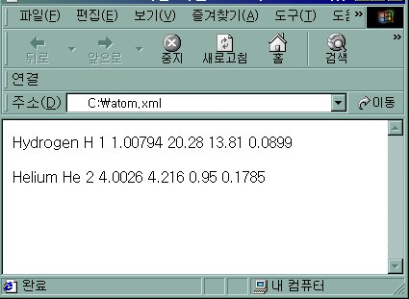
XSL 의 실제 (3)
XML for XML
atom.xml에 atom.xsl을 적용시킨 예

Slide 38
XLL
XML for XML
eXtensible Linking Language
Xlink라는 일반적인 hypertext link를 정의
<footnote xlink:form=“simple” href=“footnote7.xml”>7</footnote>

Slide 39
contents
Data exchange application
1. Meta-mark-up언어로서의 application
2. XML for XML : XML을 위한 XML application
3. Data exchange applications

Slide 40
Data Exchange application
Data exchange application
  XML은 두 시스템 또는 application간의 exchange format역할을 할 수 있다.
  EDI , RDF , MCF …
  Vender들의 XML application
  용이한 data exchange를 위해 data를 XML로 가공.

Slide 41
Data Exchange application
Data exchange application
RDB system사이의 data exchange format
  XML tag가 transfer동안 data를 감싸는 wrapper역할을 한다.
account
332
DB
<telephone number=“332”>
<dept>account</dept>
<person>Peter</person>
<person>Jim</person>
</telephone>
R&D
567
Peter
332
332
account
peter,Jim
567
R&D
Jim
332
Sue
912
RDB

