Slide 1
Ch. 17: Ajax, RSS, SOAP, and More
Seoul National University, Internet Database Laboratory
July, 2011
Hyunwoo Kim

Slide 2
Contents
Ajax Examples
Ajax Basics
RSS Basics
RSS Schema
Extending RSS
SOAP and Web Services
SOAP Message Schema
WSDL
KML Basics
ODF and OOXML
eBooks, ePub, and More

Slide 3
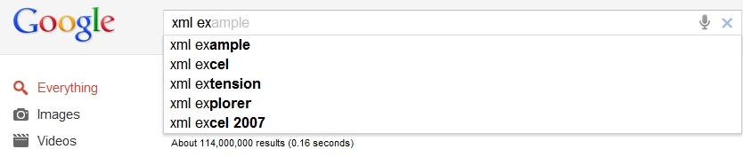
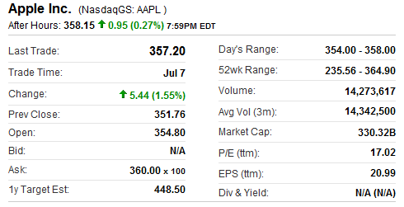
Ajax Examples
Google Suggest
Yahoo! Finance

Slide 4
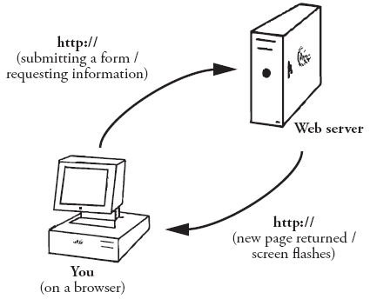
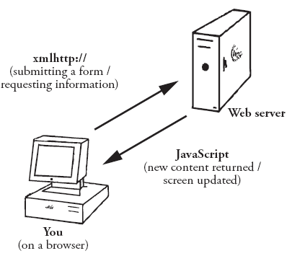
Ajax Basics
Ajax (Asynchronous JavaScript and XML)
Web-based technique
Creating a more seamless user experience when a Web page is updated based on user input
Page not using Ajax
Web page using Ajax

Slide 5
Ajax Basics
The technology of Ajax
Not a language
Specific way of using existing languages to create a more interactive Web experience
Combination of HTML, XML, and JavaScript
JavaScript
function GetXmlHttpObject() {
var xmlHttpObject = false;
try {
// Most browsers today
xmlHttpObject = new XMLHttpRequest();
}
catch (e) {
// Internet Explorer 5 and 6
xmlHttpObject = new ActiveXObject(“Msxml2.XMLHTTP”);
}
return xmlHttpObject;
}

Slide 6
Ajax Basics
Three steps for the data exchange
1. To create “retrieving function”
2. To identity the URL of the server-side script
3. To send the request to the server using the send property
Using Ajax
HTML page needs to call the RequestAjax() function
<script language=“Javascript”>
function SelectWonder(value) {
if(value != 0)
RequestAjax(“getWonder.asp?id=” + value);
}
...
<form>
Ancient Wonders:
<select name=“wonders” onchange=“SelectWonder(this.value)”>
<option value=“0” default>
Select a Wonder
<option value=“1”>Colossus of Rhodes
...
HTML

Slide 7

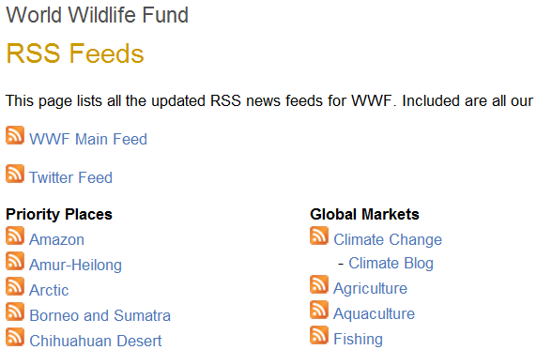
RSS Basics
RSS (Really Simple Syndication)
File format that allows Web sites to easily make their content available to readers
Content is packaged into RSS feed or RSS channel
Viewing RSS feed using RSS Reader or RSS Aggregator

Slide 8
RSS Schema
RSS 2.0 format is specified using XML
When writing an RSS document, all the rules about writing XML documents apply
Root element of an RSS file is the rss element
<?xml version=“1.0”?>
<rss version=“2.0”>
</rss>
<?xml version=“1.0”?>
<rss version=“2.0”>
<channel>
<title>WWF – Global Warming News</title>
<link>http://www.panda.org/</link>
<description>News, publications and job feeds from WWF – the global
conservation organization</description>
</channel>
</rss>

Slide 9
RSS Schema
The most important child element of channel is the item element
Actual content of RSS feed is in the item element
If there are no item elements, there is no content in the feed
<?xml version=“1.0”?>
<rss version=“2.0”>
<channel>
...
<item>
<title>Climate change means more floods for a drying Thames basin</title>
<link>http://www.panda.org/about_wwf/what_we_do/climate_change/news/
index.cfm?uNewsId=142541</link>
<description>.,..A drying Thames river basin in the UK would still face
five imtes the current risk of flooding by 2080, ...</description>
</item>
</channel>
</rss>

Slide 10
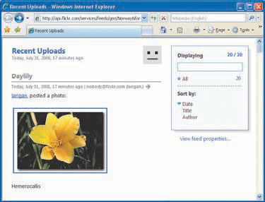
Extending RSS
Yahoo! Search developed an RSS module, Media RSS
<?xml version="1.0"?>
<rss version="2.0" xmlns:media=“http://search.yahoo.com/mrss/">
...
<item>
<title>Daylily</title>
<link>http://www.flickr.com/photos/larigan/2721793930/</link>
<description> ... Daylily"</description>
<media:content url="http://farm4.static.flickr.com/3105/2721793930_
e71f7a6ff7_m.jpg" type="image/jpeg" height="166" width="240"/>
<media:title>Daylily</media:title>
<media:description type="html">&lt;p&gt;Hemerocallis&lt;/p&gt;
</media:description>
<media:credit role="photographer">larigan.</media:credit>
<media:category scheme="urn:flickr:tags">yellow daylily hemerocallis
larigan phamilton</media:category>
</item>
...

Slide 11
SOAP and Web Services
SOAP (Simple Object Access Protocol)
XML-based messaging framework
Server-to-server communication
Platform- and language-independent communication between different applications
Web Service
A set of functions that can be accessed and executed over a network
Referring to the exchange of XML messages using the SOAP framework
<?xml version=“1.0”?>
<soap12:Envelope xmlns:soap12=“http://www.w3.org/2003/05/soap-envelope”>
<soap12:Body>
...
</soap12:Body>
</soap12:envelope>
< SOAP wrapper >

Slide 12
SOAP Message Schema
SOAP framework is based on the XML language
All rules about writing XML documents apply to SOAP messages
Root element of a SOAP message is the Envelop element
<?xml version=“1.0”?>
<soap12:Envelope xmlns:soap12=“http://www.w3.org/2003/05/soap-envelope”>
<soap12:Body>
<sayHello xmlns=“http://www.kehogo.com/ns/hello”>
<name>Kevin</name>
</sayHello>
</soap12:Body>
</soap12:envelope>
< SOAP request message >
<?xml version=“1.0”?>
<soap12:Envelope xmlns:soap12=“http://www.w3.org/2003/05/soap-envelope”
xmlns:xsi=“http://www.w3.org/2001/XMLSchema-instance”
xmlns:xsd=“http://www.w3.org/2001/XMLSchema”>
<soap12:Body>
<sayHelloResponse xmlns=“http://www.kehogo.com/ns/hello”>
<sayHelloResult>Hello Kevin (and World). It’s Sunday, September 21, 2009, 10:20 PM, and
I’ve been expecting you.</sayHelloResult>
</sayHelloResponse>
</soap12:Body>
</soap12:envelope>
< Response to the request message >

Slide 13
WSDL
WSDL (Web Services Description Language)
XML language for describing how to interface with Web Services
WSDL Schema
A WSDL document is an XML document
Root element is definitions
definitions element has five major child element
types, message, portType, binding, and service
portType describes the available operations and the messages each expects
<?xml version=“1.0”?>
<definitions xmlns=“http://schemas.xmlsoap.org/wsdl/”
xmlns:soap12=“http://schemas.xmlsoap.org/wsdl/soap12/”>
...

Slide 14
WSDL
portType
Describing the available operations and messages each expects
types and message
Working hand in hand
message element identifies the messages each operation expects
Parameters’ definitions are found in the types element
binding
Defining the transport protocol of the SOAP message exchange
service
Putting together the pieces of the Web Service by connecting the portType with the binding

Slide 15
WSDL
portType
types
message
<portType name=“hello_world”>
<operation name=“sayHelloRequest”>
<input message=“tns:hello_in”/>
<output message=“tns:hello_out”/>
</operation>
</portType>
<types>
<xs:schema targetNamespace=“http://www.kehogo.com/ns/hello”>
<xs:element name=“sayHelloRequest”>
<xs:complexType>
<xs:sequence>
<xs:element name=“name” type=“xs:string”/>
</xs:sequence>
...
</types>
<message name=“hello_in”>
<part name=“parameters” element=“tns:sayHelloRequest”/>
</message>
<message name=“hello_out”>
<part name=“parameters” element=“tns:sayHelloResponse”/>
</message>

Slide 16
WSDL
binding
service
<binding name="hello_binding12“ type="tns:hello_world">
<soap12:binding transport="http://schemas.xmlsoap.org/soap/http"/>
<operation name="sayHelloRequest">
<soap12:operation soapAction="http://www.kehogo.com/ns/hello/sayHello">
<input>
<soap12:body use="literal"/>
</input>
<output>
<soap12:body use="literal"/>
</output>
</operation>
</binding>
<service name=“xml2e_exmaple”>
...
<port name=“hello_world12” binding=“tns:hello_binding12”>
<soap12:address location=“http://www.kehogo.com/examples/hello_world.asmx”/>
</port>
</service>

Slide 17

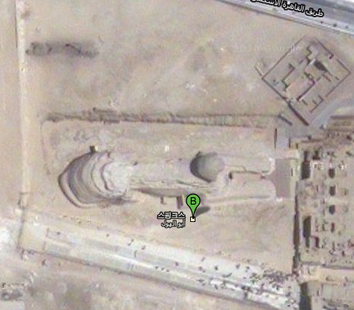
KML Basics
KML (Keyhole Markup Language)
XML markup language for annotating maps using placemarks, polygonal shapes, paths, and descriptions
Initially developed for use with Google Earth
Placemarks
A pushpin graphic marking a location
<?xml version="1.0"?>
<kml xmlns="http://www.opengis.net/kml/2.2">
<Placemark>
<name>Great Pyramid of Giza</name>
<Point>
<coordinates>
31.134224,29.979769,0
...

Slide 18
ODF and OOXML
ODF (Open Document Format) and OOXML (Office Open XML)
File formats for office productivity documents
ex) Spreadsheets, presentations, and word processing
ODF
In 2002, Sun Microsystems began working with OASIS to create an open standard based on the XML format used by OpenOffice.org
In 2005, ODF was approved as an OASIS standard
In 2006, ODF became an ISO standard
ODF packages its files and folders using the JAR file format

Slide 19
ODF and OOXML
OOXML
In 2005, Microsoft created an open standard based on the XML format used with the Office 2003
In 2006, OOXML was approved as an Ecma standard
In 2008, OOXML became an ISO standard
OOXML packages its files and folders using the ZIP file format

Slide 20
eBooks, ePub, and More
Electronic books
Books that use electronic files instead of paper
Read on personal computers or special eBook readers
ePub
A format that has gained large support in the electronic publishing industry
ePub’s specification is an open standard of the IDPF
XHTML for the book’s content
XML for the book’s structure, table of content, etc.
Files are compressed using a ZIP format for final delivery
MIME type of the ePub file: application/epub+zip

