Slide 1
More Swing
Chapter 15

Slide 2
Objectives
Add menus, icons, borders, and scroll bars to your GUIs
Use the BoxLayout manager and the Box class
Use inner classes and describe their advantages
Use the WindowListener interface
Create GUIs whose components change from visible to invisible and vice versa

Slide 3
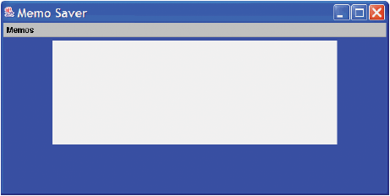
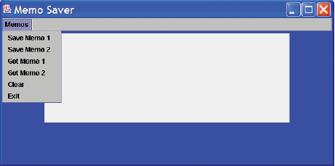
A GUI with a Menu
Menu items behave like buttons
Note example program, listing 15.1
class MemoGUI
Sample
screen output

Slide 4
Menu Bars, Menus, and Menu Items
A menu item is a JMenuItem object
A menu is a JMenu object
  Use the .add method to add a menu item to a menu
A menu bar is a JMenuBar object and a container for menus
  Add menu bar to a frame with setJMenuBar

Slide 5
Nested Menus
Class JMenu is a descendant of the JMenuItem class
Every menu is also a menu item object
Thus a menu can be a menu item in another menu

Slide 6
Adding Icons
An icon is
  A picture
  An object of ImageIcon
An icon can be placed in
  A label
  A button
  Both can also have text with the icon

Slide 7
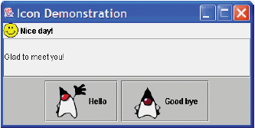
Using Icons
View sample program, listing 15.2
class IconDemo
Sample
screen output

Slide 8
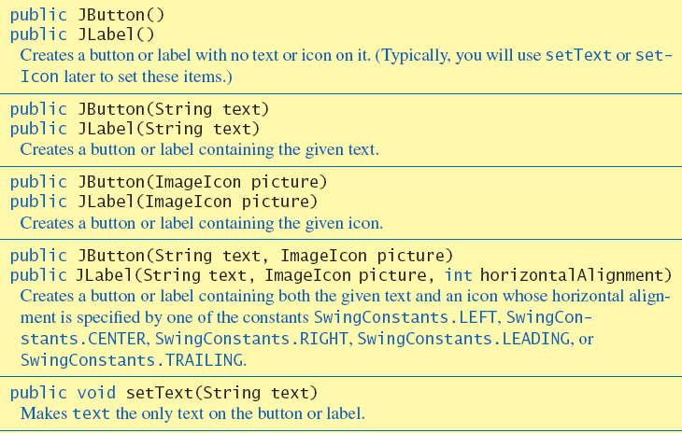
Swing Methods
Figure 15.1a some methods in the classes JButton and JLabel

Slide 9
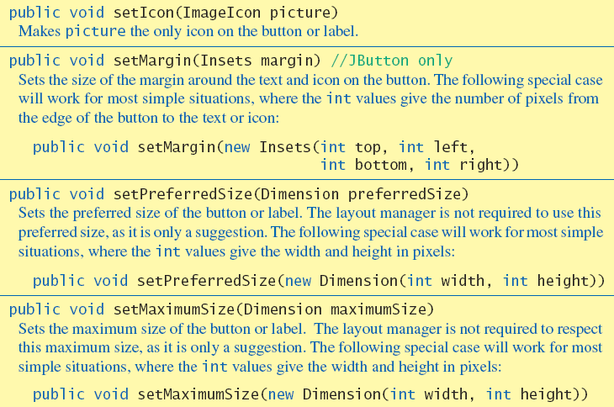
Swing Methods
Figure 15.1b some methods in the classes JButton and JLabel

Slide 10
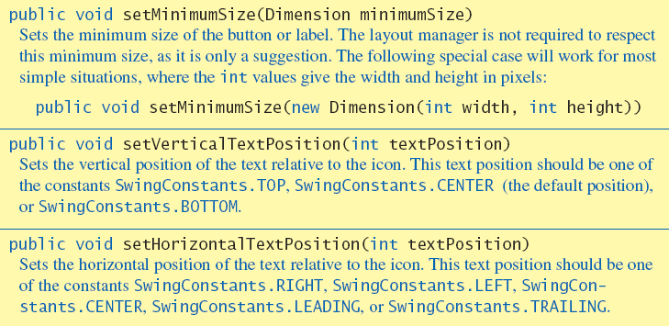
Swing Methods
Figure 15.1c some methods in the classes JButton and JLabel

Slide 11
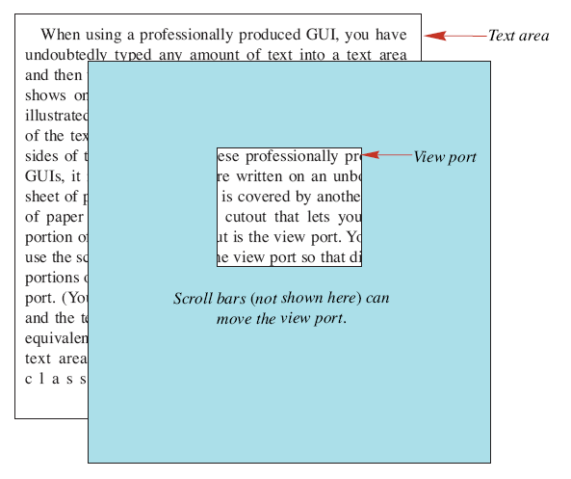
Text Area Features
Figure 15.2 View port for a text area

Slide 12
The JScrollPane Class for Scroll Bars
A view port shows a portion of the class
A scroll pane is a viewport with scrollbars
Vertical and/or horizontal scrollbars may be specified

Slide 13
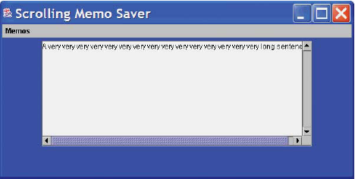
Example Program
View code, listing 15.3
class ScrollBarDemo
Sample
screen output

Slide 14
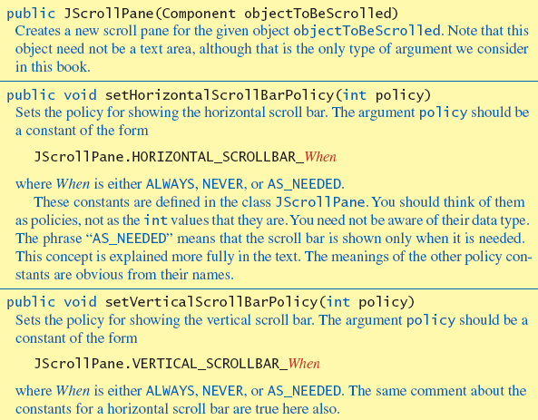
JScrollPane methods
Figure 15.3 Some methods and constants in class JScrolPane

Slide 15
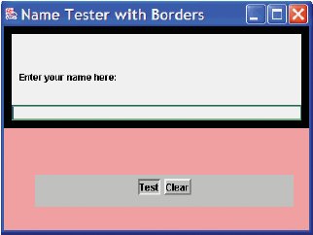
Adding Borders
View sample program, listing 15.4
class BorderDemo
Sample
screen output

Slide 16
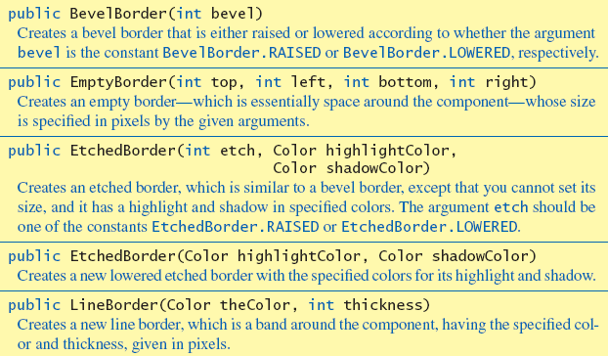
Border Class Constructors
Figure 15.4a, some constructors of various border classes

Slide 17
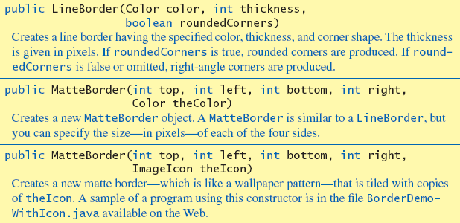
Border Class Constructors
Figure 15.4b, some constructors of various border classes

Slide 18
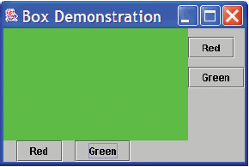
BoxLayout Manager Class
View demo program, listing 15.5
class BoxLayoutDemo
Sample
screen output

Slide 19
Struts and Glue
A strut is an invisible component
  A fixed length used to separate visible components
  Note use of strut in listing 15.5
  Struts can be either horizontal or vertical
Glue is also an invisible component
  Not used to stick things together
  Rather, they are not rigid, more like "goo"
  Glue components also separate visible items

Slide 20
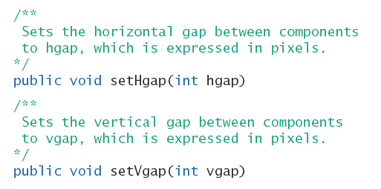
Setting Spacing Between Components
Methods used to set horizontal and vertical spacing
Except for classes Box and BoxLayout

Slide 21
The Box Container Class
View demo program, listing 15.6
class BoxClassDemo
Sample
screen output

Slide 22
The CardLayout Manager
View demo program, listing 15.7
class CardLayoutDemo
The CardLayout manager creates a set of views that can be cycled
Do not use an anonymous argument when using the CardLayout manager

Slide 23
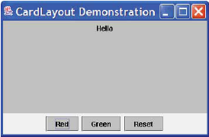
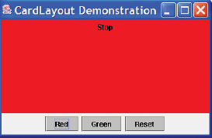
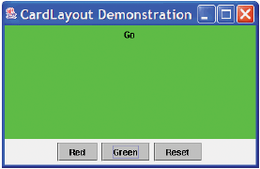
The CardLayout Manager
Sample
screen output
Initially or after reset
button clicked
After clicking red button
After clicking green button

Slide 24
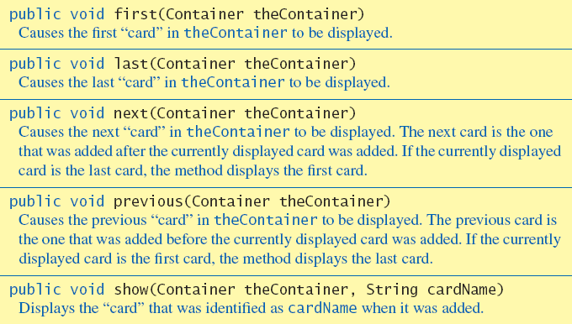
CardLayout Methods
Figure 15.5 Some methods in the CardLayout manager class

Slide 25
Inner Classes
Classes defined within other classes
Often used in Swing programs and classes
  However not confined to that usage
Advantages
  Can be used to make outer class self contained
  Methods of inner class have access to all elements of the outer class

Slide 26
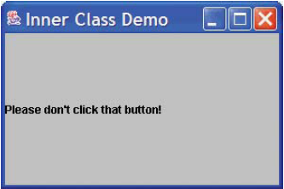
Helping Classes
View example, listing 15.8
class InnerClassDemo
Sample
screen output

Slide 27
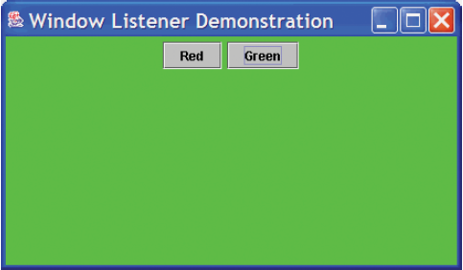
The WindowListener Interface
View demo, listing 15.9
class WindowListenerDemo
Sample
screen output

Slide 28
Programming the Close-Window Button
View example, listing 15.10
class CloseWindowDemo
By default a window's close-window button does not end the execution
It is possible to program the behavior of a window's close window button

Slide 29
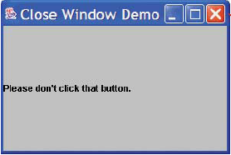
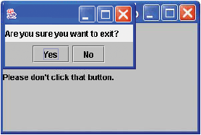
Programming the Close-Window Button
Click the close-window button
  The second window appears
Sample
screen output

Slide 30
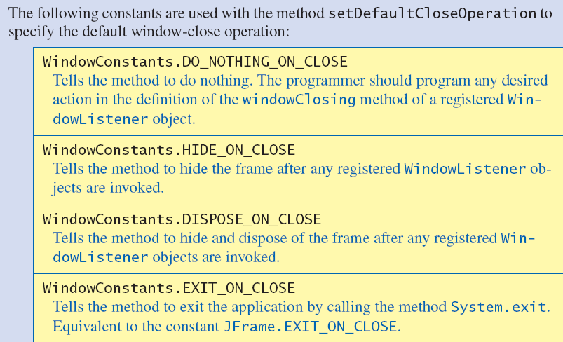
Interface WindowConstants
Figure 15.6 Constants in the interface WindowConstants

Slide 31
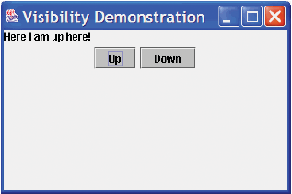
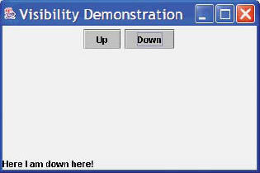
Components with Changing Visibility
View sample program, listing 15.11
class VisibilityDemo
After clicking the Up
button
After clicking the Down
button
Sample
screen output

Slide 32
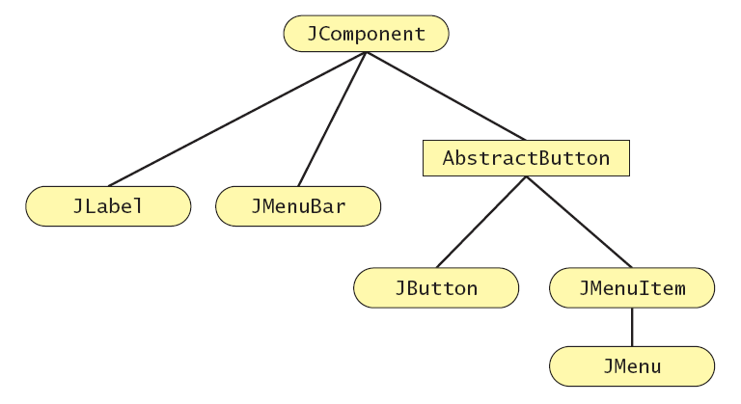
Buttons, Menus, Abstract Buttons
Figure 15.7 A portion of the Swing Class Hierarchy

Slide 33
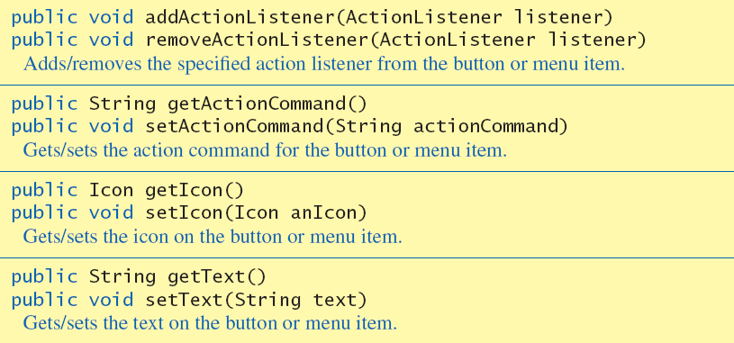
Buttons, Menus, Abstract Buttons
Figure 15.8 Some methods inherited from AbstractButton by class JButton and JMenuItem

Slide 34
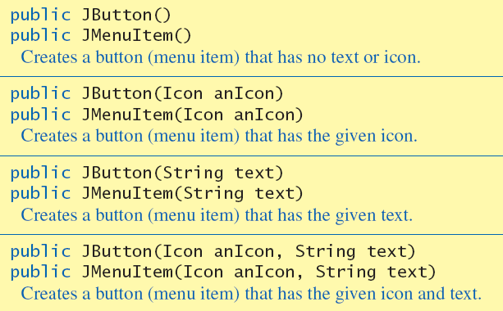
Buttons, Menus, Abstract Buttons
Figure 15.9 Some constructors of classes JButton and JMenuItem

Slide 35
Summary
Classes JMenuItem, JMenu, and JMenuBar provide menu tools
You can add icons to buttons, labels, menu items
Menu bar can be added to a frame by using
  setJmenu
  add
Buttons and menu items need registered action listeners

Slide 36
Summary
Close-window button can be reprogrammed like any other button
  May need to call setDefaultCloseOperation
Changing visibility of a component requires call to method validate

