Slide 1
Hadoop: The Definitive Guide Chap. 2 MapReduce
Kisung Kim

Slide 2
MapReduce
Programming model for parallel data processing
Hadoop can run MapReduce programs written in various languages: e.g. Java, Ruby, Python, C++
In this chapter
Introduce MapReduce programming using a simple example
Introduce some of MapReduce API
Explain data flow of MapReduce

Slide 3
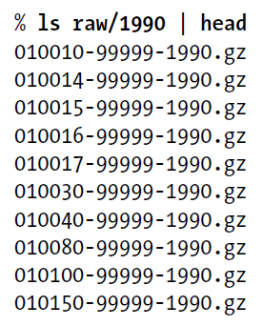
Example: Analysis of Weather Dataset
Data from NCDC(National Climatic Data Center)
A large volume of log data collected by weather sensors: e.g. temperature
Data format
Line-oriented ASCII format
Each record has many elements
We focus on the temperature element
Data files are organized by date and weather station
There is a directory for each year from 1901 to 2001, each containing a gzipped file for each weather station with its readings for that year
Query
What’s the highest recorded global temperature for each year in the dataset?
Year
Temperature
0067011990999991950051507004...9999999N9+00001+99999999999...
0043011990999991950051512004...9999999N9+00221+99999999999...
0043011990999991950051518004...9999999N9-00111+99999999999...
0043012650999991949032412004...0500001N9+01111+99999999999...
0043012650999991949032418004...0500001N9+00781+99999999999...
Contents of data files
List of data files

Slide 4
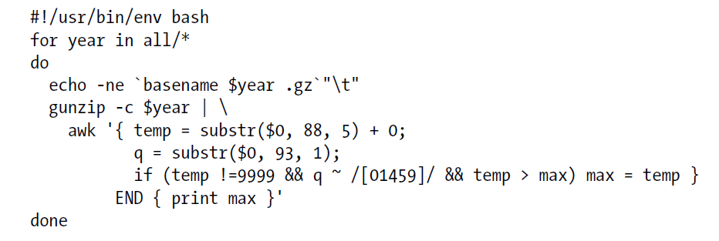
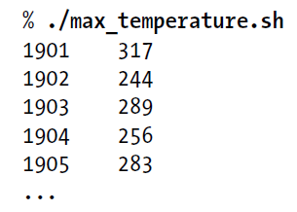
Analyzing the Data with Unix Tools
To provide a performance baseline
Use awk for processing line-oriented data
Complete run for the century took 42 minutes on a single EC2 High-CPU Extra Large Instance

Slide 5
How Can We Parallelize This Work?
To speed up the processing, we need to run parts of the program in parallel
Dividing the work
Process different years in different process
It is important to divide the work into even distribution
Split the input into fixed-size chunks
Combining the results
If using the fixed-size chunks approach, the combination is more delicate
But still we are limited by the processing capacity of a single machine
Some datasets grow beyond the capacity of a single machine
To use multiple machines, we need to consider a variety of complex problems
Coordination: Who runs the overall job?
Reliability: How do we deal with failed processes?
Hadoop can take care of these issues

Slide 6
Hadoop MapReduce
To use MapReduce, we need to express out query as a MapReduce job
MapReduce job
Map function
Reduce function
Each function has key-value pairs as input and output
Types of input and output are chosen by the programmer

Slide 7
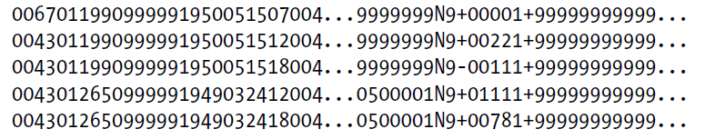
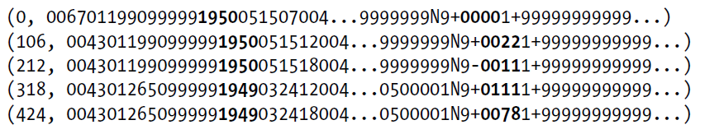
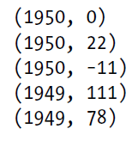
MapReduce Design of NCDC Example
Map phase
Text input format of the dataset files
Key: offset of the line (unnecessary)
Value: each line of the files
Pull out the year and the temperature
Indeed in this example, the map phase is simply data preparation phase
Drop bad records(filtering)
Input File
Output of Map Function (key, value)
Input of Map Function (key, value)
Map

Slide 8


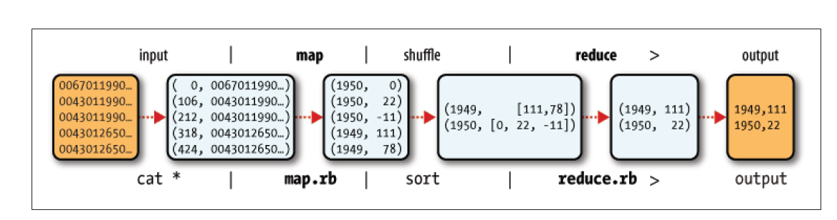
MapReduce Design of NCDC Example
The output from the map function is processed by MapReduce framework
Sorts and groups the key-value pairs by key
Sort and Group By
Reduce function iterates through the list and pick up the maximum value
Reduce

Slide 9
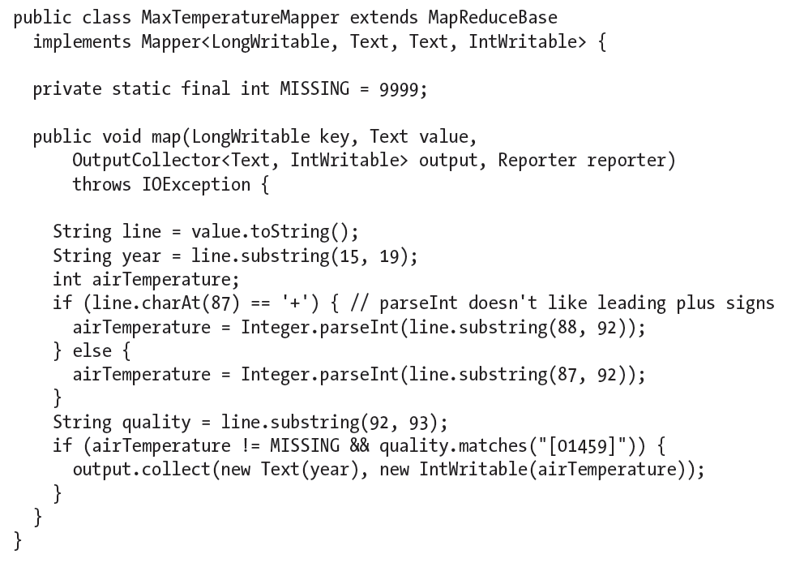
Java Implementation: Map
Map function: implementation of the Mapper interface
Mapper interface
Generic type
Four type parameter: input key, input value, output key, output value type
Hadoop provides its own set of basic types
optimized for network serialization
org.apache.hadoop.io package
e.g. LongWritable: Java Long Text: Java String IntWritable: Java Integer
OutputCollector
Write the output
Input Type
Output Type

Slide 10
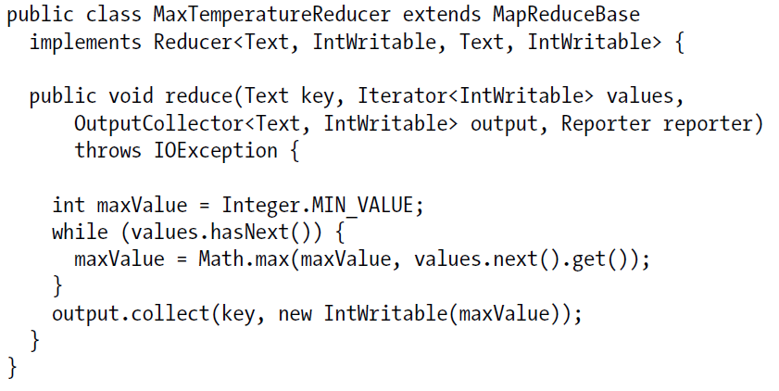
Java Implementation: Reduce
Reduce function: implementation of the Reducer interface
Reducer interface
Generic type
Four type parameter: input key, input value, output key, output value type
Input types of the reduce function must match the output type of the map function
Input Type
Output Type

Slide 11
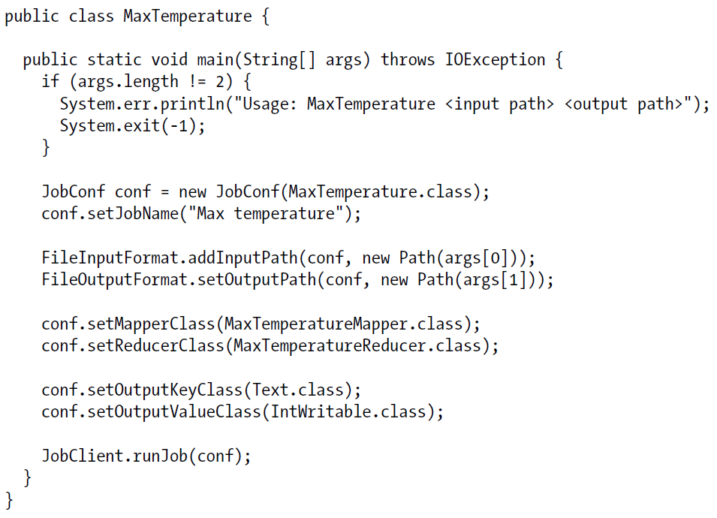
Java Implementation: Main
Construct JobConf object
Specification of the job
Control how the job is run
Pass a class to the JobConf
Hadoop will locate the relevant JAR file and will distribute round the cluster
Specify input and output paths
addInputPath(), setOutputPath()
If the output directory exists before running the job, Hadoop will complain and not run the job
Specify map and reduce types
setMapperClass(), setReducerClass
Set output type
setOutputKeyClass(), setOutputValueClass()
setMapOutputKeyClass(), setMapOutputValueClass()
Input type
Here, we use the default, TextInputFormat
runJob()
Submit the job

Slide 12
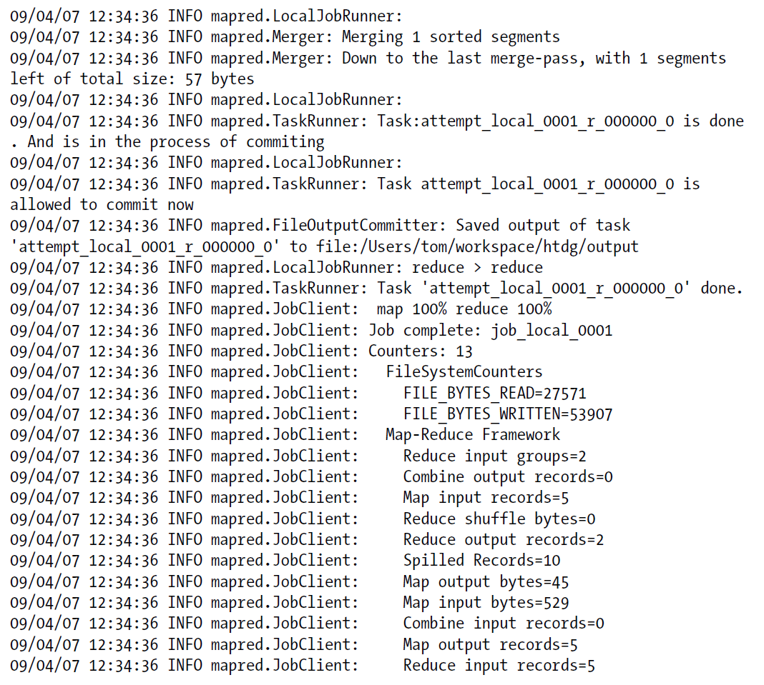
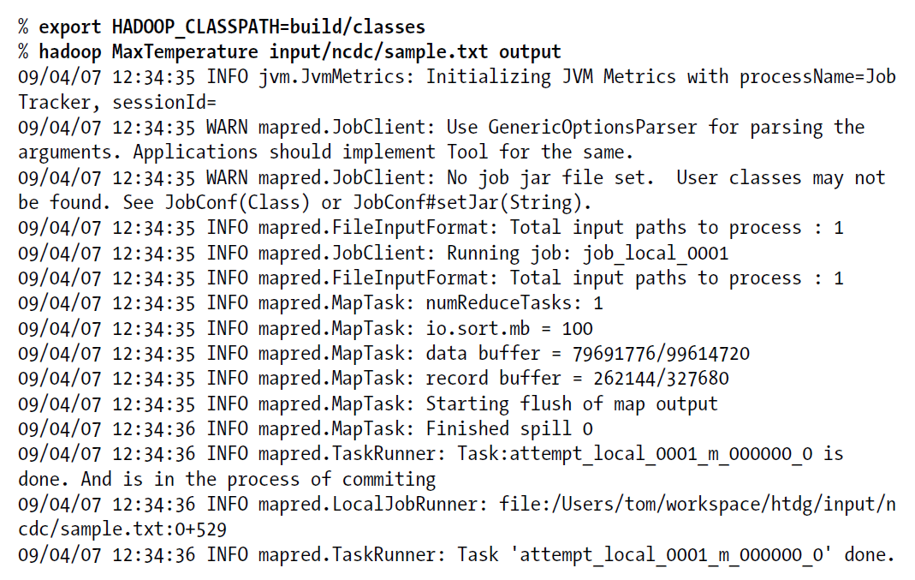
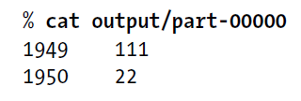
Run the Job
Install Hadoop in standalone mode (Appendix A in the book)
Standalone mode
Run using the local filesystem with a local job runner
HADOOP_CLASSPATH
Path of the application class
Output Log (cont.)
Output Log
Result

Slide 13
Java Implementation
Hadoop 0.20.0
Favors abstract classes over interfaces
Easier to evolve
Mapper and Reducer interfaces are abstract classes
org.apache.hadoop.mapreduce package
Makes extensive use of context objects to allow user code to communicate with the MapReduce system
Supports both a “push” and a “pull” style of iteration
Configuration has been unified
Job configuration is done through a Configuration object
Job control is performed through the Job class, rather than JobClient
But currently not all of the MapReduce libraries of Hadoop have been ported to work with the new API. So this book uses the old API for this reason

Slide 14
Data Flow for Large Inputs
To scale out, we need to store the data in a distributed filesystem, HDFS (Chap. 3)
MapReduce job is divided into map tasks and reduce tasks
Two types of nodes
Jobtracker
Coordinates all the jobs on the system by scheduling tasks to run on tasktrackers
If a task fails, the jobtracker can reschedule it on a different tasktracker
Tasktracker
Run tasks and send progress reports to the jobtracker
Divides input into fixed-size pieces, input splits
Hadoop creates one map task for each split
Map task runs the user-defined map function for each record in the spilit

Slide 15
Data Flow for Large Inputs
Size of splits
Small size is better for load-balancing: faster machine will be able to process more splits
But if splits are too small, the overhead of managing the splits dominate the total execution time
For most jobs, a good split size tends to be the size of a HDFS block, 64MB(default)
Data locality optimization
Run the map task on a node where the input data resides in HDFS
This is the reason why the split size is the same as the block size
The largest size of the input that can be guaranteed to be stored on a single node
If the split spanned two blocks, it would be unlikely that any HDFS node stored both blocks
Map tasks write their output to local disk (not to HDFS)
Map output is intermediate output
Once the job is complete the map output can be thrown away
So storing it in HDFS with replication, would be overkill
If the node of map task fails, Hadoop will automatically rerun the map task on another node

Slide 16
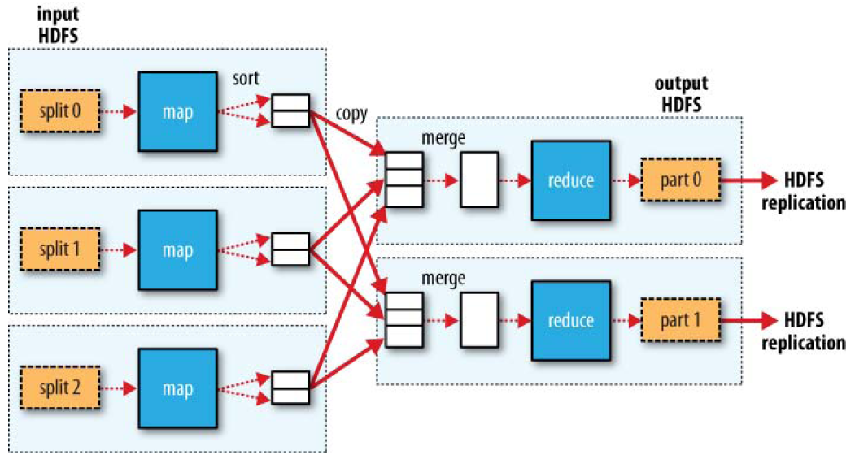
Data Flow for Large Inputs
Reduce tasks don’t have the advantage of data locality
Input to a single reduce task is normally the output from all mappers
Output of the reduce is stored in HDFS for reliability
The number of reduce tasks is not governed by the size of the input, but is specified independently
When there are multiple reducers, the map tasks partition their output:
One partition for each reduce task
The records for every key are all in a single partition
Partitioning can be controlled by a user-defined partitioning function

Slide 17
Combiner Function
To minimize the data transferred between map and reduce tasks
Combiner function is run on the map output
But Hadoop do not guarantee how many times it will call combiner function for a particular map output record
It is just optimization
The number of calling (even zero) does not affect the output of Reducers
Running a distributed MapReduce job
10-node EC2 cluster running High-CPU Extra Large Instances: 6 minutes
max(0, 20, 10, 25, 15) = max(max(0, 20, 10), max(25, 15)) = max(20, 25) = 25

Slide 18
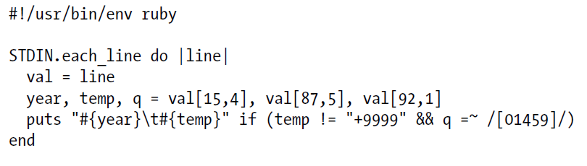
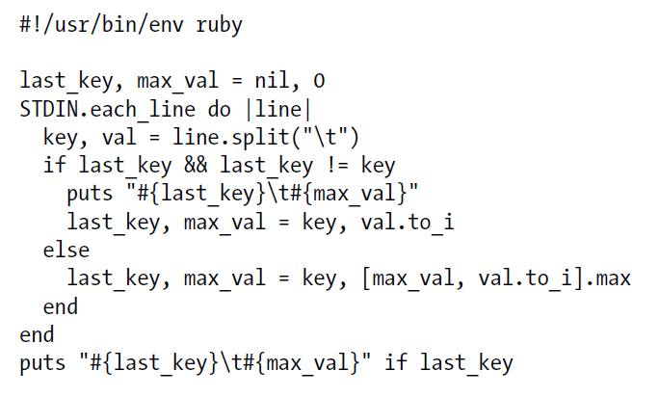
Hadoop Streaming
API for other languages (Ruby, Python,…)
Hadoop Streaming uses Unix standard streams as the interface between Hadoop and your program
Map Function in Ruby
Reduce Function in Ruby

