Slide 1
Large-scale Incremental Processing Using Distributed Transactions and Notifications
Daniel Peng and Frank Dabek
Google, Inc.
OSDI 2010
15 Feb 2012
Presentation @ IDB Lab. Seminar
Presented by Jee-bum Park

Slide 2
Outline
Introduction
Design
Bigtable overview
Transactions
Notifications
Evaluation
Conclusion
Good and Not So Good Things

Slide 3



Introduction
How can Google find the documents on the web so fast?

Slide 4

Introduction
Google uses an index, built by the indexing system, that can be used to answer search queries

Slide 5
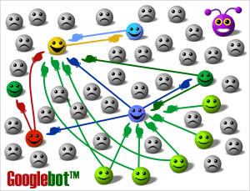
Introduction
What does the indexing system do?
Crawling every page on the web
Parsing the documents
Extracting links
Clustering duplicates
Inverting links
Computing PageRank
...

Slide 6
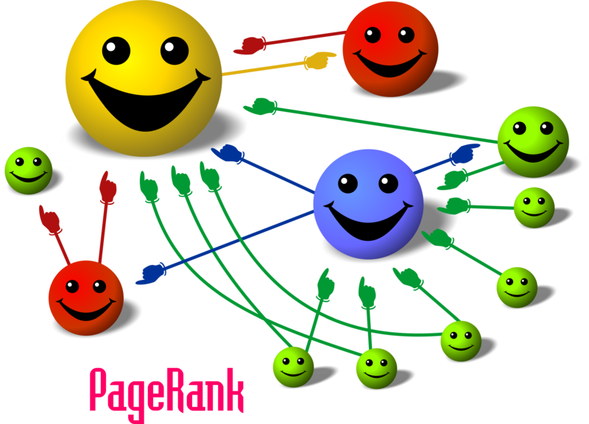
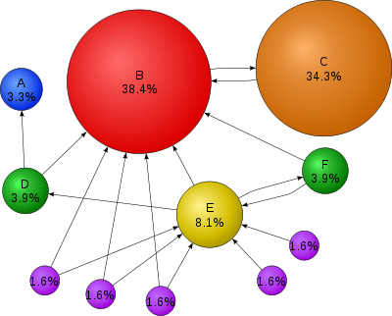

Introduction
PageRank

Slide 7
Introduction
Compute PageRank using MapReduce
Job 1: compute R(1)
Job 2: compute R(2)
Job 3: compute R(3)
...
□□□□
R(t) =

Slide 8

Introduction
Now, consider how to update that index after recrawling some small portion of the web

Slide 9
Introduction
Now, consider how to update that index after recrawling some small portion of the web
Is it okay to run the MapReduces over just new pages?

Slide 10
Introduction
Now, consider how to update that index after recrawling some small portion of the web
Is it okay to run the MapReduces over just new pages?
Nope, there are links between the new pages and the rest of the web

Slide 11
Introduction
Now, consider how to update that index after recrawling some small portion of the web
Is it okay to run the MapReduces over just new pages?
Nope, there are links between the new pages and the rest of the web
Well, how about this?

Slide 12
Introduction
Now, consider how to update that index after recrawling some small portion of the web
Is it okay to run the MapReduces over just new pages?
Nope, there are links between the new pages and the rest of the web
Well, how about this?
MapReduces must be run again over the entire repository

Slide 13
Introduction
Google’s web search index was produced in this way
Running over the entire pages
It was not a critical issue,
Because given enough computing resources, MapReduce’s scalability makes this approach feasible
However, reprocessing the entire web
Discards the work done in earlier runs
Makes latency proportional to the size of the repository, rather than the size of an update

Slide 14
Introduction
An ideal data processing system for the task of maintaining the web search index would be optimized for incremental processing
Incremental processing system: Percolator

Slide 15
Outline
Introduction
Design
Bigtable overview
Transactions
Notifications
Evaluation
Conclusion
Good and Not So Good Things

Slide 16
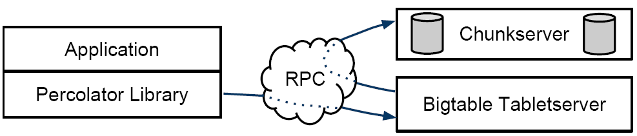
Design
Percolator is built on top of the Bigtable distributed storage system
A Percolator system consists of three binaries that run on every machine in the cluster
A Percolator worker
A Bigtable tablet server
A GFS chunkserver
All observers (user applications) are linked into the Percolator worker

Slide 17
Design
Dependencies
Observers
Percolator worker
Bigtable tablet server
GFS chunkserver

Slide 18
Design
System architecture
Node 1
Node 2
Node ...
Observers
Percolator worker
Bigtable tablet server
GFS chunkserver
Observers
Percolator worker
Bigtable tablet server
GFS chunkserver
Observers
Percolator worker
Bigtable tablet server
GFS chunkserver
Timestamp oracle service
Lightweight lock service

Slide 19
Design
The Percolator worker
Scans the Bigtable for changed columns
Invokes the corresponding observers as a function call in the worker process
The observers
Perform transactions by sending read/write RPCs to Bigtable tablet servers
Observers
Percolator worker
Bigtable tablet server
GFS chunkserver

Slide 20
Design
The Percolator worker
Scans the Bigtable for changed columns
Invokes the corresponding observers as a function call in the worker process
The observers
Perform transactions by sending read/write RPCs to Bigtable tablet servers
Observers
Percolator worker
Bigtable tablet server
GFS chunkserver
1: scan

Slide 21
Design
The Percolator worker
Scans the Bigtable for changed columns
Invokes the corresponding observers as a function call in the worker process
The observers
Perform transactions by sending read/write RPCs to Bigtable tablet servers
Observers
Percolator worker
Bigtable tablet server
GFS chunkserver
2: invoke
1: scan

Slide 22
Design
The Percolator worker
Scans the Bigtable for changed columns
Invokes the corresponding observers as a function call in the worker process
The observers
Perform transactions by sending read/write RPCs to Bigtable tablet servers
Observers
Percolator worker
Bigtable tablet server
GFS chunkserver
2: invoke
3: RPC
1: scan

Slide 23
Design
The timestamp oracle service
Provides strictly increasing timestamps
A property required for correct operation of the snapshot isolation protocol
The lightweight lock service
Workers use it to make the search for dirty notifications more efficient
Timestamp oracle service
Lightweight lock service

Slide 24
Design
Percolator provides two main abstractions
Transactions
Cross-row, cross-table with ACID snapshot-isolation semantics
Observers
Similar to database triggers or events
Transactions
Observers
Percolator

Slide 25
Design – Bigtable overview
Percolator is built on top of the Bigtable distributed storage system
Bigtable presents a multi-dimensional sorted map to users
Keys are (row, column, timestamp) tuples
Bigtable provides lookup, update operations, and transactions on individual rows
Bigtable does not provide multi-row transactions
Observers
Percolator worker
Bigtable tablet server
GFS chunkserver

Slide 26
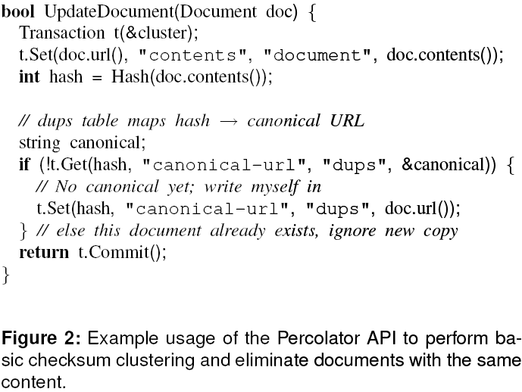
Design – Transactions
Percolator provides cross-row, cross-table transactions with ACID snapshot-isolation semantics

Slide 27

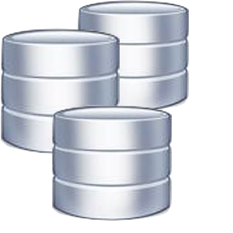
Design – Transactions
Percolator stores multiple versions of each data item using Bigtable’s timestamp dimension
Multiple versions are required to provide snapshot isolation
Snapshot isolation
1
3
2

Slide 28
Design – Transactions
Case 1: use exclusive locks
1

Slide 29

Design – Transactions
Case 1: use exclusive locks
1

Slide 30
Design – Transactions
Case 1: use exclusive locks
1
2

Slide 31
Design – Transactions
Case 1: use exclusive locks
2

Slide 32
Design – Transactions
Case 1: use exclusive locks
2

Slide 33


Design – Transactions
Case 1: use exclusive locks
2

Slide 34
Design – Transactions
Case 2: do not use any locks
1

Slide 35
Design – Transactions
Case 2: do not use any locks
1

Slide 36
Design – Transactions
Case 2: do not use any locks
1
2

Slide 37
Design – Transactions
Case 2: do not use any locks
1
2

Slide 38
Design – Transactions
Case 2: do not use any locks
2

Slide 39

Design – Transactions
Case 2: do not use any locks
2

Slide 40
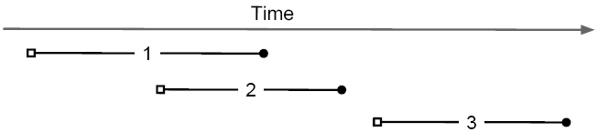
Design – Transactions
Case 2: do not use any locks
2

Slide 41

Design – Transactions
Case 3: use multiple versioning & timestamp
1

Slide 42
Design – Transactions
Case 3: use multiple versioning & timestamp
1

Slide 43
Design – Transactions
Case 3: use multiple versioning & timestamp
1

Slide 44
Design – Transactions
Case 3: use multiple versioning & timestamp
1
2

Slide 45
Design – Transactions
Case 3: use multiple versioning & timestamp
1
2

Slide 46
Design – Transactions
Case 3: use multiple versioning & timestamp
1
2

Slide 47
Design – Transactions
Case 3: use multiple versioning & timestamp
1
2

Slide 48
Design – Transactions
Case 3: use multiple versioning & timestamp
2

Slide 49
Design – Transactions
Case 3: use multiple versioning & timestamp
2

Slide 50

Design – Transactions
Case 3: use multiple versioning & timestamp
2

Slide 51
Design – Transactions
Case 3: use multiple versioning & timestamp
2

Slide 52
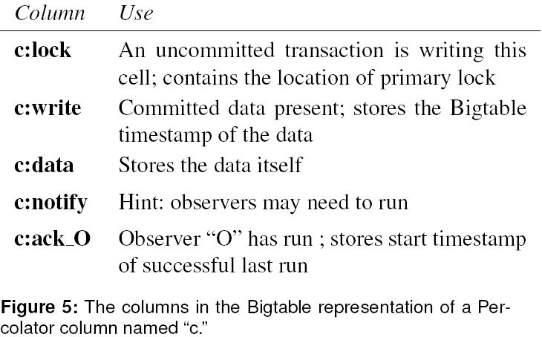
Design – Transactions
Percolator stores its locks in special in-memory columns in the same Bigtable

Slide 53
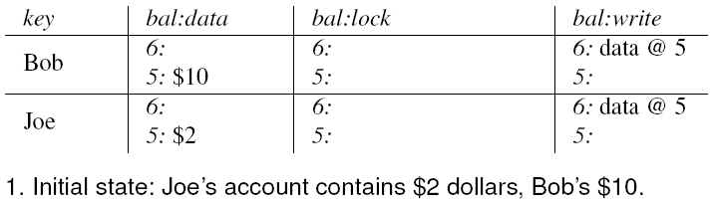
Design – Transactions
Percolator transaction demo

Slide 54
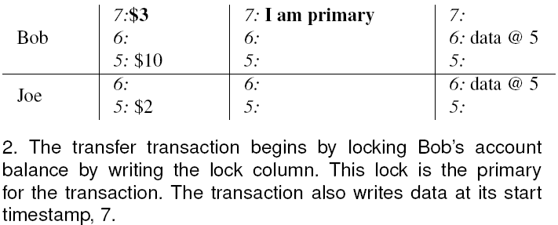
Design – Transactions
Percolator transaction demo

Slide 55
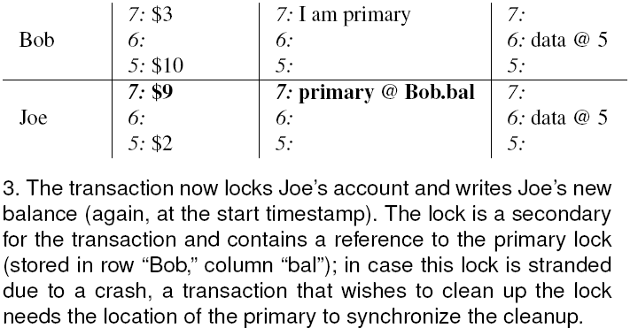
Design – Transactions
Percolator transaction demo

Slide 56
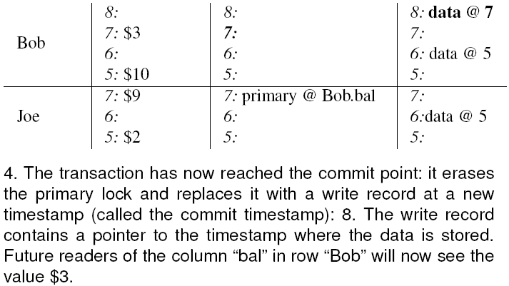
Design – Transactions
Percolator transaction demo

Slide 57
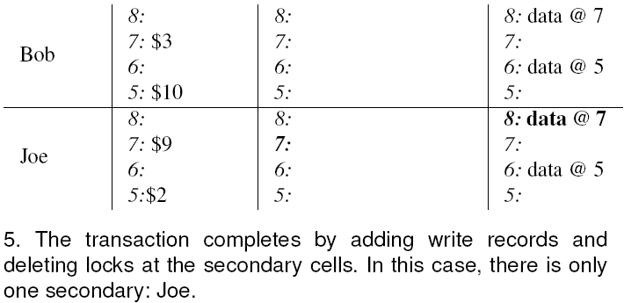
Design – Transactions
Percolator transaction demo

Slide 58
Design – Notifications
In Percolator, the user writes code (“observers”) to be triggered by changes to the table
Each observer registers a function and a set of columns
Percolator invokes the functions after data is written to one of those columns in any row
Observers
Percolator worker
Bigtable tablet server
GFS chunkserver
2: invoke
3: RPC
1: scan

Slide 59
Design – Notifications
Percolator applications are structured as a series of observers
Each observer completes a task and creates more work for “downstream” observers by writing to the table
A Percolator application
Observer 1
Observer 2
Observer 4
Observer 5
Observer 3
Observer 6

Slide 60
Design – Notifications
Google’s new indexing system
Document Processor (parse, extract links, etc.)
Clustering
Exporter
Observers
Percolator worker
Bigtable tablet server
GFS chunkserver
2: invoke
3: RPC
1: scan

Slide 61
Design – Notifications
To implement notifications, Percolator needs to efficiently find dirty cells with observers that need to be run
To identify dirty cells, Percolator maintains a special “notify” Bigtable column, containing an entry for each dirty cell
When a transaction writes an observed cell, it also sets the corresponding notify cell

Slide 62
Design – Notifications
Each Percolator worker chooses a portion of the table to scan by picking a region of the table randomly
To avoid running observers on the same row concurrently, each worker acquires a lock from a lightweight lock service before scanning the row
Timestamp oracle service
Lightweight lock service

Slide 63
Outline
Introduction
Design
Bigtable overview
Transactions
Notifications
Evaluation
Conclusion
Good and Not So Good Things

Slide 64
Evaluation
Experiences with converting a MapReduce-based indexing pipeline to use Percolator
Latency
100x faster than the previous system
Simplification
The number of observers in the new system: 10
The number of MapReduces in the previous system: 100
Easier to operate
Far fewer moving parts: tablet servers, Percolator workers, chunkservers
In the old system, each of a hundred different MapReduces needed to be individually configured and could independently fail

Slide 65
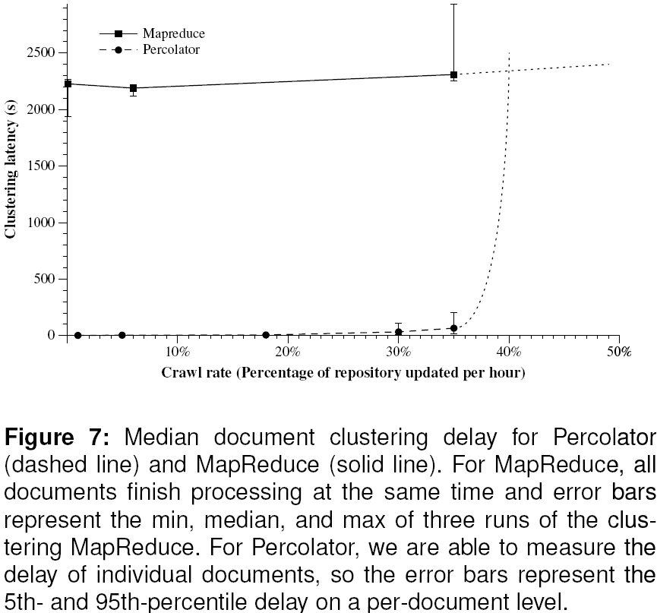
Evaluation
Crawl rate benchmark on 240 machines

Slide 66
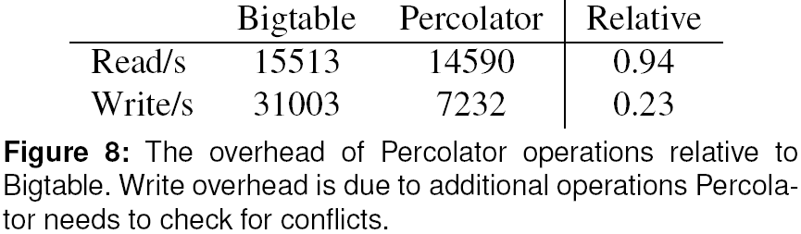
Evaluation
Versus Bigtable

Slide 67
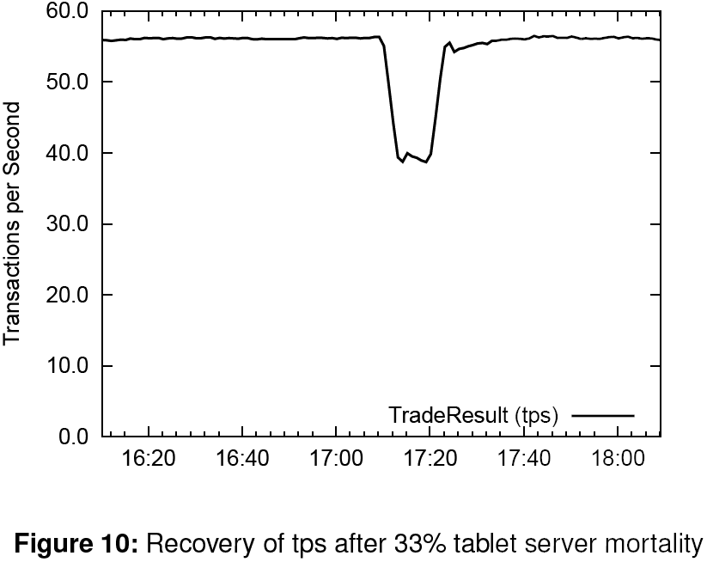
Evaluation
Fault-tolerance

Slide 68
Outline
Introduction
Design
Bigtable overview
Transactions
Notifications
Evaluation
Conclusion
Good and Not So Good Things

Slide 69
Conclusion
Percolator provides two main abstractions
Transactions
Cross-row, cross-table with ACID snapshot-isolation semantics
Observers
Similar to database triggers or events
Transactions
Observers
Percolator

Slide 70
Outline
Introduction
Design
Bigtable overview
Transactions
Notifications
Evaluation
Conclusion
Good and Not So Good Things

Slide 71
Good and Not So Good Things
Good things
Simple and neat design
Purpose of use is clear
Detailed description based on real example: Google’s indexing system
Not so good things
Lack of observer examples (Google’s indexing system in particular)

Slide 72
Thank You!
Any Questions or Comments?

