Slide 1
Storage and Retrieval of Large RDF Graph Using Hadoop and MapReduce
Mohammad Farhan Husain, Pankil Doshi,
Latifur Khan, Bhavani Thuraisingham
University of Texas at Dallas
CloudCom 2009
11 October 2012
SNU IDB Lab.
Min Sup Lee

Slide 2
Outline
Introduction
Proposed Architecture
MapReduce Framework
Result
Conclusion
Discussion

Slide 3
Introduction
RDF Query Processing
S | P | O
MS | type | Student
MS | worksFor | IDB
IDB | subOrganizationOf | SNU
IDB | type | Lab.
SNU | type | Univ.
MS | belongTo | C.S.
C.S. | type | Dept.
MS
IDB
C.S.
SELECT ?X WHERE{
?X rdf : type ub : Student
?X ub : worksFor ?Y
?Y ub : subOrganizationOf SNU }
SNU

Slide 4

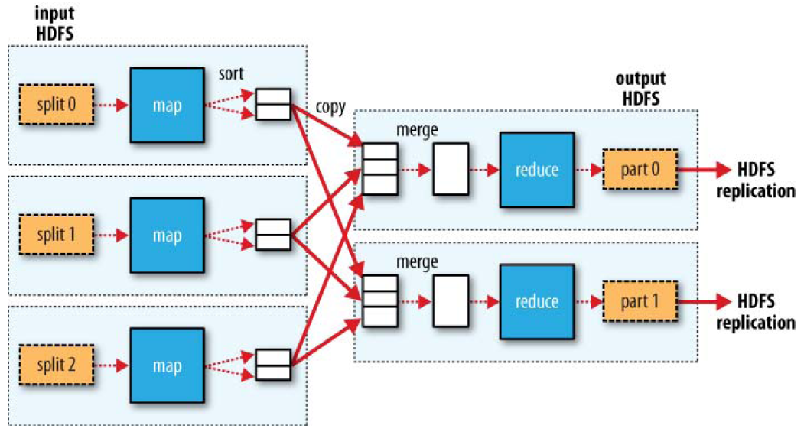

Introduction
MapReduce
Suitable for processing large amount of data in parallel
Many Join operations are performed in a MapReduce job
Hadoop
High fault tolerance and reliability
Provide an implementation of MapReduce programming model

Slide 5
Introduction
MapReduce Join
SELECT ?X WHERE{
?X ub:worksFor ?Y
?Y ub:belongTo C.S.}
Map
MS | Type | Student
HS | Type | Student
SC | worksFor | IDS
IDB | belongTo | C.S.
MJ | worksFor | ABC
IDB | Type | Lab.
IDS | Type | Lab.
SC | Type | Student
IDS | belongTo | C.S.
ABC | belongTo | E.E.
MS | worksFor | IDB
MJ | Type | Student
ABC | Type | Lab.
HS | worksFor | IDB
MS | Type | Student
HS | Type | Student
SC | worksFor | IDS
IDB | belongTo | C.S.
MJ | worksFor | ABC
Reduce
SC | worksFor | IDS
IDS | belongTo | C.S.
IDB | Type | Lab.
IDS | Type | Lab.
SC | Type | Student
IDS | belongTo | C.S.
ABC | belongTo | E.E.
SC
MS
HS
MJ | worksFor | ABC
MS | worksFor | IDB
MJ | Type | Student
ABC | Type | Lab.
HS | worksFor | IDB
MS | worksFor | IDB
HS | worksFor | IDB
IDB | belongTo | C.S.

Slide 6
Introduction
Devise a schema to store RDF data in Hadoop
Devise an algorithm
Determine the number of jobs
Determine their sequence and inputs
Minimize the amount of space
Reduce the execution time of a SPARQL query

Slide 7
Outline
Introduction
Proposed Architecture
MapReduce Framework
Result
Conclusion
Discussion

Slide 8
Proposed Architecture File Organization
Naïve model
Take long time to search
Not suitable for MapReduce framework
A file is the smallest unit of input to a MapReduce job in Hadoop
S | P | O
MS | Type | Student
MS | worksFor | IDB
IDB | subOrganizationOf | SNU
IDB | Type | Lab.
SNU | Type | Univ.
MS | belongTo | C.S.
C.S. | Type | Dept.
A | worksFor | IDB
B | worksFor | IDB
C | worksFor | IDB
A | Type | Student
B | Type | Professor
C | Type | Professor
. | . | .
. | . | .

Slide 9
Proposed Architecture File Organization
P(worksFor)
MS | IDB
A | IDS
B | IDB
C | IDB
Predicate Split (PS)
Divide the data according to the predicates
S | P | O
MS | type | Student
MS | worksFor | IDB
IDB | subOrganizationOf | SNU
IDB | type | Lab.
SNU | type | Univ.
MS | belongTo | C.S.
C.S. | type | Dept.
A | worksFor | IDS
B | worksFor | IDB
C | worksFor | IDB
A | type | Student
B | type | Professor
C | type | Professor
. | . | .
. | . | .
P(subOrganizationOf)
IDB | SNU
P(belongTo)
IDB | SNU
P(type)
MS | Stuent
IDB | Lab.
SNU | Univ.
C.S. | Dept.
A | Student
B | Professor
C | Professor

Slide 10
Proposed Architecture File Organization
Predicate Object Split (POS)
P(worksFor)
MS | IDB
A | IDS
B | IDB
C | IDB
Reduce the execution time
Reduce the amount of space
Work with the type information of objects
70.42% space gain after PS steps
PO(type.)
MS | Stuent
A | Student
P(subOrganizationOf)
IDB | SNU
PO(type.Lab.)
IDB | Lab.
P(belongTo)
IDB | SNU
PO(type.Univ.)
SNU | Univ.
P(type)
MS | Stuent
IDB | Lab.
SNU | Univ.
C.S. | Dept.
A | Student
B | Professor
C | Professor
PO(type.Dept.)
C.S. | Dept.
PO(type.Professor)
B | Professor
C | Professor

Slide 11
Outline
Introduction
Proposed Architecture
MapReduce Framework
Result
Conclusion
Discussion

Slide 12
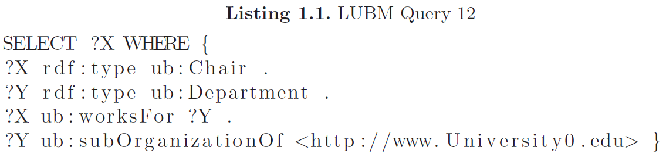
MapReduce Framework The DetermineJobs Algorithm
Naïve model
S | P | O
A | type | Chair
B | type | Chair
CS | type | Department
EE | type | Department
A | worksFor | CS
B | worksFor | EE
CS | subOrganizationOf | www.University0.edu
EE | subOrganizationOf | SNU
. | . | .
. | . | .
A
Need three join operations

Slide 13
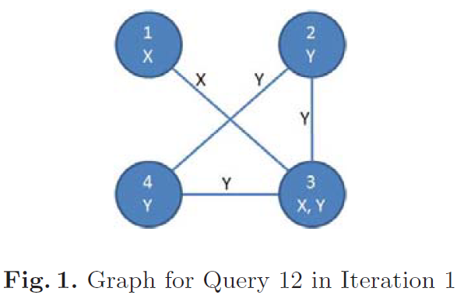
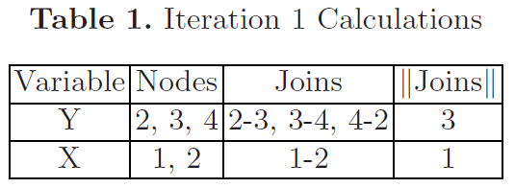
MapReduce Framework The DetermineJobs Algorithm
Devised Algorithm 1
①
②
③
④
3
3
Sort the variables in descending order according to the number of joins

Slide 14
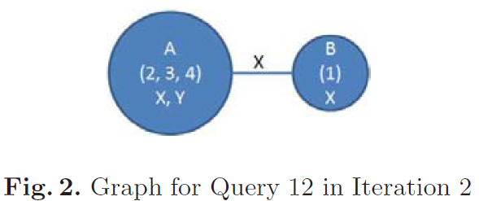
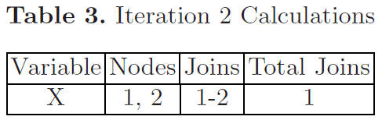
MapReduce Framework The DetermineJobs Algorithm
Nodes 2, 3 and 4 collapse and form a single node
Calculates the number of joins still left in the graph
Determine that no more job is need
Return the job collection
CS | type | Department
EE | type | Department
A | worksFor | CS
B | worksFor | EE
CS | subOrganizationOf | www.University0.edu
CS
CS | type | Department
A | worksFor | CS
CS | subOrganizationOf | www.University0.edu
3
3

Slide 15
MapReduce Framework The DetermineJobs Algorithm
MapReduce Join with devised framework
SELECT ?X WHERE{
?Y rdf:type ub:Lab.
?X ub:worksFor ?Y
?Y ub:belongTo C.S.}
Map
P(worksFor)
MJ | ABC
MS | IDB
HS | IDB
SC | IDS
MJ | ABC
MS | IDB
HS | IDB
SC | IDS
Reduce
IDB | MS
IDB | HS
PO(Type.Student)
MS | Student
HS | Student
MJ | Student
SC | Student
MS | Student
HS | Student
MJ | Student
SC | Student
IDB | Lab.
IDB | C.S.
MS
HS
SC
PO(Type.Lab.)
IDB | Lab.
IDS | Lab.
ABC | Lab.
IDB | Lab.
IDS | Lab.
ABC | Lab.
ABC | MJ
ABC | Lab.
IDS | SC
P(belongTo)
IDB | C.S.
IDS | C.S.
ABC | E.E.
IDB | C.S.
IDS | C.S.
ABC | E.E.
IDS | Lab.
IDS | C.S.

Slide 16
Outline
Introduction
Proposed Architecture
MapReduce Framework
Result
Conclusion
Discussion

Slide 17
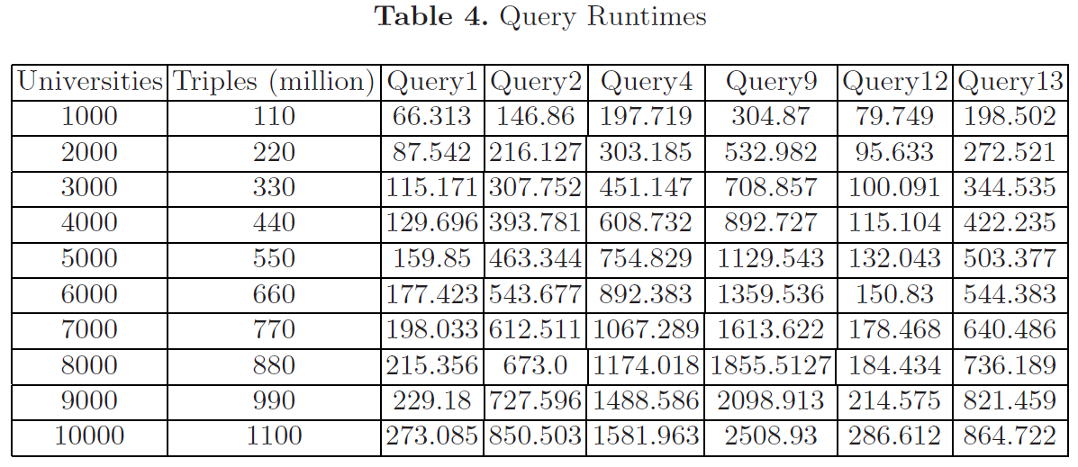
Result
Query 1 → Only one join
Query 2 → Three times more triple patterns than Query 1
Query 4 → One less triple pattern than query 2 and
inferencing to bind 1 triple pattern
Query 9 and 12 → Also require inferencing
Query 13 → Has an Inverse property

Slide 18
Result
10000 universities dataset has ten times triples than 1000 universities
For query1,
Increase by 4.12 times
For query 9,
Increase by 8.23 times
Still less than the increase in dataset size

Slide 19
Outline
Introduction
Proposed Architecture
MapReduce Framework
Result
Conclusion
Discussion

Slide 20
Conclusion
Devised efficient file organization
Made the algorithm which determines the number of jobs, sequence and inputs

Slide 21
Outline
Introduction
Proposed Architecture
MapReduce Framework
Result
Conclusion
Discussion

Slide 22
Discussion
Strong points
A good attempt for Large RDF graph at using the Hadoop
Weak points
Need the comparison with the result before applying their framework
Poor experimental environment

Slide 23
Thank you

