Slide 1
What’s in a @name? How Name Value Biases Judgment of Microblog Authors
Aditya Pal, Scott Counts
ICWSM 2011
September 15, 2011
Hyewon Lim

Slide 2
Outline
Introduction
Dataset and User Study Design
Author Rating Analysis Results
Participant Rating Analysis Results
Measuring Other Factors for Bias
Discussion

Slide 3

Introduction
Cognitive bias:
The human tendency to err systematically
when making judgment based on heuristics
rather than thorough analysis of evidence
(Tversky and Kahneman 1974)

Slide 4
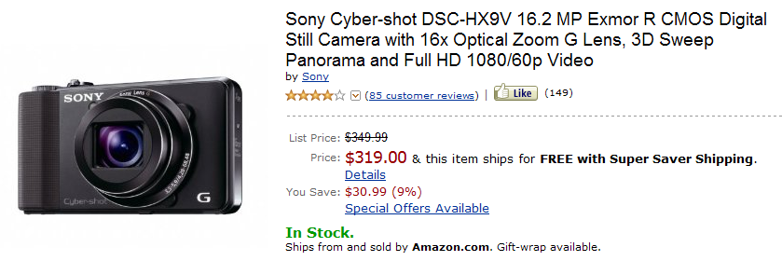
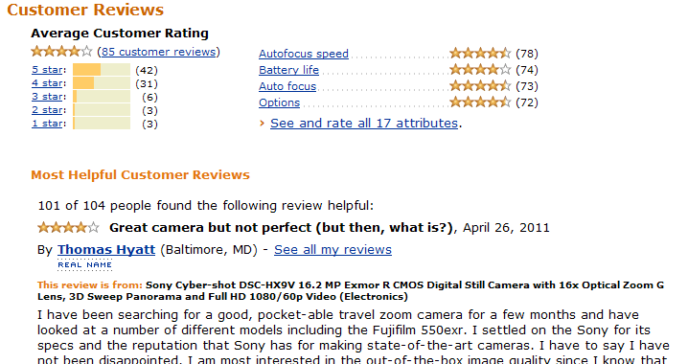
Introduction

Slide 5
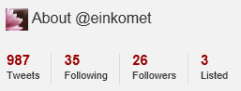
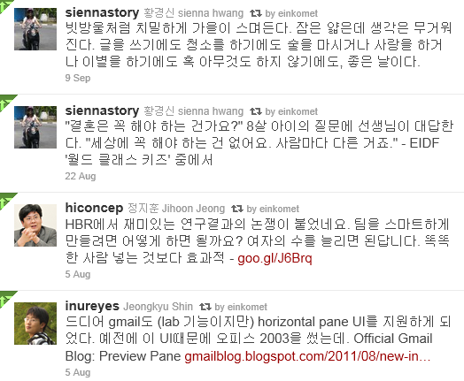
Introduction
The assessment of the quality of the content or user is based in part on biases of the users evaluating them

Slide 6
Introduction
We study how bias due to name value impacts the perception of quality of Twitter authors
Understanding this bias is increasingly important
Microblogs become a vehicle for content distribution
Readers must evaluate content from authors they do not follow
Username is a key piece of information when a reader sees only the user name and photo of the author

Slide 7
Introduction
Main contributions
Discover how name value affects ratings of the quality of an author’s tweets
Analyze the relationship between name value with follower count
Measure to what degree Tweet readers are biased
Show that certain qualities of names are more effective in influencing reader’s perception about the quality of their content

Slide 8
Outline
Introduction
Dataset and User Study Design
Author Rating Analysis Results
Participant Rating Analysis Results
Measuring Other Factors for Bias
Discussion

Slide 9
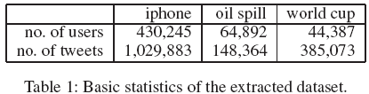
Dataset and User Study Design
Twitter dataset
Selected three topics: iPhone, Oil Spill, World Cup
40 Twitter authors per topic
30 were selected using an expert identification algorithm
Followers: 29 ~ 2,161,200
10 were selected randomly
who have tweeted on topic but were not considered authorities
For each author, we picked 4 of their topical tweets

Slide 10
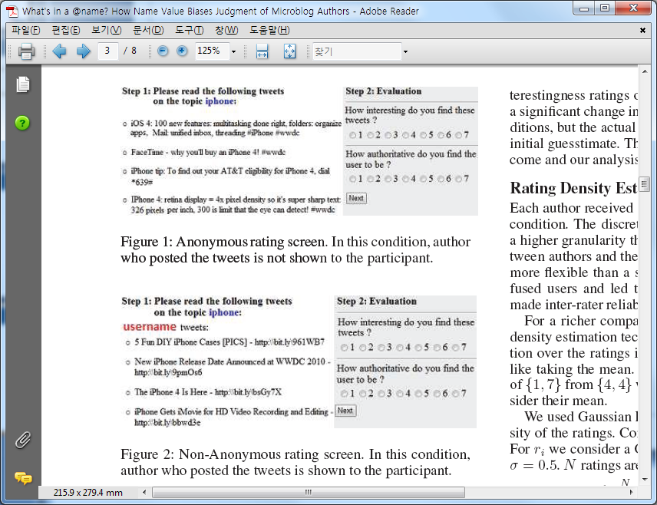
Dataset and User Study Design
Procedure and evaluation criteria
48 Participants (25% female)
The first 20 authors were presented anonymously, the second 20 authors were evaluated non-anonymously

Slide 11
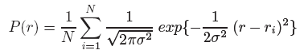
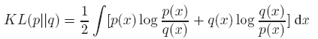
Dataset and User Study Design
Rating density estimation
Smoothes the ratings to reflect better approximation to true ratings
Reduces the effect of outliers on the small number of ratings
Enables the use of distance measures over differences of point estimates
Gaussian kernel
Estimate the continuous density of the ratings
N ratings r = {r₁, r₂, …, r_{N}}
Kullback-Leibler divergence

Slide 12
Outline
Introduction
Dataset and User Study Design
Author Rating Analysis Results
Participant Rating Analysis Results
Measuring Other Factors for Bias
Discussion

Slide 13
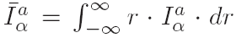
Author Rating Analysis Results
Notation
The mean of all the ratings received by user a
I
Interestingness
A
Authority
α
Anonymous
β
Non-anonymous

Slide 14
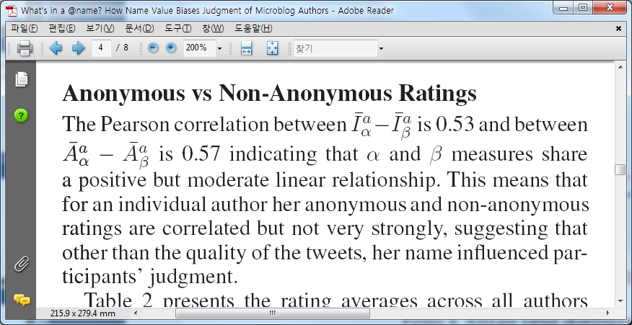
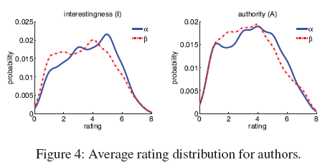
Author Rating Analysis Results
Anonymous vs non-anonymous ratings

Slide 15
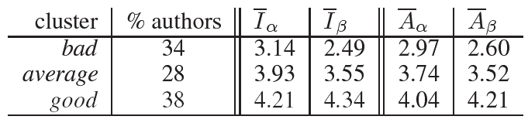
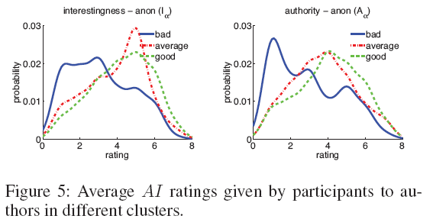
Author Rating Analysis Results
Rating distribution comparisons
Discover that all authors are better of being rated anonymously or do some authors benefit on the contrary
KMeans clustering algorithm
Over the rating distributions of authors by using symmetric KL-divergence between two authors
Notes:
Table 3을 보면, good author들의 경우, 익명이 아닐 때 더 높은 rate을 받고 있음을 알 수 있음.
앞의 해석과 대조적임. 즉, 이름 때문에 이득을 보는 사람들이 있다고 생각할 수 있음.
다른 그룹들 – 특히, bad – 은 이름이 보여지면 더 rate가 떨어지는 경향을 보임.
Figure 5를 보면, bad의 경우는 익명인 경우에도 rate가 낮음을 볼 수 있는데, 이건 전적으로 컨텐츠의 질이 나쁜 것.
Average 그룹의 경우, 익명일 때는 good 그룹과 rate의 큰 차이가 없는데, 이름이 보여지면 거의 1 point 정도 차이가 벌어지는 걸 알 수 있음
즉, average 그룹은 고 퀄리티의 트윗을 발행하지만 이름 때문에 피해보는 애들.

Slide 16
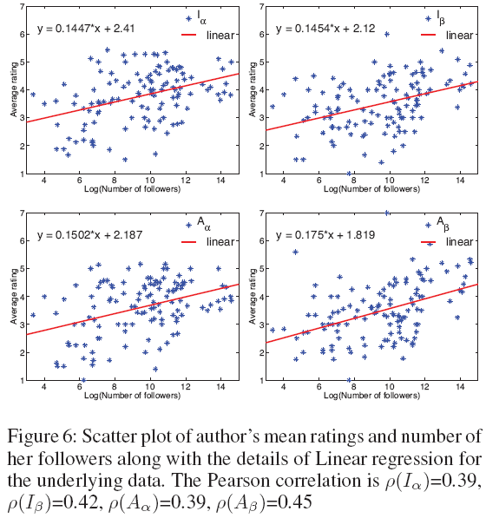
Author Rating Analysis Results
Rating and follower count
Notes:
Figure 6: linear regressions between author ratings and their # followers
Positive slope라는 것은 즉, 유명한 author들이 좋은 post를 한다 또는 좋은 컨텐츠를 만드는 애들이 유명해진다는 것을 의미함.
1. 그런데 여기서, x축 = 12 인 지점을 보면, 익명일 때는 사람들이 대체적으로 회귀선 아래에 분포하는 것을, 익명이 아닐 때는 대체적으로 회귀선 위에 분포하는 것을 볼 수 있음.
이건 그들의 이름이 보여짐으로써 더 rate을 얻는 celebrity들이나 organization들임.
2. 익명일 때보다 익명이 아닐때가 회귀선이 약간 더 가파른 기울기를 갖는 것을 볼 수 있음.
이는 익명이 아닐 때 좀 더 follower수와 rate가 관계 있음을 (follower 수에 따라 rate가 증가함을) 보여줌.
3. 익명이 아닐 때 회귀선에 좀 더 fitting 되었음.
즉, rating과 follower수가 좀 더 관련 있다는 얘기이고, 이것은 평가자들이 rate을 할 때, 이름을 heuristic으로 사용한다는 것을 – 즉, 이름으로 인해 biase가 일어남을 - 알려준다.

Slide 17
Outline
Introduction
Dataset and User Study Design
Author Rating Analysis Results
Participant Rating Analysis Results
Measuring Other Factors for Bias
Discussion

Slide 18
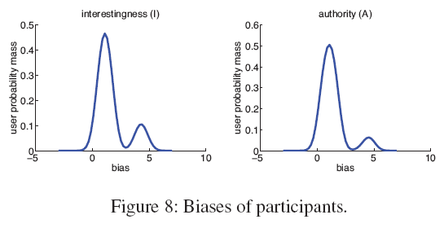
Participant Rating Analysis Results
Measuring participant bias
Notes:
여기서 하려는 거는, 이름이 보여지는 것이 어디서는 이익으로, 어디서는 불이익이 되는 것을 보았는데, 이런 이동(shift)을 측정해 보기 위함.
익명일 때의 rate을 정답으로 하고, 비익명일 때의 rate을 bias라고 할 때, figure 8의 결과를 보면, 대부분의 평가자들(65-70%)이 아주 조금 bias되었음을 알 수 있고,
적은 사용자들이 크게 bias됨을 알 수 있음.
또한, interestingness 측정 값이 authoritativeness 측정값보다 더 bias되었음을 알 수 있음.
→ A의 first peak가 I의 것보다 더 높음. 즉, 미미하게 bias된 사람이 많다는 얘기.

Slide 19
Outline
Introduction
Dataset and User Study Design
Author Rating Analysis Results
Participant Rating Analysis Results
Measuring Other Factors for Bias
Discussion

Slide 20
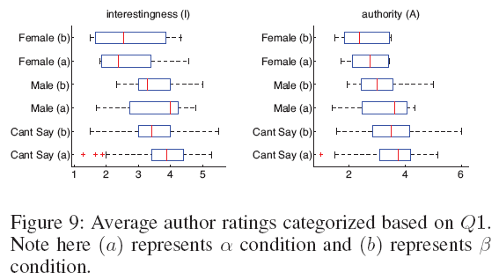
Measuring Other Factors for Bias
Author names study _Gender, type of author, and topical fit
Gender
Majority of top authors are gender neutral
Male were perceived as providing better content than the female

Slide 21
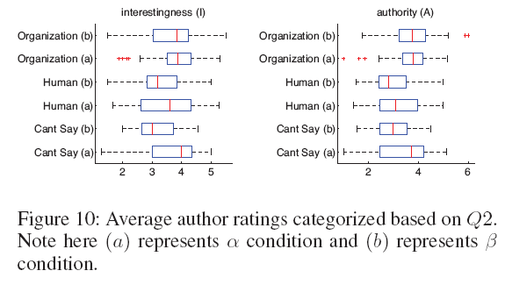
Measuring Other Factors for Bias
Author names study _Gender, type of author, and topical fit
Type
The names with organizations are better
Authority ratings of org improve from α to β conditions
“can’t tell” and human authors receive a drop in authority ratings

Slide 22
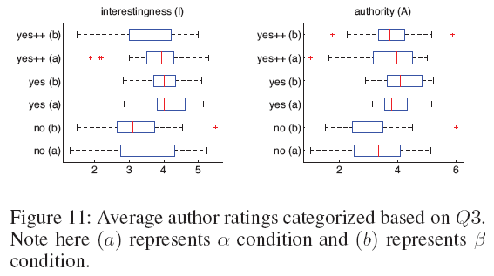
Measuring Other Factors for Bias
Author names study _Gender, type of author, and topical fit
Topical
Yes++: highly topically relevant / Yes: slightly relevant
Yes authors receive higher ratings
Better to have a name only slightly relevant to topic name
Names that are moderately on topic convey a sense that they are authorities on more than just the single topic (e.g., @Apple)

Slide 23
Outline
Introduction
Dataset and User Study Design
Author Rating Analysis Results
Participant Rating Analysis Results
Measuring Other Factors for Bias
Discussion

Slide 24
Discussion
Findings
On average authors are actually hurt by the presence of their name
“Average” and “Bad” authors are particularly hurt by the presence of their name, despite authoring content that is of roughly comparable quality to “good” authors
Authors with high follower counts reap the most benefit from their names being shown
Names that are male, organizations and moderately topical see the most shift in the positive direction in the eyes of readers

Slide 25
Discussion
How can these findings be used by system designers who wish to deliver the highest quality content to a user?
Acknowledging the phenomenology of the user and working with bias may be most appropriate
Finding the exact balance and method for showing end users content from names they expect and content free of name value bias (future work)
A carefully crafted user name can lead to more desirable results for an author
Plan to explore other author metrics, combinations of metrics as proxies for name value

