Slide 1
Learning to match ontologies on the Semantic Web
AnHai Doan¹, Jayant Madhavan², Robin Dhamankar¹, Pedro Domingos², Alon Halevy²
¹ Department of Computer Science, University of Illinois at Urbana-Champaign, Urbana
² Department of Computer Science and Engineering, University of Washington, Seattle
VLDB 2003
Feb 22, 2012
Sengyu Rim
SNU IDB Lab.

Slide 2
Outline
Introduction
Motivation
The ontology matching problem
The GLUE architecture
Evaluation
Conclusion
Discussion

Slide 3
Introduction
Semantic mapping between ontologies is important
Information processing across ontologies
Data integration from different ontologies
GLUE
Using machine learning techniques to find sematic mappings
multiple learning strategies
Several practical similarity measures

Slide 4
Introduction
Example
CS Dept US
CS Dept Aus
How to Map
UnderGrad
Courses
Courses
Staff
People
Grad Courses
Faculty
Staff
Academic Staff
Technical
Staff
Assistant
Professor
Associate
Professor
Professor
Lecturer
Senior
Lecturer
Professor
---name
--degree
-granting-institution
K.Burn
Ph.D
Univ. of A
B.Jack
Ph.D
Univ. of S
R.Cook
Ph.D
Univ. of S
R.Cook
Ph.D
Univ. of S

Slide 5
Outline
Introduction
Motivation
The ontology matching problem
The GLUE architecture
Evaluation
Conclusion
Discussion

Slide 6
Motivation
Data comes from different ontologies
Answers come from multiple web pages
Manual:
Very tedious, error prone, not very scalable

Slide 7
Outline
Introduction
Motivation
The ontology matching problem
The GLUE architecture
Evaluation
Conclusion
Discussion

Slide 8
The ontology matching problem
An ontology specifies a conceptualization of a domain
Concepts
Attributes
Relations
Each concept in a taxonomy is associated with a set of instances
Each concept is also associated with a set of attributes

Slide 9
The ontology matching problem
Given two ontologies, the ontology matching problem is to find semantic mappings between them
One-to-one
Complex mapping
Associate
Professor
UnderGrad
Courses
Grad Courses
Senior
Lecturer
Courses
One-to-One
Complex mapping

Slide 10
The ontology matching problem
Similarity
Exact similarity measure
Most-specific-parent
Staff
Associate
Professor
Academic Staff
Technical
Staff
Senior
Lecturer
Associate
Professor
Lecturer
Senior
Lecturer
Professor
Exact
MSP

Slide 11
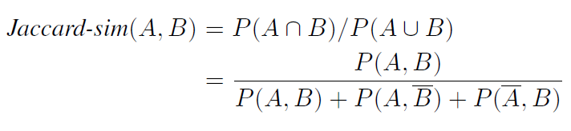
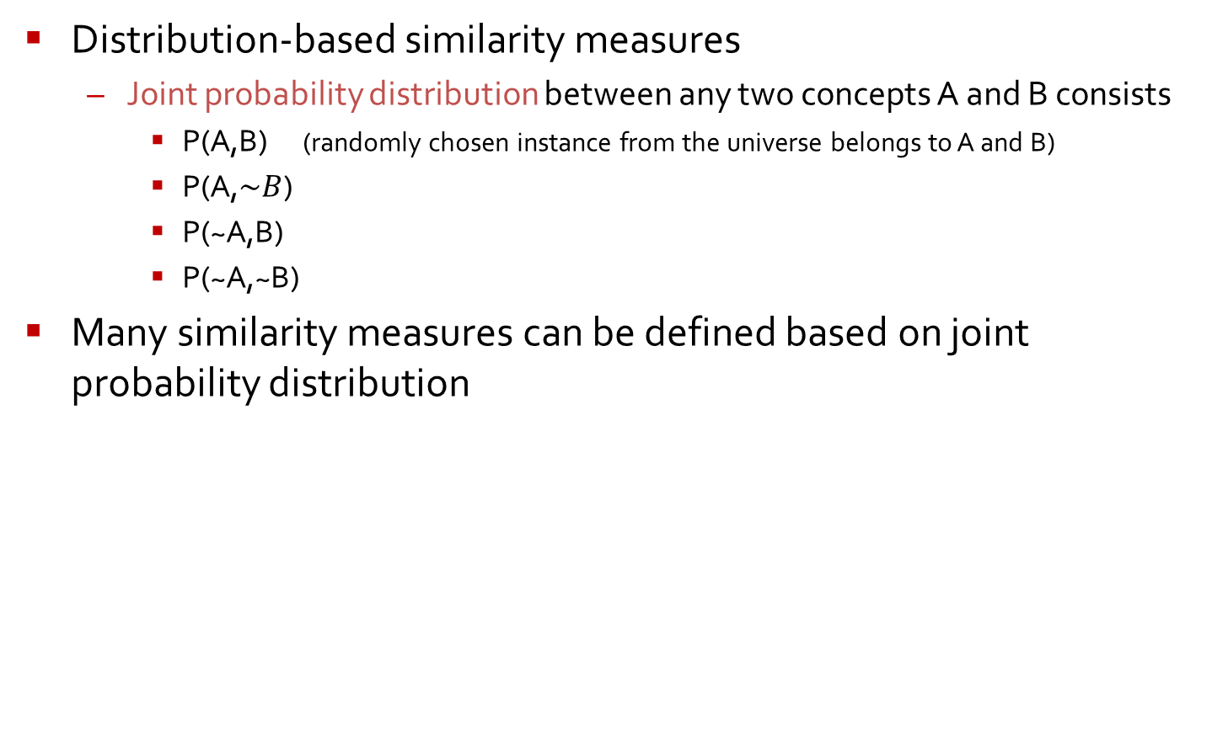
The ontology matching problem
Distribution-based similarity measures
Joint probability distribution between any two concepts A and B consists
P(A,B) (randomly chosen instance from the universe belongs to A and B)
P(A,$\sim B$)
P(~A,B)
P(~A,~B)
Many similarity measures can be defined based on joint probability distribution

Slide 12
Outline
Introduction
Motivation
The ontology matching problem
The GLUE architecture
Evaluation
Conclusion
Discussion

Slide 13
The GLUE architecture
Mappings for Taxonomies
Relaxation Labeler
Common knowledge
Domain constraints
Similarity Matrix
Similarity Estimator
Joint Distributions
Similarity function
Meta Learner M
Distribution Estimator
L₁
…………
L_{k}
Taxonomy 0₁
Taxonomy 0₂

Slide 14
The GLUE architecture
The distribution estimator
P(A,B) can be estimated by the following equation
U_{i} denotes the set of instances given for taxonomy O_{i}
N(U_{i}) is the size of U_{i}
N(U_{i} ^{A,B}) is the number of instances in U_{i} that belong to A and B
Computing P(A,B) reduces to computing N(U₁ ^{A,B}) and N(U₂ ^{A,B})

Slide 15
The GLUE architecture
We use machine learning to tell for each instance s in U₂ whether it belongs to both A and B
U₁^{A}
t1,t2,t3,t4
R
Trained
Learner L
A
C
D
U₁^{not A}
t5
t6,t7
t5,t6,t7
E
F
t1,t2
t3,t4

Slide 16
The GLUE architecture
Partition for U₂
U₂^{B}
U₂^{A,B}
U₂^{not A,B}
G
s1,s2,s3,s4
s1,s3
s2,s4
L
s1
B
H
S5,s6
s5,s6
s6
s6
I
J
s2,s3
s4
U₂^{A,not B}
U₂^{not B}
U₂^{not A,not B}

Slide 17
The GLUE architecture
Multistrategy learning
Many different types of information that a learner can glean from the training instances
Each base learner exploits well a certain type of information
Metalearner combines predictions from base learners
The content learner
Exploits the frequencies of words in the textual content of an instance
Employs Naïve Bayes learning technique
The name learner
Using the full name of the input instance instead of content

Slide 18
The GLUE architecture
Example
The content learner
The name learner
R.Cook
Ph.D
Univ. of S
R.Cook ,Ph.D., University of Sydney
R.Cook
Ph.D
Univ. of S
CS Depart US, People, Faculty, Associate professor,R.Cook

Slide 19
The GLUE architecture
Similarity estimator
Applies function from user
E.g. Jaccord-sim
Outputs a matrix between concepts
the value of probability of similarity for each concept pair
Similarity Matrix
Similarity Estimator
Joint Distributions
Similarity function

Slide 20
The GLUE architecture
Relaxation labeler
Assigning labels to nodes of a graph
The label of a node is influenced by the features of the node’s neighborhood
Recast the problem as finding the best label(concept in O₁) assignment to nodes(concept) in O₁
Constraints
Domain-independent
General knowledge
Domain-dependent
Interaction between two nodes

Slide 21
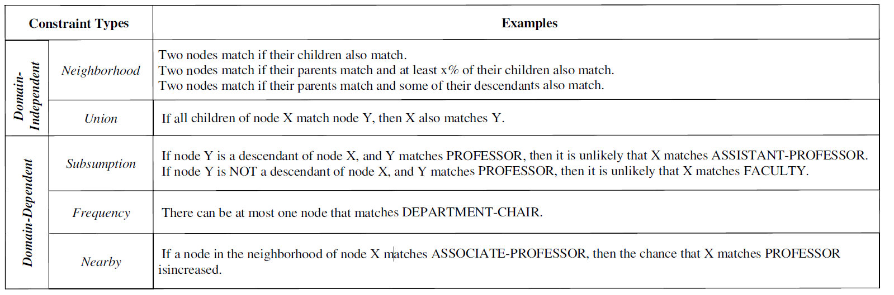
The GLUE architecture
Examples of constraints

Slide 22
Outline
Introduction
Motivation
The ontology matching problem
The GLUE architecture
Evaluation
Conclusion
Discussion

Slide 23
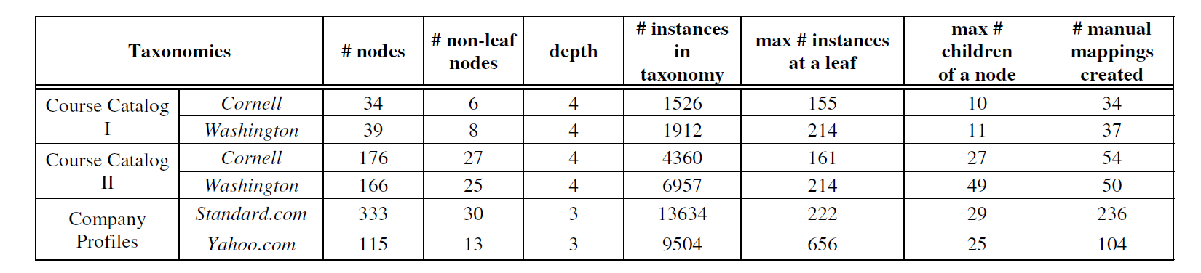
Evaluation
Domains and taxonomies
Course Ⅰ has comparatively small quantity of nodes and concepts are much similar to each other
Course Ⅱ has comparatively large quantity of nodes and concepts are less similar to each other
The company domain describes the current business status of companies

Slide 24
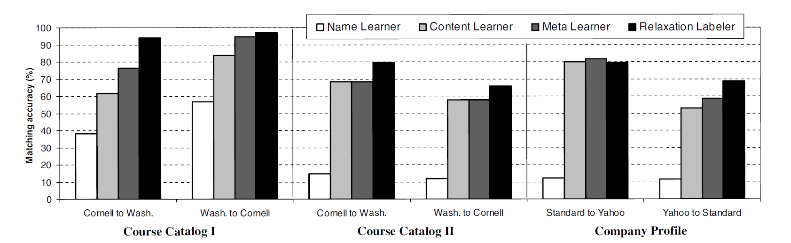
Evaluation
results

Slide 25
Outline
Introduction
Motivation
The ontology matching problem
The GLUE architecture
Evaluation
Conclusion
Discussion

Slide 26
Conclusion
We have described an approach that applies machine learning to match ontologies
We introduced relaxation labeling to the ontology matching
Future work
Extend the techniques to handle more sophisticated mappings between ontologies

Slide 27
Outline
Introduction
Motivation
The ontology matching problem
The GLUE architecture
Evaluation
Conclusion
Discussion

Slide 28
Discussion
Strong point
Well-founded notions of semantic similarity based on the joint probability distribution of the concepts involved
Weak point
No elaboration for similarity estimator , it is simple ,though

Slide 29
Thank you!!!

