Slide 1
Streaming Big Data with Self-Adjusting Computation
Umut A. Acar, Yan Chen
DDFP 2013
02 January 2014
SNU IDB Lab.
Namyoon Kim

Slide 2
Outline
Introduction
Self-Adjusting MapReduce
Regular MapReduce and User Interface
Internals
Implementation
Evaluation
Conclusion

Slide 3
Introduction
Big Data
Is all the rage at the moment
Bound to be more important with real time processing in the future
Requirements
Relatively sophisticated systems support (MapReduce)
Asymptotically linear time examining the data
Not too many updates (not fit for transaction heavy systems)

Slide 4
Problems
Live Updates
Using a single CPU, stream-updating n linear-time updates on a data set of size n requires
O(n²) time
Re-processing of Existing Data
When input is fed line by line in the classic MapReduce wordcount example, the entire
data set is re-processed (regardless of the next input chunk size, it will always take longer)

Slide 5
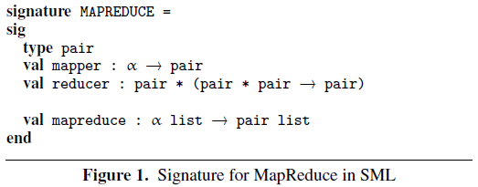
Self-Adjusting MapReduce (Regular MapReduce)
Arguments:
type of key-value pair (for wordcount, string * int)
mapper – maps a word to a string * int pair
reducer – reduces common key pairs to a pair

Slide 6
Self-Adjusting MapReduce (Internals)
Modifiable(reference)
Stores values that can change over time
Using primitives mod, read and write, execution is represented as a dependency graph
(also known as change propagation)
After initial complete run, costs only ϴ(1) to update (complete re-execution ϴ(n))
Levels
are type annotations – resulting types are called level types
Instead of explicit primitive reference, only needs identification of changeable data

Slide 7
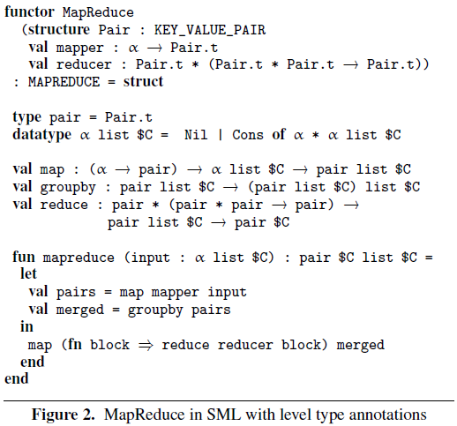
MapReduce in SML with changeables
$C – changeable data types
1. map function converts input list into key-value pairs
2. groupby function mergesorts and scans pair lists
3. reduce each sublist generated by the groupby

Slide 8
Self-Adjusting MapReduce (Implementation)
Map
Pass in a changeable list with stable elements (can add/delete, not modify)
groupby common key pairs into a pair list
Reduce
Sublist returned by groupby function is reduced to a changeable key-value pair
When inserting a new input cell, result can be updated by changing the result of the
reducer operating on the keys of the new cell
Requires no structural changes to the output
Uses stable algorithms (preserves order of records)

Slide 9
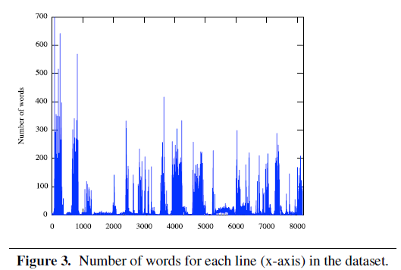
Evaluation – The Input
Data from dbpedia - 8173 lines, 123026 words
Test setup: single node with 2GHz Intel Xeon and 64GB RAM

Slide 10
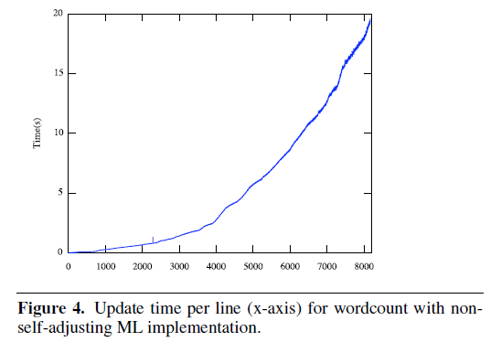
Evaluation – Regular MapReduce in SML
Data filling up fast cache

Slide 11
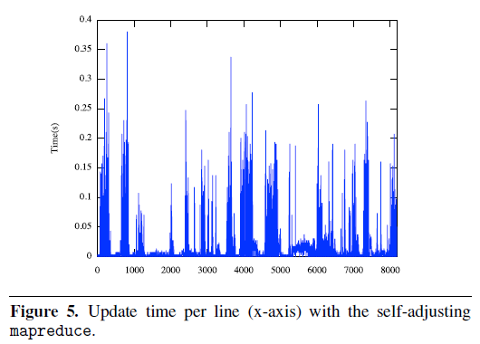
Evaluation – Self-Adjusting MapReduce

Slide 12
Evaluation – Results
Updating whole data vs. updating the delta
Non adjusted MapReduce takes 12.5 hours
Self-Adjusting MapReduce takes 1.7 minutes – 440x speedup
Memory Usage
Self-Adjusting MapReduce records the dynamic dependency graph in memory
Takes up to 16GB of memory, vs. 350MB for the standard MapReduce
45x memory cost

Slide 13
Conclusion
Contribution
Use of self-adjusting computation with dynamically changing big data
Much faster than non self-adjusting methods, albeit with a tradeoff in memory usage
Future Work
Memory optimisation – reduce memory consumption
Increase granularity of dependency
Generalise results to distributed settings, and beyond the MapReduce model

