Slide 1
Calculating the singular values and pseudo-inverse of a matrix: Singular Value Decomposition
Gene H. Golub, William Kahan
Stanford University, University of Toronto
Journal of the Society for Industrial and Applied Mathematics
May 1, 2013
Hee-gook Jun

Slide 2
Outline
Introduction
Index Structure
Index Optimization

Slide 3
Singular Values Decomposition
Factorization of a real or complex matrix
With many useful applications in signal processing and statistics
SVD of matrix M is a factorization of the form
M
U
∑
V^{T}

Slide 4
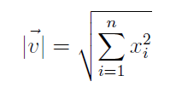






Vector
Length
Inner Product
e.g.
e.g.

Slide 5



Vector
Orthogonality
Two vectors are orthogonal = inner product is zero
Normal Vector (Unit Vector)
a vector of length 1
e.g.
Then
is a normal vector

Slide 6



Vector
Orthonormal Vectors
Orthogonal + Normal vector
e.g.
u and v is orthonormal
normal vector
+
orthogonal

Slide 7
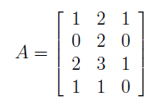
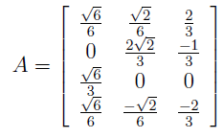

Gram-Schmidt Orthonormalization Process
Method for a set of vectors into a set of orthonormal vectors
1) normal vector
2) orthogonal

Slide 8
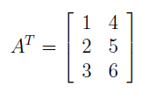

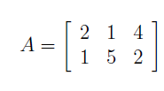
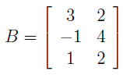
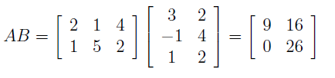
Matrix
Transpose
Matrix Multiplication
e.g.
e.g.

Slide 9
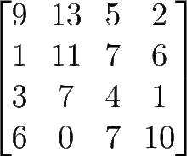

Matrix
Square Matrix
Matrix with the same number of rows and columns
Symmetric Matrix
Square matrix that is equal to its transpose
A = A^{T}
e.g.
e.g.

Slide 10

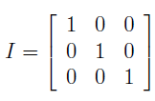
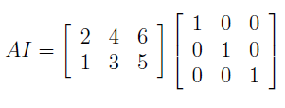

Matrix
Identity Matrix
Sqaure matrix with entries on the diagonal equal to 1 (otherwise equal zero)
e.g.

Slide 11
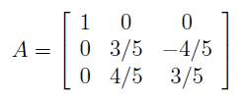
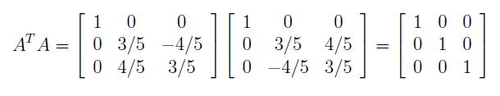
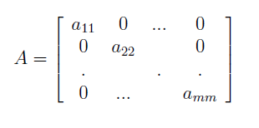
Matrix
Orthogonal Matrix
.
c.f. two vectors are orthogonal = inner product is zero ( x•y = 0)
Diagonal Matrix
Only nonzero values run along the main dialog when i=j
e.g.

Slide 12



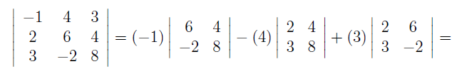

Matrix
Determinant
Function of a square matrix that reduces it to a single number
Determinant of a matrix A = |A| = det(A)
e.g.
by cofactor expansion (여인수 전개),

Slide 13














Eigenvectors and Eigenvalues
Eigenvector
Nonzero vector that satisfies the equation
A is a square matrix, is an eigenvalue (scalar), is the eigenvector
e.g.
≡
rearrange as
set of eigenvectors
$$\left[\begin{matrix}1 & 1 \\ 1 & −1\end{matrix}\right]$$

Slide 14


Eigendecomposition
Factorization of a matrix into a canonical form
matrix is represented in terms of its eigenvalues and eigenvectors
Limitation
Must be a diagonalizable matrix
Must be a square matrix
Matrix (n x n size) must have n linearly independent eigenvector
Let P =
$$\left[\begin{matrix}1 & 1 \\ 1 & −1\end{matrix}\right]$$
(columns are eigenvectors)
Let Ʌ =
$$\left[\begin{matrix}3 & 0 \\ 0 & 1\end{matrix}\right]$$
(diagonal values are eigenvalues)
Eigendecomposition of A is
AP = PɅ
Thus, A = PɅP⁻¹

Slide 15
Eigendecomposition vs. Singular Value Decomposition
Eigendecomposition
Must be a diagonalizable matrix
Must be a square matrix
Matrix (n x n size) must have n linearly independent eigenvector
e.g. symmetric matrix ..
Singular Value Decomposition
Computable for any size (M x n) of matrix
A
P
Ʌ
P⁻¹
A
U
∑
V^{T}

Slide 16
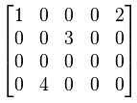
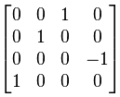
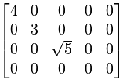
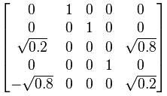
Singular Value Decomposition
SVD is a method for data reduction
Transforming correlated variables into a set of uncorrelated ones (more computable)
Identify/order the dimensions along which data point exhibit the most variations
Find the best approximation of the original data points using fewer dimensions
Singular value
m×n
m×m
m×n
n×n

Slide 17
U: Left Singular Vectors of A
Unitary matrix
Columns of U are orthonormal (orthogonal + normal)
orthonormal eigenvectors of AA^{T}
A
U
∑
V^{T}

Slide 18
∑
Diagonal Matrix
Diagonal entries are the singular values of A
Singular values
Non-zero singular values
Square roots of eigenvalues from U (or V) in descending order
A
U
∑
V^{T}

Slide 19
V: Right Singular Vectors of A
Unitary matrix
Columns of V are orthonormal (orthogonal + normal)
orthonormal eigenvectors of A^{T}A
A
U
∑
V^{T}

Slide 20
Calculation Procedure
U is a list of eigenvectors of AA^{T}
Compute AA^{T}
Compute eigenvalues of AA^{T}
Compute eigenvectors of AA^{T}
V is a list of eigenvectors of A^{T}A
Compute A^{T}A
Compute eigenvalues of A^{T}A
Compute eigenvectors of A^{T}A
∑ is a list of eigenvalues of U or V
(eigenvalues of U = eigenvalues of V)
①
②
③
A
U
∑
V^{T}

Slide 21
Full SVD and Reduced SVD
Full SVD
Reduced SVD
Utilize subset of singular values
Used for image compression
A
U
∑
V^{T}
A
U
∑
V^{T}

Slide 22
SVD Applications
Image compression
Pseudo-inverse of a matrix (Least square method)
Solving homogeneous linear equations
Total least squares minimization
Range, null space and rank
Low rank matrix approximation
Separable models
Data mining
Latent semantic analysis

Slide 23
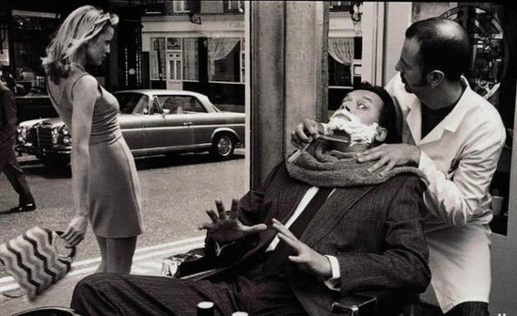
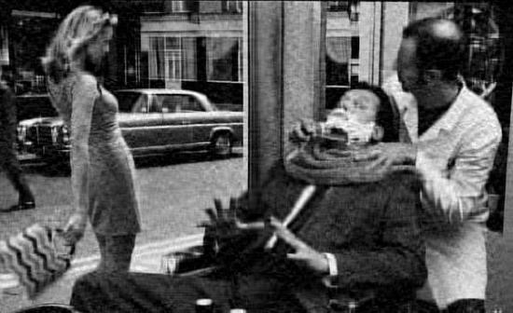

SVD example: Image Compression
Full SVD
A
U
∑
V^{T}
Reduced SVD
A
U
∑
V^{T}
More reduced SVD
U
∑
A
V^{T}

