Slide 1
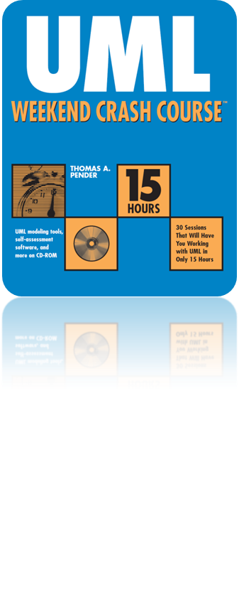
Session 5
Understanding the Use Case Model
Written by Thomas A. Pender
Published by Wiley Publishing, Inc.
October 5, 2011
Presented by Jee-bum Park

Slide 2
Contents
The Purpose of the Use Case Model
The Resources of the Use Case Model
Defining the Elements of the Use Case Diagram

Slide 3
The Purpose of the Use Case Model (1/2)
The Use Case model is
  A collection of diagrams and text that together document how users expect to interact with the system
The Use Case model focuses on
  The critical success factors of the system
  The functionality or features that the users need to interact with

Slide 4
The Purpose of the Use Case Model (2/2)
The key difference between Use Cases and functional design
  Functional design documents a process
  But the Use Case focuses on the goal of a process
Focusing on the process often leads to reproducing existing systems rather than redesigning them
  Because it focuses on "how" rather than "why"

Slide 5
Contents
The Purpose of the Use Case Model
The Resources of the Use Case Model
Defining the Elements of the Use Case Diagram

Slide 6
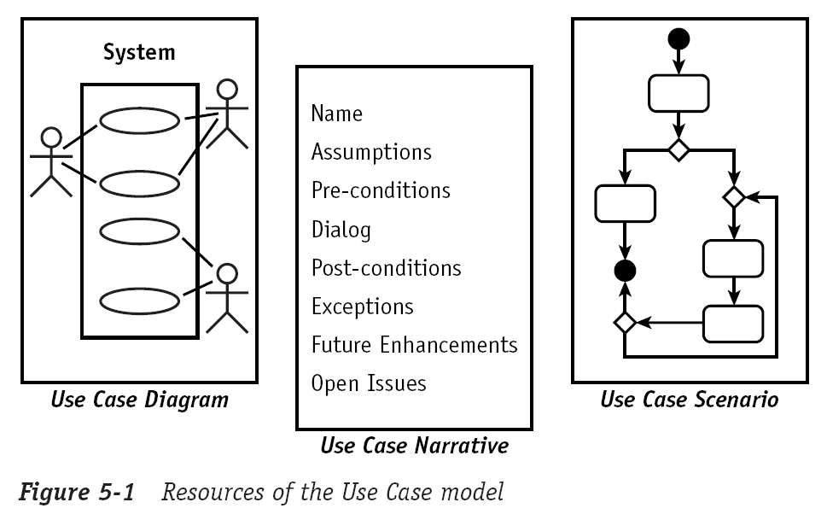

The Resources of the Use Case Model (1/2)

Slide 7
The Resources of the Use Case Model (2/2)
Use Case diagram
  Consists of system, actors, Use Cases, associations, and dependencies
  The goal of the diagram is to provide a high-level explanation of the relationship between the system and the outside world
Use Case narrative
  Textual description
  Use Case diagram doesn’t explain the detailed feature
  Provides a set of information that is required to guide the analysis, design, and coding of the feature
Use Case scenarios
  One logical path through a Use Case
  One possible sequence of steps in the execution of the Use Case

Slide 8
Contents
The Purpose of the Use Case Model
The Resources of the Use Case Model
Defining the Elements of the Use Case Diagram

Slide 9
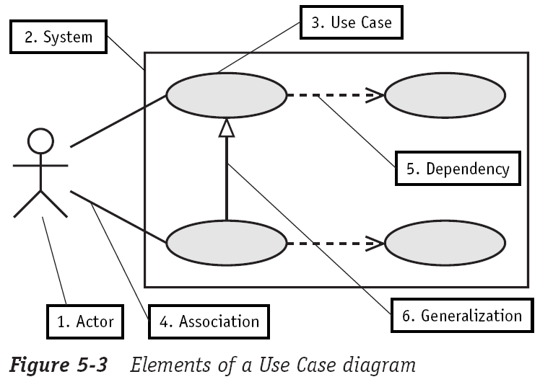
Defining the Elements of the Use Case Diagram (1/8)

Slide 10
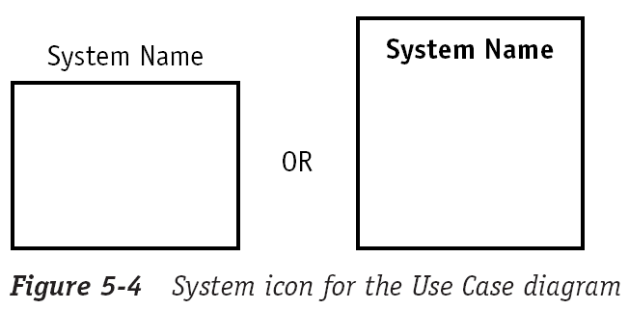
Defining the Elements of the Use Case Diagram (2/8)
System
  Sets the boundary of the system in relation to the actors who use it (outside the system) and the features it must provide (inside the system)

Slide 11
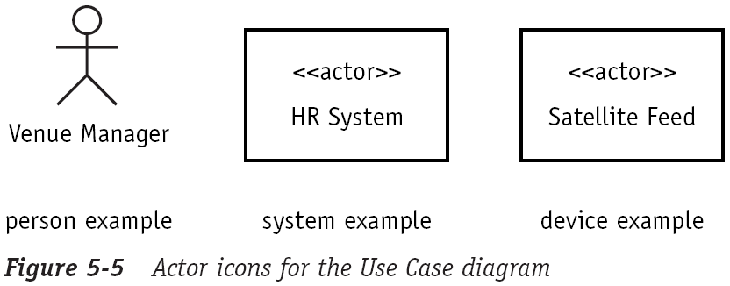
Defining the Elements of the Use Case Diagram (3/8)
Actor
  A role played by a person, system, or device

Slide 12
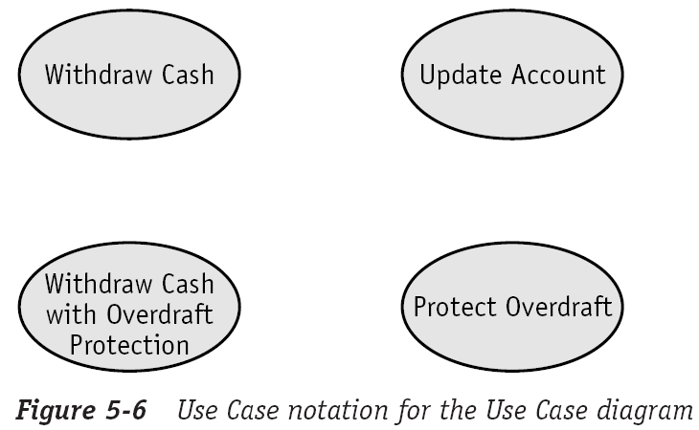
Defining the Elements of the Use Case Diagram (4/8)
Use Case
  Identifies a key feature of the system
  Each Use Case expresses a goal that the system must achieve
  Each Use Case named using a verb phrase that expresses a goal
public function WithdrawCash ( $amount ) { ... }

Slide 13
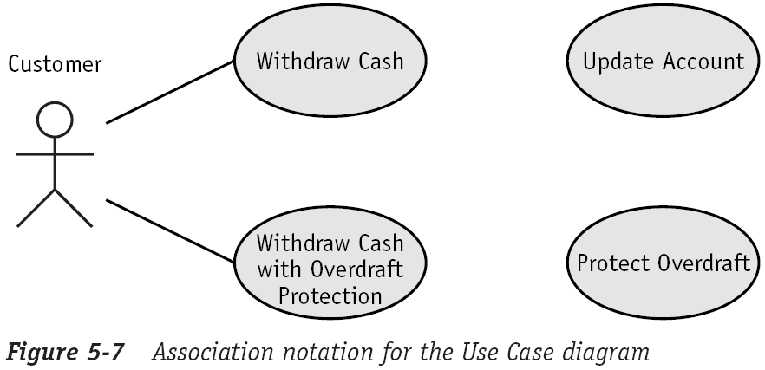
Defining the Elements of the Use Case Diagram (5/8)
Association
  Identifies an interaction between actors and Use Cases
$my_atm->WithdrawCash ( 100 );

Slide 14
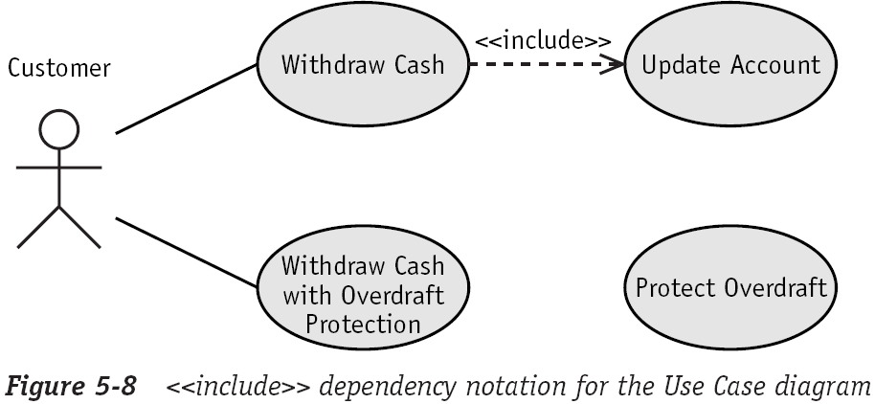
Defining the Elements of the Use Case Diagram (6/8)
<<include>> Dependency
  When one Use Case delegates to another
  The dependency is drawn as a dashed arrow from the "using" to the "used"
$this->UpdateAccount ();

Slide 15
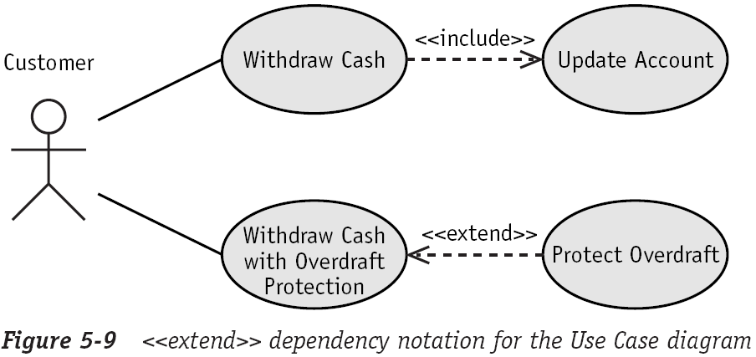
Defining the Elements of the Use Case Diagram (7/8)
<<extend>> Dependency
  One Use Case might need help from another Use Case
  In contrast, the <<include>> dependency says that one Use Case will always call the other Use Case
if ( $cond === TRUE ) $this->WithdrawCash ( 100 );

Slide 16
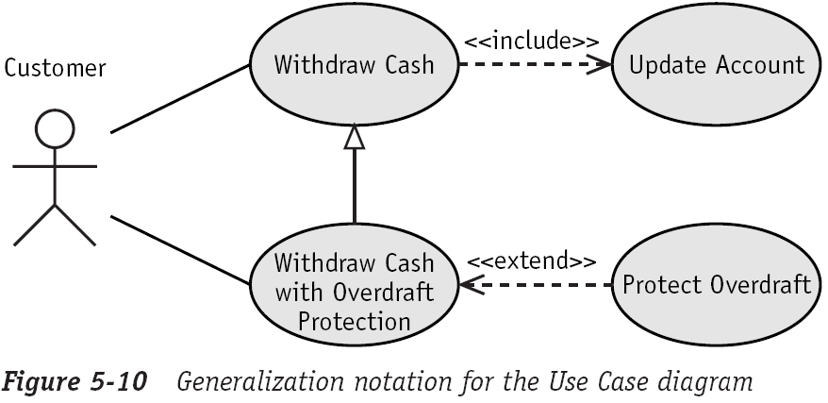
Defining the Elements of the Use Case Diagram (8/8)
Generalization
  Defines an inheritance relationship between two actors or two Use Cases
  Often goes by the nickname, an "is a" relationship
public function WithdrawCash ( $amount ) {
parent::WithdrawCash ( $amount );
...
}

Slide 17
The End

