Slide 1
A Fast Parallel Clustering Algorithm for Large Spatial Databases
XIAOWEI XU, JOCHEN JAGER, HANS-PETER KRIEGEL
University of Munich
Data Mining and Knowledge Discovery, 3, 263–290 (1999)
February 19, 2016
Heymo Kou

Slide 2
Contents
Introduction
DBSCAN
R-tree
PDBSCAN
Evaluation
Conclusion

Slide 3
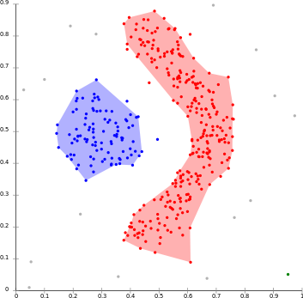
Introduction
Impossible to cluster a large spatial database with single node
Preserving speed & scalability is necessary

Slide 4
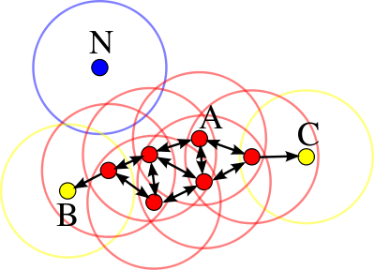
DBSCAN [Xiaowei Xu et al. 1996]
Density-based spatial clustering of applications with noise
Density based clustering algorithm
One of the most cited paper in scientific literature
Total rank : 24th & Data mining field rank : 1st
2 input parameters
ε (eps) : radius of circle
Minimum number of points (minPts)

Slide 5
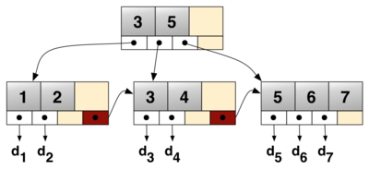
Limitation of B⁺-tree
B⁺-tree
Database default index
Single-dimensional index
Not very suitable for multidimension
Consider creating 2-dimensional index <age, sal>
Index sorts by age first
“Nearness” is not considered
Cannot support non-point data
Lines, shapes, etc.
80
70
Spatial
clusters
60
SAL
50
Consider entries:
<11, 80>, <12, 10>
<12, 20>, <13, 75>
40
30
20
B+ tree
order
10
11 12 13
AGE

Slide 6
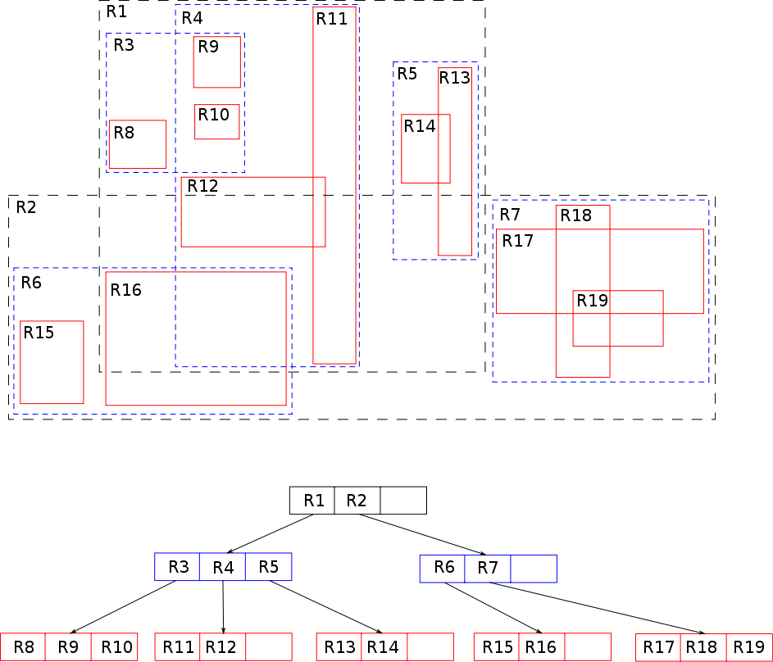
R-tree [Guttman 1984]
Each key is Minimum Bounding Rectangle(MBR)
Internal node – set of MBRs
Leaf node – set of MBR & data points
MBRs may overlap
R*-tree [Beckman et al. 1990]
Supports n-dimensional

Slide 7
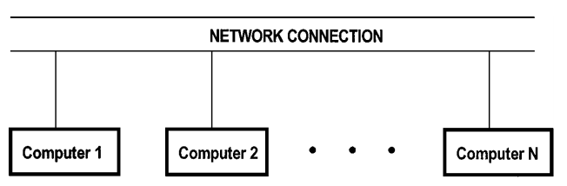
PartDBSCAN (PDBSCAN) Problem
DBSCAN is a single node algorithm
Is there any way to distribute DBSCAN
1) Divide DB data into N partitions S₁, S₂, … S_{N}
2) Process DBSCAN for N partitions
3) Merge results

Slide 8
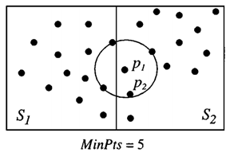
PDBSCAN Data placement
Data placement is crucial for performance and scalability
In a shared-nothing environment
Ideal data placement strategy should satisfy
Load balancing
Data should be partitioned
into almost equal size
Near by data should be partitioned into same partition
Minimized communication cost
Each partition should avoid accessing remote data
Distributed data access
Spatial access should be supported

Slide 9
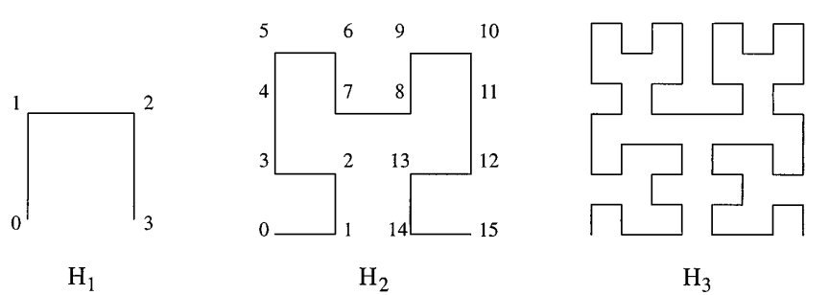
PDBSCAN Partitioning data
Partitioning should consider
Nearby data is in the same partition
Size of each partition to be equal
Every node gets R*-tree for remote access
Hilbert curves
Visit every grid exactly once without crossing itself
Run Hilbert curves and partition data into N buckets

Slide 10
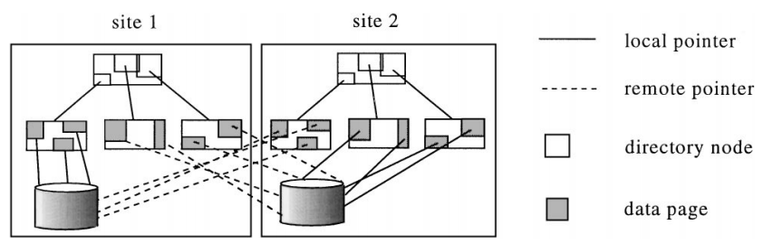
PDBSCAN dR*-tree
In case of remote access is necessary
Node should know which node to access
Modified from R*-tree
Remote data has node information
dR*-tree

Slide 11
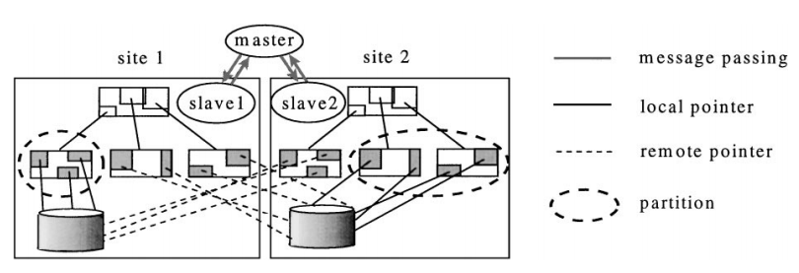
PDBSCAN Master-Slave model
Master
Spawn Process, initialization, aggregation
Slave
Perform the actual computations
Run PDBSCAN on “locally stored” data

Slide 12
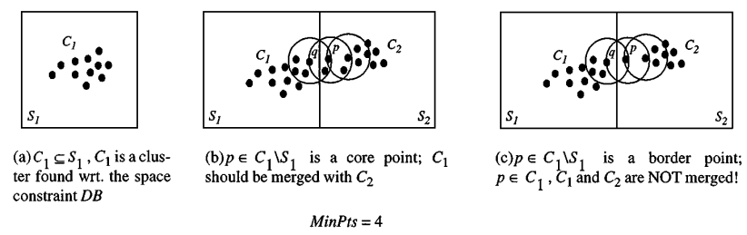
PDBSCAN Merge process
Slaves send results to Master after PDBSCAN
Master should decide and merge cluster if necessary

Slide 13
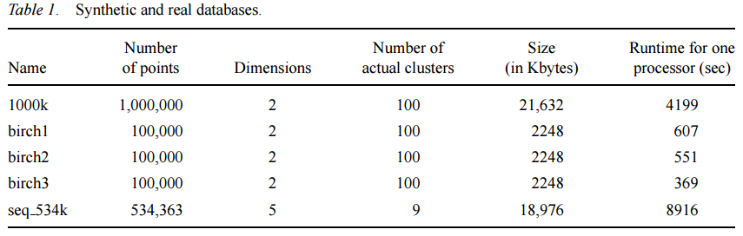
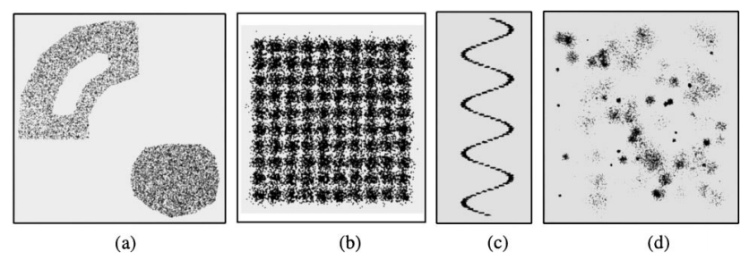
Evaluation Data set

Slide 14
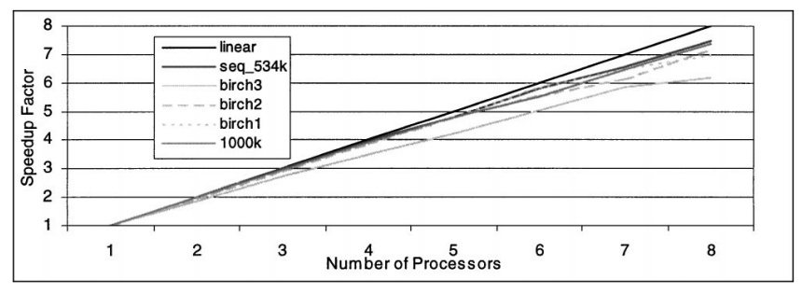
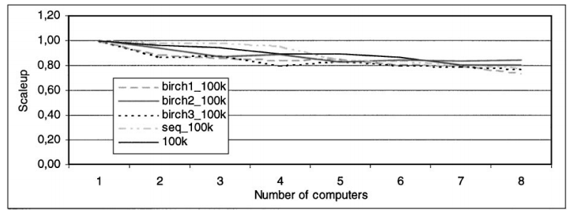
Evaluation Speedup & Scalability Factor

Slide 15
Conclusion
PDBSCAN produces exactly same result as of DBSCAN
dR*-tree is necessary for data placement policy
Proved to speedup & scaleup fairly

