Slide 1
Rating: How Difficult is It?
E. Isaac Sparling and Shilad Sen
ACM Conference on Recommender Systems 2011
December 23, 2011
Hyunwoo Kim
SNU IDB Lab.

Slide 2
Outline
Introduction
Background
Related Work
Results
Conclusion
Discussion

Slide 3




Introduction
Rating scales
unary
binary
one-to-five star
100-point slider

Slide 4



Introduction
Research questions
Do different rating scales require different amounts of time?
Do different rating scales elicit different levels of cognitive load?
Do different rating values require different amounts of time?
Do different rating scales elicit different levels of user satisfaction?

Slide 5

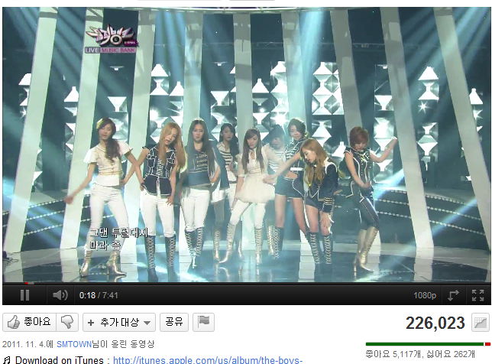


Background
rating scale change
Rating values of 2, 3, 4 star values only made up 5% of ratings

Slide 6
Related Work
Cognitive load = intrinsic load + extraneous load
Psychology of rating scales*
5 to 10 point scale: happiest and most consistent
101 point scale: best at expressing users’ feelings
Rating on the Web
Benefits: improved prediction quality, fun, keeping track of movies
Cost: time + mental effort
* Optimal number of response categories in rating scales: reliability, validity, discriminating power, and respondent preferences, Acta Psychologica, 2000

Slide 7




Methodology
Survey via public ads on four channels
MovieLens
Item selection
Movies from Internet Movie Database
Product reviews from Amazon.com
Users rate product reviews helpfulness, not the products themselves
Scales

Slide 8

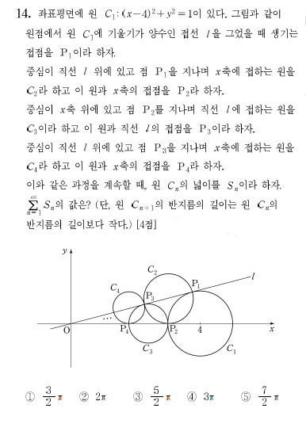
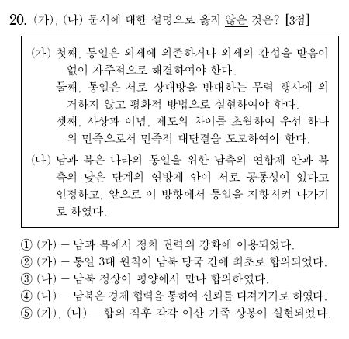
Methodology
Secondary stimulus
Measuring cognitive load using a secondary stimulus
Click when this is red

Slide 9




Results
Survey
348 people
43% 57%
26 years old
Using internet every day
91%

Slide 10
Results
As the scales increased in granularity, users rated fewer items
39.4%
73.9%
69.5%
67.9%

Slide 11
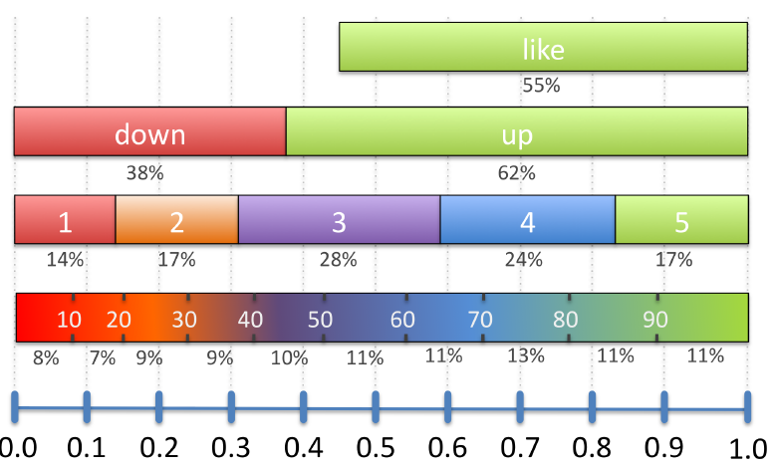
Results
Distributions of ratings
Relative frequency of rating values for each scale

Slide 12
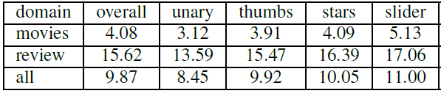
RQ1: Item Rating Time
Do different rating scales require different amounts of time?
Data collection
From the time a page is loaded
To the time user clicked continue link at the bottom of the page
Model
Users have different natural rating speeds
Users speed up as they experience during the survey
Results
62%
2.01s
25%
3.47s

Slide 13
RQ1: Item Rating Time
Do different rating scales require different amounts of time?
Higher relative difference in rating times for movies
Cognitive load = intrinsic load + extraneous load
Largest differences in total rating time for movie, music, or book
62%
2.01s
25%
3.47s

Slide 14
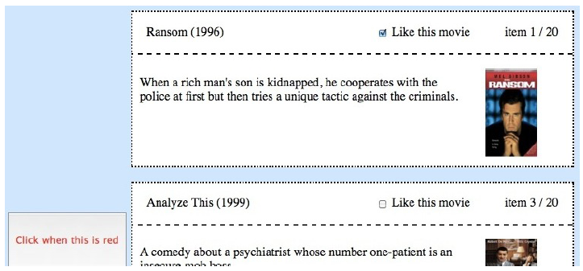
RQ2: Cognitive Load
Do different rating scales elicit different levels of cognitive load?
Data collection
By timing user’s response time to a secondary stimulus

Slide 15
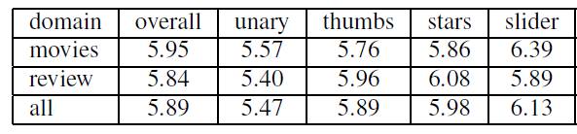
RQ2: Cognitive Load
Do different rating scales elicit different levels of cognitive load?
Model
Users responded more quickly as the survey progressed
Results
Users work less hard under the unary scale
Results for the other scales are inconclusive

Slide 16
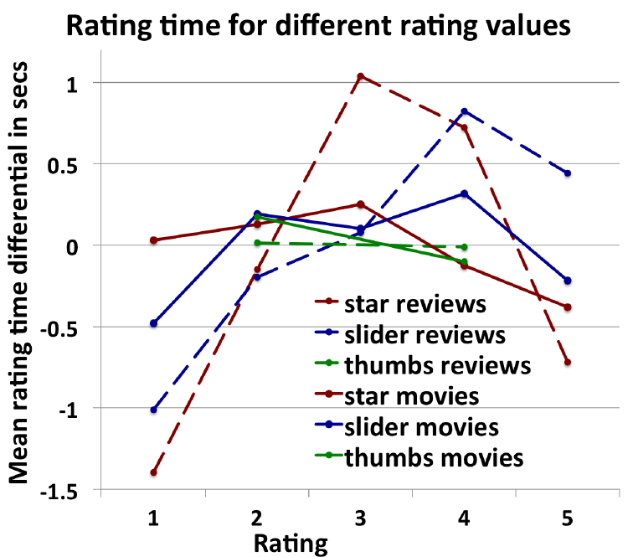
RQ3: Time for Different Rating Values
Do different rating values require different amounts of time?
Data collection
Rating time interval
Model
All rating scales are translated to the [1,5] range
Results
Extreme ratings offer the greatest insight into
a user’s taste profile

Slide 17
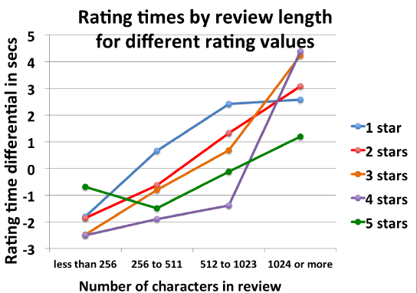
RQ3: Time for Different Rating Values
Do different rating values require different amounts of time?
Length vs. rating value
Assumption
Read a small portion of a low quality review before quick judgment
Read entire review before rating five stars
Then,
1-star would not vary with the length of a review
5-start would vary

Slide 18
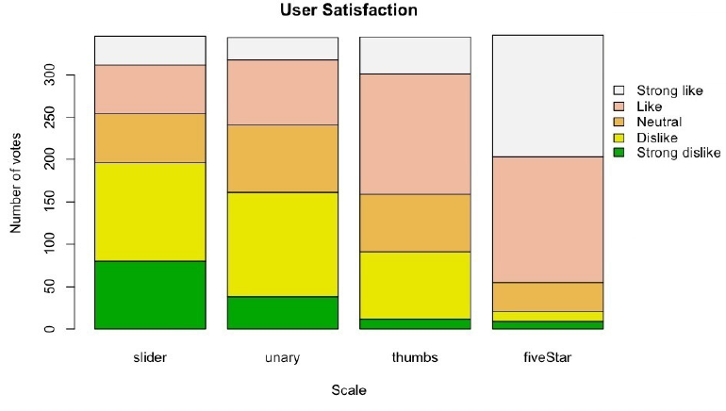
RQ4: User Satisfaction
Do different rating scales elicit different levels of user satisfaction?
Data collection
“Overall I liked using the { slider } to rate { movies }.”
strong like, like, neutral, dislike, strong dislike
Result
Users preferred the scales in the middle of the granularity spectrum

Slide 19
Conclusion
Users’ rating cost increase as they have more rating choices
Users spend more time assigning ratings at the middle of a scale
Three or four stars on a five-star scale
Users prefer the five-star scale
Our findings will apply to different domains

Slide 20
Discussion
Strong point
Present experimental results for general RQs of recommendation
Novel evaluation metric to check the user’s cognitive load
Weak point
Somewhat trivial results or inclusive results
No application to recommender systems
Improvements of results
Future work
Extreme ratings offer the greatest insight into a user’s taste profile

Slide 21
감사합니다

