Slide 1
Suggesting Friends using the Implicit Social Graph
Maayan Roth et al. (Google, Inc., Israel R&D Center)
KDD’10
Hyewon Lim
1 Oct 2014

Slide 2
Outline
Introduction
Characteristics of the Email Implicit Social Graph
Friend Suggest
Evaluation
Applications
Conclusions

Slide 3
Introduction
Online communication channels
Enable communication among groups of people
Gmail network analysis
Over 10% of emails are sent to more than one recipient
Network of Google employees: over 40%
Over 4% of emails are sent to 4 or more recipients
Network of Google employees: over 10%
Users tend to communicate repeatedly with the same groups of contacts

Slide 4
Introduction
“Group-creation is time consuming and tedious”
Users do not often take the time to create and maintain custom contact groups
Survey of mobile phone users in Europe
16% of users have created custom contact groups
Group change dynamically
Custom-created groups can quickly become stale, and lose their utility
Present “a friend-suggestion algorithm”
Based on analysis of the implicit social graph

Slide 5
Introduction
Implicit social graph
Social network that is defined by interactions between users and their contacts and groups of contacts
Weighted graph

Slide 6
Outline
Introduction
Characteristics of the Email Implicit Social Graph
Friend Suggest
Evaluation
Applications
Conclusions

Slide 7
Characteristics of the Email Implicit Social Graph
Gmail implicit social graph
A directed hypergraph
’s egocentric network
An implicit group: each hyper edge
The weight of an edge
Recency and frequency of email interactions
On average,
a typical 7-day active user has 350 implicit groups,
with groups containing an average of 6 contacts

Slide 8
Friend Suggest
Observation
Although users are reluctant to expend the effort to create explicit contact groups, they nonetheless implicitly cluster their contacts into groups via their interactions with them
Friend Suggest algorithm
Detects the presence of implicit clustering in a user’s egocentric network

Slide 9

Friend Suggest
Edge weight
The relationship strength between a user and his implicit groups
Criteria for computing weights:
Frequency: Groups with frequent interactions are more important
Recency: Group importance is dynamic over time
Direction: User initiated interactions are more significant
Interaction Rank
Interaction weights decay exponentially over time with the half-life

Slide 10
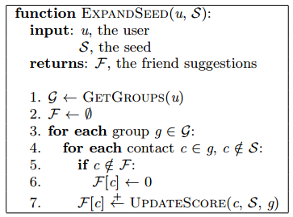
Friend Suggest
Core Routine
User:
Seed:
g₁
g₂
g₃
…
…
…
UpdateScore(c, S, g)
Goal
Find those whose interactions with u are most similar to u’s interactions
with the contacts in the seed S

Slide 11
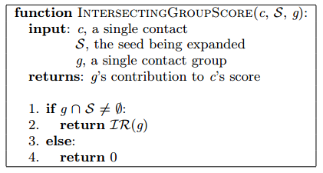
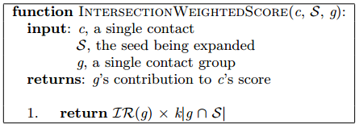
Friend Suggest
The sum of UpdateScore for a contact c
An estimate of c’s fitness to expand the seed
IntersectingGroupScore
IntersectionWeightedScore
g
S
g
S
<
g
S

Slide 12
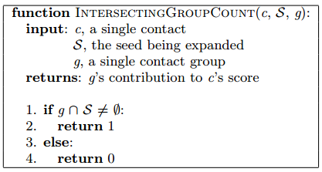
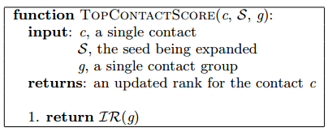
Friend Suggest
The sum of UpdateScore for a contact c
An estimate of c’s fitness to expand the seed
IntersectingGroupCount
TopContactScore
g
g
S
→ ignores the seed
→ sum the IR of the implicit groups
containing each contact
→ ignores Interactions Rank

Slide 13
Outline
Introduction
Characteristics of the Email Implicit Social Graph
Friend Suggest
Evaluation
Applications
Conclusions

Slide 14
Evaluation
Propose a novel, alternate evaluation methodology
To avoid small sample size and user selection bias
1) Randomly sampled 10,000 email interactions
between 3 and 25 recipients
2) Sample a few recipients from each group, and
3) Measure how well Friend Suggest is able to recreate the remaining recipient list
Active user
A user with a minimum of 5 implicit groups
Had sent at least one other email in the 7 days prior to the sampled interaction

Slide 15
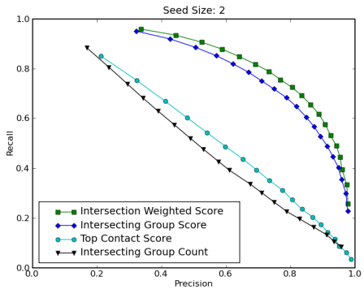
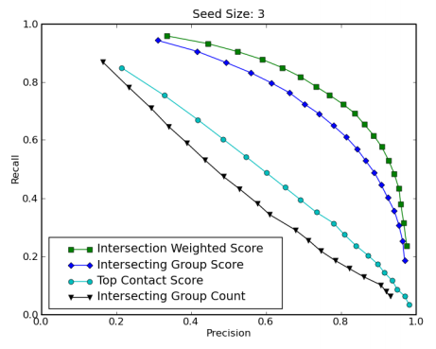
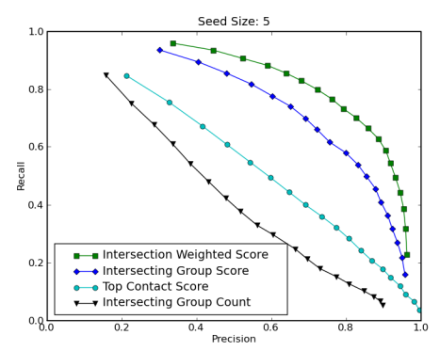
Evaluation
Results
Test the algorithm using the different scoring functions
with seed groups ranging in size from 1 to 5
IntersectionWeightedScore is the best
The scoring functions that take into account both group and relative group importance significantly out-perform

Slide 16
Outline
Introduction
Characteristics of the Email Implicit Social Graph
Friend Suggest
Evaluation
Applications
Conclusions

Slide 17
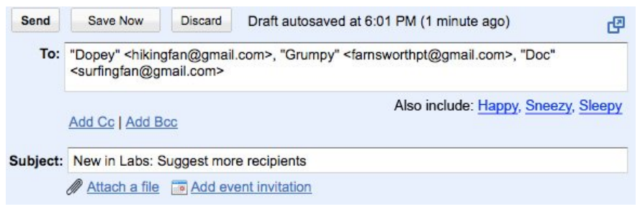
Applications
1. Don’t Forget Bob!
The first contact treats as the seed set
Add at least two contacts
Queries the implicit social graph to fetch the user’s egocentric network

Slide 18
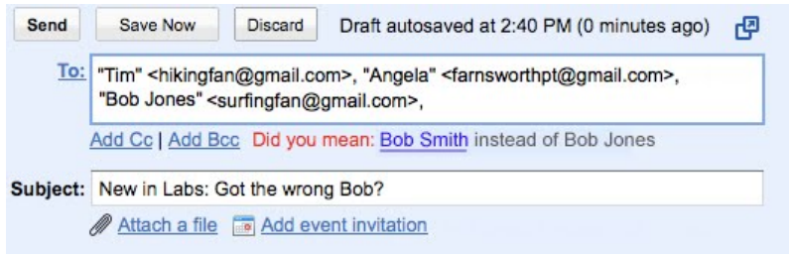
Applications
2. Got the Wrong Bob?
⬇︎
algorithm
⬇︎
⬇︎
⇒
⇒
✘
seed

Slide 19
Outline
Introduction
Characteristics of the Email Implicit Social Graph
Friend Suggest
Evaluation
Applications
Conclusions

Slide 20
Conclusions
Summary
Studied implicit social graph
Propose an interaction-based metric
for computing the relative importance of the contacts and groups
Defined the Friend Suggest algorithm
Showed two applications
Future work
The relative importance of different interaction types
Other applications of the Friend Suggest algorithm

