Slide 1
How Does Social Capital Affect Retweets?
Raquel Recuero, Ricardo Araujo, Gabriela Zago
PPGL / UCPel, PPGC / UFPel, PPGCOM / UFRGS
ICWSM 2011
Nobember 10 2011
Presented by Somin Kim

Slide 2
Outline
Introduction
Retweet Practices
Social Capital and Twitter
Methodology
Results
Conclusion

Slide 3
Introduction
One of key motivations for Twitter’s usage is information access
Twitter also has characteristics of social network sites
Actors make decisions to share or not certain types of information based on the possible benefits they may receive from the social network
We focus on the benefits of retweets

Slide 4
Outline
Introduction
Retweet Practices
Social Capital and Twitter
Methodology
Results
Conclusion

Slide 5
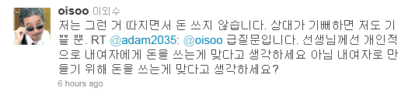
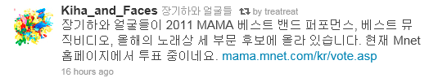
Retweet Practicies (1/2)
Retweet
Copying someone’s tweet and prefixing it with the letters “RT”
It is a common practice to mention the source or sources of information
Retweet focus on information
92% has a URL, 97 has the @username
Mentions are focused on a public response to someone
Changes to the retweet may happen
Users add sources or a personal comment
Through commenting, users believe that they generate more value to the retweets

Slide 6
Retweet Practicies (2/2)
Several roles of retweets within the social network
It’s a way to share information
It’s a way to initiate or create a context for conversations
It may influence the social structure
It may lead users to follow other users
The identity of who is retweeted may influence the total number of clicks a URL receives

Slide 7
Outline
Introduction
Retweet Practices
Social Capital and Twitter
Information as a form of Social Capital
Methodology
Results
Conclusion

Slide 8
Social Capital and Twitter (1/3)
Social capital
Values obtained by being part of a social network
The sum of social resources
Through this structure, actors can achieve benefits
“Better connected people enjoy higher returns”
As a form of capital
Product of each actor’s investments in her social network
Public good? Private good? or Both?
Actors have control over certain types of resources and are interested in resources controlled by others
In order to gain access to these types of values, users engage in exchanges from which they may benefit

Slide 9
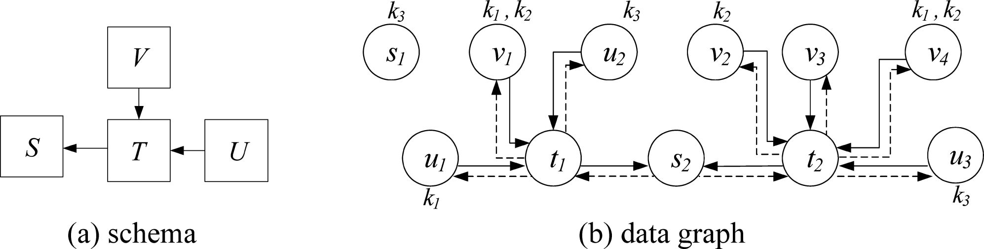
Social Capital and Twitter (2/3) Information as a form of Social Capital
The most common form of social capital is information access
Social capital must also be a key ingredient of Twitter
Benefits obtained from information in social networks (Burt 1992)
- Receiving a valuable piece of information and knowing who can use it
- Using the social network to filter and to give you information
Information
Access
- Making information quickly accessible
- The earlier the information reaches, someone the more value this person can get form it
Timing
- Associating the information to particular people
- Adding value to the information(credibility)
- Adding value to the individuals who are referred
Referrals

Slide 10
Social Capital and Twitter (3/3) Information as a form of Social Capital (cont.)
In social network,
There is a high cost involved in the search for information within a social network
One has to invest time and emotion in order to create and maintain social ties, so as to remain connected and receive useful information
Connections rely on interaction to be created and maintained
However, in Twitter
There is a very low cost
One has to engage in following each other in order to receive information
It is possible to follow a thousand people and to keep receiving information from all of them
Connection rely only in computer databases to exist
Thus, Twitter is an useful information tool !
Notes:
그럼에도 불구하고 실제로 대다수의 유저들은 수동적이다!

Slide 11
Outline
Introduction
Retweet Practices
Social Capital and Twitter
Methodology
Results
Conclusion

Slide 12
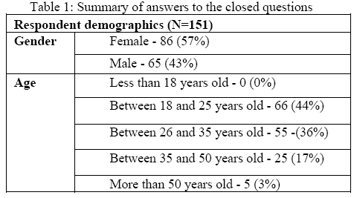
Methodology (1/3)
Qualitative study on questionnaire
151 users answered
Check your last 5 retweets, and explain why you retweeted each of them
Dose these retweets represent your usual reasons to RT in general?
Which is the most important value in Twitter for you?
How do you choose whom to follow in Twitter?
The demographics of the respondents

Slide 13
Methodology (2/3)
Quantitative study on four case studies
We chose the most popular links in Migre.me
A news about the rain tragedy in Rio de Janeiro
The Brazilian Ministry of Health was creating a registry of health professionals interested in helping in the flooding zones
The changes in the Zodiac
An astronomer claimed zodiacal signs were incorrect
A promotion for a publicity action in Campus Party Brazil
The promotion asked users to retweet the information in order to participate in a raffle of a netbook
A picture of a famous actress
She was being made fun of by a popular humor site
1
2
3
4

Slide 14
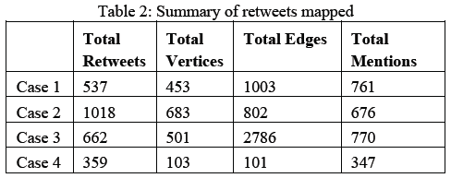
Methodology (3/3)
Quantitative study on four case studies (cont.)
Dataset
All cases considered only information in Portuguese and contained tweets that were published in January of 2011
Data was collected within three days after the day they first appeared
NodeXL
NodeXL collects and maps the retweets

Slide 15
Outline
Introduction
Retweet Practices
Social Capital and Twitter
Methodology
Results
Twitter Values
Retweet Values
Benefits from Referrals
Benefits from Information Access
Benefits from Timing
Conclusion

Slide 16
Results (1/10) Twitter Values
Three key values make Twitter relevant
The three benefits were often pointed out together
“I like Twitter because I can quickly receive relevant information from relevant people”
Most answers regard Twitter as a collective information filter
“newspaper that only has information I choose”
Retweets are key to the twittersphere

Slide 17
Results (2/10) Retweet Benefits
Two types of retweet benefits
It benefits particular users
It allows for original information to reach farther from their social network
It benefits the social network as whole
It is used to spread information that may interest all users
Retweets generate both private and public goods for the social structure

Slide 18
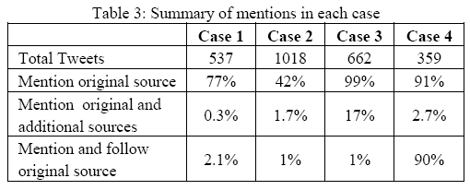
Results (3/10) Benefits from Referrals
B
“RT @A : Blah~”
“RT @B : Blah~”
“RT @A @B : Blah~”
How users perceive the values they may obtain from referring particular sources
The user who originally tweeted the information received most of the credit
Even when the information is retweeted by users who are not followers
Creating original pieces of information in Twitter allows for a user to increase her visibility in the network
“Blah~”
“RT @A Blah~”
A
C
D

Slide 19
Results (3/10) Benefits from Referrals
B
“RT @A : Blah~”
“RT @B : Blah~”
“RT @A @B : Blah~”
How users perceive the values they may obtain from referring particular sources
The user who originally tweeted the information received most of the credit
Even when the information is retweeted by users who are not followers
Creating original pieces of information in Twitter allows for a user to increase her visibility in the network
“Blah~”
“RT @A Blah~”
A
C
D

Slide 20
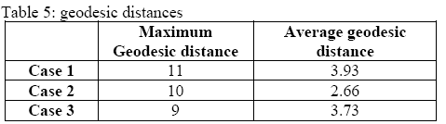
Results (4/10) Benefits from Referrals
How users perceive the values they may obtain from referring particular sources (cont.)
The chain of mentions is much shorter than the length the information traverses the network
The average number of mentions in the collected tweets was close to 1, and the largest was 3
But many followers were quite distant from the original source
Even though information can reach users that are far from the original source, not all users are credited in the same way for spreading the information

Slide 21
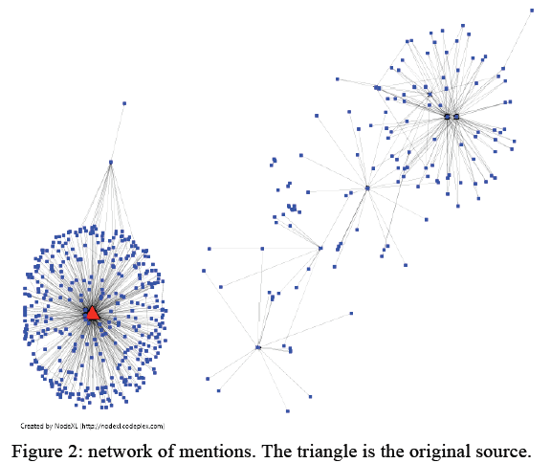
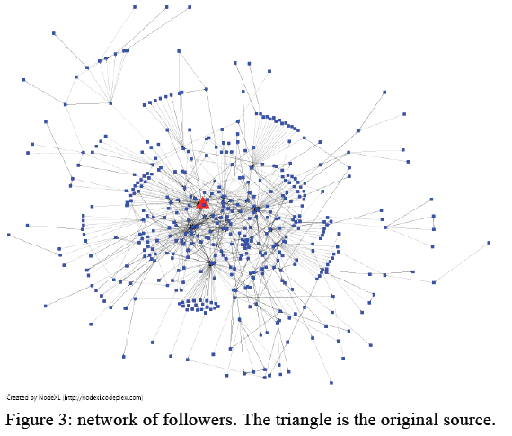
Results (5/10) Benefits from Referrals
How users perceive the values they may obtain from referring particular sources (cont.)

Slide 22
Results (6/10) Benefits from Referrals
Why do “some users” get mentioned in a retweet?
The original source receives a disproportionate large faction of the total number of mentions
Credibility
Ex. an information that comes from a major newspaper’s account
Reputation
If the source is popular, mentioning its tweet account is a way to inject reputation in the retweet
Ex. a joke from a popular website

Slide 23
Results (7/10) Benefits from Referrals
Why does the limit in the number of mentions appear?
Twitter limits in the length of the messages
Additional mentions require more characters
The more mentions in a tweet, the older the contained information looks
“I cut sometimes [the names of the sources] because I want the information to seem fresh”
If it were not for the editing of retweets, the chain of mentions could be used to determine how new some information is

Slide 24
Results (8/10) Benefits from Referrals
Some differences between the cases
Case 2 : conversational act
The majority of retweets didn’t quote the source, and only quoted the link and commented
Case 3
The original source had to be mentioned in order for the user to participate in the raffle
Users would also mention the friend that first made the promotion visible to them, as a way to show appreciation for letting them know
Case 4
“Funny things” was the second most pointed retweet reason
Humor was a more general and widespread value, while other retweets had very specific information on subjects they like

Slide 25
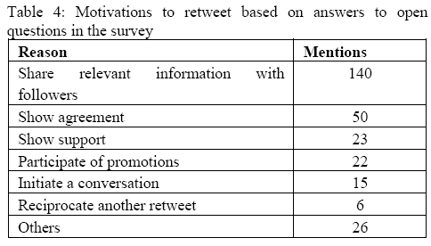
Results (9/10) Benefits from Information Access
The motivations behind retweets
To give visibility to some information that will be relevant to their followers
By retweeting, users invest less time and effort in seeking information
To show their social network to others
“I retweet people I think are relevant”
“I like to show who my contacts are”
To show agreement or support with an expressed opinion
“I retweet things I agree with so my followers will know I support these ideas”
To create conversations

Slide 26
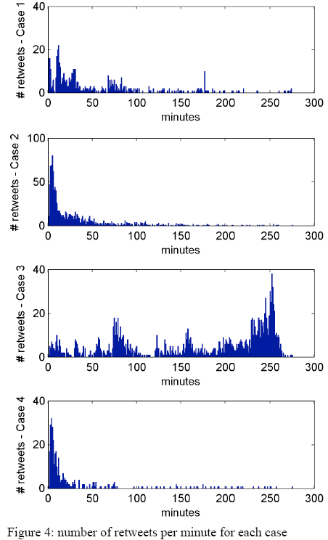
Results (10/10) Benefits from Timing
Timing is a very important value associated to Twitter
19.8% of users mentioned the timing as a key value of retweets
29.8% of users mentioned receiving information quickly is one of the Twitter’s advantage
The number of retweets fell as time passed
In case 3
The opposite was observed, because users had to retweet in order to participate
The value was not to spread in the information

Slide 27
Outline
Introduction
Retweet Practices
Social Capital and Twitter
Methodology
Results
Conclusion

Slide 28
Conclusion
Retweets are a form to gather some values without having to invest so much time in searching for news
Referral, Information access, Timing
Retweets create not only private goods but also public goods
Understanding these motivatoins and their related behavior may be key to understand how retweets construct value in Twitter

