Slide 1
Maximizing the Spread of Influence through a Social Network
David Kempe, Jon Kleinberg, Éva Tardos (Cornell University)
KDD 2003
Hyewon Lim
27 June 2012

Slide 2
Outline
Introduction
Approximation Guarantees in the Independent Cascade and Linear Threshold Models
Experiments
A General Framework for Influence Maximization
Non-progressive Processes
General Marketing Strategies

Slide 3

Introduction
…
…
If we trigger a large cascade of further adoptions,
which set of individuals should we target?

Slide 4
Introduction
How should we choose the few key individuals to use for seeding the process?
Probabilistic model of interaction*
- P. Domingos and M. Richardson
General model (2001): NP-hard
Polynomial-time solvable model (2002)

Slide 5
Introduction Two Basic Diffusion Models
inactive
active
Each node’s tendency to become active increases monotonically as more of its neighbors become active

Slide 6


Introduction Two Basic Diffusion Models
Linear Threshold Model
The thresholds intuitively represent the different latent tendencies of nodes to adopt the innovation when their neighbors do
We are in effect averaging over possible threshold values for all the nodes
0.7
0.4
0.2
0.3
0.1
0.8
0.3
0.3
0.7
0.2
0.6
0.5
0.4
0.3

Slide 7
Introduction Two Basic Diffusion Models
Independent Cascade Model (Goldenberg, Libai, and Muller)
step t
step t+1
v
v
v
v
Success probability p_{v,w}

Slide 8
Introduction Influence Maximization Problem
Find a k-node set of maximum influence
NP-hard to determine the optimum for influence maximization
e.g., k = 3
v

Slide 9
Outline
Introduction
Approximation Guarantees in the Independent Cascade and Linear Threshold Models
Experiments
A General Framework for Influence Maximization
Non-progressive Processes
General Marketing Strategies

Slide 10
Approximation Guarantees in the Independent Cascade and Linear Threshold Models
We wish to find a k-element set S for which f(S) is maximized!
f(·)
Maps subsets of a finite ground set U to non-negative real numbers
f is submodular
If it satisfies a natural “diminishing returns” property
This is an NP-hard optimization problem
Nemhauser, Wolsey, and Fisher shows that the greedy hill-climbing algorithm approximates the optimum to within a factor of (1 – 1/e)

Slide 11
Approximation Guarantees in the Independent Cascade and Linear Threshold Models Independent Cascade
Theorem 2.2. For an arbitrary instance of the Independent Cascade Model, the resulting influence function σ(·) is submodular
σ(A ∪ {v}) - σ(A) → difficult to analyze directly
live
step t
step t+1
blocked
live
v
v
v
v
…
live
Flipping
a coin
blocked

Slide 12
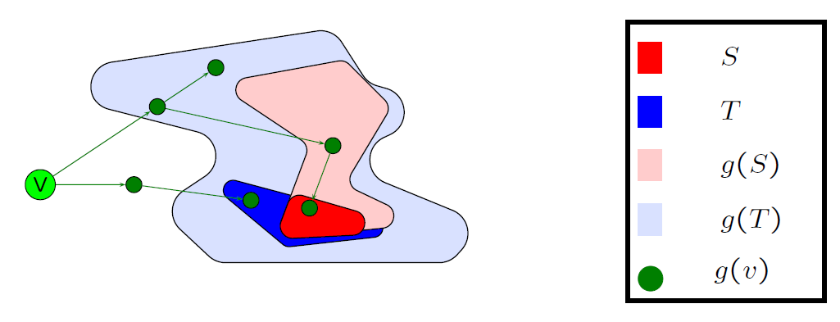

Approximation Guarantees in the Independent Cascade and Linear Threshold Models Independent Cascade
Proof of Theorem 2.2
From the picture: g(T + v) – g(T) ⊆ g(S + v) – g(S) when S ⊆ T
⇨ f is submodular
* This slide is based on the author’s slide

Slide 13
Approximation Guarantees in the Independent Cascade and Linear Threshold Models Linear Thresholds
Theorem 2.2. For an arbitrary instance of the Linear Threshold Model, the resulting influence function σ(·) is submodular
v picks at most one of its incoming edges at random
Selecting the edge from w with probability b_{v,w} : live
Selecting no edge with probability 1 - ∑_{v} b_{v,w} : blocked
The crux of the proof
Linear Threshold model is equivalent to reachability via live-edge paths

Slide 14
Outline
Introduction
Approximation Guarantees in the Independent Cascade and Linear Threshold Models
Experiments
A General Framework for Influence Maximization
Non-progressive Processes
General Marketing Strategies

Slide 15
Experiments
Data
Collaboration graph obtained from co-authorships in physics publications
Papers in the high-energy physics theory section of the e-print arXiv
10748 nodes, 53000 edges
Algorithms
Greedy: linear threshold model, independent cascade model
High-degree (“degree centrality”)
High-degree nodes are more influential
Central (“distance centrality”)
A node with short paths to other nodes is more influential
Random (baseline)
Choose nodes uniformly at random

Slide 16
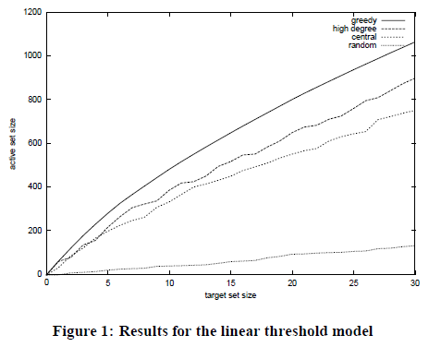
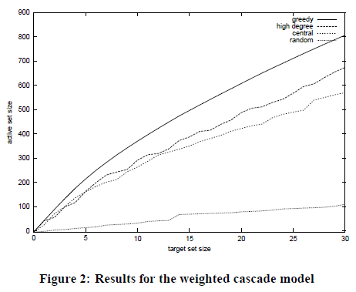
Experiments
The results

Slide 17
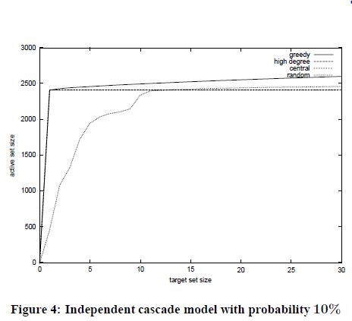
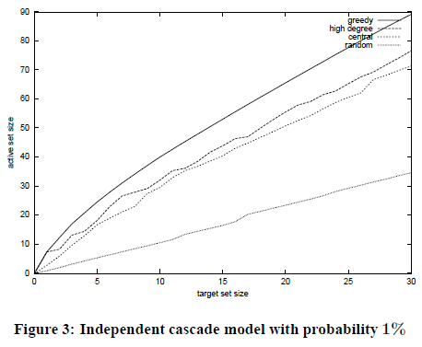
Experiments
The results

Slide 18
Outline
Introduction
Approximation Guarantees in the Independent Cascade and Linear Threshold Models
Experiments
A General Framework for Influence Maximization
Non-progressive Processes
General Marketing Strategies

Slide 19
A General Framework for Influence Maximization
General threshold model
Monotone threshold function f_{v}
Maps subsets of v’s neighbor set to real numbers in [0, 1]
v becomes active in step t if f_{v}(S) ≥ θ_{v}
where S is the set of neighbors of v that are active in step t – 1
Linear Threshold Model is the special case
General cascade model
Incremental function p_{v}(u, S) ∈ [0, 1]
Independent Cascade Model is the special case
p_{v}(u, S) = constant p_{u, v}

