Slide 1
Efficient Processing of
Transitive Closure Queries in Ontology Store using Graph Labeling
Kim, Jongnam
SNU OOPSLA Lab.
Dec. 3, 2004

Slide 2
Contents
Introduction
Motivation
Our Approach
Experiments
Related Work
Closing Remarks

Slide 3
Introduction (1/2)
What are Ontologies?
  “Document that formally defines the relations among terms”
  Hierarchical taxonomy and a set of inference rules
Gene Ontology
  Gene Ontology Consortium
  Information about the role of gene products within an organism
Jena
  Hewlett-Packard
  The most general framework for ontology and semantic web
  RDF/ OWL API, inference support, RDBMS persistence
Gene Ontology
Molecular function
Apoptosis regulator
Enzyme activator
Apoptosis activator
Protease activator
Apoptotic protease activator
Galactos activator
Coalation activator
Protease synthesis
Coalation Synthesis
Galactos Systhesis
<Gene Ontology>

Slide 4
Introduction (2/2)
What are transitive closure queries?
  “Find all enzyme genes”
  “Find transitive *correlations between terms”
Why important in ontology queries?
  To find ‘Enzyme’ gene, we should also look into ‘helicase’ and ‘DNA helicase’ etc.
  Transitive closure computation is expensive
molecular function
ligand binding or carrier
enzyme
is_a
nucleic acid binding
helicase
implied
DNA binding
DNA helicase
*correlation: whether two terms have same gene products

Slide 5
Motivation (1/3)
Naïve approach for transitive closure queries
Dynamic approach
  Most implementations of SQL do not support recursive querying
  Requires multiple SQL calls
Static approach
  not space-efficient
G*
B subClassOf A
C subClassOf B
C subClassOf A
D subClassOf C
D subClassOf B
D subClassOf A
E subClassOf D
E subClassOf C
E subClassOf B
E subClassOf A
A
G
B
B subClassOf A
C subClassOf B
D subClassOf C
E subClassOf D
C
D
E
G : data set
G*: its presentation
“pre-computation is essential”

Slide 6
Motivation (2/3)
C subClassOf A
B subClassOf C
D subClassOf B
E subClassOf D
D
E
Approach in Jena
  Space-efficient, but not time-efficient
  Most of work in Jena are for transitive reduction
  Transitive closure is done by brute force (graph traversal)
B
C
G⁻
A
Memory
C subClassOf A
B creator “kim”
B date “12-03”
B subClassOf C
C date “10-12”
B subClassOf D
D name “blar”
D subClassOf C
E subClassOf C
E subClassOf D
Jena Transitive Reasoner
D
E
B
C
G
Ontology
A
Reasonable in quite large ontology ?

Slide 7
Motivation (3/3)
Approach in Jena (cont.)
subClassOf
anonymous
Restriction
subClassOf
anonymous
onProperty
someValuesFrom
is_a
part_of
develops_from
part_of
is_a
part_of
<owl:Class rdf:about="http://www.geneontology.org/go#stress+fibers">
<rdfs:subClassOf>
<owl:Class rdf:about="http://www.geneontology.org/go#part_of_cellular_component"/>
</rdfs:subClassOf>
<rdfs:subClassOf>
<owl:Restriction>
<owl:onProperty rdf:resource="http://www.geneontology.org/go#part-of"/>
<owl:someValuesFrom>
<owl:Class rdf:about="http://www.geneontology.org/go#actin+cytoskeleton"/>
</owl:someValuesFrom>
</owl:Restriction>
</rdfs:subClassOf>
</owl:Class>
gene ontology file

Slide 8
Our Approach
: Interval-based Labeling for Graph
We propose efficient approach in both space and time
  Labeling is a one-time activity, and it can be used repeatedly
{(1,1)}
{(1,1)}
{(2,2)}
{(6,6)}
{(2,5)}
{(6,6)}
{(3,3)}
{(7,7)}
{(3,3)}
{(7,7)}
{(4, 4)}
{(5,5)}
{(4, 4)}
{(5,5)}
<DFS >
<Merge>
{(1,7)}
{(1,1)}
{(2,5)}
{(4,4),(6,7)}
{(2,5)}
{(4,4),(6,7)}
{(3,3)}
{(7,7)}
{(3,3)}
{(7,7)}
{(4, 4)}
{(5,5)}
{(4, 4)}
{(5,5)}
<Merge>
<Merge and Replication>

Slide 9
Our Approach
: Data Structures
Interval = (start, end)
Node_ID = start
Node_Label = { (start, end), … , (start, end) }
B⁺-tree index over start number
To make the best of performance, we maintain the list of each relation type (e.g. is_a, part_of)
B⁺-tree index
{(1,7)}
{(2,5)}
{(4,4),(6,7)}
Interval List
for each relation
{(3,3)}
{(7,7)}
(3,3) (4,4) (5,5) (2,5) (7,7) (6,7) (1,7)
{(4, 4)}
{(5,5)}

Slide 10
Our Approach
: Algorithms
Preprocessing
*Transitive closure queries
  Descendants (v) = {u}
    start(v) <= start(u) ^ end(v) >= end(u)
  Ancestors (v) = {u}
    start(v) >= start(u) ^ end(v) <= end(u)
  Nearest Common Ancestor (v, w) = {u}
    start(u) <= i ^ end(u) > p ^ ~∃u’
    s.t. start(u’) <= i ^ end(u’) > p ^ start(u’) <= end(u) ^ end(u’) < end(u)
    where i = minStart(v, w), p = maxEnd(v, w)
Find the roots of each relation
is_a
part_of
develops_from
Do labeling each graph of different relation
Materialize
* See appendix 2

Slide 11
Our Approach
: Analytical Efficiency
Triples
Space
  Naïve: n + (n-1) + … + 1 = O(n²)
  Jena: O(n)
  Our approach: average O(n)
  (n := # of nodes)
Time
  Jena: O(k)
  Our approach
    subclass: O(1)
    superclass: O(k)
  (k := # of answer nodes)
When considering quite large ontology
  the situation that cannot load necessary triples completely
  Jena behave like naïve approach except that it uses transitive reduction
A
B subClassOf A
C subClassOf B
D subClassOf C
E subClassOf D
B
C
D
E
A
{(1,7)}
{(2,5)}
{(4,4),(6,7)}
{(3,3)}
{(7,7)}
{(4, 4)}
{(5,5)}
Jena
listSubClasses(A)
{
for each A’s child C
add C to result
listSubClasses(C)
until A has no child
}
Our approach
listSubClasses(A)
{
L := label(A)
for each interval L_{k}in L
add contained node
in Lk to result
}

Slide 12

Experiments (1/2)
Data
  Gene Ontology (term-db/owl)
  Information about the role of gene products within an organism
Subject of evaluation
  Naïve approach
  Jena transitive reasoner (i.e. OWL_MEM_TRANS_INF)
  Our approach
 | Molecular function | Biological process | Cellular component | Total
Term | 5399 | 7309 | 1304 | 14012
Edge | 6856 | 11202 | 1644 | 19702
* is_a: 17602, part_of: 2100, total: 19702

Slide 13
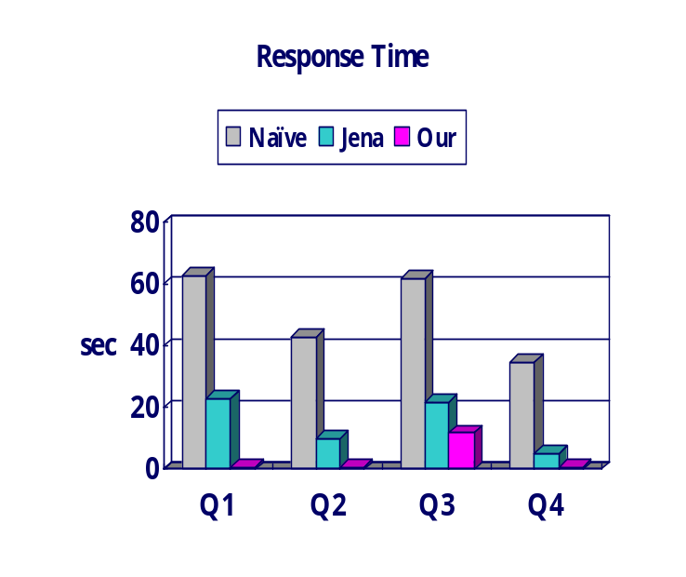
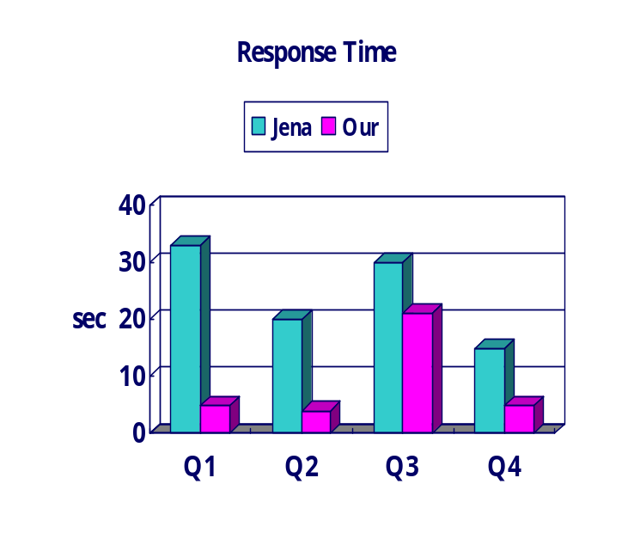
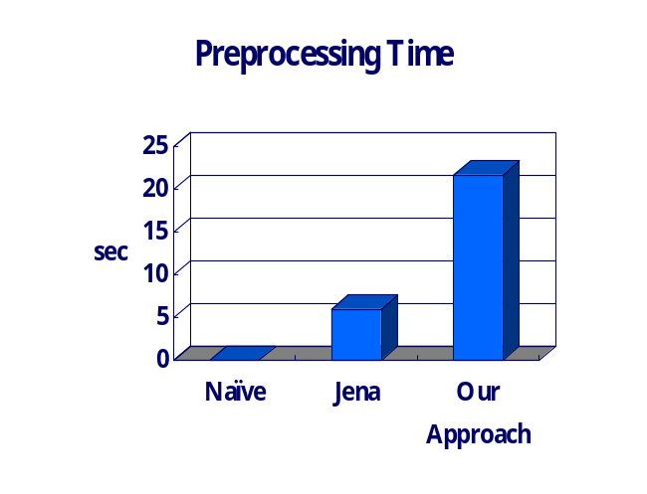
Experiments (2/2)
Query Set
Results
Q1 | Find all (is_a) subclasses of one class
Q2 | Find all (part_of) subclasses of one class
Q3 | Find all superclasses of one class
Q4 | Find the nearest common ancestor of two classes
memory version
disk version

Slide 14
Related Work
[1] Indexing Techniques for Object-Oriented Databases. W. Kim. Object-Oriented Concepts, Databases, and Applications, 1989
[2] Efficient processing of regular path joins using PID. J. Kim. Information and Software Technology, 2002
[3] On supporting containment queries in relational database management systems. C. Zhang. ACM SIGMOD, 2001
[4] The ICS-FORTH RDFSuite: Manageing voluminous RDF description bases. S. Alexaki. Semantic Web Workshop, 2001
[5] Efficient RDF storage and retrieval in Jena2. K. Wilkinson. SWDB, 2003
[6] Sesame: An Architecture for Storing and Querying RDF Data and Schema Information. J. Broekstra. Semantics for the WWW, 2001
[7] Gene Ontology Consortium. http://www.geneontology.org

Slide 15
Closing Remarks
We present a technique for processing transitive closure queries using interval-based labeling
We present both analytical and empirical evidence of its efficiency in compared with Jena
When it comes to quite large ontology, our approach and data structures reduce response time remarkably

Slide 16
Transitive Closure & Reduction
Appendix 1
Transitive closure (G*)
  Given a digraph G, the transitive closure of G is the digraph G* s.t
    G* has the same vertices as G
    if G has a directed path from u to v (u ≠ v), G* has a directed edge from u to v
  The transitive closure provides reachability information about a digraph
Transitive reduction (G⁻)
  Digraph G⁻ s.t smallest number of edges such for every path between vertices in G
D
E
B
C
G
A
D
E
B
C
A
G*
D
E
B
C
G⁻
A

Slide 17
Algorithms for Transitive Closure Queries
Appendix 2
listSubclasses(target)
{
for i = target.start to target.end
find node of i
add to result
return result
}
listSubClasses
listSuperClasses
Nearest Common Ancestor
listSupersubclasses(target)
{
for each node s.t. node.end >= target.end
if node.start <= target.start
add to result
return result
}
getNCA(target1, target2)
{
let target1 to have larger postorder number
for each node s.t. node.end >= target1.end
if node.start <= target1.start and node.start <= target2.start
return node
}

Slide 18
Incremental Maintenance
Appendix 3
Leave gaps bet. postorder numbers (e.g. 10)
  Addition
  Deletion
    just delete
{(1,60)}
{(1,60)}
{(10,40)}
{(30,30),(50,60)}
{(10,40)}
{(30,30),(50,60)}
{(20,20)}
{(60,60)}
{(30,30)}
{(40,40)}
{(20,20)}
{(60,60)}
{(30,30)}
{(40,40)}
{(15,15)}

