Slide 1
An Optimal and Progressive Algorithm for Skyline Queries
Dimitris Papadias¹, Yufei Tao², Greg Fu¹, and Bernhard Seeger³
¹ Hong Kong University of Science and Technology, Hong Kong
² Carnegie Mellon University, USA
³ Phillipps-University Marburg, Germany
20 Jan 2012
Taewhi Lee
SIGMOD ’03

Slide 2
Outline
Introduction
Related Work
Branch and Bound Skyline(BBS) Algorithm
Experimental Evaluation
Conclusion

Slide 3
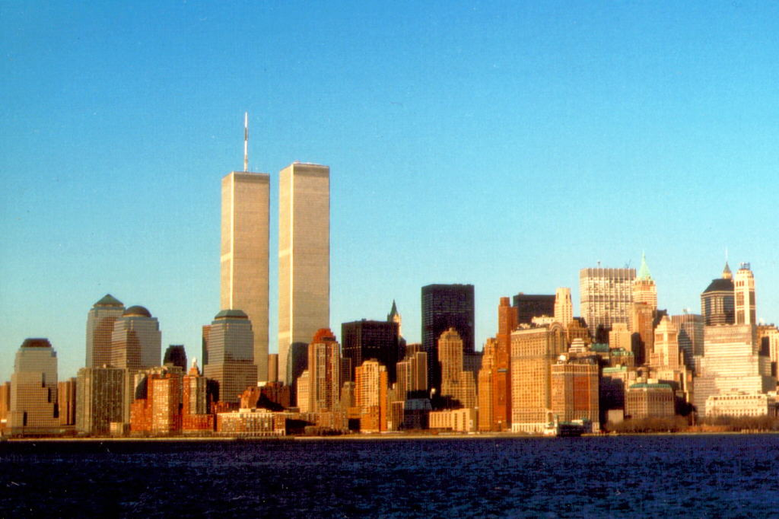
The Skyline of Manhattan
Higher than other buildings in the same position

Slide 4

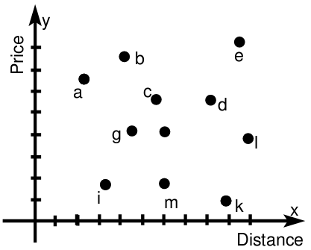
Example: The Skyline of Hotels
I’m looking for a hotel that is cheap and close to the beach!
Q) Which is the best choice?
a: closest to the beach
k: cheapest price
f
i: fairly close to the beach fairly cheap price
h
n
A) One among {a, i, k}

Slide 5
Problem Definition
Skyline Query
Given a set of points p₁, p₂, …, p_{N}, the skyline query returns a set of points P (referred to as the skyline points), s.t. any point p_{i} ∈ P is not dominated by any other point in the dataset.
Domination
A point p_{i} dominates another point p_{j} iff the coordinate of p_{i} on any axis is better than the corresponding coordinate of p_{j}.

Slide 6
Outline
Introduction
Related Work
Branch and Bound Skyline(BBS) Algorithm
Experimental Evaluation
Conclusion

Slide 7
Existing Skyline Query Processing Algorithms
Block Nested Loop(BNL)
Divide-and-Conquer(D&C)
Bitmap
Index
Nearest Neighbor(NN)
[BKS01]
[TEO01]
[KRR02]
[BKS01] Borzsonyi, S., Kossmann, D., and Stocker, K. The Skyline Operator. ICDE, 2001.
[TEO01] Tan, K., Eng, P., and Ooi, B. Efficient Progressive Skyline Computation. VLDB, 2001.
[KRR02] Kossmann, D., Ramsak, F., and Rost, S. Shooting Stars in the Sky: an Online Algorithm for Skyline Queries. VLDB, 2002.

Slide 8
1. Block Nested Loop(BNL)
id | x | y
a | 1 | 9
b | 2 | 10
c | 4 | 8
d | 6 | 7
e | 9 | 10
f | 7 | 5
g | 5 | 6
h | 4 | 3
i | 3 | 2
k | 9 | 1
l | 10 | 4
m | 6 | 2
n | 8 | 3
Candidates (in memory)
a
h
c
i
d
f
k
f
g
3 cases for each point p:
1) p is dominated by any candidate
2) p dominates some candidates
3) p is not comparable with all candidates

Slide 9
1. Block Nested Loop(BNL)
Pros
Wide applicability: it can be used for any dimensionality w/o indexing or sorting the data file
Cons
Reliance on main memory
Inadequacy for on-line processing
Time complexity: O(n²) in worst case

Slide 10
2. Divide-and-Conquer(D&C)
Divide: break up datasets into smaller partitions
Conquer: compute skyline in each partition
Merge: merge skylines to get the total skyline
Time complexity: O(nlogn)
Cons
Partitioning overhead
Inadequacy for on-line processing
f
h
n
Notes:
Divide - Continue till each partition fits in main memory
For large datasets, the partitioning process requires reading and writing the entire dataset at least once, thus incurring significant IO cost.

Slide 11
3. Bitmap
id | x | y | Bitmap-x | Bitmap-y
a | 1 | 9 | 1111111111 | 1100000000
b | 2 | 10 | 1111111110 | 1000000000
c | 4 | 8 | 1111111000 | 1110000000
d | 6 | 7 | 1111100000 | 1111000000
e | 9 | 10 | 1100000000 | 1000000000
f | 7 | 5 | 1111000000 | 1111110000
g | 5 | 6 | 1111110000 | 1111100000
h | 4 | 3 | 1111111000 | 1111111100
i | 3 | 2 | 1111111100 | 1111111110
k | 9 | 1 | 1100000000 | 1111111111
l | 10 | 4 | 1000000000 | 1111111000
m | 6 | 2 | 1111100000 | 1111111110
n | 8 | 3 | 1110000000 | 1111111100
c_{x} & c_{y}
= 0010000110000
c
h
i
c is dominated by h and i
Repeat the same ops for every point
c_{x}
c_{y}

Slide 12
3. Bitmap
Pros
Fast speed by using bit-wise operations
Cons
Space overhead
Expensive computation for the entire skyline

Slide 13
4. Index
Partition data points into d lists according to min. coordinate(minC)
Points in each list are indexed by a B-tree
sorted in asc. order of their minC
Skyline:
a, k
, i
List 1 |  | List 2
a(1,9) | minC = 1 | k(9,1) | minC = 1
b(2,10) | minC = 2 | i(3,2), m(6,2) | minC = 2
c(4,8) | minC = 4 | h(4,3), n(8,3) | minC = 3
g(5,6) | minC = 5 | l(10,4) | minC = 4
d(6,7) | minC = 6 | f(7,5) | minC = 5
e(9,10) | minC = 9

Slide 14
4. Index
Pros
Smaller search space
Cons
Exponential pre-computation of lists to support queries for arbitrary dimensionality subsets

Slide 15
5. Nearest Neighbor (NN)
The nearest neighbor p of the origin is in skyline
Three kinds of regions
R₁: no point
R₂: points dominated by p
R₃, R₄: points not dominated by p
Repeat the procedure recursively in R₃, R₄
Skyline: i To-do list: R₃, R₄
R₃
R₂
f
h
n
R₁
R₄

Slide 16
Outline
Introduction
Related Work
Branch and Bound Skyline(BBS) Algorithm
Experimental Evaluation
Conclusion

Slide 17
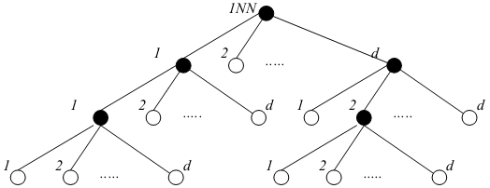
Motivation: Problem of NN Approach
Each non-empty query spawns d new recursive queries
Some queries may be redundant
To-do list size grows exponentially
Recursion tree

Slide 18
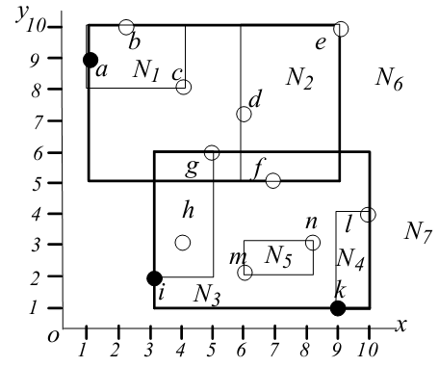
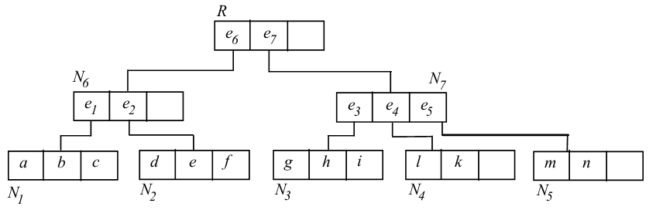
Background: R-tree
A node contains a set of entries
Internal node entry: <child, Minimum Bounding Rectangle>
Leaf node entry: <pointID, coordinates>

Slide 19
Branch and Bound Skyline(BBS)
Build a min heap on the mindist of every entry (node)
mindist: the minimum L1 distance to the origin (sum of coordinates)
An entry is checked for dominance twice
Before it is inserted in the heap
Before it is expanded
Skyline
i, a
i, a, k
i
Heap
<e₇,4><e₆,6>
<e₃,5><e₆,6><e₅,8><e₄,10>
<i,5><e₆,6> <h,7><e₅,8><e₄,10><g,11>
<i,5><e₆,6> <h,7><e₅,8><e₄,10><g,11>
<e₆,6><h,7><e₅,8><e₄,10><g,11>
<h,7><e₅,8><e₁,9><e₄,10><g,11>
<a,10><e₄,10><g,11><b,12><c,12>
<a,10><e₄,10><g,11><b,12><c,12>
<a,10><e₄,10><g,11><b,12><c,12>
<e₄,10><g,11><b,12><c,12>
<k,10><g,11><b,12><c,12><l,14>
<k,10><g,11><b,12><c,12><l,14>
<g,11><b,12><c,12><l,14>

Slide 20
Branch and Bound Skyline(BBS)
Properties
Progressiveness: the first results is output to the user almost instantly
Absence of false hits/misses
Fairness: the algorithm does not favor points that are particularly good in one dimension
Incorporation of preferences
Universality: the algorithm is applicable to any dataset distribution and dimensionality

Slide 21
Outline
Introduction
Related Work
Branch and Bound Skyline(BBS) Algorithm
Experimental Evaluation
Conclusion

Slide 22
Test Environment
Data sets
Independent (uniform) / anti-correlated dataset
R*-tree index
Dimensionality d: [2,5]
Cardinality N: [100K, 10M]
Pentium 4 CPU 2.4GHz, 512MB RAM

Slide 23

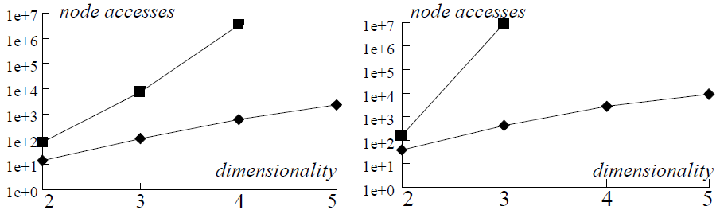
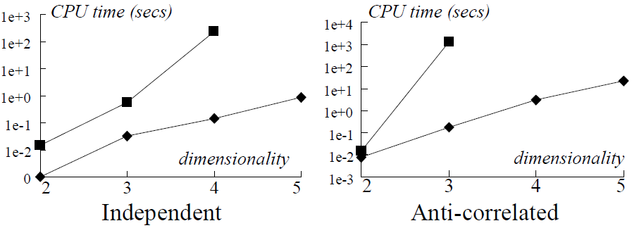
The Effects of Dimensionality (N=1M)
Due to the prohibitive size of the to-do list

Slide 24
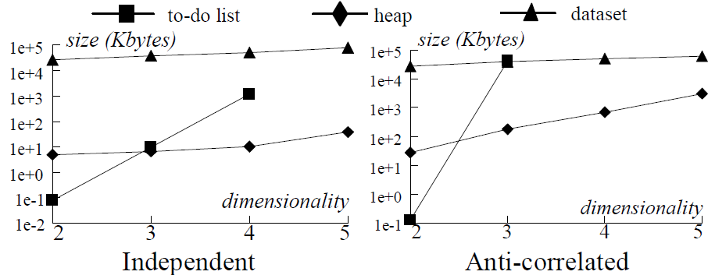
Heap and To-do List Size (N=1M)
Max. size of the to-do list exceeds the main memory for d ≥ 4
Max. size of the heap remains relatively stable

Slide 25
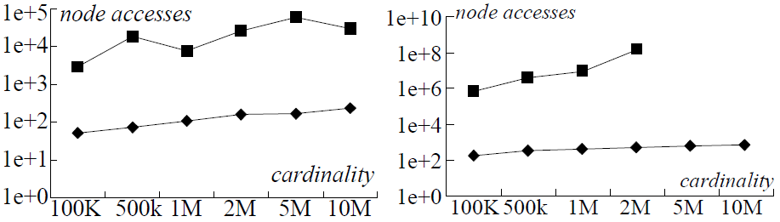
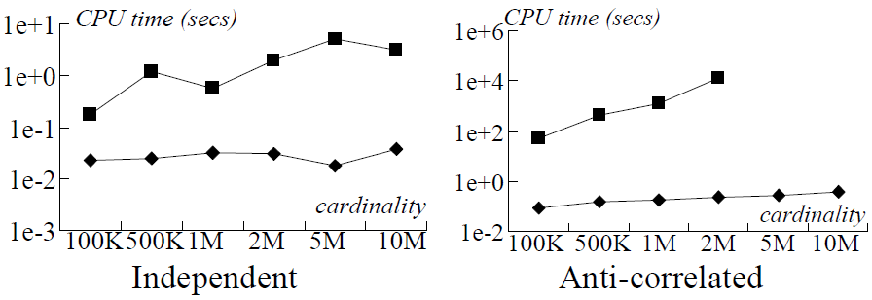
The Effect of Cardinality (d=3)

Slide 26
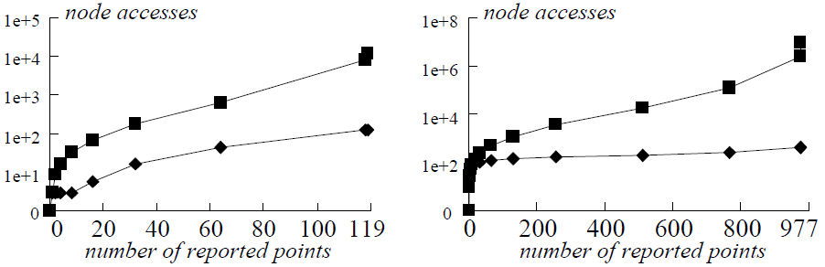
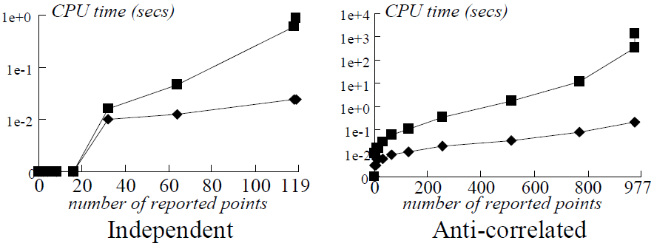
Progressive Behavior

Slide 27
Conclusion
Deficiencies of existing algorithms
BNL, D&C: very sensitive to main memory size
Bitmap: applicable only for datasets with small attribute domains
Index: not applicable for skyline queries on a subset of the dimensionality
NN: poor performance and prohibitive space requirement
BBS algorithm overcomes all these deficiencies

Slide 28
Epilogue…
Good introduction to skyline queries
“Related work” describes existing algorithms in detail
Skyline query can help us cope with information overload
It filters information not meaningful
We can only concentrate on important information
My research topics for the near future
Skyline query, skyline join with Semantic Web

Slide 29
Thank You!
Any questions or comments?

Slide 30
Heap
Data structure
An array
Can be viewed as a nearly complete binary tree
parent(i) = i/2
left_child(i) = 2i
right_child(i) = 2i+1
Min heap: A[parent(i)] ≤ A[i]
Operations
insert
extract_top
1 | 2 | 3 | 4 | 5 | 6 | 7 | …
1 | 2 | 7 | 9 | 6 | 8 | … | …
1 | 2 | 5 | 9 | 6 | 8 | 7 | …
2 | 6 | 5 | 9 | 7 | 8 | … | …
5
1
1
2
2
3
2
6
7
5
4
5
6
7
9
6
7
8
5
7

