Slide 1
Generic Text Summarization Using Relevance Measure and Latent Semantic Analysis
Gong Yihong and Xin Liu
SIGIR, 2001
21 April 2015
Yubin Lim

Slide 2
Outline
Introduction
Generic Summaries
Creating Generic Summary
Performance Evaluation
Further Observation
Future Work

Slide 3
Introduction
Dramatically increased scale of information dissemination
Conventional IR technology have become more and more insufficient
How to identify relevant document?
Text search
Summarization

Slide 4
Query-relevant vs Generic Summary
Query-relevant summary
Contents related to initial search query
Retrieval query relevant sentences from document
Query-biased
Inappropriate for content overview
Generic summary
Overall sense of contents with minimum redundancy
No query, no topic
Challenging

Slide 5
Generic Summaries
Summarization by Relevance Measure
Uses standard IR method
Summarization by Latent Semantic Analysis
Identify semantically important sentences
Both strive to select highly ranked and different sentences
Performance evaluation by comparing with manual summaries generated by
human evaluators

Slide 6
Creating Generic Summary
Common process
First, decompose document into individual sentences
Create term-frequency vector for each passage
T_{i} = [t_{1i}, t_{2i} … t_{ni}]^{T}
Weighted term-frequency vector
a_{ji} = L(t_{ji}) ∙ G(t_{ji})
A_{i} = [a_{1i}, a_{2i} … a_{ni}]^{T}

Slide 7
Creating Generic Summary
Summarization by Relevance Measure
Decompose document into sentences and form candidate sentence set S
Create weighted TF vector A_{i} for S and D for whole document
Compute relevance score between A_{i} and D
Select sentence k with highest relevance score and add it to summary
Delete k from S and eliminate all terms in k from document.
Recompute TF vector D
If number of sentences = N, terminate. Else, go to Step 3

Slide 8
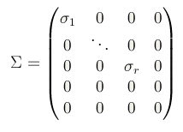
Creating Generic Summary
SVD (Singular Value Decomposition)
A = U∑V^{T}
U = [u_{ij}] m x m column-orthonormal matrix, left singular vector
∑ = diag(σ₁, σ₂, …, σ_{n}) n x n diagonal matrix
If rank(A) = r , σ₁ ≥ σ₂ ··· ≥ σ_{r} > σ_{r+1} = ··· = σ_{n} = 0
V = [v_{ij}] n x n orthonorm al matrix, right singular vector

Slide 9
Creating Generic Summary
Summarization by Latent Semantic Analysis
Create terms by sentences matrix A = [A₁ A₂ … A_{n}]
m x n matrix A, for m terms and n sentences
Apply SVD
A = U ∑ V^{T}
Transformation point of view
Map m-dimensional space spanned by weighted TF vector and r-dimensional singular vector space
Project column vector i in Matrix A to column vector ψ_{i} = [v_{i1} v_{i2} … v_{ir}]^{T} of V^{T}
Map row vector j in Matrix A to row vector φ_{i} = [u_{i1} u_{i2} … u_{ir}] of U

Slide 10
Creating Generic Summary
Semantic point of view
Derive latent semantic structure represented by matrix A
Reflect breakdown of original document into r linearly-independent base vectors
Term and sentence jointly indexed by base vectors
SVD can semantically cluster by capturing and modeling interrelationships among terms
doctor, physician are mapped near in r-dimensional singular vector space
Salient and recurring word combination pattern will be captured and represented by singular vector
Magnitude of corresponding singular value is importance
Best described pattern have largest index value

Slide 11
Creating Generic Summary
Summarization by Latent Semantic Analysis
Decompose document into sentences and form candidate sentence set S
Construct terms by sentences matrix A for document D
Perform SVD on A to obtain matrix ∑ and V^{T}
Select k’th right singular vector from V^{T}
Select sentence with largest index value with k’th RSV and include in summary
If number of sentences = N, terminate. Else, go to Step 4

Slide 12
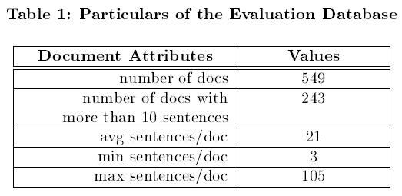
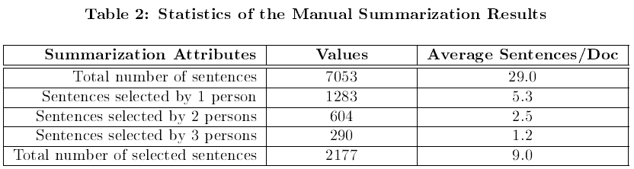
Performance Evaluation
Data corpus
CNN Worldview news with more than 10 sentences
Three human evaluators select exactly 5 sentences which they deem the most important for summary

Slide 13

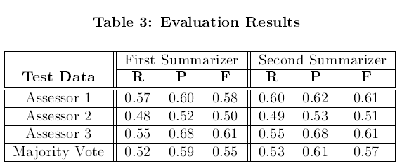
Performance Evaluation
Evaluation measure
Results
Performance measures are quite compatible (BNN)

Slide 14
Performance Evaluation
Weighting Schemes
Possible local weighting L(i)
No weight : L(i) = tf(i)
Binary weight : L(i) = 1, if term i appears at least once; else L(i) = 0
Augmented weight : L(i) = 0.5+0.5 * (tf(i)/tf(max))
Logarithm weight : L(i) = log(1+tf(i))
Possible global weighting G(i)
No weight : G(i) = 1
Inverse document frequency : G(i) = log(N/n(i))
If weighted TF vector A_{k} is created using one of weighting schemes
Normalization : normalizes A_{k} by length |A_{k} |
No normalization : use original A_{k}

Slide 15
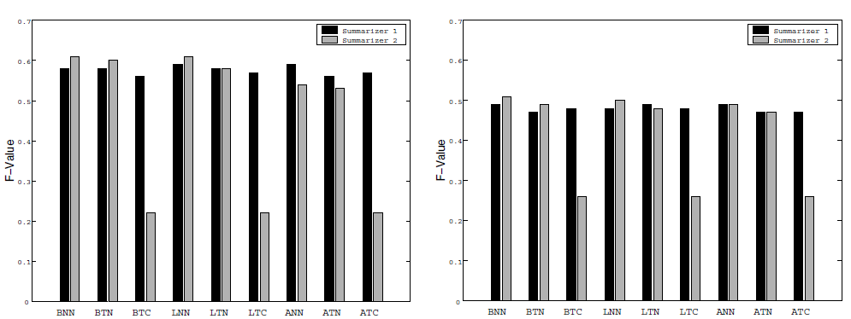
Performance Evaluation
Evaluator 1 Evaluator 2

Slide 16
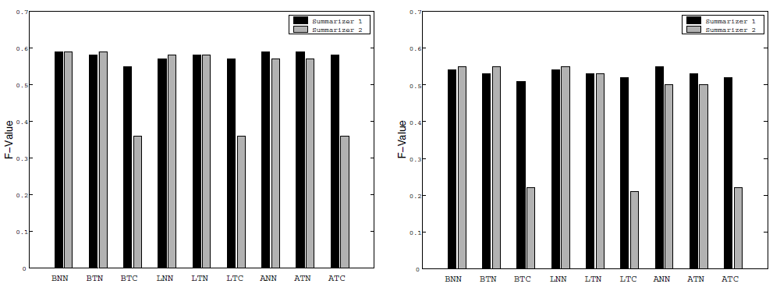
Performance Evaluation
Evaluator 3 Majority Vote

Slide 17

Further Observation
Performance can be variable by manual summarization method
Low performance using evaluator 2’s results

Slide 18
Future Work
Machine learning incorporating additional features
Linguistic features : discourse structure, anaphoric chains…
Semantic features : name entity, time, location information…
Interrelationship between image, audio acoustic features and text summarization quality

