Slide 1

Session 16
Modeling the Dynamic View:
The Sequence Diagram
Written by Thomas A. Pender
Published by Wiley Publishing, Inc.
October 20, 2011
Presented by Jee-bum Park

Slide 2
Contents
Knowing the purpose of Sequence and Collaboration diagrams
Mapping interactions to objects
Defining the basic notation of the Sequence diagram
Defining the extended notation for the Sequence diagram

Slide 3
Knowing the purpose of Sequence and Collaboration diagrams
There are actually three UML diagrams in the dynamic view:
  The Sequence diagram
  The Collaboration diagram
  The Statechart diagram
The Sequence and Collaboration diagrams both illustrate the interactions between objects
The Sequence diagram provides a path from the textual descriptions of behaviors in the scenarios to operations/interfaces in the Class diagram

Slide 4
Contents
Knowing the purpose of Sequence and Collaboration diagrams
Mapping interactions to objects
Defining the basic notation of the Sequence diagram
Defining the extended notation for the Sequence diagram

Slide 5
Mapping interactions to objects
Everything in an object-oriented system is accomplished by objects
  Objects work together by communicating or interacting with one another
Building the Sequence diagram is easier if you have completed at least a first draft of the Use Case model and the Class diagram

Slide 6
Contents
Knowing the purpose of Sequence and Collaboration diagrams
Mapping interactions to objects
Defining the basic notation of the Sequence diagram
Defining the extended notation for the Sequence diagram

Slide 7
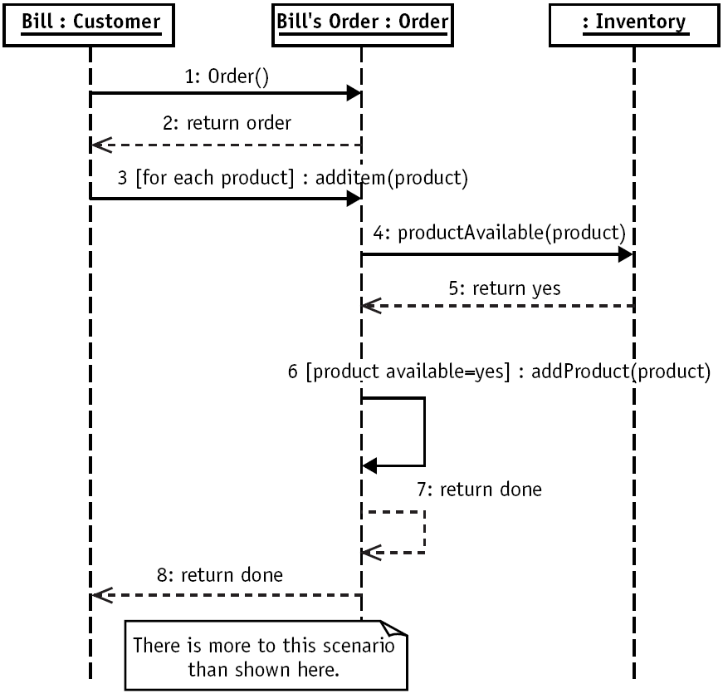

Defining the basic notation of the Sequence diagram (1/2)

Slide 8
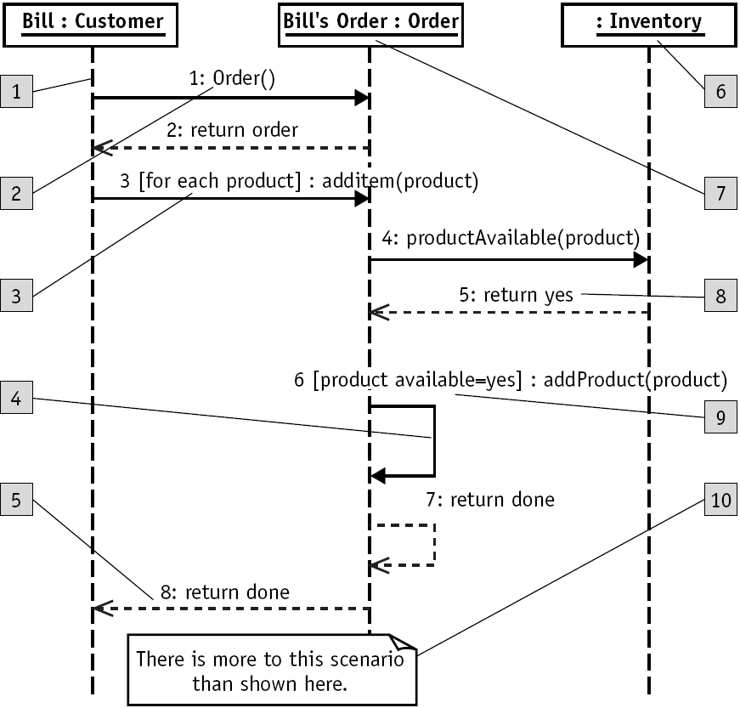
Defining the basic notation of the Sequence diagram (2/2)
Object lifeline
Message/Stimulus
Iteration
Self-reference
Return
Anonymous object
Object name
Sequence number
Condition
Basic comment

Slide 9
Contents
Knowing the purpose of Sequence and Collaboration diagrams
Mapping interactions to objects
Defining the basic notation of the Sequence diagram
Defining the extended notation for the Sequence diagram

Slide 10
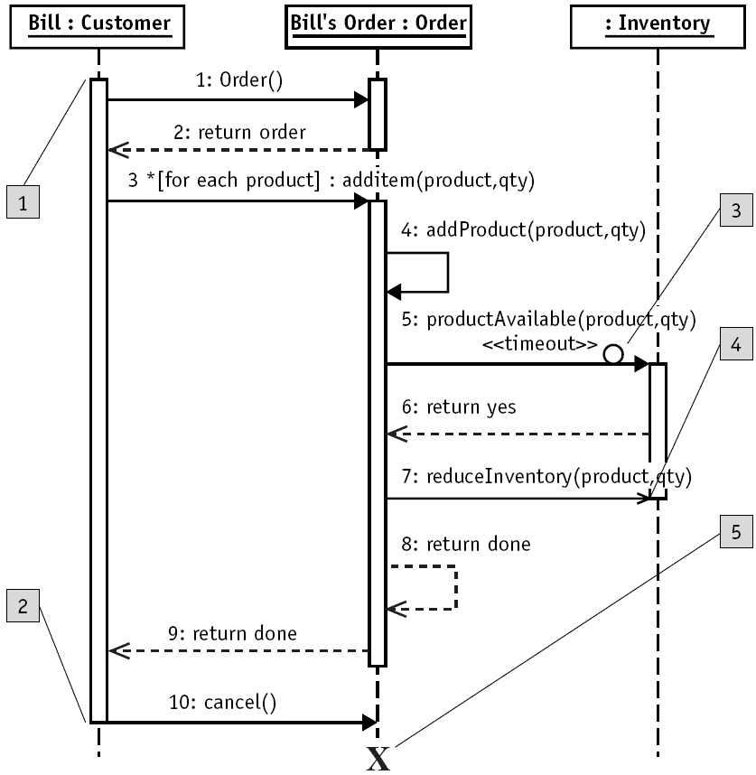
Defining the extend notation for the Sequence diagram (1/2)
Activation
  The start of the vertical rectangle, the activation bar
Deactivation
  The end of the vertical rectangle, the activation bar
Timeout event
  Typically signified by a full arrowhead with a small clock face or circle on the line
Asynchronous event
  Typically signified by a stick arrowhead
Object termination
  Symbolized by an X

Slide 11
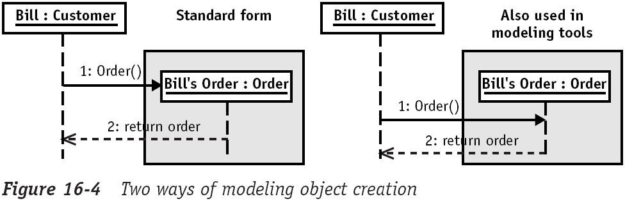
Defining the extend notation for the Sequence diagram (2/2)
Message 1, Order()
  This is a common coding convention for a constructor, an operation that creates an object
But the Sequence diagram uses an object lifeline that should allow us to represent object creation visually

Slide 12
The End

