Slide 1
빅데이터 팀 세미나 #맵리듀스 기반 Set Similarity Join
Some slides from vldb 2012 tutorial

Slide 2
Outline
Serial Set Similarity Join (Jaccard)
Set Similarity Join 소개
Naïve 알고리즘
Inverted Index 기반 알고리즘
필터링 기법 소개
맵리듀스 기반 Set Similarity Join (Jaccard)
맵리듀스 기반 Set Similarity Join (Vector:코사인 )

Slide 3
Similarity Join 정의
Given a collection of records, find all pairs of records, <x,y> s.t. sim(x,y) >= t
Each record is converted into a multiset of tokens
Since tokens may occur multiple times in a record
x = “yes as soon as possible”
y = “as soon as possible please”
x = {A, B, C, D, E}, y = {B, C, D, E, F}
word | yes | as | soon | as₁ | possible | please
token | A | B | C | D | E | F

Slide 4
Similarity Function
x = {A,B,C,D,E} y = {B,C,D,E,F}
4/6 = 0.67
4
Similarity functions
Jaccard:
Overlap:
Jaccard can be equivalently converted to Overlap

Slide 5
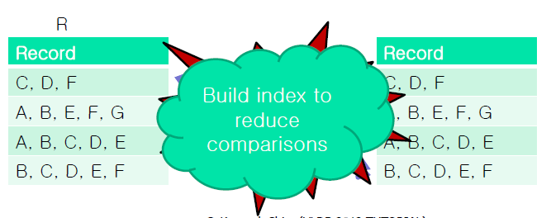
Naïve Approach
Naïve algorithm
Compare every pair of objects → O(n²) time complexity

Slide 6
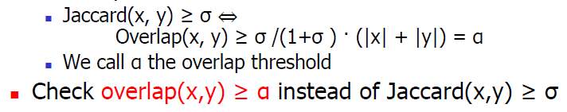
Similarity Self-Joins using Inverted Lists
Make an inverted lists for all items in set data
Generate candidates by considering every pair of record IDs in each inverted list
Find similar pairs by verifying each candidate
Relationship between Jaccard and Overlap similarity measures

Slide 7
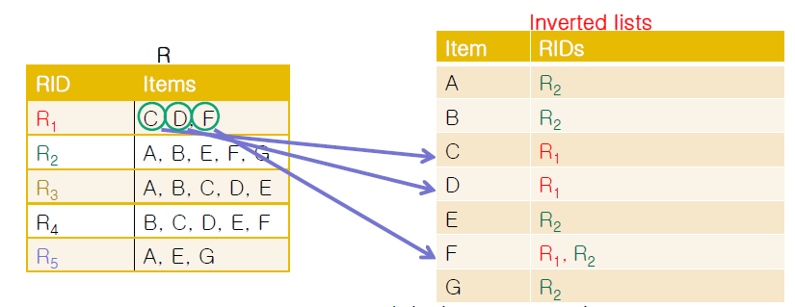
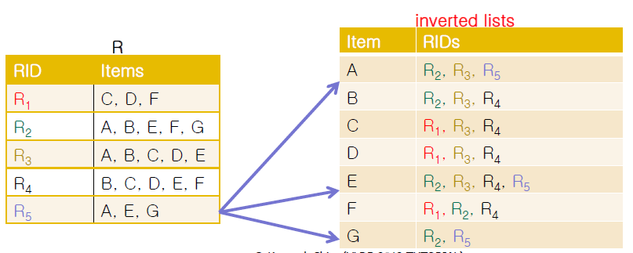
Building Inverted Lists
While scan each record in the data
Insert the identifier of the record (RID) into the inverted list entries of its items

Slide 8
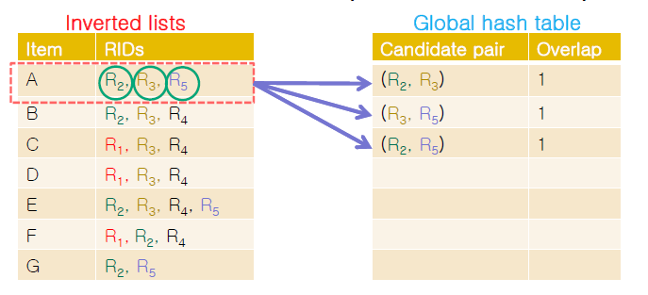
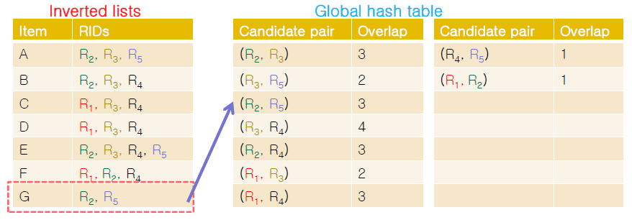
Generating Candidates
Generate candidates by making every RID pair in the each inverted list entry
Increase the overlap of the candidate pair

Slide 9
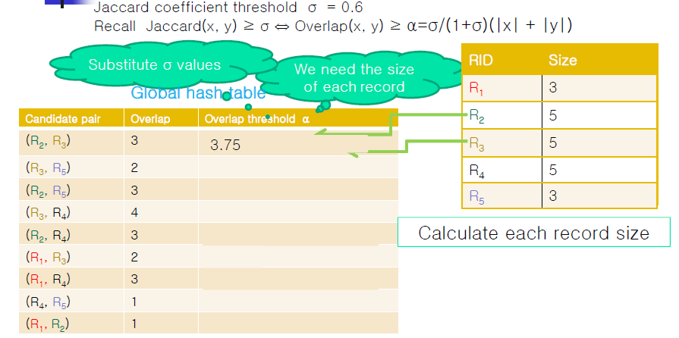
Finding Similar Pairs

Slide 10
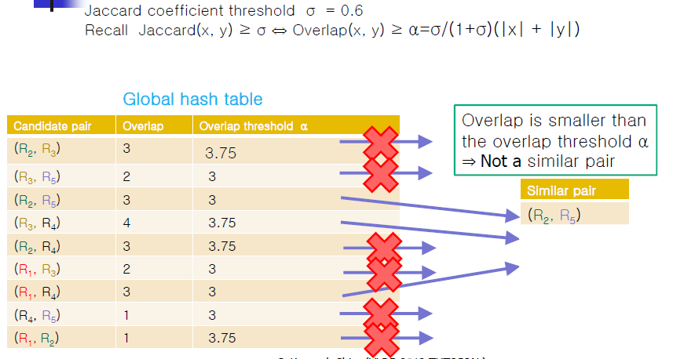
Verifying Candidates

Slide 11
Filtering Techniques
Filtering techniques were proposed to reduce the number of candidate pairs to consider similarity
Reduce the size of the global similarity hash table
Size filtering
[Bayardo, Ma, Srikant: WWW, 2007]
If |r| >> |s|, a pair (r,s) cannot be the similar pair
Positional filtering
[Xiao, Wang, Lin, Yu: WWW 2008]
Utilize an upper bound of similarities
Reduce the sizes of inverted lists
Prefix filtering
[Xiao, Wang, Lin, Yu: WWW 2008]
Index the items in a subset of each set record only

Slide 12
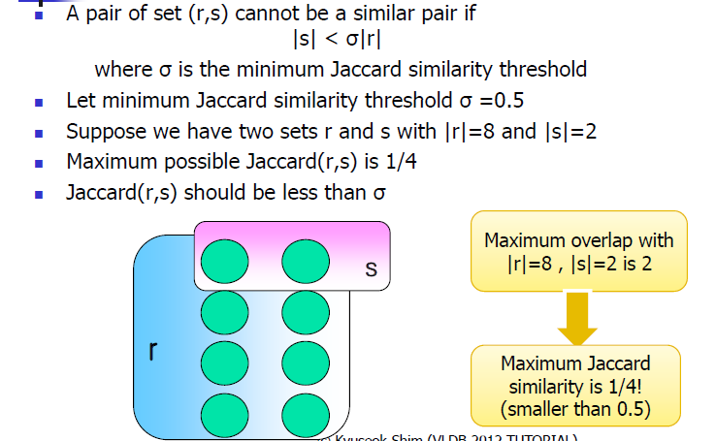
Size Filtering

Slide 13
Prefix Filtering
Sort the tokens by a global ordering
Increasing order of document frequency
Index the first few tokens (prefix) for each record
Must share at least one token in prefix to be a candidate pair
Suppose O(x,y) >= 4
sorted
C | D | E
A | B
C | D | E
E | F | G
A | B
ubound_{O(x,y)} = 3 < 4!
C | D
E | F | G
A | B | E
E | F | G
C | D
sorted
prefix

Slide 14
Prefix Filtering
→ → prefix length = |x| - + 1
→ → prefix length = |x| - t|x| + 1
Example: suppose J(x,y) >= 0.8
w = {D, E, F, G}
x = {C, D, E, F, G}
y = {B, C, D, E, G}
z = {A, B, C, F, G}
Candidate Pairs <w,x> <x,y> <y,z>
Results <w,x>
14

Slide 15
Prefix Filtering + Positional Information
Prefix filter (All-Pairs [www07]) is used as basic framework
Intuition
Tokens sorted → rank, or position of tokens within a record
Estimate tighter upper bounds of overlap between x and y with positional information
Index construction → PPJoin algorithm
Index not only tokens, but their positions in the record
Candidate generation → PPJoin+ algorithm
Probe tokens in suffix, compare the positions in the record

Slide 16
PPJoin: Positional Filtering within Prefix
Index both tokens and their positions
ubound_{O(x,y)} = 1+ min(|x| - p_{x}, |y| - p_{y})
1 | 2 | 3 | 4 | 5
1
2
B | C | D | E | F
ubound _{O(x,y)} =
1 + min(4, 3) = 4
A | B | C | D | F

Slide 17
PPJoin+:Positional Filtering within Suffix
Divide and Conquer
Probe suffix recursively
Until either candidate pair is pruned, or reach max-depth
prefix
suffix
A | B | C | D
3
2
3
1
3
2
3
A | B | C | D
ubound_{dep=1} =
4
+ 6
+ 1
+ 7
= 18
ubound_{dep=2} =
4
+ 3
+ 1
+ 1
+ 1
+ 3
+ 1
+ 3
= 17
ubound_{dep=3} =
4
+ 1
+ 1
+ 1
+ 1
+ 1
+ 1
+ 1
+ 1
+ 1
+ 1
+ 1
= 15

Slide 18
Effect of Filters
Suppose J(x,y) >= 0.8
u = {C, D, E, F}
v = {B, C, D, E, F}
w = {A, B, C, D, F}
x = {G, A, B, E, F}
y = {A, B, D, E, F}
z = {G, A, C, D, E, F}
After prefix filter:
<u,v>, <v,w>, <v,y>, <w,x>, <w,y>, <w,z>, <x,y>, <x,z>, <y,z>
After PPJoin:
<u,v>, <w,y>, <w,z>, <x,z>, <y,z>
After PPJoin+ (max-depth = 1):
<u,v>, <x,z>, <y,z>
Real result:
<u,v>

Slide 19
Set-Similarity Self-Join Algorithms with MapReduce
Vernica Algorithm [SIGMOD 2010]
For each record, emit every item in the prefix with its entire record to the reduce functions
Generate and verify candidates pairs in each inverted list in parallel
For a pair of records, we may compute similarity value several times in different inverted lists
V-SMART-Join [VLDB 2012]
Decompose similarity computations and parallelize each decomposed computation
Build inverted lists of all items in each record and calculate partial similarities of pairs in each inverted list
Compute the exact similarities of all pairs by aggregating partial similarities

Slide 20
Vernica Algorithm
[Vernica, Carey, Li: SIGMOD 2010]
The shorter an inverted list is, the less number of candidate pairs is
Inverted lists of infrequent items are small
Use infrequent items for prefixes
Order items in each set record based on frequency

Slide 21
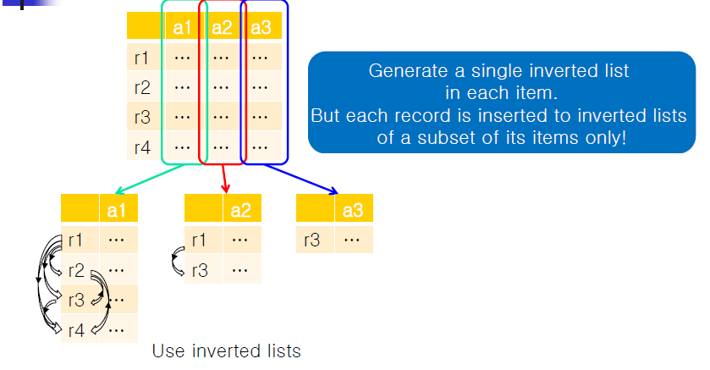
Vernica Algorithm

Slide 22
Vernica Algorithm
Step 1 : Find global item ordering
Sort the items based on frequency
1-phase vs. 2-phase
Step 2 : Produce similar record id pairs
Basic kernel vs. Indexed kernel
Step 3 : Generate similar record pairs
Replace rid pairs with record pairs
1-phase projection vs. 2-phase projection

Slide 23
Step 2: Produce Similar Record ID Pairs
Extract the prefix of each record using the global item ordering computed by Step 1
Extract the record ID and the join-attribute value of each record with prefix filtering
Verify the record pairs in an inverted list using a reduce function
Two algorithms
Basic kernel
Use individual items and apply the nested loop approach with filtering techniques
Indexed kernel
Use the grouping key technique and apply the PPJoin+ [WWW 2008]

Slide 24
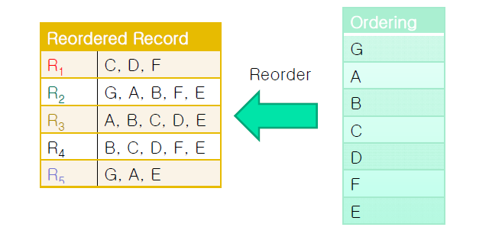
Preprocessing: Order Items in a Record
Sort the items in a record based on the broadcasted global item ordering
(frequent가 작은 아이템을 앞으로 보내는 게 유리!!)

Slide 25

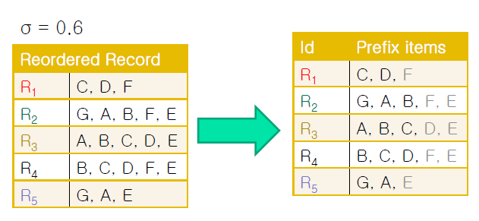

Preprocessing: Prefix Filtering
Extracts the prefix items
Prefix length = |x|
where σ is the minimum similarity threshold

Slide 26

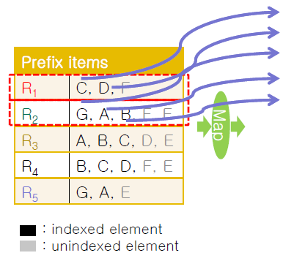
Basic Kernel
Generate a (key, value) pair for each of its prefix items
인덱스 된 엘리먼트만 맵 함수에 적용

Slide 27
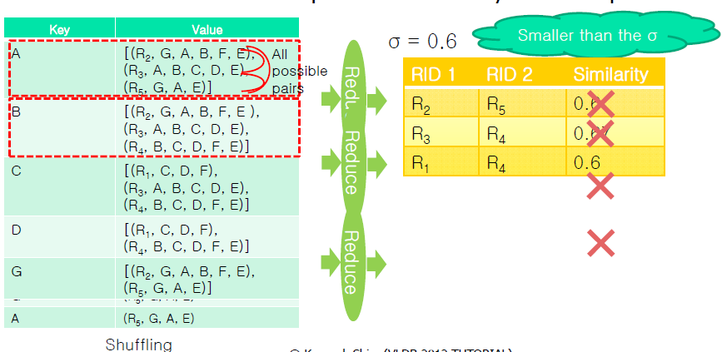
Basic Kernel
A reduce function compute the similarity for each pair

Slide 28
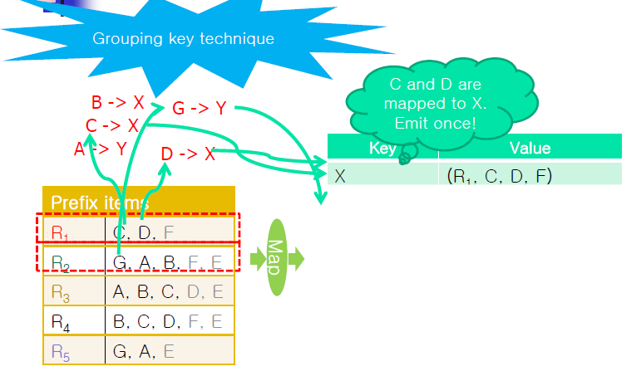
Indexed Kernel

Slide 29
Prefix Filtering-Based Algorithm with MR [SIGMOD10]
Record set
Global token ordering (increasing idf order)
Phase 1 (1~2 MR job)
Index construction (prefix tokens only)
Phase 2 (1 MR job)
Candidate generation
Phase 3 (1~2 MR job)
Verification
Result pairs
Pros
Inverted lists only include prefix tokens
Small # of candidate pairs are generated

Slide 30
Finding Similar RID Pairs with Prefix Filtering (1) [SIGMOD10]
Suppose O(x,y) ≥ 3
Map output
Record duplication
Map input
(DFS)
K₂: token / V₂: <rid, record>
Reduce input
Reduce
output
K₂ | V₂
F | <w, F G H I>
G | <w, F G H I>
E | <x, E F G H I>
F | <x, E F G H I>
G | <x, E F G H I>
K₂ | List(V₂)
A | <v, A B C>
C | <z, C D E H I>
E | <x, E F G H I>
 | <y, D E F G I>
 | <z, C D E H I>
G | <w, F G H I>
 | <x, E F G H I>
K₁: record id
V₁: raw data
K₃: rid pair
V₃: overlap sim.
K₃ | V₃
x y | 4
x z | 3
y z | 3
w x | 4
K₁ | V₁
w | F G H I
x | E F G H I
y | D E F G I
z | C D E H I
v | A B C
K₂ | V₂
D | <y, D E F G I>
E | <y, D E F G I>
F | <y, D E F G I>
C | <z, C D E H I>
D | <z, C D E H I>
E | <z, C D E H I>
K₃ | V₃
y z | 3
w x | 4
w y | 3
x y | 4
K₂ | List(V₂)
D | <y, D E F G I>
 | <z, C D E H I>
F | <w, F G H I>
 | <x, E F G H I>
 | <y, D E F G I>
Token order
A B … H I
K₂ | V₂
A | <v, A B C>
Duplicated
computation
30

Slide 31
Prefix Filtering-Based Algorithm with MR [SIGMOD10]
Record set
Global token ordering (increasing idf order)
Phase 1 (1~2 MR job)
Index construction (prefix tokens only)
Phase 2 (1 MR job)
Candidate generation
Phase 3 (1~2 MR job)
Verification
Result pairs
Cons
Each record is always sent to a number of reducers
One candidate pair may be verified many times
Using q-gram tokens
The # of gram tokens will be large
Many record pairs have 1+ common prefix tokens

Slide 32
Prefix Filtering-Based Algorithm with MR (2) [ICDM10]
Record set
Global token ordering (increasing idf order)
Phase 1 (1~2 MR job)
Index construction (prefix tokens only)
Phase 2 (1 MR job)
Phase 3 (1 MR job)
Candidate generation
Phase 4 (1~2 MR job)
Verification
Result pairs
Improved features
A record pair is accessed only if they share at least one token in their prefix
One candidate pair is verified just once

Slide 33
Finding Similar RID Pairs with Prefix Filtering (2) [ICDM10]
Suppose O(x,y) ≥ 3
Reduce input
Map input
(DFS)
Reduce
output
Map output
K₂ | List(V₂)
w x | 1 1
x y | 1 1
y z | 1 1
K₂: rid pair
V₂: token
K₁: token
V₁: record id
K₃: rid pair
V₃: overlap sim.
K₂ | V₂
y z | 1
x y | 1
x z | 1
y z | 1
K₁ | V₁
A | v
C | z
D | y z
E | x y z
F | w x y
G | w x
K₃ | V₃
w x | 4
x y | 4
y z | 3
K₂ | List(V₂)
w y | 1
x z | 1
rid | tokens
w | F G H I
x | E F G H I
y | D E F G I
z | C D E H I
v | A B C
K₃ | V₃
w y | 3
x z | 3
K₂ | V₂
w x | 1
w y | 1
x y | 1
w x | 1
Remote I/O (to read original record from DFS)
33

Slide 34
V-SMART-Join
[Metwally, Faloutsos: VLDB 2012]
To reduce network overhead of Vernica algorithm, do not emit entire records
Consider multiset and vector data
Decompose similarity computations and parallelized each decomposed computation
Build inverted lists of all items in each record and calculate partial similariites of pairs in each inverted list
Compute the exact similarities of all pairs by aggregating partial similarities

Slide 35
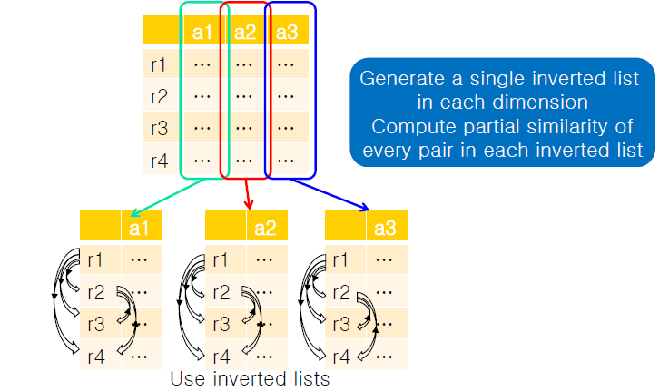
V-SMART-Join

Slide 36
Vector Similarity Self-Joins using MapReduce
All pair partitioning algorithm
Distribute all pairs of records
Full inverted list algorithm
Build inverted lists for all dimensions
VSMART-JOIN algorithm
Build inverted lists for all dimensions
Decompose and parallelize the similarity computations into sub-expression
Prefix-filtering algorithms
Build inverted lists of a subset of dimensions

Slide 37
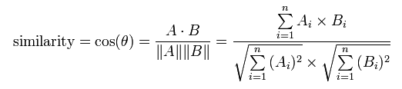
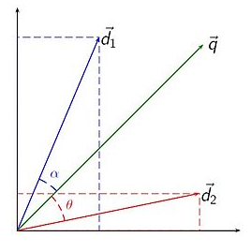
Cosine Similarity
벡터의 내적
코사인 유사도 계산 :
문서와 질의 혹은 문서와 문서의 유사도로 확장
문서를 벡터로 표시
(Wi,q : q문서에서 word1의 weight)

Slide 38
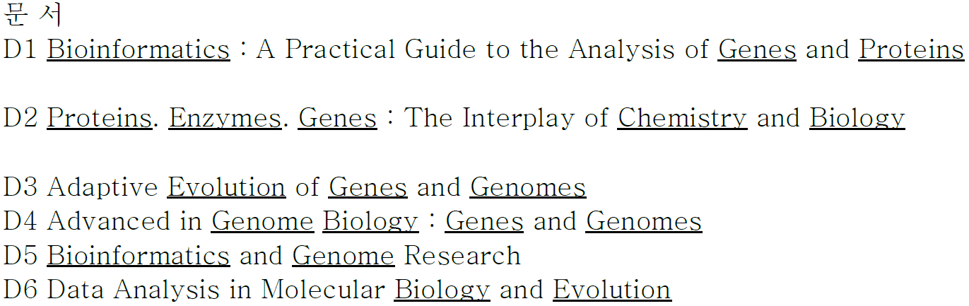
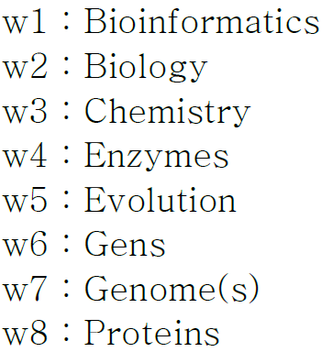
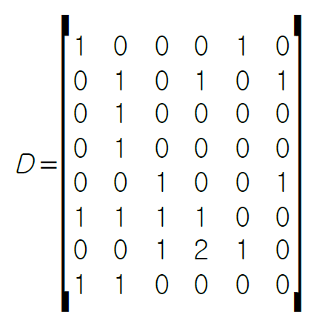
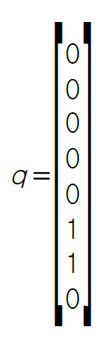
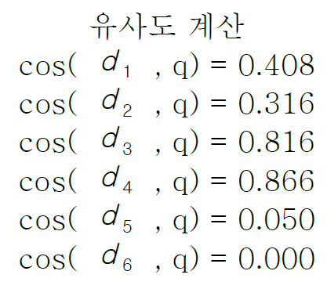
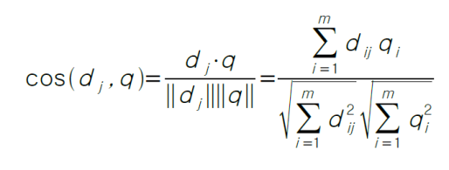
Cosine Similarity 예
색인어
벡터

Slide 39
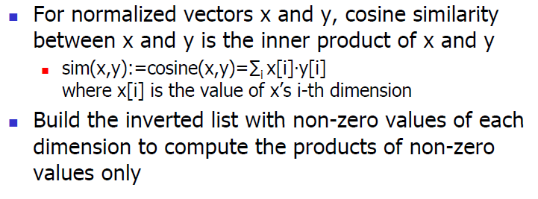
Cosine Similarity Measure

Slide 40
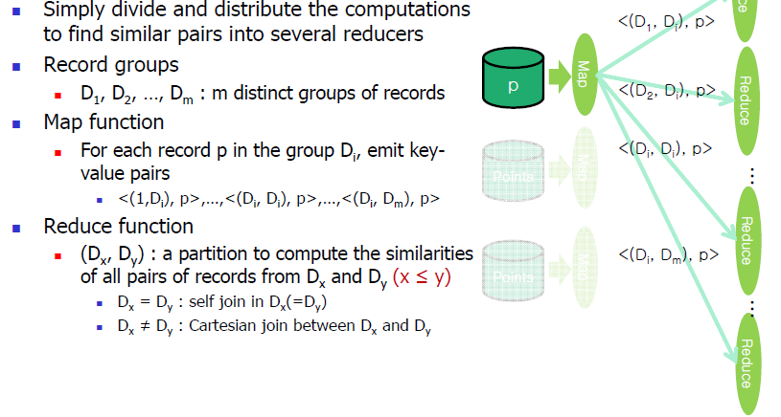
All Pair Partitioning Algorithm

Slide 41
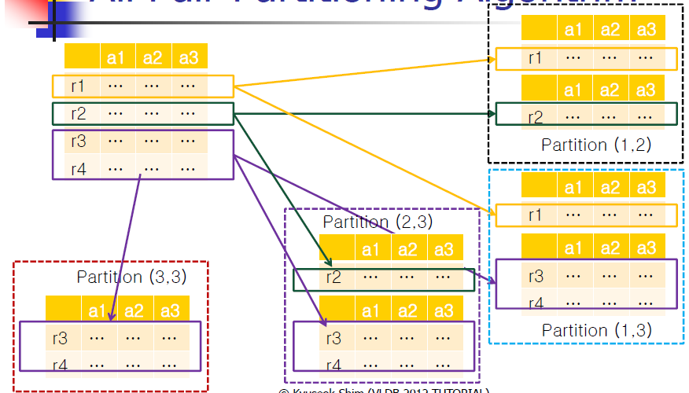
All Pair Partitioning Algorithm
R3와 r4를 계산하기 위해 partition (3,3)을 계산

Slide 42
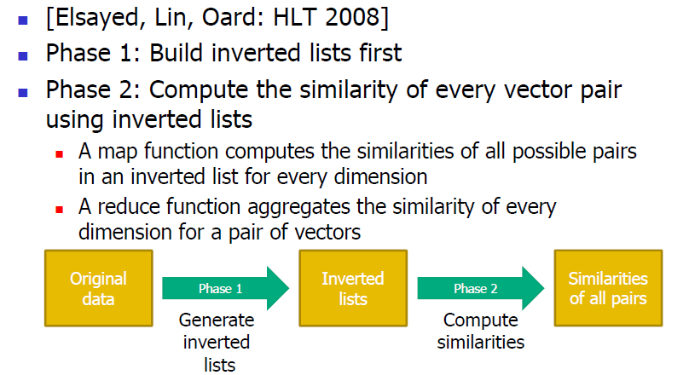
Full Inverted List Algorithm

Slide 43
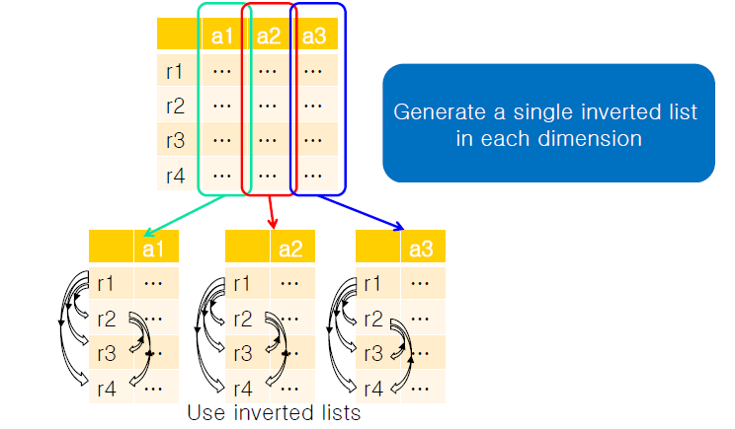
Full Inverted List Algorithm

Slide 44
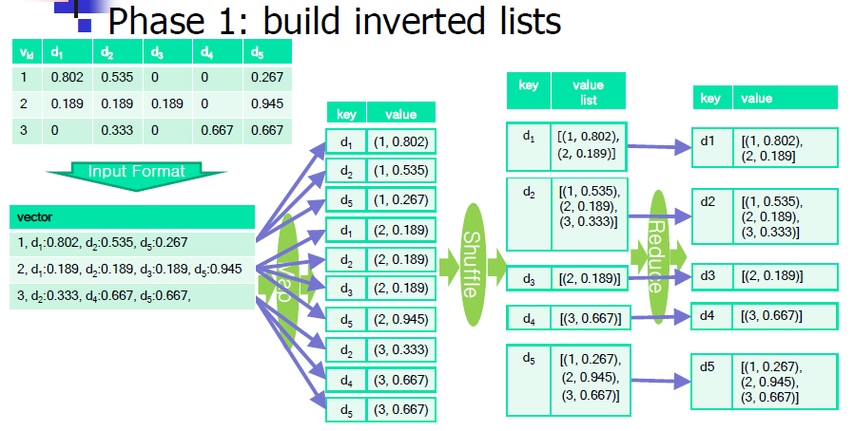
An Illustration of Full Inverted List Algorithm

Slide 45
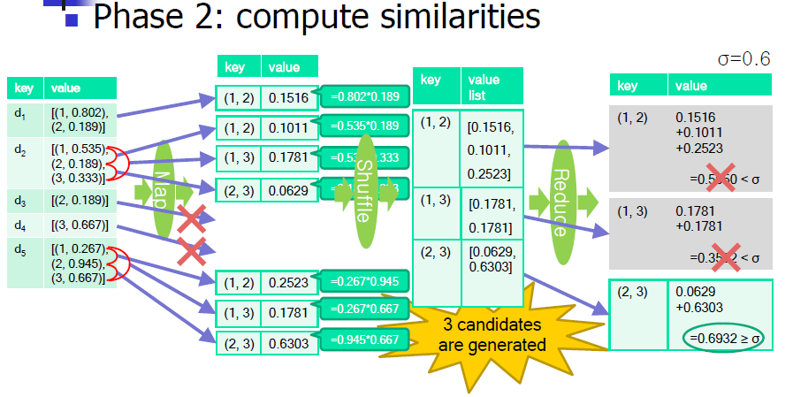
An Illustration of Full Inverted List Algorithm

Slide 46
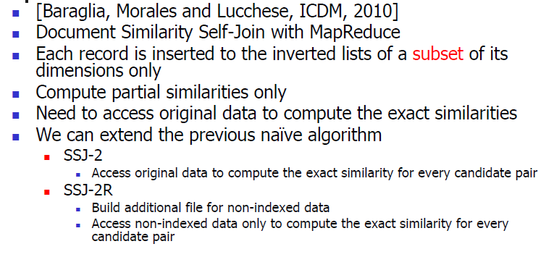
Prefix Filtering

Slide 47
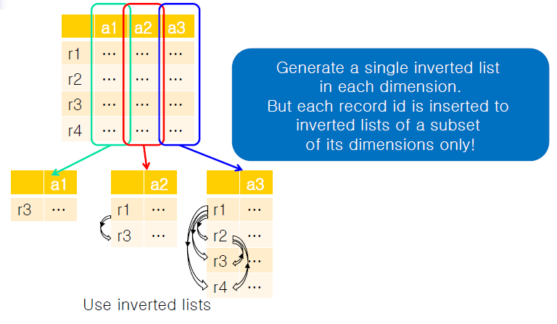
Prefix Filtering

Slide 48
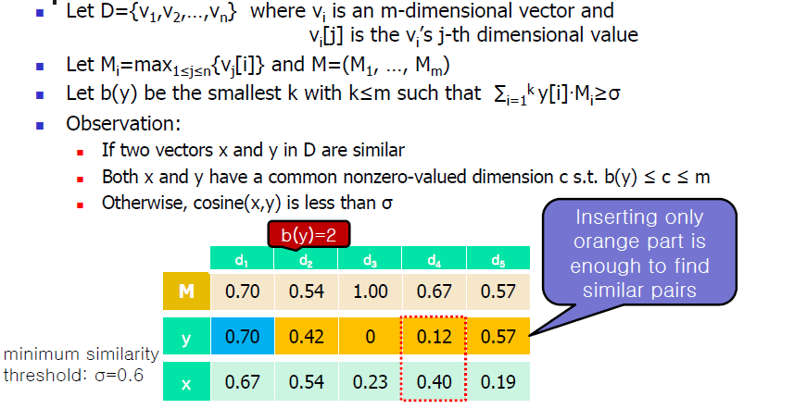
Prefix Filtering

Slide 49
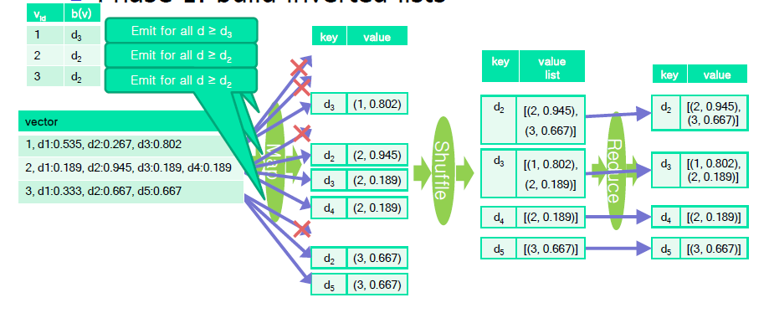
An Illustration of Prefix Filtering
Phase 1 : build inverted lists
Threshold를 넘지 않는 최대

Slide 50
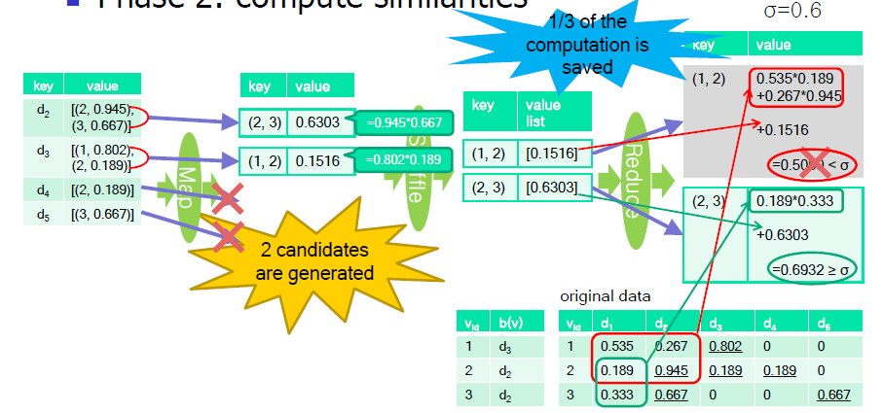
An Illustration of Prefix Filtering
Phase 2: compute similarities

