Slide 1
빅데이터 팀 세미나 #맵리듀스 프레임워크 기반 데이터마이닝
Adapted from vldb 2012 tutorial slides (prof. Kyuseok shim)

Slide 2
Outline
맵리듀스 기반 Apriori 알고리즘
맵리듀스 기반 FP-Tree 알고리즘
맵리듀스 기반 K-Means 클러스터링

Slide 3
Apriori 알고리즘
2-candidates
Scan D
Min_sup=2
Data base D
Scan D
1-candidates
Freq 1-itemsets
Itemset
ab
ac
ae
af
bc
be
bf
ce
cf
ef
Itemset | Sup
ab | 1
ac | 2
ae | 1
af | 2
bc | 2
be | 3
bf | 0
ce | 2
cf | 1
ef | 0
TID | Items
10 | a, c, d, f
20 | b, c, e
30 | a, b, c, e,
40 | b, e
50 | a, f
Itemset | Sup
a | 3
b | 3
c | 3
d | 1
e | 3
f | 2
Itemset | Sup
a | 3
b | 3
c | 3
e | 3
f | 2
Freq 3-itemsets
Scan D
3-candidates
Itemset | Sup
bce | 2
Itemset | Sup
bce | 2
Itemset
bce
pruning
3-candidates
Freq 2-itemsets
Itemset
acf
bce
Itemset | Sup
ac | 2
af | 2
bc | 2
be | 3
ce | 2
From [Agrawal, Srikant 1994]

Slide 4
맵리듀스 기반
Outline of map/reduce algorithms
Emit all subsets of each transaction
Count number of appearance of each subset
Repeat map/reduce until no more pattern found
For each j-th pass, map emits j-length subset of transactions and reduce finds j-length patterns

Slide 5
Outline of Steps
Map
For each transaction t_{i} in j-th pass where 1≤i≤n, emit j-length subsets of t_{i} with count 1
Output
Key : each j-length subset of transaction t_{i} (string)
Value : 1 ( number of appearance )
That is, emit <j-length subset, 1>
Reduce
Aggregate counts of same key
If aggregated count is bigger than given minimum support, output subset(key) with its count

Slide 6
Illustration : Pass 1
key value
<“1”, 1>
<“2”, 1>
<“3”, 1>
<“2”, 1>
<“3”, 1>
<“5”, 1>
…
map
Transaction1의
데이터
Transaction
t₁: {1,2,3}
t₂: {2,3,5}
t₃: {1,2,4,5}
…
t_{n}: {1,2,3}
map
…
map

Slide 7
Illustration : Pass 1
minimum support = 4
key value
<“1”, 1 1 1 1 1>
<“2”, 1 1 1 1 1 1>
<“3”, 1 1 …>
<“5”, 1 1 …>
…
Reduce
<“1”, 5>
<“2”, 6>
…
Reduce
Reduce
Reduce
…

Slide 8
Illustration : Pass 2
key value
<“1,2”, 1>
<“1,3”, 1>
<“2,3”, 1>
<“2,3”, 1>
<“2,5”, 1>
<“3,5”, 1>
…
map
Transaction1의
2개 쌍에 대한 데이터
Transaction
t₁: {1,2,3}
t₂: {2,3,5}
t₃: {1,2,4,5}
…
t_{n}: {1,2,3}
map
…
map

Slide 9
Illustration : Pass 2
minimum support σ : 4
key value
<“1,2”, 1 1 1 1>
<“1,3”, 1 1>
<“2,3”, 1 1 1 1>
<“2,5”, 1 1 …>
…
Reduce
<“1,2”, 4>
<“2,3”, 4>
…
Reduce
Reduce
Reduce
…

Slide 10
Map/Reduce : FP-Tree algorithm
TID Items bought (ordered) frequent items
100 {f, a, c, d, g, i, m, p} {f, c, a, m, p}
200 {a, b, c, f, l, m, o} {f, c, a, b, m}
300 {b, f, h, j, o, w} {f, b}
400 {b, c, k, s, p} {c, b, p}
500 {a, f, c, e, l, p, m, n} {f, c, a, m, p}
min_support = 3
{}
Header Table
Item frequency head
f 4
c 4
a 3
b 3
m 3
p 3
Scan DB once, find frequent 1-itemset (single item pattern)
Sort frequent items in frequency descending order, f-list
Scan DB again, construct FP-tree
f:4
c:1
c:3
b:1
b:1
a:3
p:1
m:2
b:1
F-list=f-c-a-b-m-p
p:2
m:1
10

Slide 11
Example Construction of FP-tree
TID | Items bought | (Ordered) frequent items
100 | f, a, c, d, g, i, m, p | f, c, a, m, p
200 | a, b, c, f, l, m, o | f, c, a, b, m
300 | b, f, h, j, o | f, b
400 | b, c, k, s, p | c, b, p
500 | a, f, c, e, l, p, m, n | f, c, a, m, p
Min_sup = 3
root
f:1
f:2
c:1
c:2
item | support
f | 4
c | 4
a | 3
b | 3
m | 3
p | 3
item-name | head of node-link
f
c
a
b
m
p
a:1
a:2
m:1
b:1
p:1
m:1

Slide 12
Properties of FP-Tree
FP-tree contains the complete information of DB relevant to frequent pattern mining (completeness)
A lot of sharing of frequent items makes the FP-tree more compact
e.g.
The total # of occurrence of frequent items : 2,219,609
The total # of nodes in the FP-tree : 13,339

Slide 13
Conditional pattern base
A sub-pattern base under the condition of existence of a certain pattern
Example (min_sup = 3)
root
Nodes that contribute m’s cond. pattern bases
f:4
c:1
f
c
a
b
m
p
c:3
b:1
b:1
m’s cond. pattern bases
- (fca:2), (fcab:1)
a:3
p:1
m:2
m:2
b:1
p:2
m:1
m:1

Slide 14
Conditional FP-tree
FP-tree on the conditional pattern bases of a certain item
If FP-tree consists of single path, all the combinations of items in the path are the freq patterns
Example (min_sup = 3)
root
The nodes that contribute to m’s cond. FP-tree
f:4
c:1
f:4
f
c
a
b
m
p
c:3
m’s cond. FP-tree
- (fca:3)
c:3
b:1
b:1
a:3
p:1
a:3
root
m:2
m:2
b:1
f:3
f
c
a
p:2
m:1
c:3
m:1
m’s cond. pattern bases
- (fca:2), (fcab:1)
a:3

Slide 15
Example : FP-Growth
root
item | conditional pattern base | conditional FP-tree | result freq. pattern
p | (fcam:2), (cb:1) | (c:3) | p, cp
m | (fca:2), (fcab:1) | (fca:3) | m, am, cm, fm, cam, fam, fcm, fcam
b | (fca:1), (f:1). (c:1) | none | b
a | (fc:3) | (fc:3) | a, ca, fa, fca
c | (f:3) | (f:3) | c, fc
f | none | none | f
f:4
c:1
f
c
a
b
m
p
c:3
b:1
b:1
a:3
p:1
m:2
b:1
p:2
m:1
Min_sup=3

Slide 16
Partition-based Projection
Parallel projection needs a lot of disk space
Partition projection saves it
Tran. DB
fcamp
fcabm
fb
cbp
fcamp
p-proj DB
fcam
cb
fcam
m-proj DB
fcab
fca
fca
b-proj DB
f
c
…
a-proj DB
fc
…
c-proj DB
f
…
f-proj DB
…
am-proj DB
fc
fc
fc
cm-proj DB
f
f
f
…

Slide 17
FP-Tree Algorithm with Map/Reduce
Step 1: sharding
Dividing DB into P different computers
Step 2: parallel counting
Count all items (frequent items: F-List)
Sort each transaction in order of frequency
Step 3: grouping items
Dividing all frequent items into Q
Step 4: parallel FP-Growth
Generate group-independent databases
FP-Growth on group-independent databases
Step 5: aggregating
Aggregate frequent patterns
For each item, get the set of patterns including the item

Slide 18
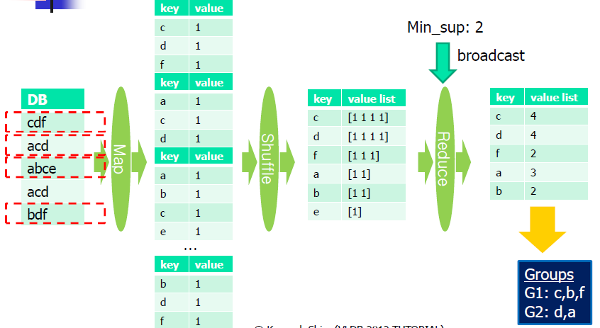
Example : Step 1, Step 2

Slide 19
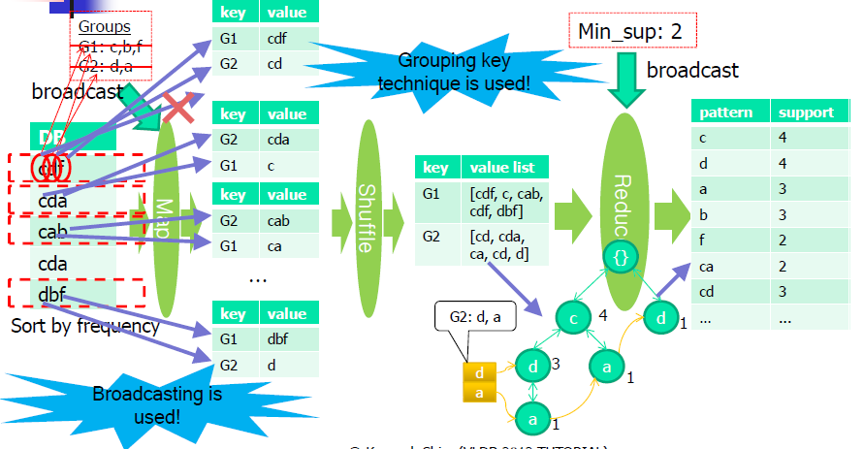
Example : Step 3
G1은 c,b,f로 끝나는 패턴에 대한 그룹

Slide 20
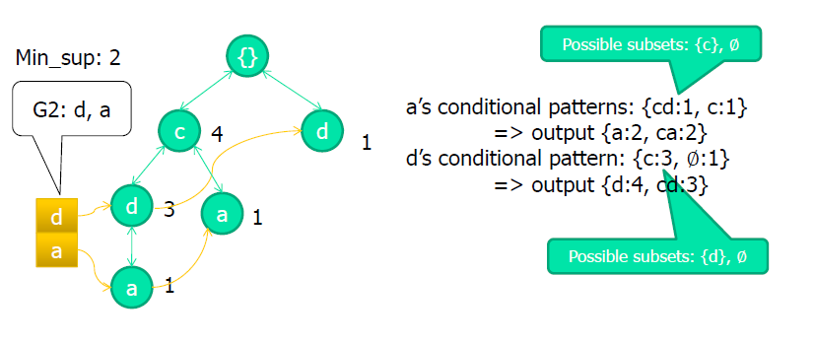
Example : Step 3
FPGrowth

Slide 21
클러스터링이란?
Given:
Data points and number of desired clusters K
Group the data points into K clusters
Data points within clusters are more similar than across clusters
사용 사례
Customer segmentation
Market basket customer analysys

Slide 22
Naïve Clustering Algorithm
Find Global optimal by exhaustively enumerate all partition
Too expensive!!
Thus, approximate algorithms are used
Partitional clustering algorithms
K-Means
EM-Clustering
Hierarchical clustering algorithms
Centroid-based
Group Average
Max distance
Min distance

Slide 23
K-Means Clustering Method
Given k, the k-means algorithm is implemented in four steps:
Partition objects into k nonempty subsets
Compute seed points as the centroids of the clusters of the current partition (the centroid is the center, i.e., mean point, of the cluster)
Assign each object to the cluster with the nearest seed point
Go back to Step 2, stop when no more new assignment

Slide 24
An Example for K-Means Clustering Method
10
10
10
9
9
9
8
8
8
7
7
7
6
6
6
5
5
Update the cluster means
5
4
Assign each objects to most similar center
4
4
3
3
3
2
2
2
1
1
1
0
0
0
0
1
2
3
4
5
6
7
8
9
10
0
1
2
3
4
5
6
7
8
9
10
0
1
2
3
4
5
6
7
8
9
10
Reassign each object
reassign
K=2
Arbitrarily choose K object as initial cluster center
10
10
9
9
8
8
7
7
6
6
5
Update the cluster means
5
4
4
3
3
2
2
1
1
0
0
0
1
2
3
4
5
6
7
8
9
10
0
1
2
3
4
5
6
7
8
9
10

Slide 25
K-Means Clustering Example
(1, 1)
(2, 1)
(1, 2)
(5, 5)
(6, 5)
(5, 6)
(7, 7)
7
6
5
Class A
Class B
(1, 1)
(1, 2)
(5, 5)
(2, 1)
(6, 5)
(5, 6)
(7, 7)
2
1
1
2
5
6
7
Assume we randomly partitioned the objects into 2 nonempty subsets as above!

Slide 26
K-Means Clustering Example
(1, 1)
(2, 1)
(1, 2)
(5, 5)
(6, 5)
(5, 6)
(7, 7)
7
6
5
Class A
Class B
(1, 1)
(1, 2)
(5, 5)
(2, 1)
(6, 5)
(5, 6)
(7, 7)
2
1
Center : (7/3, 8/3)
Center : (20/4, 19/4)
1
2
5
6
7

Slide 27
K-Means Clustering Example
(1, 1)
(2, 1)
(1, 2)
(5, 5)
(6, 5)
(5, 6)
(7, 7)
7
6
5
Class A
Class B
(1, 1)
2
1
Center : (7/3, 8/3)
Center : (20/4, 19/4)
1
2
5
6
7

Slide 28
K-Means Clustering Example
(1, 1)
(2, 1)
(1, 2)
(5, 5)
(6, 5)
(5, 6)
(7, 7)
7
6
5
Class A
Class B
(1, 1)
(2, 1)
2
1
Center : (7/3, 8/3)
Center : (20/4, 19/4)
1
2
5
6
7

Slide 29
K-Means Clustering Example
(1, 1)
(2, 1)
(1, 2)
(5, 5)
(6, 5)
(5, 6)
(7, 7)
7
6
5
Class A
Class B
(1, 1)
(2, 1)
(1, 2)
2
1
Center : (7/3, 8/3)
Center : (20/4, 19/4)
1
2
5
6
7

Slide 30
K-Means Clustering Example
(1, 1)
(2, 1)
(1, 2)
(5, 5)
(6, 5)
(5, 6)
(7, 7)
7
6
5
Class A
Class B
(1, 1)
(2, 1)
(1, 2)
(5, 5)
2
1
Center : (7/3, 8/3)
Center : (20/4, 19/4)
1
2
5
6
7

Slide 31
K-Means Clustering Example
(1, 1)
(2, 1)
(1, 2)
(5, 5)
(6, 5)
(5, 6)
(7, 7)
7
6
5
Class A
Class B
(1, 1)
(2, 1)
(1, 2)
(5, 5)
(6, 5)
2
1
Center : (7/3, 8/3)
Center : (20/4, 19/4)
1
2
5
6
7

Slide 32
K-Means Clustering Example
(1, 1)
(2, 1)
(1, 2)
(5, 5)
(6, 5)
(5, 6)
(7, 7)
7
6
5
Class A
Class B
(1, 1)
(2, 1)
(1, 2)
(5, 5)
(6, 5)
(5, 6)
2
1
Center : (7/3, 8/3)
Center : (20/4, 19/4)
1
2
5
6
7

Slide 33
K-Means Clustering Example
(1, 1)
(2, 1)
(1, 2)
(5, 5)
(6, 5)
(5, 6)
(7, 7)
7
6
5
Class A
Class B
(1, 1)
(2, 1)
(1, 2)
(5, 5)
(6, 5)
(5, 6)
(7, 7)
2
1
Center : (7/3, 8/3)
Center : (20/4, 19/4)
1
2
5
6
7

Slide 34
K-Means Clustering Example
(1, 1)
(2, 1)
(1, 2)
(5, 5)
(6, 5)
(5, 6)
(7, 7)
7
6
5
Class A
Class B
(1, 1)
(2, 1)
(1, 2)
(5, 5)
(6, 5)
(5, 6)
(7, 7)
2
1
1
2
5
6
7

Slide 35
K-Means Clustering Example
(1, 1)
(2, 1)
(1, 2)
(5, 5)
(6, 5)
(5, 6)
(7, 7)
7
6
5
Class A
Class B
(1, 1)
(2, 1)
(1, 2)
(5, 5)
(6, 5)
(5, 6)
(7, 7)
2
1
Center : (4/3, 4/3)
Center : (23/4, 23/4)
1
2
5
6
7
Update the cluster means

Slide 36
K-Means Clustering Example
(1, 1)
(2, 1)
(1, 2)
(5, 5)
(6, 5)
(5, 6)
(7, 7)
7
6
5
Class A
Class B
(1, 1)
2
1
Center : (4/3, 4/3)
Center : (23/4, 23/4)
1
2
5
6
7

Slide 37
K-Means Clustering Example
(1, 1)
(2, 1)
(1, 2)
(5, 5)
(6, 5)
(5, 6)
(7, 7)
7
6
5
Class A
Class B
(1, 1)
(2, 1)
(1, 2)
(5, 5)
(6, 5)
(5, 6)
(7, 7)
2
1
Center : (4/3, 4/3)
Center : (23/4, 23/4)
1
2
5
6
7
No change ⇒ STOP

Slide 38
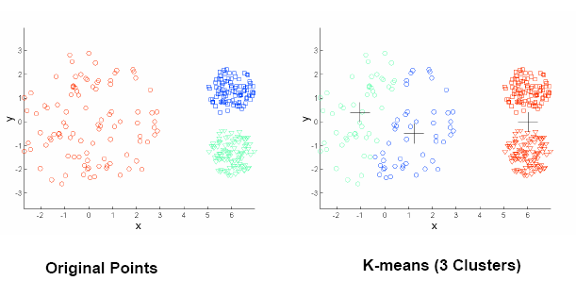
Drawbacks of K-Means
K-Means has problems when clusters are of differing
Sizes
Densities
Non-spherical shapes
Problems with outliers

Slide 39
K-Means using Map/Reduce
Iteratively improves partitions of the data into k clusters
Do
Map
Input is a data point and k centers are broadcasted
Finds the closest center among k centers for the input point
Reduce
Input is one of k centers and all data points having this center as their closest center
Calculates the new center using data points
Until all of new centers are not changed

Slide 40
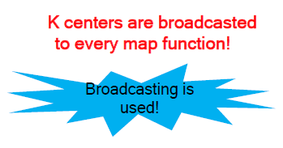
An Illustration of K-Means Clustering: Map
p₁₁
p₂₁
center₁
p₂₂
map
p₁₂
center₂
key value
(center₁, p₁₁)
(center₁, p₁₂)
(center₂, p₂₁)
(center₃, p₃₁)
…
center₃
p₃₁
map
k centers are given as input argument!
…
…
map
find the closest center

Slide 41
Reduce
Reduce
key value
(center₁, [p₁₁, p₁₂])
(center₂, [p₂₁, p₂₂, p₂₃])
(center₃, [p₃₁,…,])
…
key value
(center₁, center₁’)
(center₂, center₂’)
…
(center_{k}, center_{k}’ )
Reduce
…
Reduce
calculate new center

Slide 42
K-Means for Large Dataset
New centers are not converged well
Alternative terminating condition is needed
Iteratively execute map/reduce procedure until |E_{cur}-E_{prev}| ≤ ε
E_{cur}: sum of squared distance in the current step
E_{prev}: sum of squared distance in the previous step

Slide 43
Map/Reduce
Broadcast
: center[1…k]
closest center from p
p
Map
< c_{i}, (p, d) >
squared distance between c_{i} and p
Reduce
< c_{i}, (∑p)/n) >
< c_{i}, ((p, d)₁ …(p, d)_{n}) >
< “SSD”, ∑d >

Slide 44
Hierarchical Approach
Given k, the hierarchical algorithm is implemented in four steps:
Say "Every point is it's own cluster"
Find “most similar” pair of clusters
Merge it into a parent cluster
Repeat…until you've merged the whole dataset into k clusters

Slide 45
An Example of Centroid-based Clustering Algorithm
(1, 1)
(2, 1)
(1, 2)
(5, 5)
(6, 5)
(5, 6)
(7, 7)
7
6
5
2
1
closest
1
2
5
6
7

Slide 46
An Example of Centroid-based Clustering Algorithm
(1, 1)
(2, 1)
(1, 2)
(5, 5)
(6, 5)
(5, 6)
(7, 7)
7
6
5
Center : (3/2, 1)
2
1
1
2
5
6
7

Slide 47
An Example of Centroid-based Clustering Algorithm
(1, 1)
(2, 1)
(1, 2)
(5, 5)
(6, 5)
(5, 6)
(7, 7)
7
6
5
Center : (3/2, 1)
closest
2
1
1
2
5
6
7

Slide 48
An Example of Centroid-based Clustering Algorithm
(1, 1)
(2, 1)
(1, 2)
(5, 5)
(6, 5)
(5, 6)
(7, 7)
7
6
Center : (3/2, 1)
Center : (11/2, 5)
5
2
1
1
2
5
6
7

Slide 49
An Example of Centroid-based Clustering Algorithm
(1, 1)
(2, 1)
(1, 2)
(5, 5)
(6, 5)
(5, 6)
(7, 7)
7
6
Center : (3/2, 1)
Center : (11/2, 5)
5
closest
2
1
1
2
5
6
7

Slide 50
An Example of Centroid-based Clustering Algorithm
(1, 1)
(2, 1)
(1, 2)
(5, 5)
(6, 5)
(5, 6)
(7, 7)
7
6
Center : (4/3, 4/3)
Center : (11/2, 5)
5
2
1
1
2
5
6
7

Slide 51
An Example of Centroid-based Clustering Algorithm
closest
(1, 1)
(2, 1)
(1, 2)
(5, 5)
(6, 5)
(5, 6)
(7, 7)
7
6
Center : (4/3, 4/3)
Center : (11/2, 5)
5
2
1
1
2
5
6
7

Slide 52
An Example of Centroid-based Clustering Algorithm
(1, 1)
(2, 1)
(1, 2)
(5, 5)
(6, 5)
(5, 6)
(7, 7)
7
6
Center : (4/3, 4/3)
Center : (16/3, 16/3)
5
2
1
1
2
5
6
7

Slide 53
An Example of Centroid-based Clustering Algorithm
closest
(1, 1)
(2, 1)
(1, 2)
(5, 5)
(6, 5)
(5, 6)
(7, 7)
7
6
Center : (4/3, 4/3)
Center : (16/3, 16/3)
5
2
1
1
2
5
6
7

Slide 54
An Example of Centroid-based Clustering Algorithm
(1, 1)
(2, 1)
(1, 2)
(5, 5)
(6, 5)
(5, 6)
(7, 7)
7
6
Center : (4/3, 4/3)
Center : (23/4, 23/4)
5
2
1
1
2
5
6
7

Slide 55
An Example of Centroid-based Clustering Algorithm
(1, 1)
(2, 1)
(1, 2)
(5, 5)
(6, 5)
(5, 6)
(7, 7)
7
6
5
Class A
Class B
(1, 1)
(2, 1)
(1, 2)
(5, 5)
(6, 5)
(5, 6)
(7, 7)
2
1
1
2
5
6
7

Slide 56
Hierarchical Clustering using Map/Reduce
Do
1st step map/reduce
Find the closest pair of clusters
2nd step map/reduce
Merge the closest pair of clusters
Until k clusters remain

