Slide 1
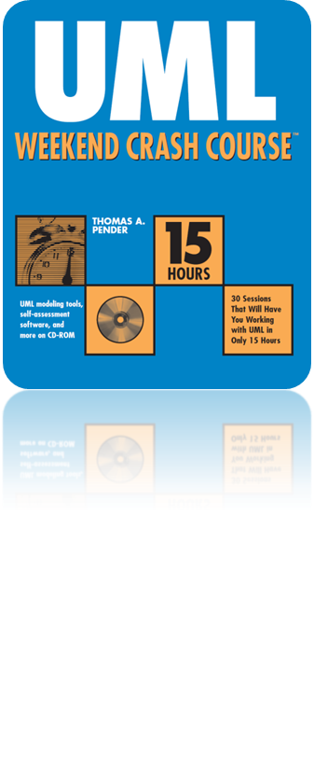
Session 28
Analysis and Architectural
Design of a Web Application
Written by Thomas A. Pender
Published by Wiley Publishing, Inc.
November 2, 2011
Presented by Hyewon Kim

Slide 2
Contents
The Friendly Reminder Case Study
Requirements Gathering
Architectural Design
MVC pattern in the case study

Slide 3

The Friendly Reminder Case Study
Friendly Reminder
Enter contact data such as names, phone numbers, and addresses.
Enter appointment data such as date, time, and description.
Associate contacts with appointments.
Search for specific contacts or appointments.
Receive notification when an appointment is approaching.
+ Network component
Upload all their appointments and contacts
to a server where they can be remotely accessed
Query those appointments and contacts
whenever and from wherever they wish

Slide 4
Requirements Gathering (1/3)
Process of communication with the client
to discover and document the business requirements
to ensure that the development team knows what it must create in order for the customer to be successful
Availability
and reliability
Performance
Adaptability
Scalability
Security

Slide 5
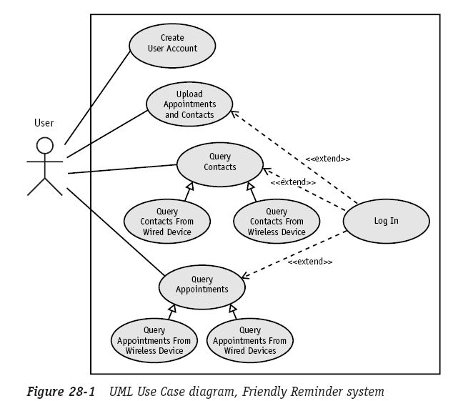
Requirements Gathering (2/3)
Creating the Use Case diagram
The Use Case model helps you to better understand who will use your system and what features they will use
Use case narratives,
Activity diagrams,
Use case scenarios....

Slide 6
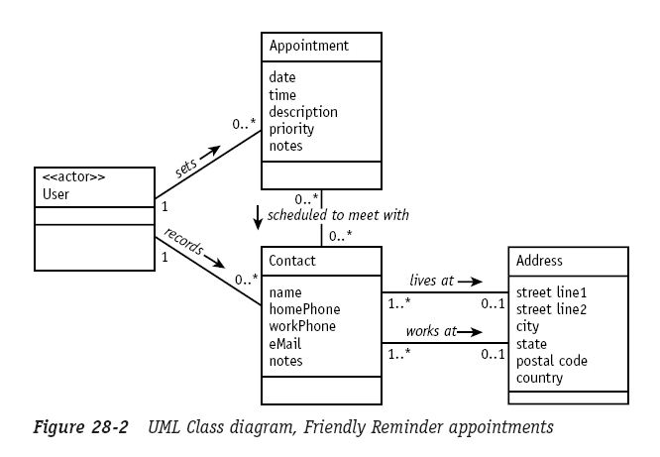
Requirements Gathering (3/3)
Analysis
You expand your understanding of the business problem using a Class diagram

Slide 7
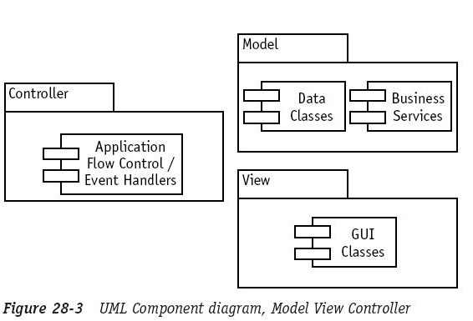
Architectural Design (1/2)
How to utilize the Web and non-Web technologies to meet the customer’s requirements
Model View Controller
  Model
  View
  Controller
It allows you
to more easily change one aspect of the system without affecting the other aspects!

Slide 8
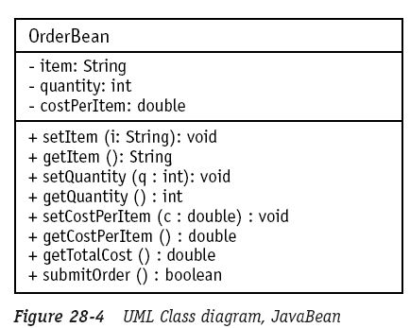
Architectural Design (2/2)
Separate the model from the view
Java Beans
  A regular Java class with private attributes and public get/set methods for accessing the attributes
JSP
JSP
Java
A lot of
Java code!
Method call
Java Syntax
<% order.setItem
(“UML Weekend Crash Course”); %>
JSP Tag Syntax
<jsp:setProperty name=”order”
property=”item”
value=”UML Weekend Crash Course”/>

Slide 9
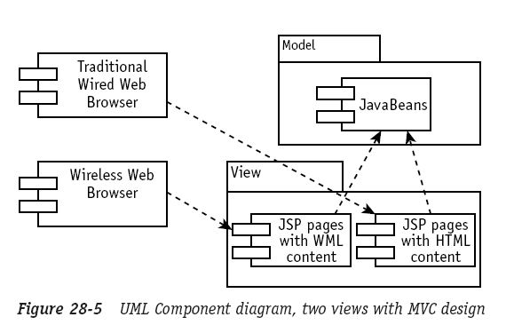
MVC pattern in the case study (1/2)
Query those appointments and contacts whenever and from wherever they wish

Slide 10
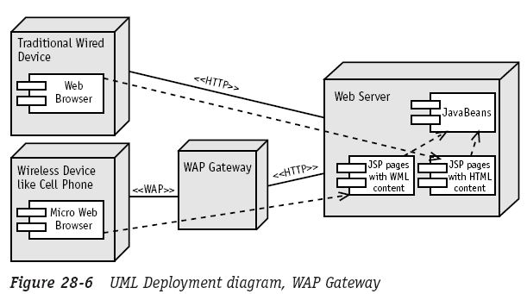
MVC pattern in the case study (2/2)
Query those appointments and contacts whenever and from wherever they wish

Slide 11
The End

