Slide 1
Scalable Semantic Web Data Management Using Vertical Partitioning
Daniel J. Abadi, Adam Marcus, Samuel R. Madden, Kate Hollenbach
VLDB, 2007
Oct 15, 2014
Kyung-Bin Lim

Slide 2
Outline
Introduction
Methodology
Experiments
Conclusion

Slide 3
RDF Triples
Semantic breakdown
“Rick Hull wrote Foundations of Databases.”
Representation
Graph
Statement
<“Foundations of Databases”, hasAuthor, “Rick Hull”>
XML format
hasAuthor
Foundations of Databases
Rick Hull
<rdf:RDF xmlns:rdf="http://www.w3.org/1999/02/22-rdf-syntax-ns#">
<rdf:Description rdf:about="Foundations of Databases>
<hasAuthor>Rick Hull</hasAuthor>
</rdf:Description>
</rdf:RDF>

Slide 4
Example RDF Graph
title
XYZ
MNO
title
ID1
author
language
ID3
Fox, Joe
English
copyright
type
2001
type
type
ID6
BookType
copyright
2004
DVDType
ABC
type
title
artist
ID4
Orr, Tim
title
ID2
copyright
DEF
1985
language
1985
French
copyright
type
GHI
title
CDType
type
ID5

Slide 5
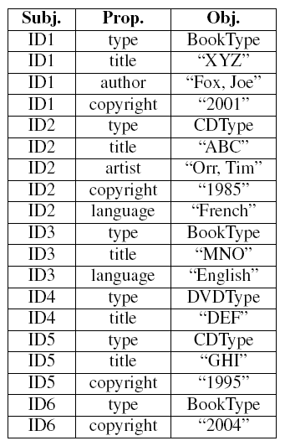
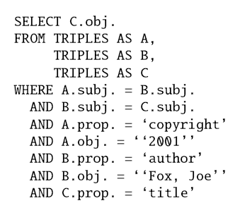
Triples Storage - Problem
Many triples
3 column schema
Performance: Self-joins
One massive triples table
Queries require many self-joins
SELECT ?title
FROM table
WHERE { ?book author “Fox, Joe”
?book copyright “2001”
?book title ?title }

Slide 6
Goal
Achieve scalability & performance in triple storage
Survey approaches in RDBMS
Benefits of vertical partition and column store

Slide 7
Current State of the Art
Majority use RDBMs
Multi-layered architecture
Querying: SPARQL converted to SQL
SPARQL query
RDF layer
RDF in XML/Graph
SQL query
Result Set
RDBM
SELECT C.obj
FROM TRIPLES AS A, TRIPLES AS B, TRIPLES AS C
WHERE A.subj = B.subj AND
B.subj = C.subj AND
A.prop = ‘copyright’ AND
A.obj = “2001” AND
B.prop = ‘author’ AND
B.obj = “Fox, Joe” AND
C.prop = ‘title’
SELECT ?title
FROM table
WHERE { ?book author “Fox, Joe”
?book copyright “2001”
?book title ?title }

Slide 8
Outline
Introduction
Methodology
Experiments
Conclusion

Slide 9
Improving RDF data organization
Method 1 – Property Table
Method 2 – Vertically Partitioned Table

Slide 10
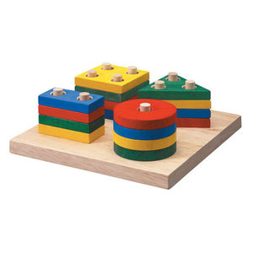
Property Table Technique
Goal: speed up queries over triple-stores
Idea: cluster triples containing properties defined over similar subjects
Example: “title”, “author”, “copyright”
Books, journals, CDs, etc.
Reduces number of self-joins

Slide 11
RDF Physical Organization
Property tables
Clustered property table
Denormalize RDF (wider tables)
Clustering algorithm
NULL values

Slide 12
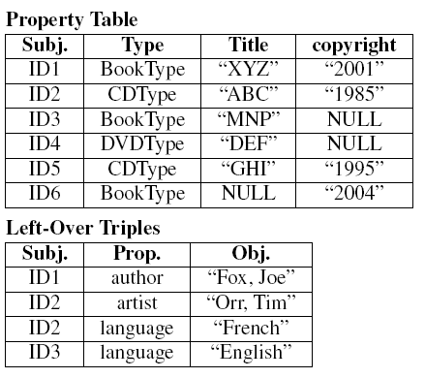
Clustered Property Tables

Slide 13
RDF Physical Organization
Property tables
Property-Class Tables
Exploit the type property
Properties may exist in multiple tables

Slide 14
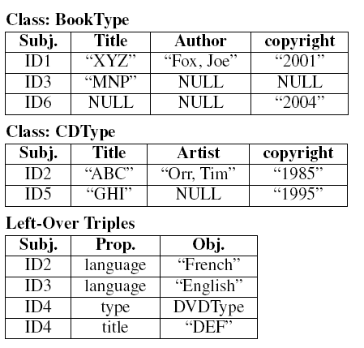
Property-Class Tables

Slide 15
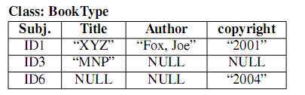
Property Tables: Issues
NULLs
Multi-valued attributes
Proliferation of unions and joins
hasAuthor
Rick Hull
Foundations of Databases
hasAuthor
John Green

Slide 16
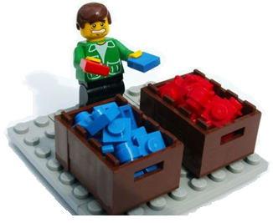
Property Tables Summary
The Good
Reduce subject-subject self-joins
The Bad
Sluggish on cross-table joins
How do we cluster property tables?

Slide 17
Vertically Partitioned Approach
Goal: speed up queries over triples-store
Idea: one table per property
Column 1: Subjects
Column 2: Objects
Table sorted by subject

Slide 18
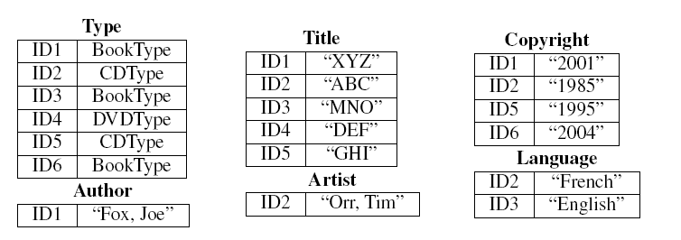
Vertically Partitioned Approach

Slide 19


Vertically Partitioned Approach: Advantages
Support for multi-valued attributes
Support for heterogeneous records

Slide 20
Vertically Partitioned Approach: Advantages
Access requested properties only
No need for clustering algorithms
Less is more: fewer and faster joins

Slide 21
Vertically Partitioned Approach: Disadvantages
More joins than property tables
Multi-property queries – merge joins
Slower insertions into tables
Multiple-table access for same-subject statements
Solution: batch insertions
Standard DBMSs not optimal for this approach

Slide 22
Column-Oriented DBMS
+ Only relevant columns are retrieved
- Slower insertions
Advantages for Vertical Partitioning:
Separate tuple metadata
35 bytes in Postgres vs. 8 bytes in C-Store
Fixed-length tuples
Column-oriented data compression
Run-length encoding (ex. 1,1,1,2,2 → 1x3, 2x2)
Optimized merge code

Slide 23
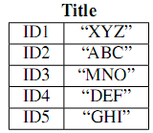
DB Orientation: Column vs Row
Row-Oriented DBMS
Column-Oriented
DBMS Memory File
ID1, “XYZ”
ID2, “ABC”
ID3, “MNO”
ID4, “DEF”
ID5, “GHI”
…
DBMS Memory File
ID1, ID2, ID3, ID4, ID5 “XYZ”, “ABC”, “MNO”, “DEF”, “GHI”
…

Slide 24
Outline
Introduction
Methodology
Experiments
Conclusion

Slide 25
Benchmark: Dataset
Barton Libraries
50 million triples
77% multi-valued
221 unique properties
37% multi-valued
Good representation of Semantic Web data
RDF/XML converted into triples

Slide 26
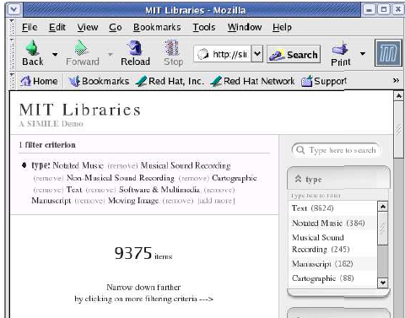
Benchmark: Longwell
GUI for exploring RDF data
User applies filters to property panels
Shows list of currently filtered resources(RDF subjects) in main portion of the screen and a list of filters in panels along the side
Longwell-style queries provide realistic benchmark for testing
7 queries were chosen
Each query represents typical browsing session
Exercises on query diversity

Slide 27
System specifications
System data
- 3.0 GHz Pentium IV
- RedHat Linux
28 properties are selected over which queries will be run
PostgreSQL Database
- Triple-store schema, property table and vertically partitioned schema
C-Store : vertically partitioned schema

Slide 28
Evaluation: Schema Implementations
Performance comparison of all 3 schemas
Triple Store
Property Table Store
Vertically Partitioned Store
Row-oriented (Postgres)
Column-oriented (C-Store)

Slide 29
Evaluation: Size Matters
Memory usage per implementation
Triple Store
- 8.3 GBytes
Property Table store
- 14 GBytes
Vertically Partitioned Store (Postgres)
- 5.2 GBytes
Vertically Partitioned Store (C-Store)
- 2.7 GBytes

Slide 30
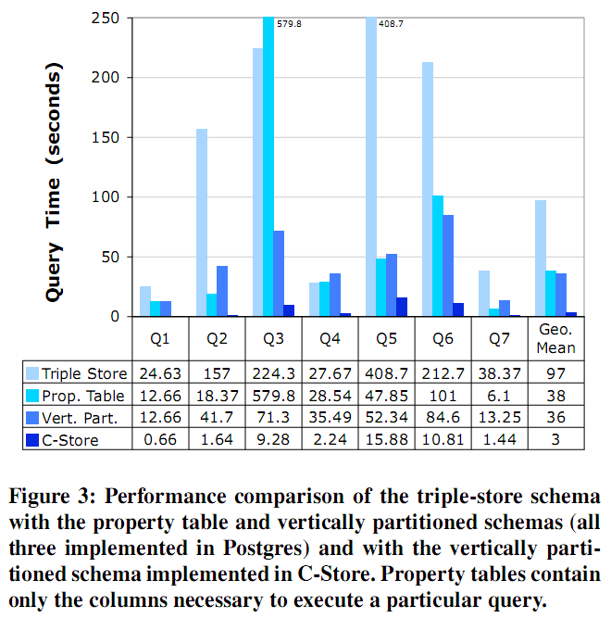
Results

Slide 31
Scalability
How does performance scale with size of data?
Increased number of triples from 1 million to 50 million.

Slide 32
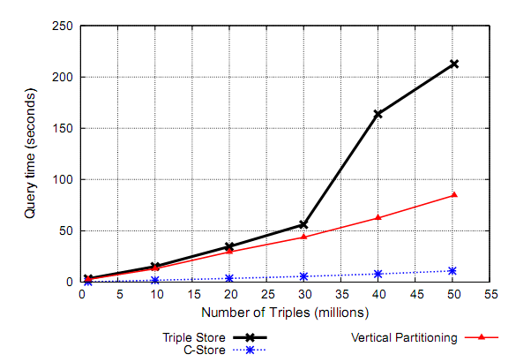
Results: Scalability
Vertical partitioning schemes scale linearly
Triple-store scales super-linearly
Prevalent sorting operations

Slide 33
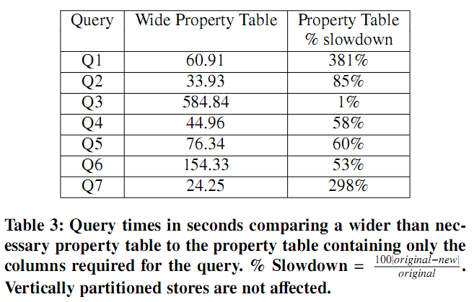
Results: Further Widening

Slide 34
Outline
Introduction
Methodology
Experiments
Conclusion

Slide 35
Summary
Semantic Web users require fast responses to queries
Current triple-stores just don’t cut it
Can’t stand up to sluggish self-joins
Property tables are good, but have their limitations
Vertical partitioning takes the cake
Competes with optimal performance of property table solution
Step toward an interactive-time Semantic Web

