Slide 1
Resilient Distributed Datasets: A Fault-Tolerant Abstraction for In-Memory Cluster Computing
Matei Zaharia, Mosharaf Chowdhury, Tathagata Das, et al.
NSDI 2012
Dongjun Lee
27 May 2016

Slide 2
Introduction
Cluster computing frameworks before Spark
MapReduce(Google), Dyrad(Microsoft)
Use disk for data processing
Lack abstractions for leveraging distributed memory
inefficient to reuse intermediate results
inefficient for iterative algorithms
Pregel, HaLoop
only support specific computation patterns
Need For In-memory cluster computing framework
Each node’s memory has become bigger and bigger

Slide 3
Resilient Distributed Datasets (RDDs)
RDD
An abstraction for data residing in memory
Read-only(immutable) & partitioned collection of records
Can only be created through operations on either
data in stable storage
other RDDs
Two types of RDD operations
1. Transformation – making another RDD
2. Action – making a result output
Lazy Execution
- Optimized schedule would be executed at Action operation
Notes:
storage -> RDD or RDD -> RDD
transformation -> transformation -> .. -> transformation -> action
transformation 단계에서는 RAM에 load 되지 않음.

Slide 4

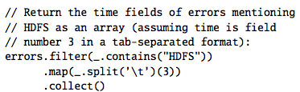
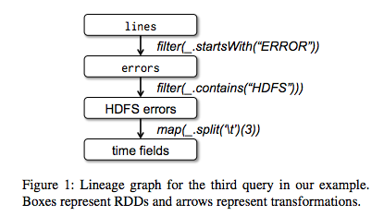
Resilient Distributed Datasets (RDDs)
Spark Programming Interface
Notes:
Line 1 defines an RDD backed by an HDFS file.
Line 3 asks for errors to persist in memory so that it can be shared across queries.

Slide 5
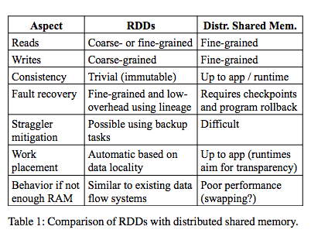
Resilient Distributed Datasets (RDDs)
Advantages of the RDD Model
More efficient fault tolerance
can be recovered using lineage
Let system mitigate stragglers by running backup copies of slow tasks
Runtime can schedule tasks based on data locality to improve performance

Slide 6
Fault Tolerance
RDD Lineage
A graph for ensuring fault-tolerance
Tracks how and from which each RDD is transformed
Coarse-grained operation
Data is processed in the unit of each RDD, not the data inside the RDD
More efficient for recovering
A lot less things to log
Shorter recovery process
Checkpoint
For iterative jobs, lineages could be very long
Checkpointing allows RDDs to be stored in stable storage
Proper checkpointing can reduce the recovering cost

Slide 7
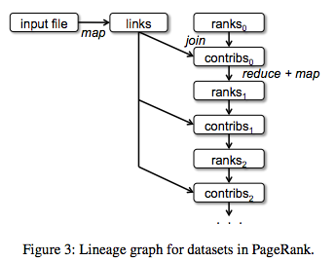
Fault Tolerance
Fault Tolerance
Lineage
Checkpoint

Slide 8
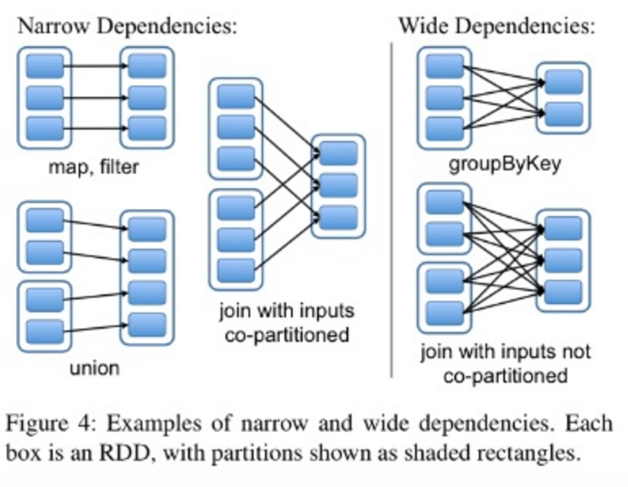
Implementation
Dependencies between RDDs
Narrow Dependency
Each partition of the parent RDD is used by at most one partition of the child RDD
Allow pipelined execution on one cluster node
Easy fault recovery
Wide Dependency
Multiple child partitions may depend on it
Require data from all parent partitions to be available and to be shuffled across the nodes
A single failed node might cause a complete re-execution
Notes:
narrow dependency : 해당 작업이 한 노드에서 돌 수 있다. 가지고 있는 파티션이 부셔져도, 해당 노드에서 다 복구 가능하다.
wide dependency : shuffle이 일어나야 하는 애들. network 타야됨. 부셔지면 계산비용 비쌈.(그래서 이런애들은 checkpointing 해주는게 좋을 수 있다.)

Slide 9
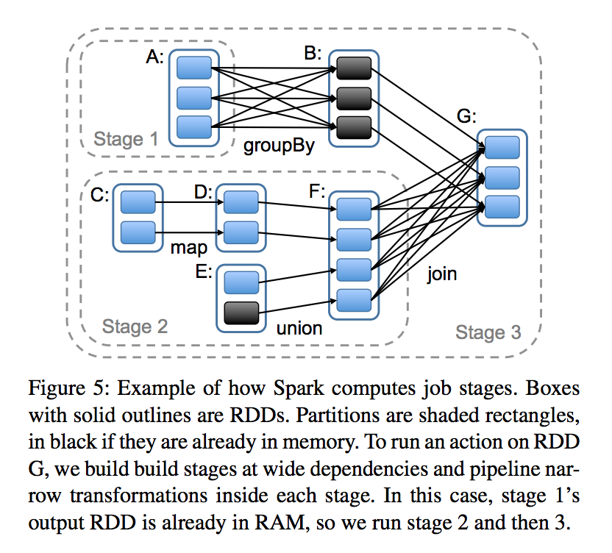
Implementation
Job Scheduling
To execute an action on an RDD
Scheduler examines the job’s lineage to make a stage
Stage is a unit of a task which can be executed once
Each stage contains as many pipelined transformations with narrow dependencies as possible
Notes:
DAG (directed acyclic graph)
Stage Boundaries
Shuffle operations with wide dependencies
Already computed result

Slide 10
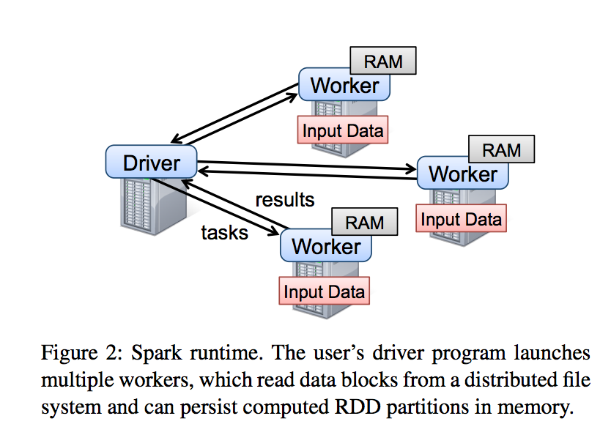
Implementation
Spark Runtime Structure
Notes:
Data is partitioned and distributed on many machines.
Driver에서 내려온 transformation들이 각 partition마다 수행됨.

Slide 11
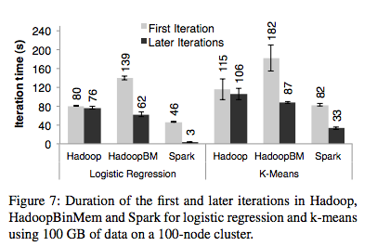
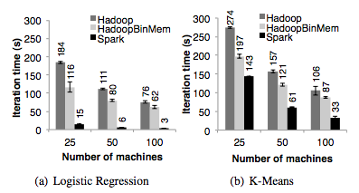
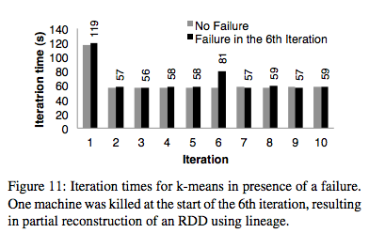
Evaluation
Iterative Machine Learning Applications
Fault Recovery
Notes:
10 iterations of k-means on a 75 node cluster
a node fails at the start of the 6th iteration
<vs checkpoint-based recovery>
checkpoint-based mechanism, recovery would likely require rerunning at least several iterations.
system would need to replicate the application’s working set. Lineage graphs for RDDs were less than 10KB size.

Slide 12
Conclusion
RDDs
Efficient
General-purpose
can express a wide range of parallel applications including iterative
Fault-tolerant abstraction
Existing storage abstraction for clusters require data replication
RDDs offer API based on coarse-grained transformations
recover data efficiently using lineage
Performance
RDD is implemented on system Spark
Spark outperforms Hadoop by up to 20x in iterative applications
Can be used interactively to query hundreds of gigabytes of data

