Slide 1
O’Reilly – Hadoop: The Definitive Guide Ch.5 Developing a MapReduce Application
2 July 2010
Taewhi Lee

Slide 2
Outline
The Configuration API
Configuring the Development Environment
Writing a Unit Test
Running Locally on Test Data
Running on a Cluster
Tuning a Job
MapReduce Workflows

Slide 3
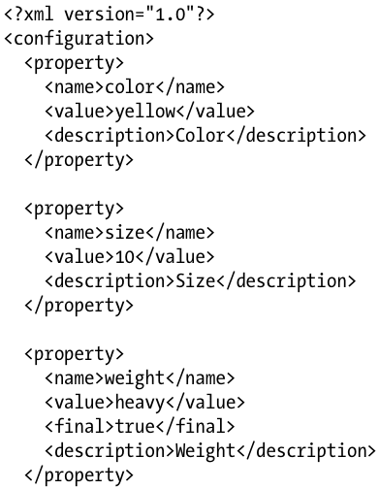

The Configuration API
org.apache.hadoop.conf.Configuration class
Reads the properties from resources (XML configuration files)
Name
String
Value
Java primitives
boolean, int, long, float, …
Other useful types
String, Class, java.io.File, …
configuration-1.xml

Slide 4
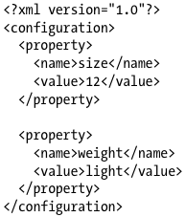

Combining Resources
Properties are overridden by later definitions
Properties that are marked as final cannot be overridden
This is used to separate out the default properties from the site-specific overrides
configuration-2.xml

Slide 5


Variable Expansion
Properties can be defined in terms of other properties

Slide 6
Outline
The Configuration API
Configuring the Development Environment
Writing a Unit Test
Running Locally on Test Data
Running on a Cluster
Tuning a Job
MapReduce Workflows

Slide 7
Configuring the Development Environment
Development environment
Download & unpack the version of Hadoop in your machine
Add all the JAR files in Hadoop root & lib directory to the classpath
Hadoop cluster
To specify which configuration file you are using
 | Local | Pseudo-distributed | Distributed
fs.default.name | file:/// | hdfs://localhost/ | hdfs://namenode/
mapred.job.tracker | local | localhost:8021 | jobtracker:8021

Slide 8
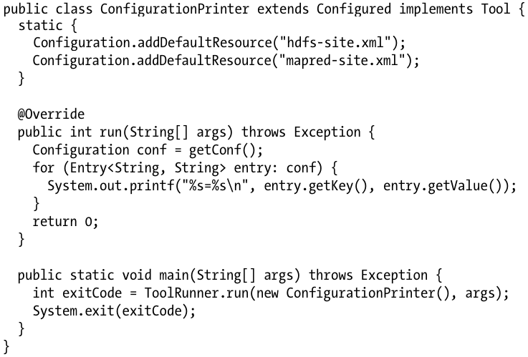
Running Jobs from the Command Line
Tool, ToolRunner
Provides a convenient way to run jobs
Uses GenericOptionsParser class internally
Interprets common Hadoop command-line options & sets them on a Configuration object

Slide 9

GenericOptionParser & ToolRunner Options
To specify configuration files
To set individual properties

Slide 10
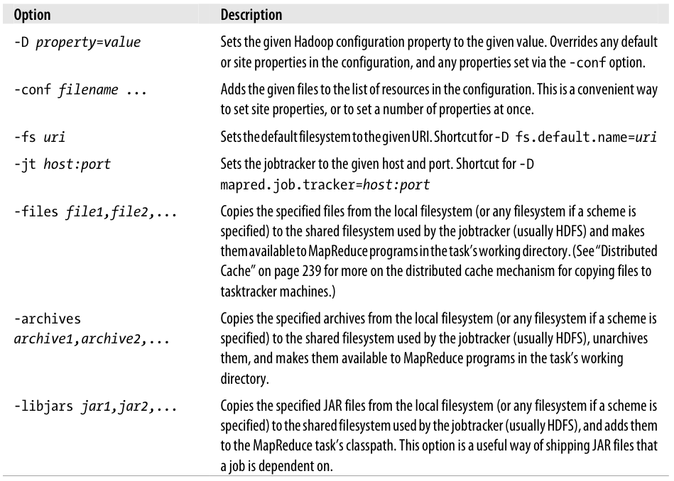
GenericOptionParser & ToolRunner Options

Slide 11
Outline
The Configuration API
Configuring the Development Environment
Writing a Unit Test
Running Locally on Test Data
Running on a Cluster
Tuning a Job
MapReduce Workflows

Slide 12
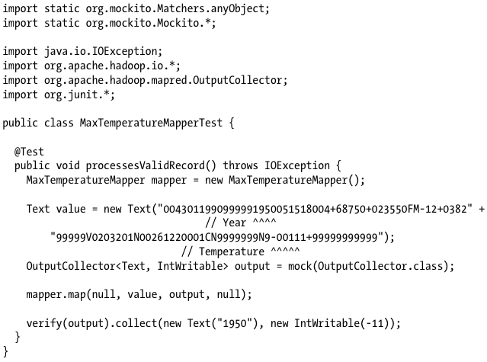
Writing a Unit Test – Mapper (1/4)
Unit test for MaxTemperatureMapper

Slide 13
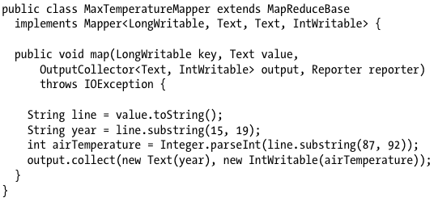
Writing a Unit Test – Mapper (2/4)
Mapper that passes MaxTemperatureMapperTest

Slide 14
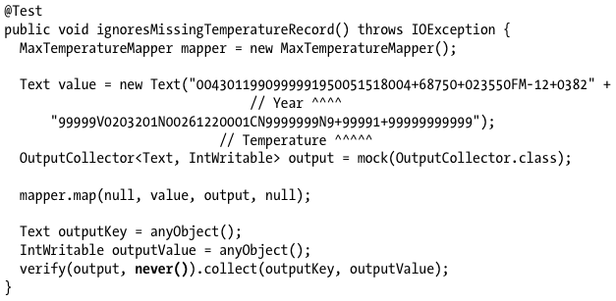
Writing a Unit Test – Mapper (3/4)
Test for missing value

Slide 15
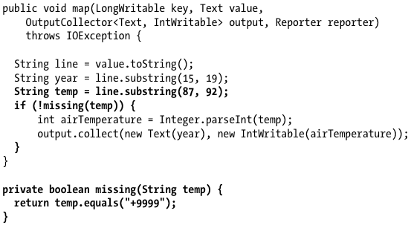
Writing a Unit Test – Mapper (4/4)
Mapper that handles missing value

Slide 16
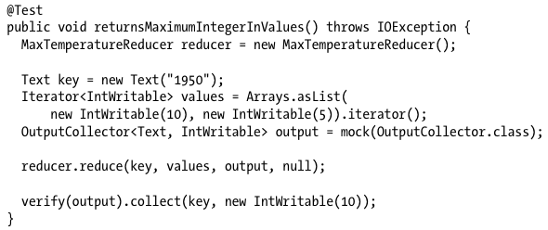
Writing a Unit Test – Reducer (1/2)
Unit test for MaxTemperatureReducer

Slide 17
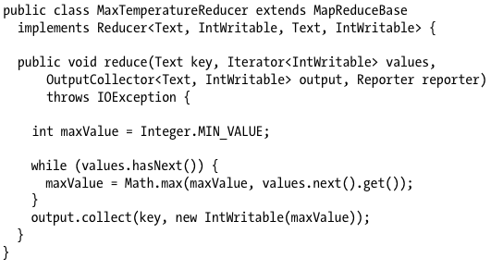
Writing a Unit Test – Reducer (2/2)
Reducer that passes MaxTemperatureReducerTest

Slide 18
Outline
The Configuration API
Configuring the Development Environment
Writing a Unit Test
Running Locally on Test Data
Running on a Cluster
Tuning a Job
MapReduce Workflows

Slide 19
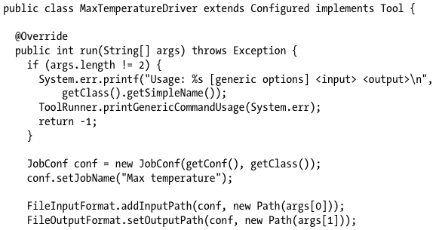
Running a Job in a Local Job Runner (1/2)
Driver to run our job for finding the maximum temperature by year

Slide 20
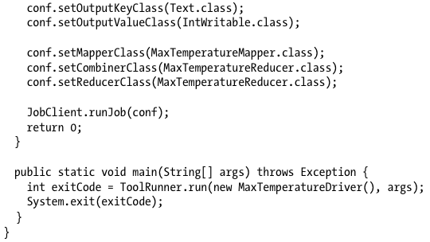
Running a Job in a Local Job Runner (2/2)
To run in a local job runner
or
➔

Slide 21
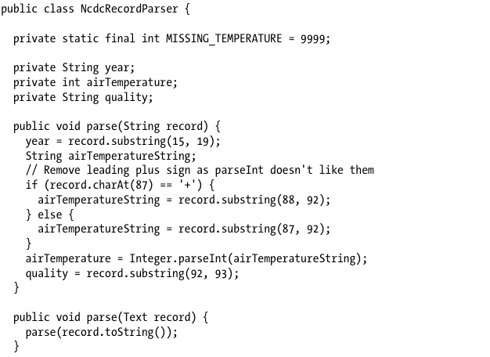
Fixing the Mapper
A class for parsing weather records in NCDC format

Slide 22
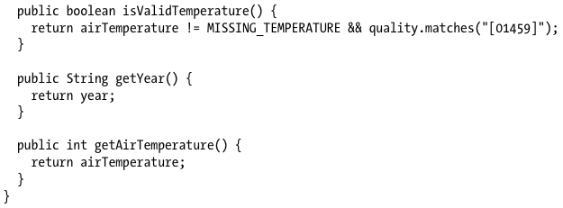
Fixing the Mapper

Slide 23
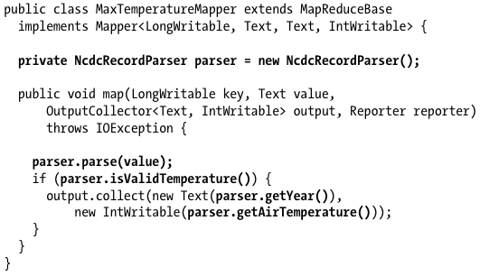
Fixing the Mapper
Mapper that uses a utility class to parse records

Slide 24
Testing the Driver
Two approaches
To use the local job runner & run the job against a test file on the local filesystem
To run the driver using a “mini-” cluster
MiniDFSCluster, MiniMRCluster class
Creates in-process cluster for testing against the full HDFS and MapReduce machinery
ClusterMapReduceTestCase
A useful base for writing a test
Handles the details of starting and stopping the in-process HDFS and MapReduce clusters in its setUp() and tearDown() methods
Generates a suitable JobConf object that is configured to work with the clusters

Slide 25
Outline
The Configuration API
Configuring the Development Environment
Writing a Unit Test
Running Locally on Test Data
Running on a Cluster
Tuning a Job
MapReduce Workflows

Slide 26
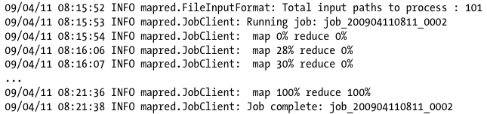
Running on a Cluster
Packaging
Package the program as a JAR file to send to the cluster
Use Ant for convienience
Launching a job
Run the driver with the -conf option to specify the cluster

Slide 27
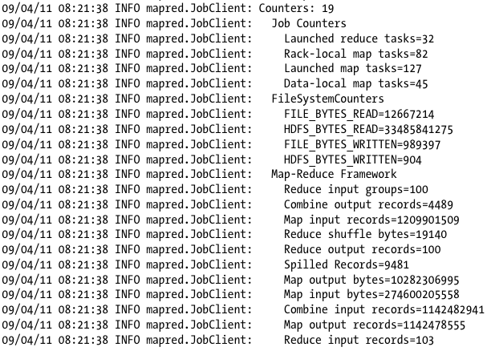
Running on a Cluster
The output includes more useful information

Slide 28
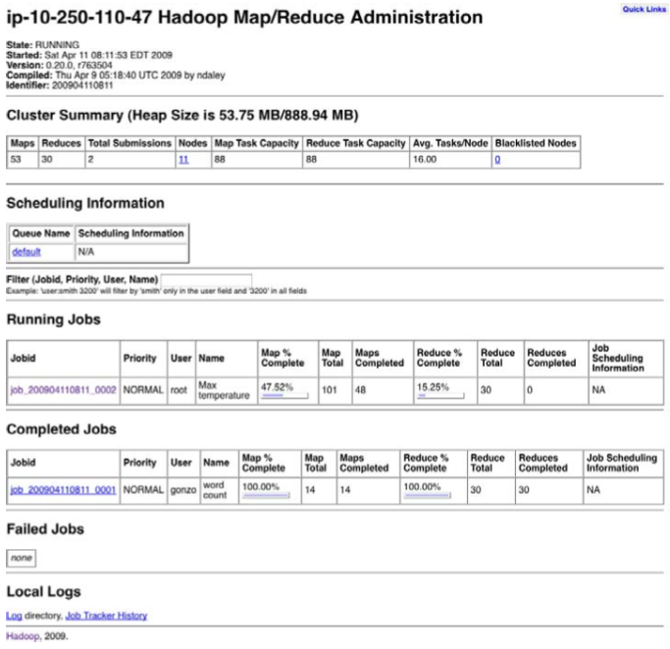
The MapReduce Web UI
Useful for finding job’s progress, statistics, and logs
The Jobtracker page (http://jobtracker-host:50030)

Slide 29
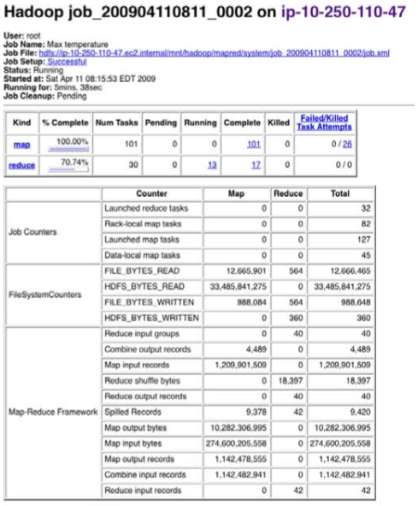
The MapReduce Web UI
The Job page

Slide 30
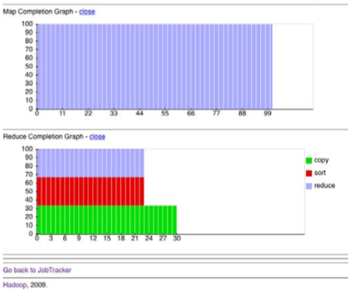
The MapReduce Web UI
The Job page

Slide 31
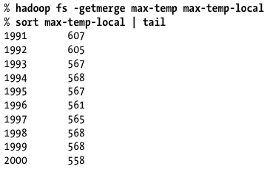
Retrieving the Results
Each reducer produces one output file
e.g., part-00000 … part-00029
Retrieving the results
Copy the results from HDFS to the local machine
-getmerge option is useful
Use -cat option to print the output files to the console

Slide 32
Debugging a Job
Via print statements
Difficult to examine the output which may be scattered across the nodes
Using Hadoop features
Task’s status message
To prompt us to look in the error log
Custom counter
To count the total # of records with implausible data
If the amount of log data is large,
Write the information to the map’s output rather than to standard error for analysis and aggregation by the reduce
Write the program to analyze the logs

Slide 33
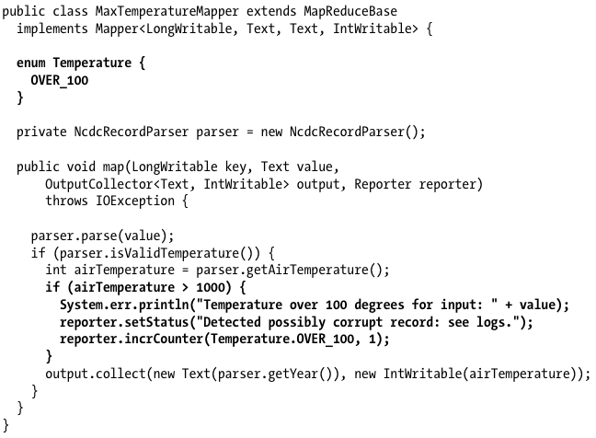
Debugging a Job

Slide 34
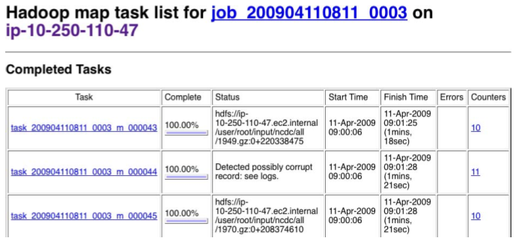
Debugging a Job
The tasks page

Slide 35
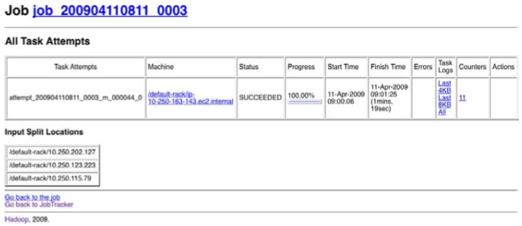
Debugging a Job
The task details page

Slide 36
Using a Remote Debugger
Hard to set up our debugger when running the job on a cluster
We don’t know which node is going to process which part of the input
Capture & replay debugging
Keep all the intermediate data generated during the job run
Set the configuration property keep.failed.task.files to true
Rerun the failing task in isolation with a debugger attached
Run a special task runner called IsolationRunner with the retained files as input

Slide 37
Outline
The Configuration API
Configuring the Development Environment
Writing a Unit Test
Running Locally on Test Data
Running on a Cluster
Tuning a Job
MapReduce Workflows

Slide 38
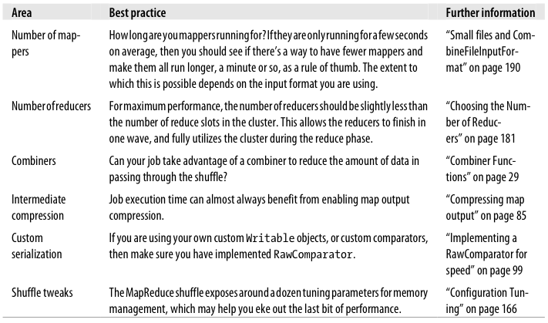
Tuning a Job
Tuning checklist
Profiling & optimizing at task level

Slide 39
Outline
The Configuration API
Configuring the Development Environment
Writing a Unit Test
Running Locally on Test Data
Running on a Cluster
Tuning a Job
MapReduce Workflows

Slide 40
MapReduce Workflows
Decomposing a problem into MapReduce jobs
Think about adding more jobs, rather than adding complexity to jobs
For more complex problems, consider a higher-level language than MapReduce (e.g., Pig, Hive, Cascading)
Running dependent jobs
Linear chain of jobs
Run each job one after another
DAG of jobs
Use org.apache.hadoop.mapred.jobcontrol package
JobControl class
Represents a graph of jobs to be run
Runs the jobs in dependency order defined by user

