Slide 1
Intrusion Detection in RBAC-administered Database
Elisa Bertino, Ashish Kamra,
Evimaria Terzi and Athena Vakali
Purdue University, USA
ACSAC, 2005
Presented by Jae-Min Ahn
IDB SNU, KOREA
Notes:
이 논문은 처음에 딱 제목을 보고 security 에 대한 논문인 줄 알았는데 ,
로그 파일로 profile을 만다는 측면에서 잘 모르지만 data mining 쪽 이 아닌가 생각해봅니다.
이 논문은 ACSAC이라는 컴퍼런스에 실린 논문으로
같은 필자가 작성한 이 다음 버전이 VLDB에 실렸습니다.
원래 그것을 하려고 했으나, 2005년에 나온 이것이 베이스가 되는 논문이기에 이것부터 발표를 하고
호응이 좋으면 다음에 발표를 해볼 생각입니다

Slide 2
Contents
Introduction
Preliminaries
Classifier
Experimental evaluation
Conclusions
Appendix

Slide 3
Introduction
RBAC(Role Based Access Control)
  Permissions are associated with roles
  Grouping several users rather than single user
Role intruder
  Individuals that while holding a specific role
  Have a behavior different form the normal behavior of the role

Slide 4
Introduction
Intrusion Detection (ID) system
  able to detect anomalous behavior
  but there is few ID mechanism
  this paper propose to ID is based on mining database traces stored in log files
motivation
  malicious for the network or the OS
  ID systems designed for networks and operating
  systems are not adequate to protect databases against
  insider threats

Slide 5
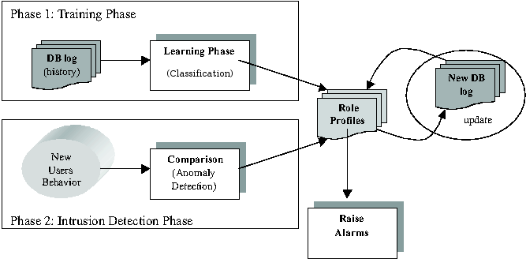
Introduction
Overview of the ID process

Slide 6
Preliminaries
SQL language
  SELECT [DISTINCT] {TARGET-LIST}
  FROM {RELATION-LIST}
In order to build profiles, we need to transform the log file entries into a format that can be processed and analyzed.
Therefore, we represent each entry by a data basic unit that contains three fields, and thus it is called triplet

Slide 7

Preliminaries
  triplets - T(c,R,A)
  basic unit for viewing the log files and are the basic components for forming user and role profiles,
  consists of three fields (SQL Command, Relation Information, Attribute Information)
  c : command
  R : relation information
  A : attribute information
Notes:
Triplet이라는 용어를 다들 아시나요? 저는 이 단어을 이 논문을 보다가 처음 봐서 뇌이버에 물어봤었습니다.
그랬더니 제일 첫 줄에 나오는 것이 셋잇단음표라는 것이었습니다.
.

Slide 8
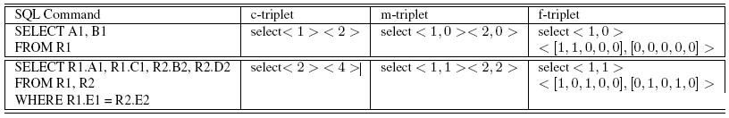
Preliminaries
c-triplet (coarse triplet)
  consists of 3 fields
  (SQL-CMD, REL-COUNTER, ATTR-COUNTER)
  first field is a symbolic SQL command,
  the other two are numeric and correspond to the number of relations and attributes Involved in SQL command
  recording least amount of information

Slide 9
Preliminaries
m-triplet (medium-grain triplet)
  (SQL-CMD, REL-BIN[], ATTR-COUNTER[])
  the second is a binary (bit) vector (size = # of relations) and This bit vector contains 1 in its i-th position if the i-th relation is included in the SQL command
  The third field is a vector (size = the size of the REL-BIN[] vector) and The i-th element of vector is # of attributes of the i-th relation that are involved in the SQL command

Slide 10
Preliminaries
f-triplet (fine triplet)
  (SQL-CMD, REL-BIN[], ATTR-BIN[])
  first and second field = same as m-triplet
  The third field is a vector of N vectors, where N is the number of relations in the database. Element ATTR-BIN[i][j] = 1 if the SQL command at hand accesses the j-th attribute of the i-th relation and 0 otherwise

Slide 11
Classifier
Maximum Aposteriori Probability(MAP)
  Correct classification as long as the correct class is more probable than any other class
  Enable us to raise an alarm when the probability of a user, acting according to the role he is claiming to have, is low

Slide 12

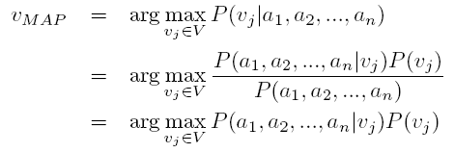

Classifier
Using Naïve Bayes classifier
· · · (1)
· · · (2)
· · · (3)
· · · (4)

Slide 13
Classifier
(1) -> (2)
  P(B|A) = P(A^B)/P(A)
  P(A|B) = P(A^B)/P(B)
  P(A^B)=P(B)*P(A|B)
  P(B|A) = P(B)*P(A|B)/P(A) substitute P(A^B)
(2) -> (3)
  Denominator does not depend on the choice of v_{j}
  It can be omitted from the arg max argument

Slide 14



Classifier
c-triplet
m-triplet
f-triplet

Slide 15
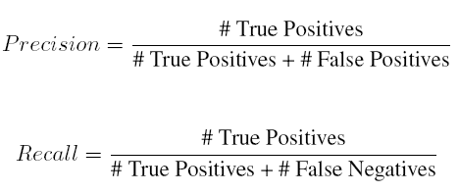
Experimetal evaluation
Quality Measures
  # Flase Positives is the number of false alarms
  # Flase Negatives is the number of times the system is not able to detect the anomalous queries

Slide 16
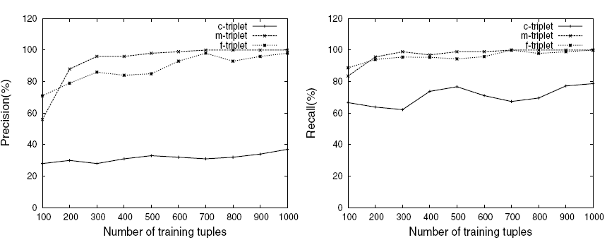
Experimetal evaluation
Precision and Recall statistics

Slide 17
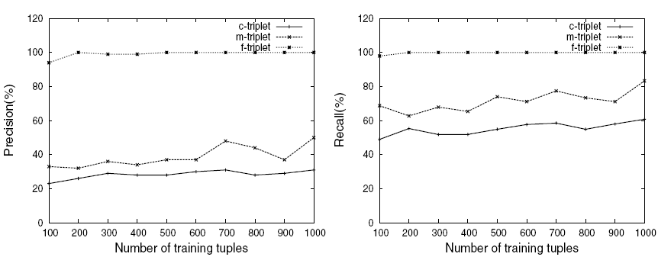
Experimetal evaluation
Precision and Recall statistics

Slide 18
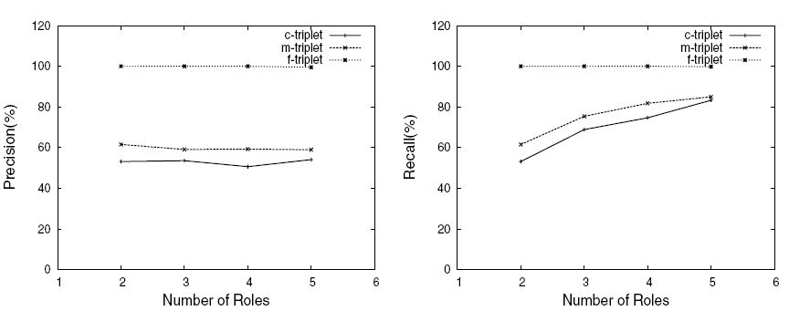
Experimetal evaluation
Precision and Recall statistics

Slide 19

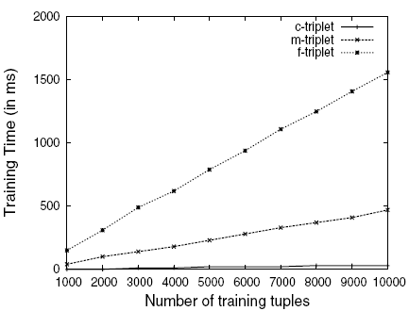


Experimetal evaluation

Slide 20
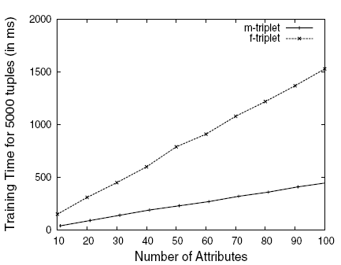
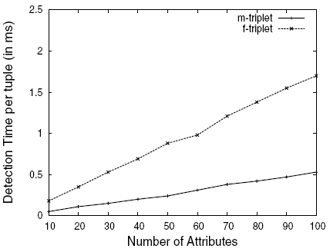
Experimetal evaluation
d

Slide 21
Conclusions
three models, of different granularity, to represent the log records appearing in the database log files
In that way, we managed to extract useful information from the log records regarding the access pattern of the users
Since role information was available in the log records, we used it for training a classifier that was then used as the basic component for our-intrusion detection mechanism

Slide 22
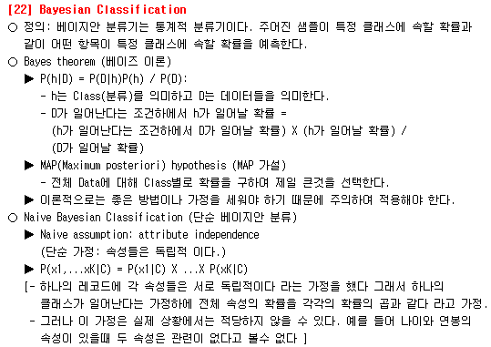
Appendix

