Slide 1
Build Your Own Music Recommender by Modeling Internet Radio Streams
Natalie Aizenberg, Yehuda Koren, Oren Somekh
WWW 2012
5 July 2013
SNU IDB Lab.
Namyoon Kim

Slide 2
Outline
Introduction
Internet Radio as a Data Source
Playlist Modeling
Empirical Studies
Conclusions

Slide 3
Introduction
Convergence of media industry and the internet
Created a variety of new media services
Variety and volume of new content is overwhelming
Difficult for users to navigate
Nowadays, recommendation services are the norm

Slide 4
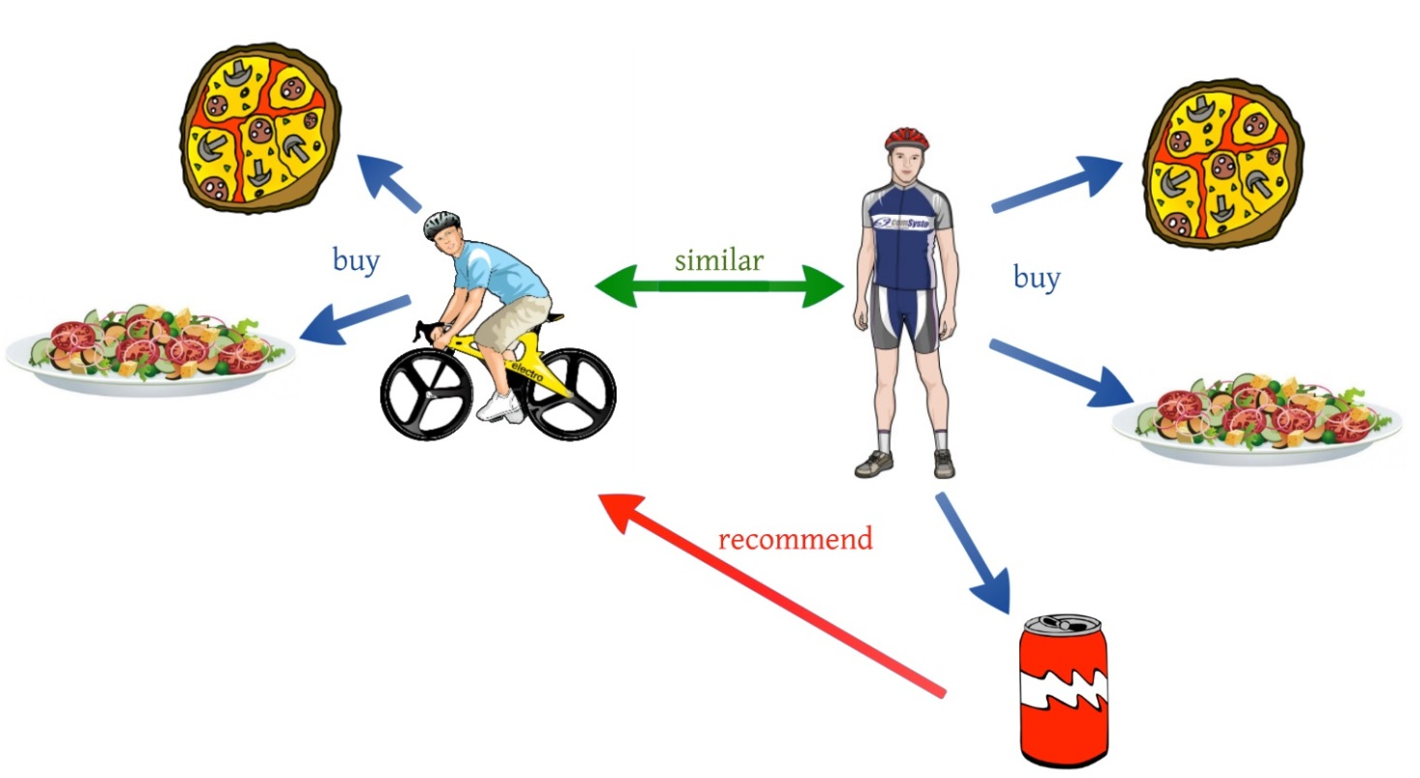
Introduction – music recommeders
Often employ a technique called collaborative filtering (CF), which:
Relies ONLY on past user behaviour
Require no domain knowledge or content analysis
Good at exploiting popularity trends
src: http://blog.comsysto.com/2013/04/03/background-of-collaborative-filtering-with-mahout/

Slide 5
Introduction – alternate methods
CF relies on the wisdom of crowds
Requires sufficient amount of user feedback signal on record
This puts new market players at a competitive disadvantage
Always under risk of a cold start, if user signal is scarce
New methods that rely less on these restrictions required
Internet radio streams are potentially resourceful

Slide 6
Internet Radio as a Data Source
Internet Radio provides several advantages over user playlists and feedback data
Freshness
Existing datasets provide only a snapshot of time
Internet radio, in contrast, provides continuous cover
Completeness
Public music dataset generally do not provide the entire metadata
Internet radio tends to promote items publicly, usually the metadata being complete

Slide 7
Internet Radio as a Data Source (Continued)
Robustness
No worry of actually running out of collectible data
Scale
The number of internet radio stations is increasing constantly, measured worldwide in the hundreds of thousands
Dataset size is theoretically unbounded
Diversity
Data stemming from thousands of independent stations weaken bias considerably
Accessibility
Stations are available to the public

Slide 8
Collection procedure
Collection period of 15 days (Sep.22 – Oct.06, 2011)
Data collected across 4147 stations
All monitored stations are associated with the ShoutCast directory (www.shoutcast.com)

Slide 9
Playlist metadata collection
Metadata collection consisted of three phases
First was to compose the list of stations, sampling all major genres in the ShoutCast directory
Filter stations (unrelated ones such as news broadcast stations)
Monitor the listed stations, collecting metadata (track, artist), station local time of play and corresponding system time
Apply parsing heuristics to each playlist

Slide 10
Statistics
Dataset statistics
563,417 unique tracks
Played a total of 6,727,692 times
96,681 different artists
Over 3,541 stations
Restricted records to include only stations that were playing at least 10 plays of more than 5 different tracks
Artists are associated with more than 10 plays

Slide 11
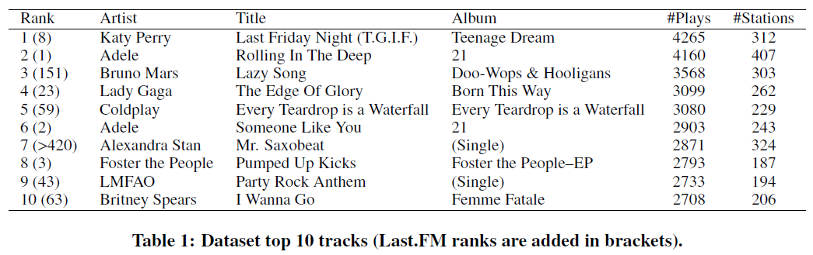
Dataset top 10 tracks

Slide 12
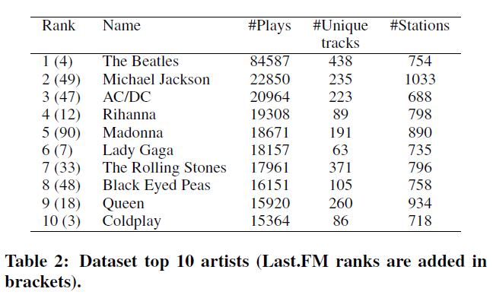
Dataset top 10 artists

Slide 13
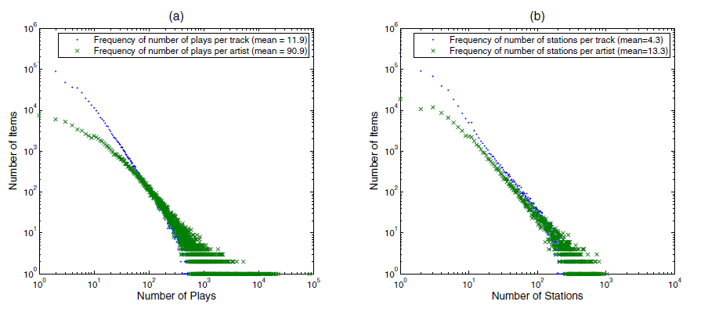
General statistics (1)

Slide 14
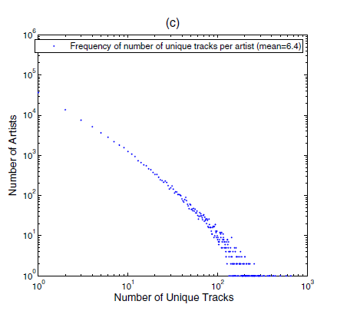
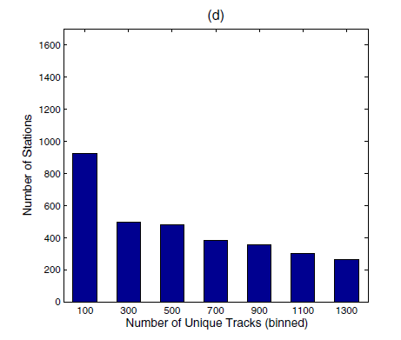
General statistics (2)

Slide 15
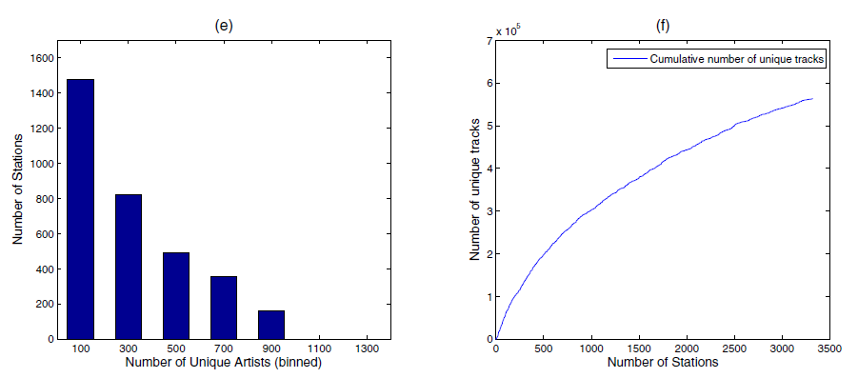
General statistics (3)

Slide 16

Modeling outline
Model captures relations between tracks and their corresponding artists, indirectly tying all tracks belonging to same artist
Given a playlist, the model predicts the probability distribution of the next played item
Uses latent factor model - map both items and stations to latent factor vectors

Slide 17
Modeling outline (Continued)
Biases reflect popularity of each item
P_{s} denotes list of tracks played by station s along with associated timestamps
Each playlist induces a probability distribution over the items
The playlists are arranged within a train set S

Slide 18


Latent factor vector
Parameters associated with track i sum both its own representation with the one associated with its artist, a(i)
Artist enhanced bias of track i is
Affinity of item i to station s at time t

Slide 19

Likelihood equation
The likelihood of observing i as the item played in station s and time t, with the multinomial distribution
Θ denotes model parameters

Slide 20

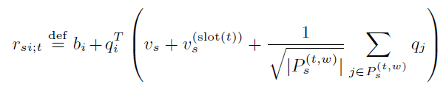
Affinity function
First order approximate
With time slot (one of eight three-hour slots) and time window [t-w, t)

Slide 21


Log likelihood maximization
Seek Θ that will maximize training set
Update each θ ∈ Θ by, η being the learning rate and w a weighting function

Slide 22
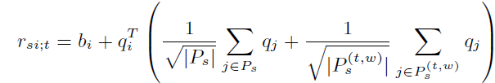
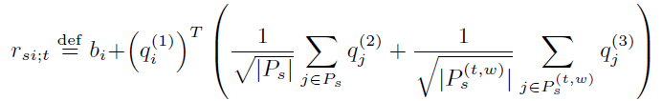
Optimization models
Station based model
Station-less model
Map each item to three distinct factor factors, for roles: being recommended (1), annotating a station (2), and annotating a time window (3)
None of the model parameters describe stations – handling new stations becomes trivial

Slide 23
Empirical Studies
Weak generalization test
Represents scenario of modeling existing stations
Strong generalization test
Represents scenario of exploiting an existing model for predicting new stations or users
Cross source learning test
Model fully trained on internet radio dataset predicts behavior of Yahoo! Music users

Slide 24
Evaluation metrics
Pair each played item in test set with randomly drawn item not played by the user
Use model to rank two items for the relevant station – fraction of successfully ranked pairs is the metric value

Slide 25
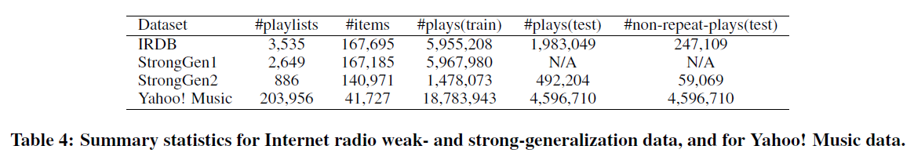
Capturing different performance aspects
Non repeat vs. uniformly picked
Non repeat: Test items that have not previously appeared in the train or test set for the same station
Non repeat vs. pop
Number of plays per item follows a power law distribution, so matching played items to popular items makes sense
Played vs. pop
Over an extended period, playlists will inevitably repeat some songs

Slide 26
Baseline methods
Popularity
Always favors the more popular item
Genre
Used Yahoo! Music database
Each of 45,713 tracks associated with one to six genre(s)
Compute genre distribution for each station
Score item based on mean probability its genres receive on station
K-means
Alternative of “made-up genres” using k-means clustering
Treat each cluster as a genre

Slide 27
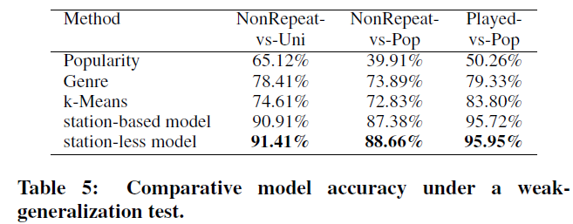
Results – weak generalization
Picked latent factor dimension space to be 20
Station-less model is more accurate, but slower

Slide 28
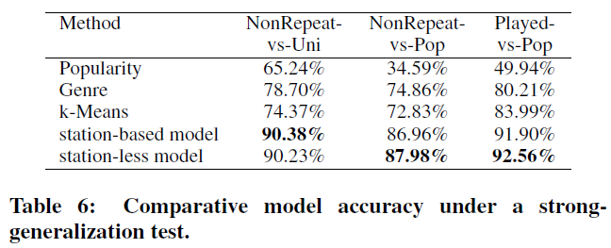
Results – strong generalization
Results are similar

Slide 29
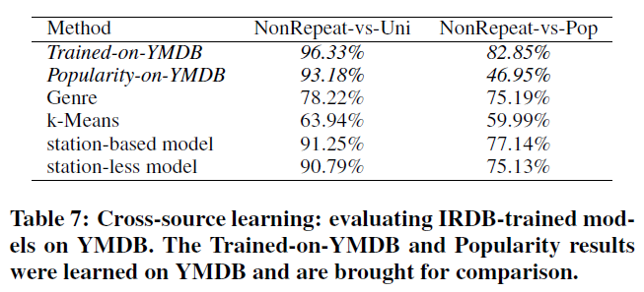
Results – cross-source learning
Evaluating internet radio (IRDB) models on Yahoo! Music database (YMDB)
As expected, YMDB-trained model on YMDB test set outperforms all others
However, the IRDB models fare very well too

Slide 30
Conclusion
Tried to break the “rich get richer” situation in the music recommendation business
Modeling a huge number of human crafted playlists allows building a successful playlist
Experts-generated data vs. crowd-sourced data
Reliance on experts and its effect on recommendations to the end user

