Slide 1
Dremel: Interactive Analysis of WebScale Datasets
Sergey Melnik, Andrey Gubarev, Jing Jing Long, Geoffrey Romer,
Shiva Shivakumar, Matt Tolton, Theo Vassilakis
Google, Inc.
8 January 2014
SNU IDB
Hyesung Oh
(slides by authors)

Slide 2




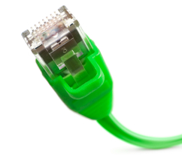

Speed matters
Interactive Tools
Trends
Detection
Spam
Web Dashboards
Network Optimization

Slide 3

Example: data exploration
1
Runs a MapReduce to extract billions of signals from web pages
Googler Alice
2
Ad hoc SQL against Dremel
DEFINE TABLE t AS /path/to/data/*
SELECT TOP(signal, 100), COUNT(*) FROM t . . .
3
More MR-based processing on her data (FlumeJava [PLDI'10], Sawzall [Sci.Pr.'05])
Notes:
Ad hoc SQL -> 단발성 질의
FlumeJava -> data-parallel pipelining framework
Sawzall -> sql-like language

Slide 4
Dremel system
Trillion-record, multi-terabyte datasets at interactive speed
Scales to thousands of nodes
Fault and straggler tolerant execution
Nested data model
Complex datasets; normalization is prohibitive
Columnar storage and processing
Tree architecture (as in web search)
Interoperates with Google's data mgmt tools
In situ data access (e.g., GFS, Bigtable)
MapReduce pipelines
Notes:
Trillion 1조
Management tools

Slide 5
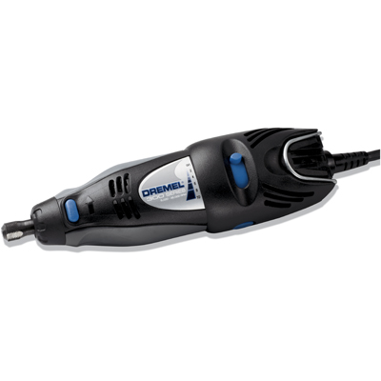
Why call it Dremel
Brand of power tools that primarily rely on their speed as opposed to torque
Data analysis tool that uses speed instead of raw power

Slide 6
Widely used inside Google
Analysis of crawled web documents
Tracking install data for applications on Android Market
Crash reporting for Google products
OCR results from Google Books
Spam analysis
Debugging of map tiles on Google Maps
Tablet migrations in managed Bigtable instances
Results of tests run on Google's distributed build system
Disk I/O statistics for hundreds of thousands of disks
Resource monitoring for jobs run in Google's data centers
Symbols and dependencies in Google's codebase

Slide 7
Outline
Nested columnar storage
Query processing
Experiments
Observations

Slide 8
Records vs. columns
r₁
DocId: 10
Links
Forward: 20
Name
Language
Code: 'en-us'
Country: 'us'
Url: 'http://A'
Name
Url: 'http://B'
A
*
*
B
. . .
E
*
C
D
r₁
r₁
r₁
r₁
r₂
r₂
r₂
Read less,
cheaper decompression
r₂
. . .
Challenge: preserve structure, reconstruct from a subset of fields

Slide 9
Nested data model
http://code.google.com/apis/protocolbuffers
r₁
DocId: 10
Links
Forward: 20
Forward: 40
Forward: 60
Name
Language
Code: 'en-us'
Country: 'us'
Language
Code: 'en'
Url: 'http://A'
Name
Url: 'http://B'
Name
Language
Code: 'en-gb'
Country: 'gb'
multiplicity:
message Document {
required int64 DocId; [1,1]
optional group Links {
repeated int64 Backward; [0,*]
repeated int64 Forward; }
repeated group Name {
repeated group Language {
required string Code;
optional string Country; [0,1] }
optional string Url; } }
r₂
DocId: 20
Links
Backward: 10
Backward: 30
Forward: 80
Name
Url: 'http://C'

Slide 10
Column-striped representation
DocId
Name.Url
Links.Forward
Links.Backward
value | r | d
10 | 0 | 0
20 | 0 | 0
value | r | d
http://A | 0 | 2
http://B | 1 | 2
NULL | 1 | 1
http://C | 0 | 2
value | r | d
20 | 0 | 2
40 | 1 | 2
60 | 1 | 2
80 | 0 | 2
value | r | d
NULL | 0 | 1
10 | 0 | 2
30 | 1 | 2
Name.Language.Code
Name.Language.Country
value | r | d
en-us | 0 | 2
en | 2 | 2
NULL | 1 | 1
en-gb | 1 | 2
NULL | 0 | 1
value | r | d
us | 0 | 3
NULL | 2 | 2
NULL | 1 | 1
gb | 1 | 3
NULL | 0 | 1
Notes:
Repitition level
Definition level

Slide 11
Repetition and definition levels
r₁
DocId: 10
Links
Forward: 20
Forward: 40
Forward: 60
Name
Language
Code: 'en-us'
Country: 'us'
Language
Code: 'en'
Url: 'http://A'
Name
Url: 'http://B'
Name
Language
Code: 'en-gb'
Country: 'gb'
r=1
r=2
(non-repeating)
Name.Language.Code
value | r | d
en-us | 0 | 2
en | 2 | 2
NULL | 1 | 1
en-gb | 1 | 2
NULL | 0 | 1
record (r=0) has repeated
Language (r=2) has repeated
r: At what repeated field in the field's path the value has repeated
r₂
DocId: 20
Links
Backward: 10
Backward: 30
Forward: 80
Name
Url: 'http://C'
d: How many fields in paths that could be undefined (opt. or rep.) are actually present

Slide 12
Record assembly FSM
Transitions
labeled with
repetition levels
DocId
0
1
Links.Backward
0
Links.Forward
1
0
Name.Language.Code
0,1,2
Name.Language.Country
2
1
Name.Url
0,1
0
For record-oriented data processing (e.g., MapReduce)
Notes:
Edge are labeled with repetition levels

Slide 13
Reading two fields
s₁
DocId: 10
Name
Language
Country: 'us'
Language
Name Name
Language
Country: 'gb'
DocId
0
1,2
Name.Language.Country
0
s₂
DocId: 20
Name
Structure of parent fields is preserved.
Useful for queries like /Name[3]/Language[1]/Country

Slide 14
Outline
Nested columnar storage
Query processing
Experiments
Observations

Slide 15
Query processing
Optimized for select-project-aggregate
Very common class of interactive queries
Single scan
Within-record and cross-record aggregation
Approximations: count(distinct), top-k
Joins, temp tables, UDFs/TVFs, etc.
Notes:
User defined function
Table valued function(return multi-reow result)

Slide 16
SQL dialect for nested data
SELECT DocId AS Id,
COUNT(Name.Language.Code) WITHIN Name AS Cnt, Name.Url + ',' + Name.Language.Code AS Str FROM t WHERE REGEXP(Name.Url, '^http') AND DocId < 20;
Output table
Output schema
t₁
Id: 10
Name
Cnt: 2
Language
Str: 'http://A,en-us'
Str: 'http://A,en'
Name
Cnt: 0
message QueryResult {
required int64 Id;
repeated group Name {
optional uint64 Cnt;
repeated group Language {
optional string Str; } } }

Slide 17
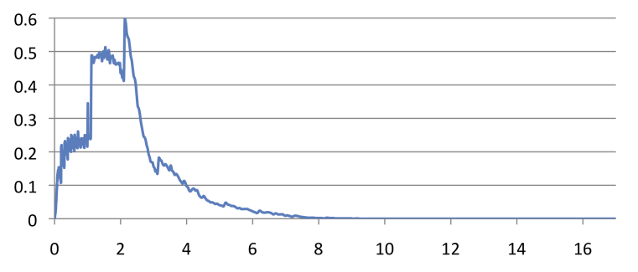
Serving tree
[Dean WSDM'09]
client
Parallelizes scheduling and aggregation
Fault tolerance
Stragglers
Designed for "small" results (<1M records)
root server
intermediate
servers
. . .
. . .
leaf servers
(with local
storage)
. . .
histogram of response times
storage layer (e.g., GFS)
Notes:
Each server has query execution tree

Slide 18
Example: count()
SELECT A, COUNT(B) FROM T GROUP BY A
T = {/gfs/1, /gfs/2, …, /gfs/100000}
SELECT A, SUM(c) FROM (R₁1 UNION ALL R₁10) GROUP BY A
0
R₁1
R₁2
1
SELECT A, COUNT(B) AS c FROM T₁1 GROUP BY A
T₁1 = {/gfs/1, …, /gfs/10000}
SELECT A, COUNT(B) AS c FROM T₁2 GROUP BY A
T₁2 = {/gfs/10001, …, /gfs/20000}
. . .
. . .
SELECT A, COUNT(B) AS c FROM T₃1 GROUP BY A
T₃1 = {/gfs/1}
. . .
3
Data access ops

Slide 19
Outline
Nested columnar storage
Query processing
Experiments
Observations

Slide 20
Experiments
1 PB of real data (uncompressed, non-replicated)
100K-800K tablets per table
Experiments run during business hours
Table name | Number of records | Size (unrepl., compressed) | Number of fields | Data center | Repl. factor
T1 | 85 billion | 87 TB | 270 | A | 3×
T2 | 24 billion | 13 TB | 530 | A | 3×
T3 | 4 billion | 70 TB | 1200 | A | 3×
T4 | 1+ trillion | 105 TB | 50 | B | 3×
T5 | 1+ trillion | 20 TB | 30 | B | 2×

Slide 21
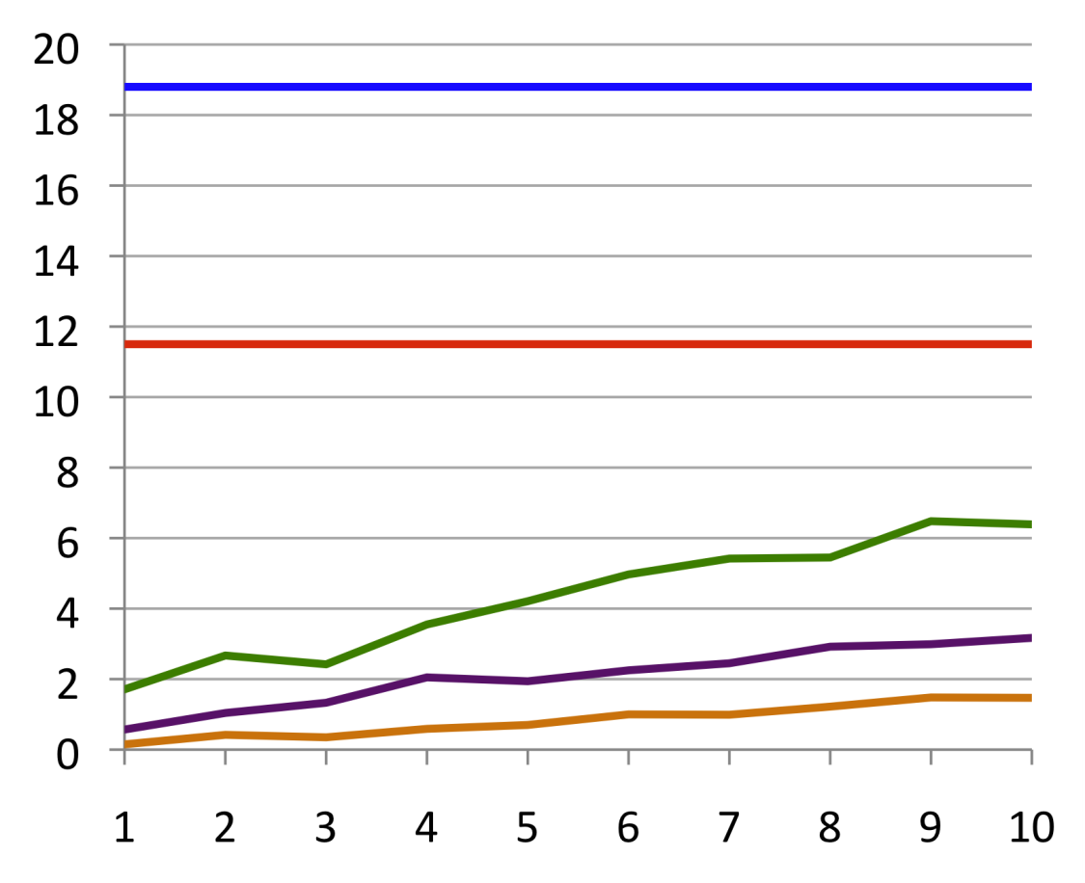
Read from disk
"cold" time on local disk, averaged over 30 runs
time (sec)
(e) parse as C++ objects
10x speedup using columnar
storage
from records
objects
(d) read + decompress
records
columns
(c) parse as C++ objects
2-4x overhead of using records
from columns
(b) assemble records
(a) read + decompress
number of fields
Table partition: 375 MB (compressed), 300K rows, 125 columns
Notes:
Graph a-c : columnar storage 70MB/s read bandwidth
1GB data
Graph d-e : record-oriented storage

Slide 22
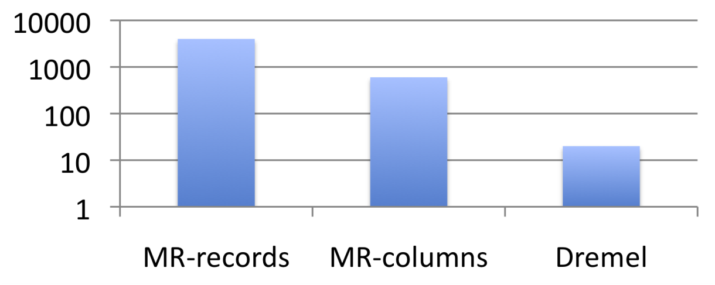
MR and Dremel execution
Avg # of terms in txtField in 85 billion record table T1
execution time (sec) on 3000 nodes
Sawzall program ran on MR:
num_recs: table sum of int; num_words: table sum of int; emit num_recs <- 1; emit num_words <- count_words(input.txtField);
87 TB
0.5 TB
0.5 TB
Q1:
SELECT SUM(count_words(txtField)) / COUNT(*)
FROM T1
MR overheads: launch jobs, schedule 0.5M tasks, assemble records

Slide 23
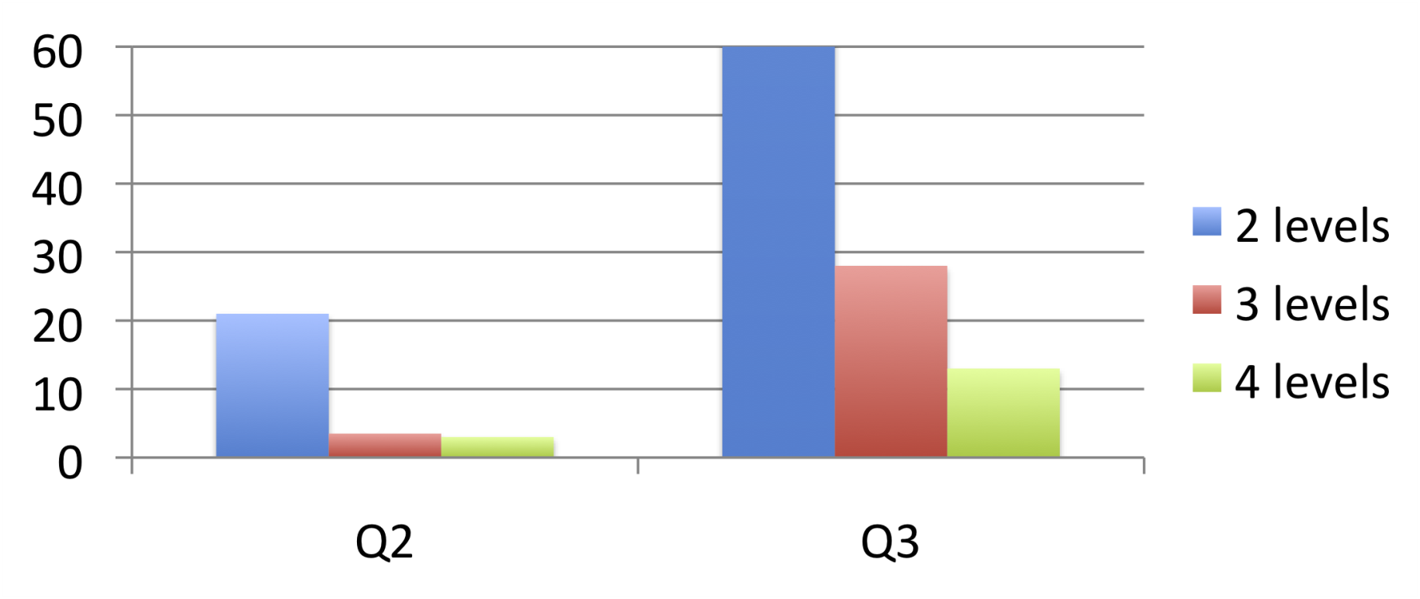
Impact of serving tree depth
execution time (sec)
(returns 100s of records)
(returns 1M records)
Q2:
SELECT country, SUM(item.amount) FROM T2 GROUP BY country
Q3:
SELECT domain, SUM(item.amount) FROM T2 WHERE domain CONTAINS ’.net’ GROUP BY domain
40 billion nested items

Slide 24
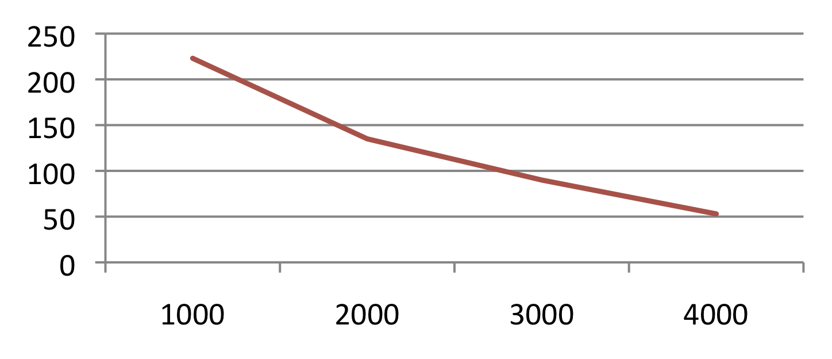
Scalability
execution time (sec)
number of
leaf servers
Q5 on a trillion-row table T4:
SELECT TOP(aid, 20), COUNT(*) FROM T4

Slide 25
Outline
Nested columnar storage
Query processing
Experiments
Observations

Slide 26
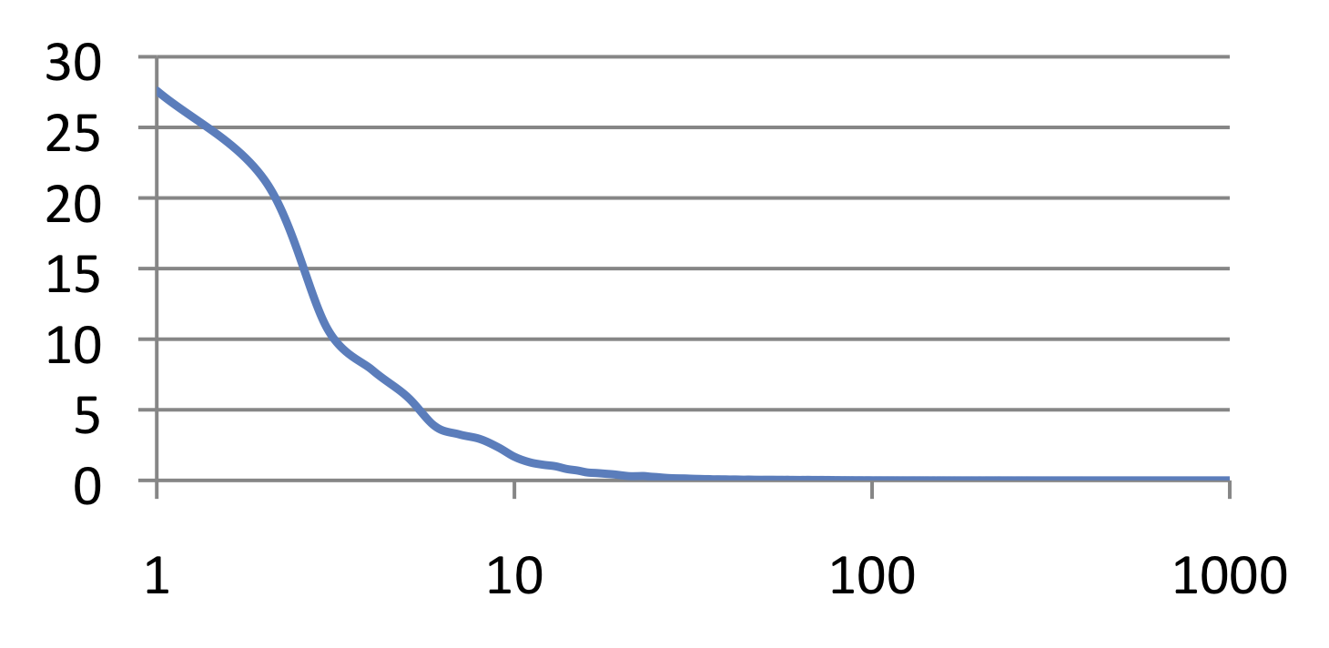
Interactive speed
Monthly query workload
of one 3000-node Dremel instance
percentage of queries
execution time (sec)
Most queries complete under 10 sec

Slide 27
Observations
Possible to analyze large disk-resident datasets interactively on commodity hardware
1T records, 1000s of nodes
MR can benefit from columnar storage just like a parallel DBMS
But record assembly is expensive
Interactive SQL and MR can be complementary
Parallel DBMSes may benefit from serving tree architecture just like search engines

Slide 28







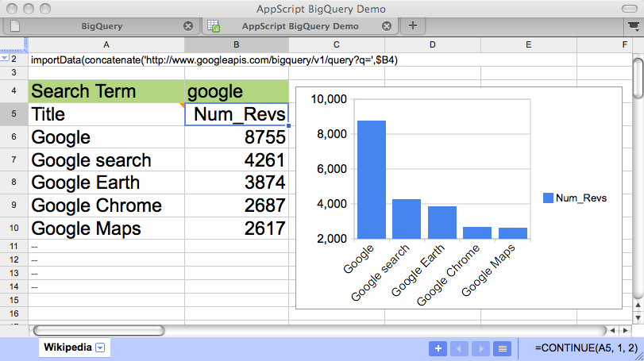

BigQuery: powered by Dremel
http://code.google.com/apis/bigquery/
Your Data
Upload your data
to Google Storage
1. Upload
BigQuery
2. Process
Import to tables
Your Apps
3. Act
Run queries

