Slide 1
빅데이터 팀 세미나 2주차 #맵리듀스 프레임워크 고급
Some slides from vldb 2012 tutorial

Slide 2
Outline
Reducer에서의 키 분배
브로드캐스팅 기법
파티션을 이용한 성능 향상
Sharding 기법 (PageRank)
키의 그룹화 및 No reduce 사용

Slide 3
Forcing Key Distributions to Reducer
파티션 클래스
원하는 키값을 특정 리듀서에게 보낼 수 있음
Default
Uniform하게 리듀서에게 보냄
하지만 같은 키와 값은 같은 리듀서에게 보내줘야 함
Reducer1
Key | Value
And | 1
zoo | 1
Key | Value
And | 1
This | 1
abandon | 1
zoo | 1
Reducer2
Key | Value
This | 1
abandon | 1

Slide 4
Forcing Key Distributions to Reducer
특정 키값을 특정 리듀서에게 보내고 싶은 경우
예를 들어, 알파벳 순서에 의한 소팅
한 리듀서에는 ‘a’로 시작하는 키값을
나머지 리듀서에는 나머지 알파벳 값을 보내고 싶다.
파티션을 재정의한다
Reducer1
Key | Value
And | 1
abandon | 1
Key | Value
And | 1
This | 1
abandon | 1
zoo | 1
Reducer2
Key | Value
This | 1
zoo | 1
“파티션을 재정의한다”

Slide 5
Broadcast to Map and Reduce
Small data
Use the configuration class provided in Hadoop
Large data
Simply, write and read the data in HDFS
First, write a file to broadcast on HDFS in the main function before executing a MapReduce task
Read the broadcast file in the setup function of each map or reduce function from HDFS
Hadoop autimatically calls “setup” function before the map and reduce functions are called

Slide 6
Example : Broadcast
job을 main에서 세팅할 때, (Main 함수에서)
Job jobOne = new Job(confOne, "statistics"); jobOne.setJarByClass(MyAlgorithmMR.class); jobOne.setMapperClass(MapperPhaseOne.class); //jobOne.setCombinerClass(ReducerPhaseOne.class); jobOne.setReducerClass(ReducerPhaseOne.class); jobOne.setOutputKeyClass(Text.class); jobOne.setOutputValueClass(DoubleWritable.class); FileInputFormat.addInputPath(jobOne, new Path(otherArgs[0])); FileOutputFormat.setOutputPath(jobOne, new Path(phaseOneOutFileName));
// broadcast
confOne = jobOne.getConfiguration(); confOne.setInt( "Dimension", dimension );
와 같이 configuration에 setInt를 하게 되면, configuration에 Dimension이라는 이름의 integer 값이 설정 됩니다.

Slide 7
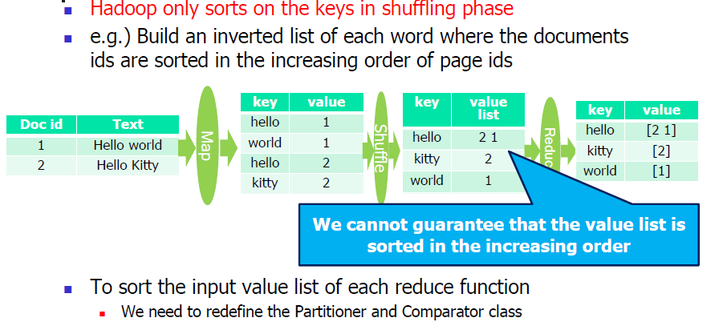
Redefine Partitioning Scheme of Shuffling

Slide 8
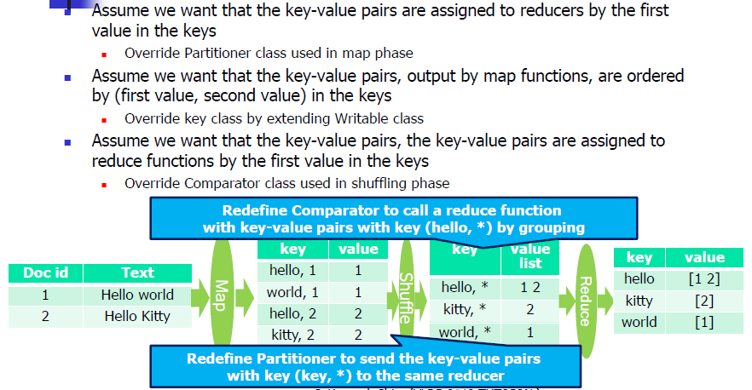

Slide 9
Sharding Data for Multiple MapReduce Phase
Split data into partitions and store each partition in a predefined machine
Sharding for mapper
Store the partition P_{i} in the machine M_{i}
Sharding for reducer
Key-value pairs, output by map functions, related to Pi are sent to the machine Mi
Why sharding?
To reduce network overheads by distributed data intentionally when multiple MapReduce phase are used
An Example using sharding: computing PageRank

Slide 10
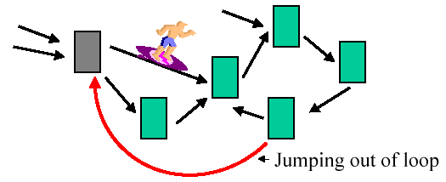
An Example of Sharding with PageRank Computation
Page Rank corresponds to the probability distribution of a random walk on the web graphs
Sometimes, a random surfer gets bored and jumps to a different page

Slide 11
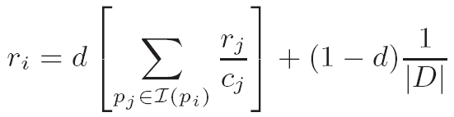
PageRank Algorithm
Let D be the set of all Web pages. Let I(p) be the set of pages that link to the page p and let c_{i} be the total number of links going out of page p_{i}. The PageRank of page p_{i}, denoted by r_{i}, is then given by

Slide 12
Random Surfer Model: Illustration
Surfer falls down
in prob. of 1 / |D|
P2
Surfer come from P2
in prob. of 1 / 4 * PR(P2)
P1
P3
P4
P?
Surfer starts new surfing
In prob. of 1-d

Slide 13
Key Ideas for Map/Reduce
The calculation depends on only the PageRank values of previous iteration
Individual rows of the adjacency matrix can be processed in parallel
Algorithm
Map - Provide each page’s page rank “fragments” to linkees
Reduce - sum up the page rank fragments provided for each page

Slide 14
Computing PageRank
Properties of PageRank
Can be computed iteratively
Effects at each iteration is local
Outlines of algorithm:
Start with seed PR_{i} values
Each page distributes PR_{i} “credit” to all pages it links to
Each target page adds up “credit” from multiple in-bound links to compute PR_{i+1}
Iterate until values converge

Slide 15
PageRank in MapReduce
Map: distribute PageRank “credit” to link targets
Reduce: gather up PageRank “credit” from multiple sources to compute new PageRank value
Iterate until
convergence
...

Slide 16
Pseudo Code
Map
Input
target_page_id, page_rank_value_to_distribute
Body
emit (target_page_id, pagerank_value_to_distribute)
Reduce
Input
page_id, list of page_rank_value
Body
sum each page_rank_value in the list
emit (page_id, sum of page_rank_values)

Slide 17
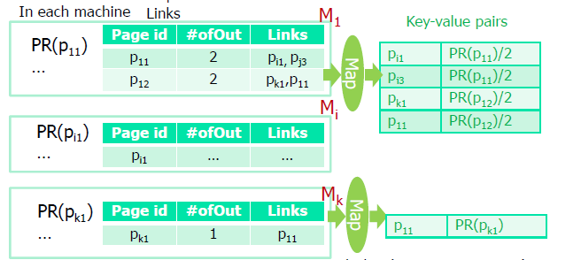
Sharding for PageRank
Sharding for map
Split the URLs into k partitions
Each machine M_{i} has page ids in each partition P_{i} = {p_{i1}, p_{i2}, … , p_{in}} and the adjacent page id list of each page p_{ij} ∈ P_{i}
In each machine M_{i}, we maintain the computed PageRank values of the URLs in P_{i}

Slide 18
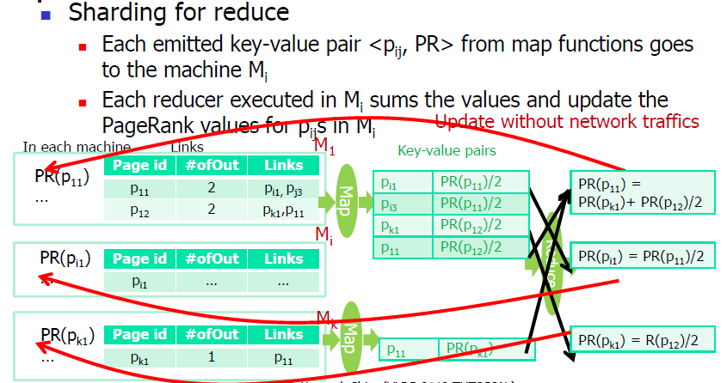
Sharding for PageRank

Slide 19
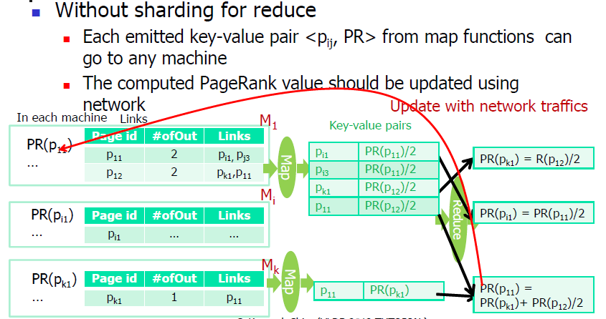
PageRank without Sharding

Slide 20
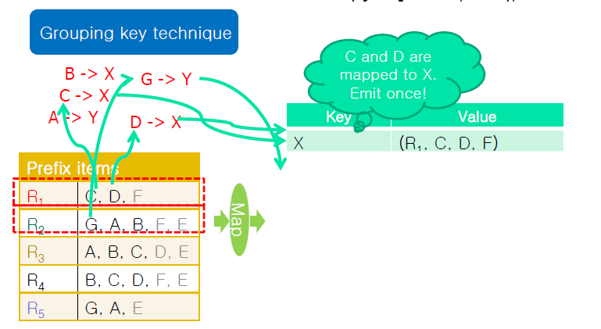
Grouping Keys
Set similarity [Vernica, Carey, Li : SIGMOD 2010]

Slide 21
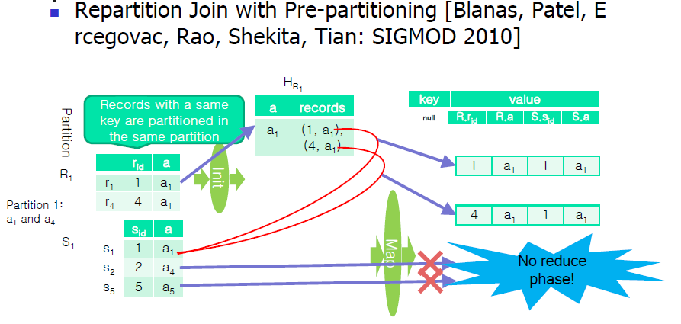
No Reduce Phase

Slide 22
고급 기능 정리
Forcing key distribution
Theta join, similarity join, etc.
Broadcasting to mappers and reducers
Theta join, similarity join, clustering, decision tree, matrix multiplication and factorization, EM algorithm, etc.
Redefine partitioning scheme of shuffling
Theta join, similarity join, etc.
Sharding data for multiple Mapreduce Phases
PageRank, clustering, EM algorithm, etc.
Grouping keys
Association rule, similarity join, etc.
No reduce phase
Theta join

