Slide 1
SkewTune: Mitigating Skew in MapReduce Applications
YongChul Kwon*, Magdalena Balazinska*, Bill Howe*, Jerome Rolia**
*University of Washington, **HP Labs
SIGMOD’12
24 Sep 2014
SNU IDB
Hyesung Oh

Slide 2
Outline
Introduction
UDOs with MapReduce
Types of skew
Past Solutions
SkewTune
Overview
Skew mitigation in SkewTune
Skew Detection
Skew Mitigation
SkewTune For Hadoop
Evaluation
Skew Mitigation Performance
Overhead of Local Scan vs. Parallel Scan
Conclusion

Slide 3




Introduction
User-defined operations(UDOs)
Transparent optimization in UDO Programming -> key goal!
accumulate

Slide 4
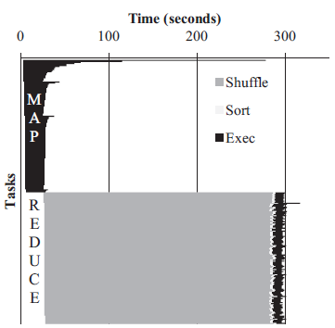
UDOs with MapReduce
MapReduce provides a simple API for writing UDOs
Simple map and reduce function
Shared-nothing cluster
Limitations of MapReduce
Skew causes slowing down entire computation
Load imbalance can occur map or reduce phases
Map-skew
Reduce-skew
A timing chart of a MapReduce job running
the PageRank algorithm from Cloud 9 – case of map-skew

Slide 5
Types of skew
First type : uneven distribution of input data
Second type : some portions of the input data taking longer process time
Input data 1
(large)
Mapper 1
Mapper 2
Input data 2

Slide 6
Past solutions
Special skew-resistant operators
Extra burden to UDOs
Only applies to operations that satisfy properties
Extremely fine-grained partitions and re-allocating
Significant overhead
State migration
Extra task scheduling
Materializing the output of an operator
Sampling output and Plan how to repartition it
Requires a synchronization barrier between operators
Preventing pipelining and online query processing

Slide 7
SkewTune
New technique for handling skew in parallel UDOs
Implemented by extending Hadoop system
Key features
Mitigates two types of skew
Uneven distribution of data
Taking longer to process
Optimize unmodified MapReduce programs
Preserves interoperability with other UDOs
Compatible with pipelining optimizations
Does not require any synchronization barrier

Slide 8
Overview
Coordinator-worker architecture
On completion of a task, the worker node requests a new task from the coordinator
De-coupled execution
Operators execute independently of each other
Independent record processing
Per-task progress estimation
Remaining time
Per-task statistics
Such as total number of (un)processed bytes and records
Coordinator
Worker 1
Worker 2

Slide 9
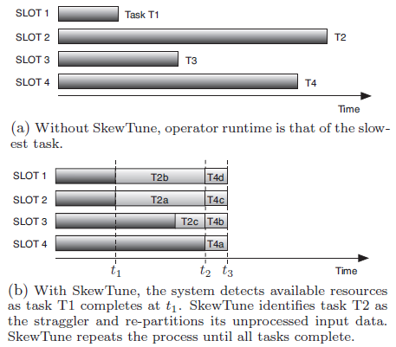
Skew mitigation in SkewTune
Conceptual skew mitigation in SkewTune

Slide 10
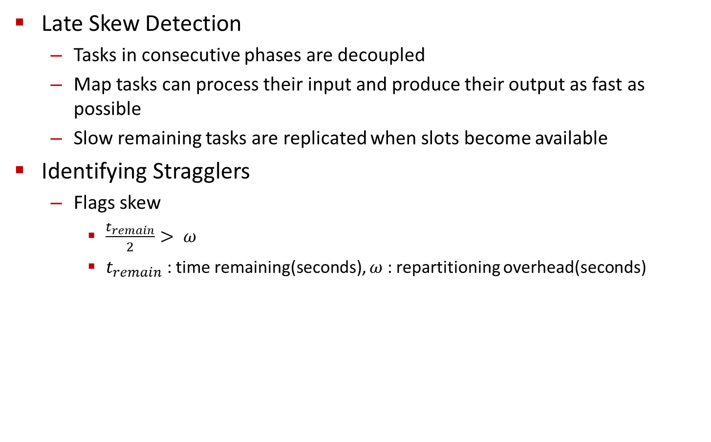
Skew Detection
Late Skew Detection
Tasks in consecutive phases are decoupled
Map tasks can process their input and produce their output as fast as possible
Slow remaining tasks are replicated when slots become available
Identifying Stragglers
Flags skew
$\frac{t_{remain}}{2}> ω$
$t_{remain}$ : time remaining(seconds), $ω$ : repartitioning overhead(seconds)

Slide 11
Skew Mitigation - 1
SkewTune uses range partitioning
To preserve original output order of the UDO
Stopping a straggler
Straggler captures the position of its last processed input record
Allowing mitigators to skip previously processed input
If straggler is impossible or difficult to stop
Request fails and the coordinator selects another straggler

Slide 12

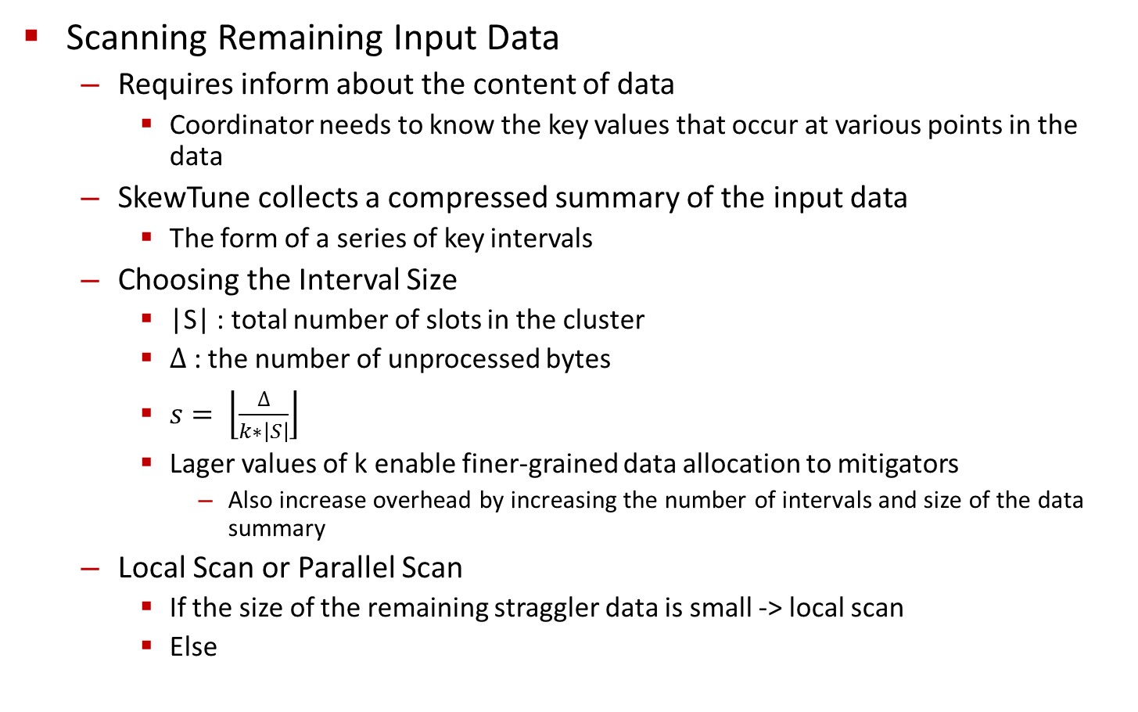
Skew Mitigation - 2
Scanning Remaining Input Data
Requires inform about the content of data
Coordinator needs to know the key values that occur at various points in the data
SkewTune collects a compressed summary of the input data
The form of a series of key intervals
Choosing the Interval Size
|S| : total number of slots in the cluster
$∆$ : the number of unprocessed bytes
$s= \left\lfloor \frac{∆}{k∗\left|S\right|}\right\rfloor$
Lager values of k enable finer-grained data allocation to mitigators
Also increase overhead by increasing the number of intervals and size of the data summary
Local Scan or Parallel Scan
If the size of the remaining straggler data is small -> local scan
Else

Slide 13
Skew Mitigation - 3
Planning Mitigators
The goal is to find a contiguous order-preserving assignment of intervals to mitigators
Two phases
Computes the optimal completion time
The phase stops when a slot assigned less then 2w work
2w is the largest amount of work such that further repartitioning is not beneficial
Sequentially packs the intervals for the earliest available mitigator

Slide 14
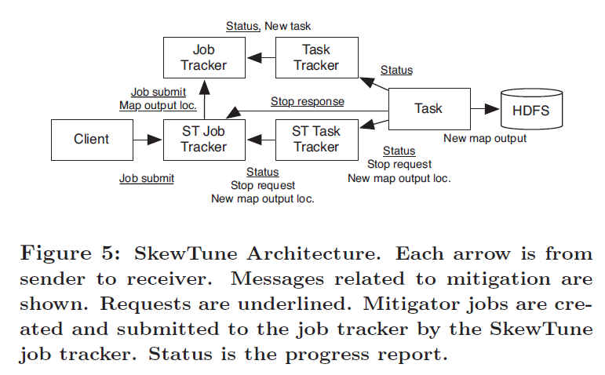
SkewTune For Hadoop

Slide 15
Evaluation
Twenty-node cluster
Hadoop 0.21.1
2 GHz quad-core CPUs
16GB RAM
750GB SATA disk drive
HDFS block size 128MB
Following applications
Inverted Index
Full English Wikipedia archive
Page Rank
Cloud 9, 2.1GB
CloudBurst
MapReduce implementation of the RMAP algorithm for short-read gene alignment
1.1GB

Slide 16
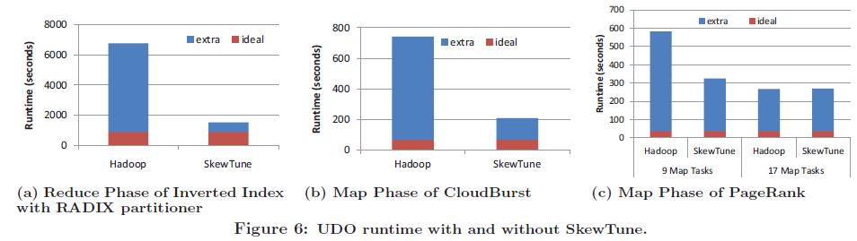
Skew Mitigation Performance
Ideal case, SkewTune has overhead
Extra latency compared with ideal are scheduling overheads
An uneven load distribution due to inaccuracies in SkewTune’s simple runtime estimator

Slide 17
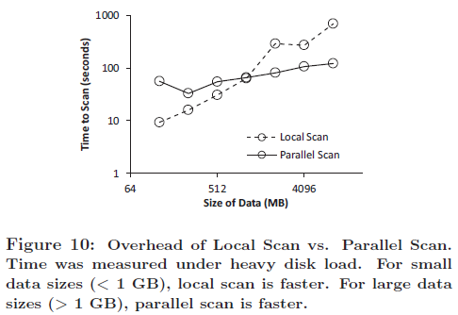
Overhead of Local Scan vs. Parallel Scan

Slide 18
Conclusion
SkewTune requires no input from users
Broadly applicable as it makes no assumptions about the cause of skew
Preserving the order and partitioning properties of the output
4X improvement over Hadoop
Good Paper

