Slide 1
Lazy Maintenance of Materialized Views
Jingren Zhou, PerAke Larson, Hicham G. Elmongui
VLDB 2007
Research Session 6: Relational Models and Views
Junseok Yang
IDB Lab., SNU
2008-04-04

Slide 2
Contents
Introduction
Solution overview
Maintenance algorithms
Condensing delta streams
Experiments
Conclusion

Slide 3
Introduction [1/2]
Materialized views
Reduce query execution time
Have to be up to date whenever it is accessed by a query
Traditional solutions
Eager maintenance
Maintain views as part of the base table update statement (transaction)
Poor response times for updates, especially when multiple views are affected
Deferred maintenance
Maintenance of a view takes place when explicitly triggered by a user
Query may see an out-of-date view and produce an incorrect result

Slide 4
Introduction [2/2] Lazy View Maintenance
Delay maintenance of a view until
The system has free cycles, or
The view is needed by a query
Store away enough information so that views can be maintained later
Version store and delta tables
Transparent to queries: views are always up-to-date
Benefits
View maintenance cost can be hidden from queries
More efficient maintenance when combining multiple (small) update

Slide 5
Contents
Introduction
Solution overview
Maintenance algorithms
Condensing delta streams
Experiments
Conclusion

Slide 6
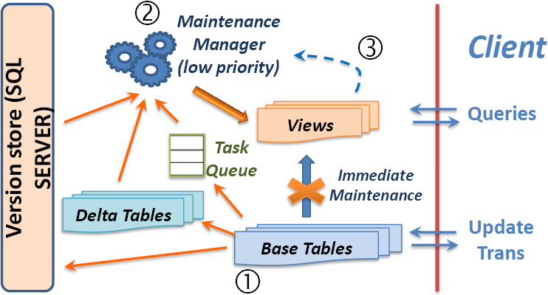
Solution Overview [1/5] System Overview
Under Snapshot isolation
All reads within a transaction
will see a consistent snapshot
of the database
Version store
Keeps track of all active database
versions
Delta tables
Store delta rows; one per base table
Task queue
store pending maintenance tasks
Maintenance manager (low priority, in memory)

Slide 7
Solution Overview [2/5] Step 1: Update Transactions
For each update statement
Skip view maintenance
Store into the corresponding delta table
The delta stream (transform delta stream to split delta stream with an additional action column)
Action column, transaction sequence number(TXSN), statement number(STMTSN)
When the update transaction commits
Construct a lazy maintenance task per affected view
Report tasks to the maintenance manager
Write tasks to the persistent task table
What if the transaction fails?
No information is stored in the manager
No task is constructed

Slide 8
Solution Overview [3/5] Step 2: Lazy Maintenance
The manager wakes up every few seconds
Goes back to sleep if the system is busy or there are no pending maintenance tasks
Constructs a low-priority background maintenance job and schedules it
Maintenance jobs
Jobs for the same view are always executed in the commit order of the originating transactions
Completion: report to the manager and delete the task(s) from the persistent task table
Garbage collection in the manager
Reclaims versions that are no longer used
Cleans up delta tables

Slide 9
Solution Overview [4/5] Step 3: Query Execution
If the view is up-to-date
Virtually no delay in query execution
If the view has pending maintenance tasks,
Ask the maintenance manager to schedule them immediately (On-demand Maintenance)
Maintenance jobs are executed in separate transactions and commits
If query aborts, committed jobs will not roll back
Query resumes execution when all the tasks have completed
Complex scenario: query uses a view that is affected by earlier updates within the same transaction
Split maintenance into two parts
Bring view up-to-date as of before the trans
in a separate trans
Maintain pending updates within the current trans

Slide 10
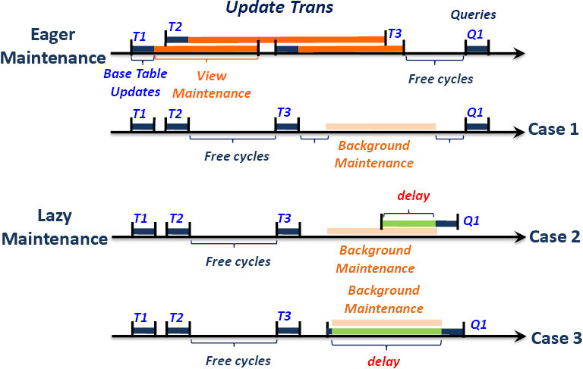
Solution Overview [5/5] Effect on Response Time

Slide 11
Contents
Introduction
Solution overview
Maintenance algorithms
Condensing delta streams
Experiments
Conclusion

Slide 12
Maintenance Algorithms [1/1] Normalized Delta Streams
Example: V = R S
Update transaction T: initial state R₀, S₀, final state R₁, S₁
Delta stream ∆R¹, ∆S¹, ∆R², ∆S², …
New normalized delta stream
∆R = ∆R¹ + ∆R² + … + ∆R^{n}, ∆S = ∆S¹ + ∆S² + … + ∆S^{n}
“+” means concatenation
The ordering is important: done by sorting ∆R, ∆S in ascending order on TXSN and STMTSN
One delta stream for each affected table
Equivalent to the original delta stream

Slide 13
Maintenance Algorithms [2/2] Computing View Delta Streams
V = R S
Update on table R:
∆R can be retrieved by scanning the delta table with predicate
(delta.TXSN = task.TXSN and delta.STMTSN >= task.STMTSN)
∆V = ∆R S
Update tables R and S (normalized delta streams ∆R and ∆S)
R, S denote before version and R’, S’ denote after version (R’ = R + R)
Apply streams in sequence: first R, then S
Step 1: update R R’
V₁ = ∆R S
Step 2: update S S’
V₂ = R’ ∆S
V = ∆V₁ {1} + ∆V₂ {2} -- Setp sequence number (SSN)
= ∆R S {1} + R’ ∆S {2}
Update ordering: (SSN, TXSN, STMTSN)

Slide 14
Maintenance Algorithms [3/3] Combining Maintenance Tasks
Benefits of combining maintenance tasks
Fewer, larger jobs – less overhead
Able to eliminate redundant (intermediate) updates
Example: V has a queue of l pending tasks T₁, …, T_{l}
Te begins the earliset (has the smallest TXSN)
Combined into a single large trans T0: starts at Te.TXSN, ends at Tl.CSN, and updates R₁ ∪ … ∪ R_{m}
Before version: before T_{e}; after version: after all l transactions
∆V = ∆R₁ R₂ … R_{n} {1} +
R’₁ ∆R₂ R₃ … R_{n} {2} +
… +
R’₁ … R’_{m-1} ∆R_{m} … R_{n} {m}

Slide 15
Maintenance Algorithms [4/4] Schedule Maintenance Tasks
General rule:
Tasks for the same view are executed strictly in the original commit order
Tasks for different views can be scheduled independently
Background scheduling
Triggered when the system has free cycles
Assign priorities based on how soon view are expected to be referenced by querys
Combine tasks for efficiency, but too large maintenance results in a long-running maintenance transaction
Need to consider the size of combined delta stream, the maintenance cost, and the system workload
Give a higher priority for older maintenance tasks (implemented)
On-demand scheduling
The maintenance job(s) inherit the same priority as query
Avoid maintenance if the pending updates do not affect the par of the view accessed by the query
For example, project the query on delta tables to check if updates are relevant, etc.

Slide 16
Contents
Introduction
Solution overview
Maintenance algorithms
Condensing delta streams
Experiments
Conclusion

Slide 17
Condensing delta streams [1/4] Applying View Delta
Under lazy maintenance, maintenance task may include delta streams from multiple statements
There can be more than two delta rows with the same keys
Key | … | Action
6 | … | Insert
1 | … | Delete
5 | … | Delete
2 | … | Insert
5 | … | Insert
Key | … | Action
1 | … | Delete
2 | … | Insert
5 | … | Delete
5 | … | Insert
6 | … | Insert
Key | … | Action
1 | … | Delete
2 | … | Insert
5 | … | Update
6 | … | Insert
Sort
(key, Action)
Collapse
View Delta
Sorted view delta
Collapsed view delta

Slide 18
Condensing delta streams [2/4] “Condense” Operator
Key | … | SSN | TXSN | STMTSN | ACT
5 |  | 2 | 103 | 1 | Delete
5 |  | 2 | 103 | 2 | Insert
5 |  | 1 | 101 | 1 | Delete
8 |  | 1 | 101 | 3 | Delete
5 |  | 3 | 101 | 2 | Delete
5 |  | 1 | 100 | 1 | Insert
5 |  | 2 | 101 | 2 | Insert
Key | … | SSN | TXSN | STMTSN | ACT
5 |  | 1 | 100 | 1 | Insert
5 |  | 1 | 101 | 1 | Delete
5 |  | 2 | 101 | 2 | Insert
5 |  | 2 | 103 | 1 | Delete
5 |  | 2 | 103 | 2 | Insert
5 |  | 3 | 101 | 2 | Delete
8 |  | 1 | 101 | 1 | Insert
Sort
(key, Update order, Action)
Condense
Key | … | SSN | TXSN | STMTSN | ACT
5 |  | 2 | 103 | 1 | Delete

Slide 19
Condensing delta streams [3/4] “Condense” Operator
 |  | First delta rows in the group
 |  | Insert | Delete
Last delta row in the group | Insert | Output last delta row | Full condense: output an update delta row Partial condense: output first and last delta rows
 | Delete | Output nothing | Output last delta row

Slide 20
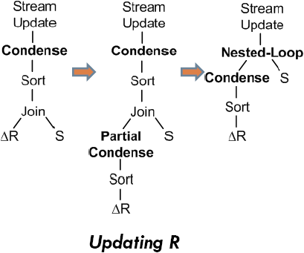
Condensing delta streams [4/4] Partial Condense

Slide 21
Contents
Introduction
Solution overview
Maintenance algorithms
Condensing delta streams
Experiments
Conclusion

Slide 22
Experiments [1/5] Experimental Setup
Materialized views
V1: SELECT n_name, c_mktsegment, count(*) as totalcnt
sum(l_extendedprice) as totalprice, sum(l_quantity) as totalquan
FROM Customer, Orders, Lineitem, Nation
WHERE c_custkey= o_custkeyAND o_orderkey= l_orderkey
AND n_nationkey= c_nationkey
GROUP BY n_name, c_mktsegment
V2: SELECT s_name, c_name, c_mktsegment, ps_comment, …
FROM Customer, Orders, Lineitem, Supplier, Partsupp
WHERE c_custkey= o_custkeyAND o_orderkey= l_orderkey AND …
AND s_nationekey<> c_nationkey

Slide 23
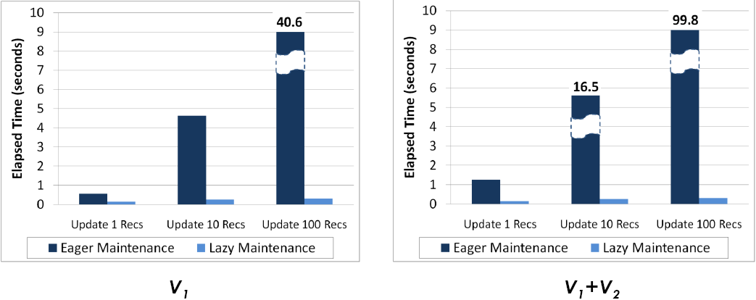
Experiments [2/5] Update Response Time

Slide 24
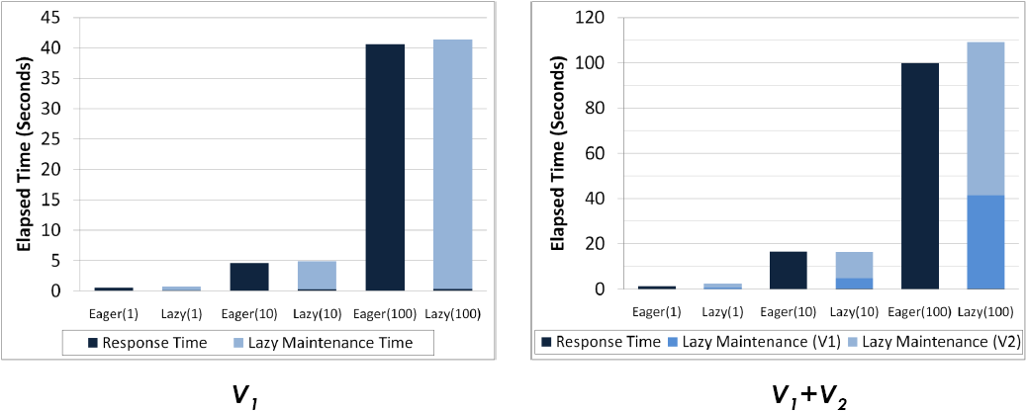
Experiments [3/5] Maintenance Cost

Slide 25
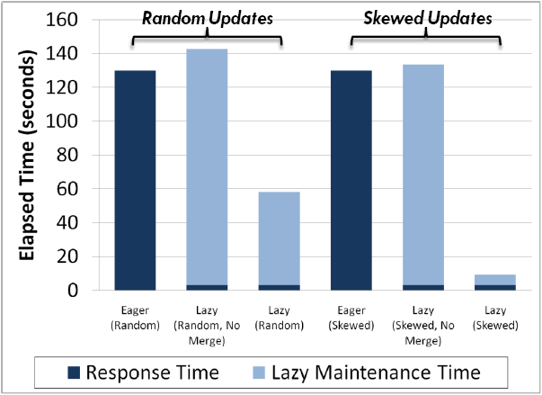
Experiments [4/5] Multiple Updates

Slide 26
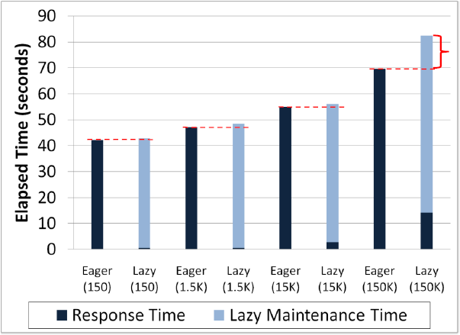
Experiments [5/5] Lazy Maintenance Overhead

Slide 27
Contents
Introduction
Solution overview
Maintenance algorithms
Condensing delta streams
Experiments
Conclusion

Slide 28
Conclusion
Lazy maintenance separates maintenance from update transactions
Greatly improves update response time without sacrificing view usability
More efficient maintenance by combining and condensing updates
Totally transparent to applications
The choice of maintenance strategy (eager v.s. lazy) depends on
The ratio of updates to queries and how soon queries follow after updates
The size of updates, relative to the maintenance cost
Lazy maintenance can be applied to other auxiliary data structures, such as indexes

