Slide 1
Appendix B: Hierarchical Model

Slide 2
Database System Concepts
Chapter 1: Introduction
Part 1: Relational databases
  Chapter 2: Relational Model
  Chapter 3: SQL
  Chapter 4: Advanced SQL
  Chapter 5: Other Relational Languages
Part 2: Database Design
  Chapter 6: Database Design and the E-R Model
  Chapter 7: Relational Database Design
  Chapter 8: Application Design and Development
Part 3: Object-based databases and XML
  Chapter 9: Object-Based Databases
  Chapter 10: XML
Part 4: Data storage and querying
  Chapter 11: Storage and File Structure
  Chapter 12: Indexing and Hashing
  Chapter 13: Query Processing
  Chapter 14: Query Optimization
Part 5: Transaction management
  Chapter 15: Transactions
  Chapter 16: Concurrency control
  Chapter 17: Recovery System
Part 6: Data Mining and Information Retrieval
  Chapter 18: Data Analysis and Mining
  Chapter 19: Information Retreival
Part 7: Database system architecture
  Chapter 20: Database-System Architecture
  Chapter 21: Parallel Databases
  Chapter 22: Distributed Databases
Part 8: Other topics
  Chapter 23: Advanced Application Development
  Chapter 24: Advanced Data Types and New Applications
  Chapter 25: Advanced Transaction Processing
Part 9: Case studies
  Chapter 26: PostgreSQL
  Chapter 27: Oracle
  Chapter 28: IBM DB2
  Chapter 29: Microsoft SQL Server
Online Appendices
  Appendix A: Network Model
  Appendix B: Hierarchical Model
  Appendix C: Advanced Relational Database Model

Slide 3
Online Appendices
(available only in http://www.db-book.com)
Appendix A: Network Model
Appendix B: Hierarchical Model
Although most new database applications use either the relational model or the object-relational model, the network and hierarchical data models are still in use in some legacy applications.
Appendix C: Advanced Relational Database Model
  describes advanced relational-database design, including the theory of multivalued dependencies, join dependencies, and the project-join and domain-key normal forms.

Slide 4
Appendix-B: Hierarchical Model
G
Basic Concepts
Tree-Structure Diagrams
Data-Retrieval Facility
Update Facility
Virtual Records
Mapping of Hierarchies to Files
The IMS Database System
Summary

Slide 5
Basic Concepts
A hierarchical database consists of a collection of records which are connected to one another through links.
a record is a collection of fields, each of which contains only one data value.
A link is an association between precisely two records.
The hierarchical model differs from the network model in that the records are organized as collections of trees rather than as arbitrary graphs.

Slide 6
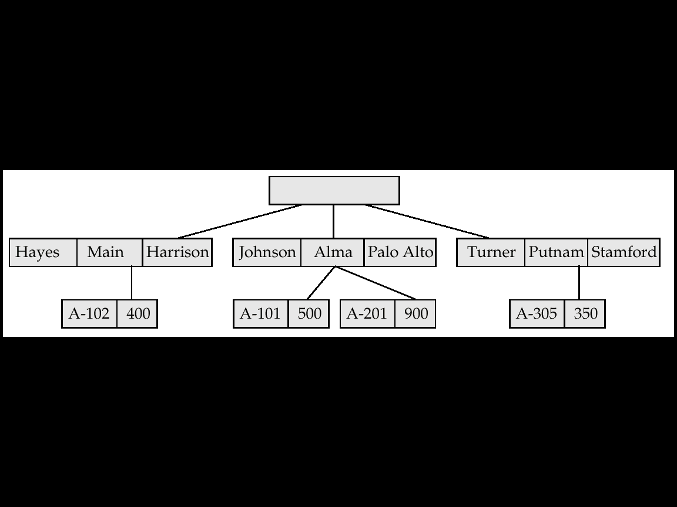
Sample Hierarchical Database
G

Slide 7
Appendix-B: Hierarchical Model
G
Basic Concepts
Tree-Structure Diagrams
Data-Retrieval Facility
Update Facility
Virtual Records
Mapping of Hierarchies to Files
The IMS Database System
Summary

Slide 8
Tree-Structure Diagrams
The schema for a hierarchical database consists of
  boxes, which correspond to record types
  lines, which correspond to links
Record types are organized in the form of a rooted tree.
  No cycles in the underlying graph.
  Relationships formed in the graph must be such that only
  one-to-many or one-to-one relationships exist between a parent and a child.

Slide 9
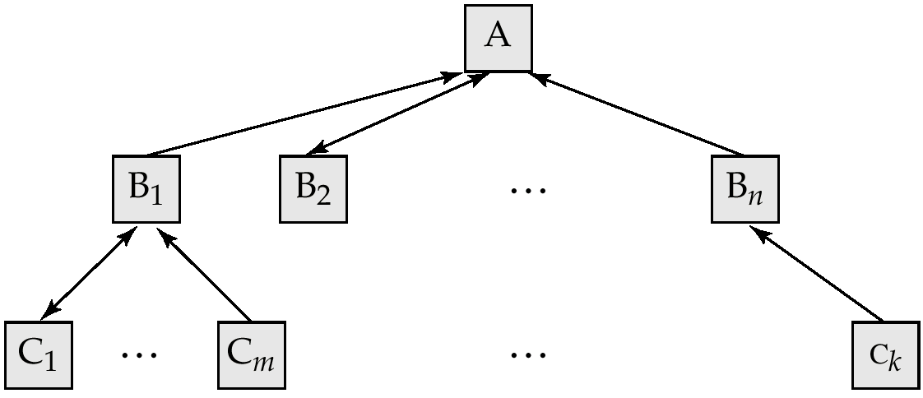
General Structure
A parent may have an arrow pointing to a child, but a child must have an arrow pointing to its parent.

Slide 10
Tree-Structure Diagrams (Cont.)
Database schema is represented as a collection of tree-structure diagrams.
  single instance of a database tree
  The root of this tree is a dummy node
  The children of that node are actual instances of the appropriate record type
When transforming E-R diagrams to corresponding tree-structure diagrams, we must ensure that the resulting diagrams are in the form of rooted trees.

Slide 11
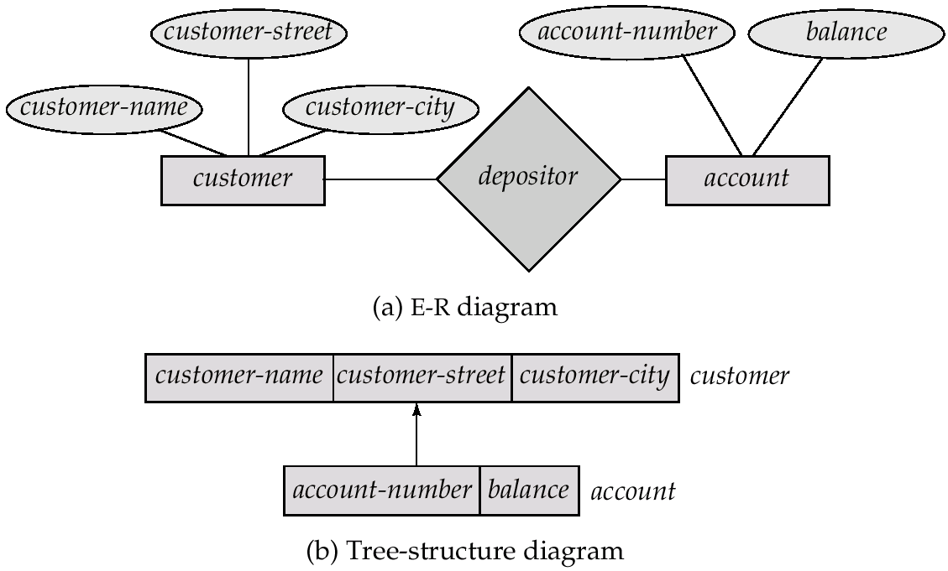
Single Relationships
G

Slide 12
Single relationships (Cont.)
Example E-R diagram with two entity sets, customer and account, related through a binary, one-to-many relationship depositor.
Corresponding tree-structure diagram has
  the record type customer with three fields: customer-name, customer-street, and customer-city.
  the record type account with two fields: account-number and balance
  the link depositor, with an arrow pointing to customer

Slide 13
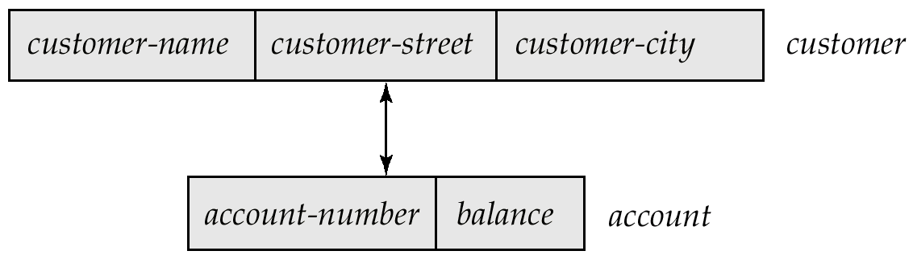
Single Relationships (Cont.)
If the relationship depositor is one to one, then the link depositor has two arrows.
Only one-to-many and one-to-one relationships can be directly represented in the hierarchical mode.

Slide 14
Transforming Many-To-Many Relationships
G
Must consider the type of queries expected and the degree to which the database schema fits the given E-R diagram.
In all versions of this transformation, the underlying database tree (or trees) will have replicated records.

Slide 15
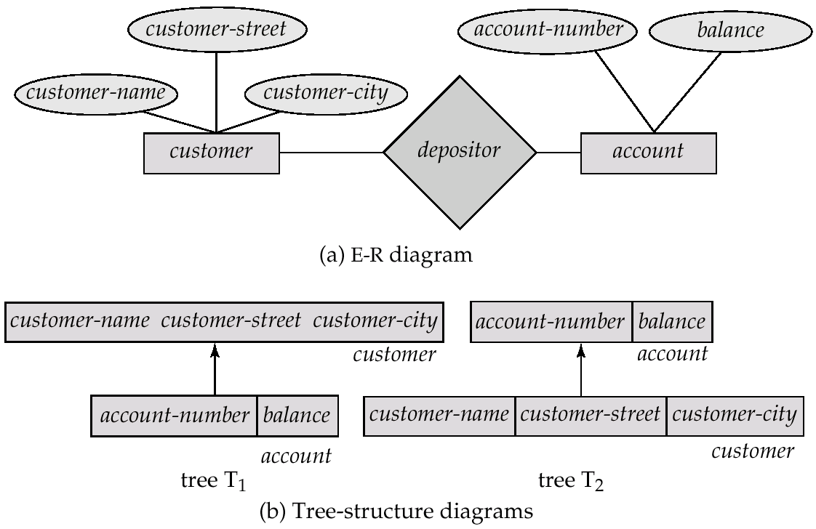
Many-To Many Relationships (Cont.)
G

Slide 16
Many-To-Many Relationships (Cont.)
Create two tree-structure diagrams, T₁, with the root customer, and T₂, with the root account.
In T₁, create depositor, a many-to-one link from account to customer.
In T₂, create account-customer, a many-to-one link from customer to account.

Slide 17
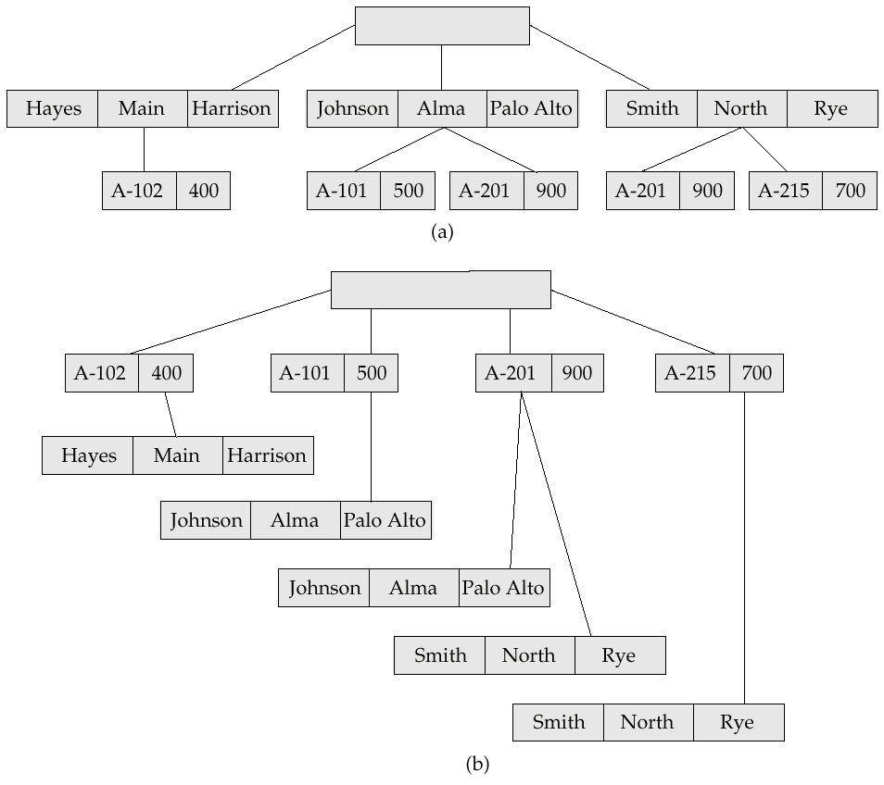
Sample Database
G

Slide 18
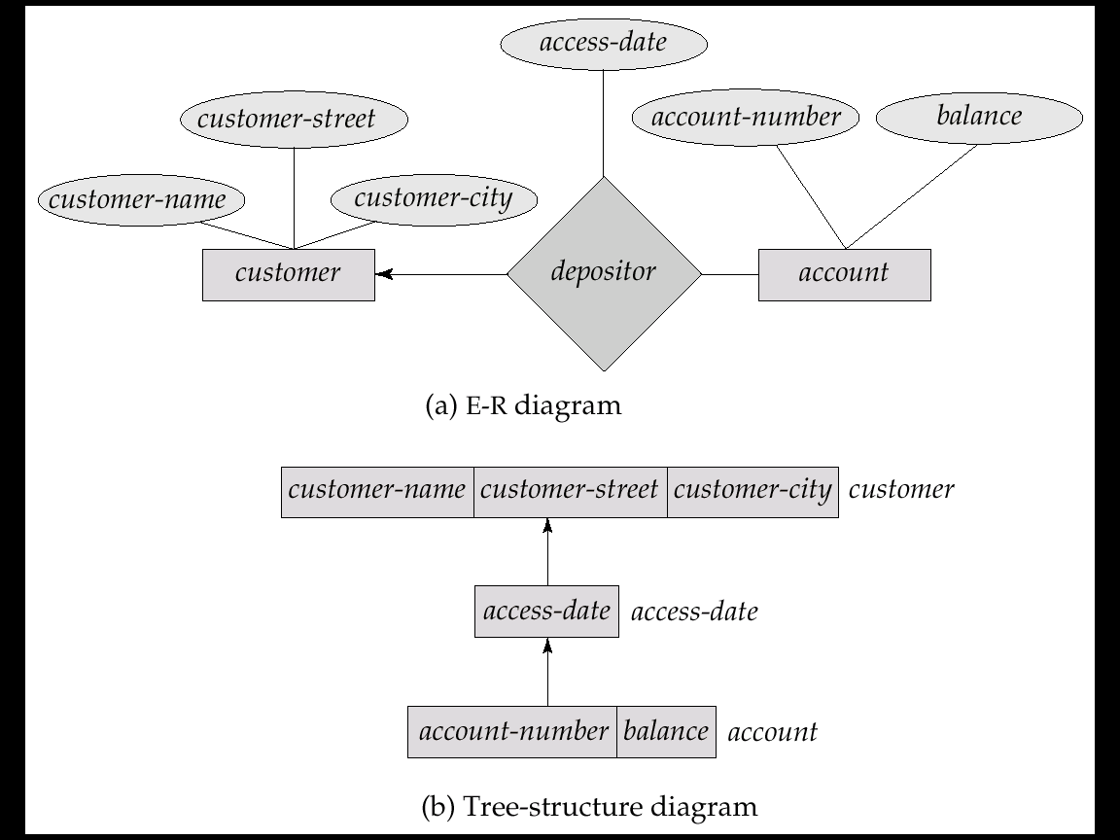
General Relationships
Example ternary E-R diagram and corresponding tree-structure diagrams are shown on the following page.

Slide 19
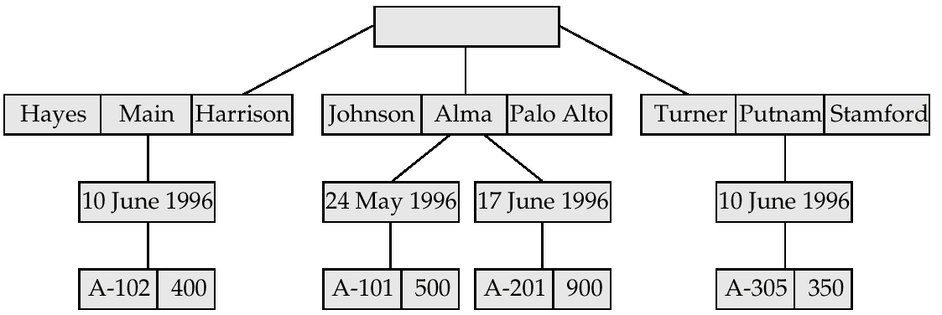
Sample Database Corresponding To Diagram of Figure B.8b

Slide 20
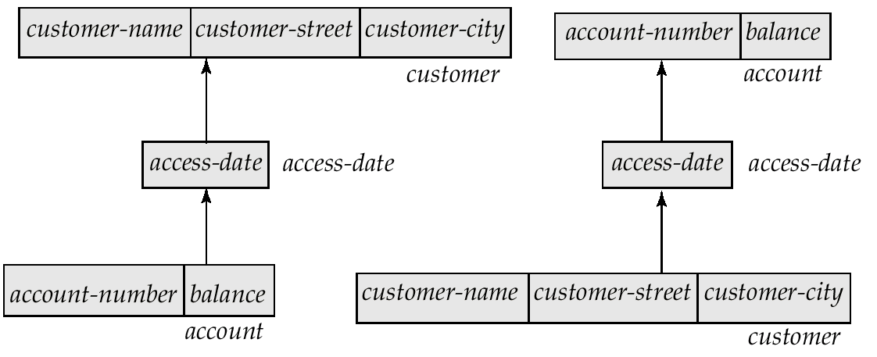
Tree-Structure Diagram With
Many-To-Many Relationships

Slide 21
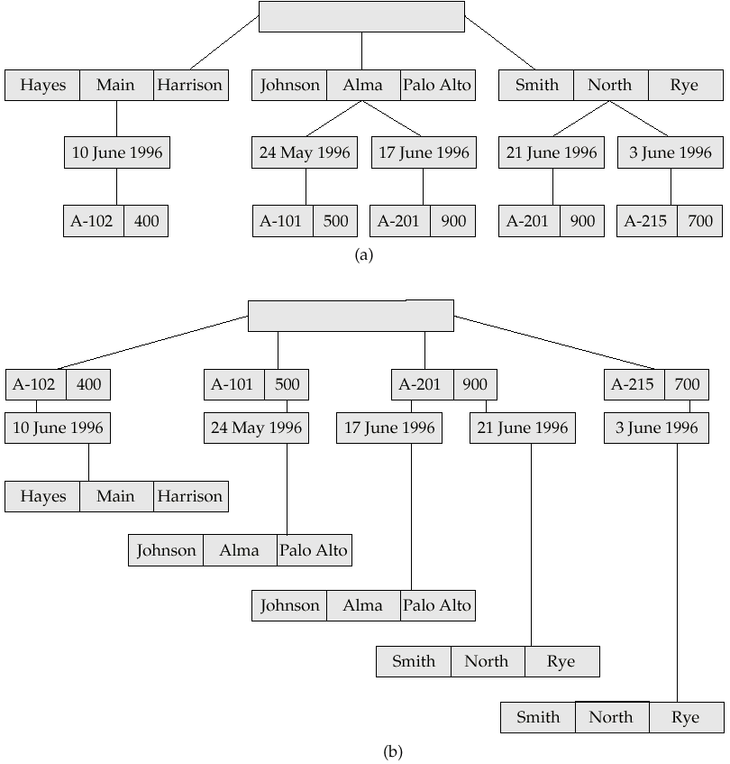
Sample Ternary Databases. (a) T₁ (b) T₂

Slide 22
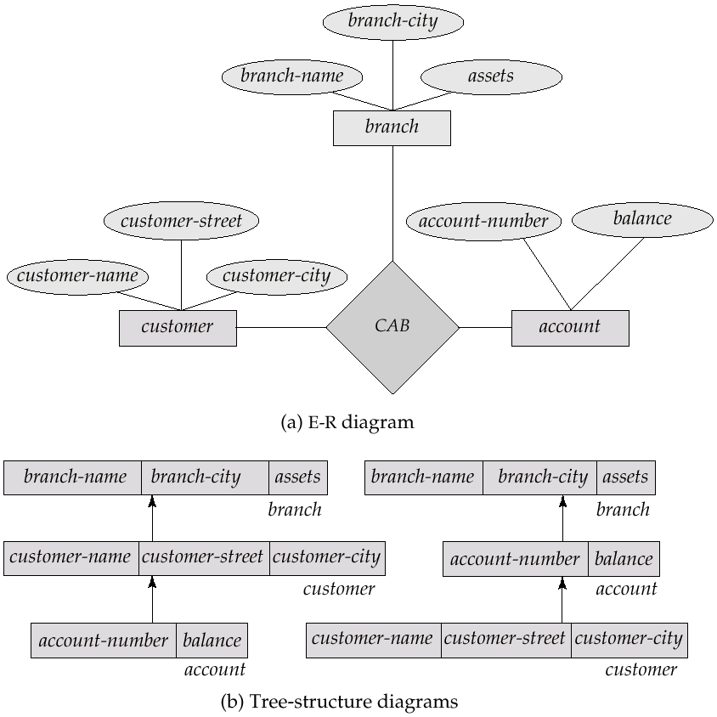
E-R Diagram and Its Corresponding Tree-Structure Diagrams

Slide 23
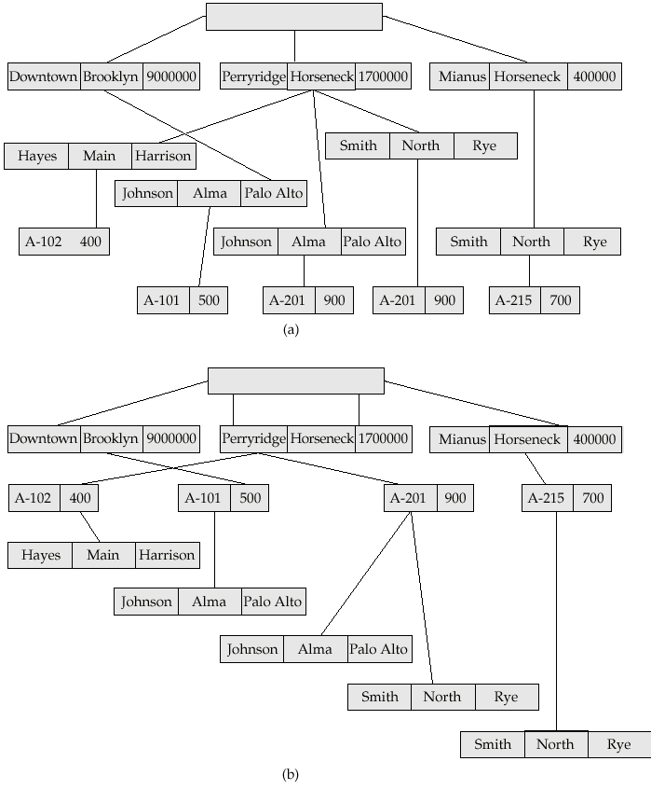
Sample Database Corresponding To Diagram of Figure B.12b

Slide 24
Several Relationships
To correctly transform an E-R diagram with several relationships, split the unrooted tree structure diagrams into several diagrams, each of which is a rooted tree.
Example E-R diagram and transformation leading to diagram that is not a rooted tree:

Slide 25
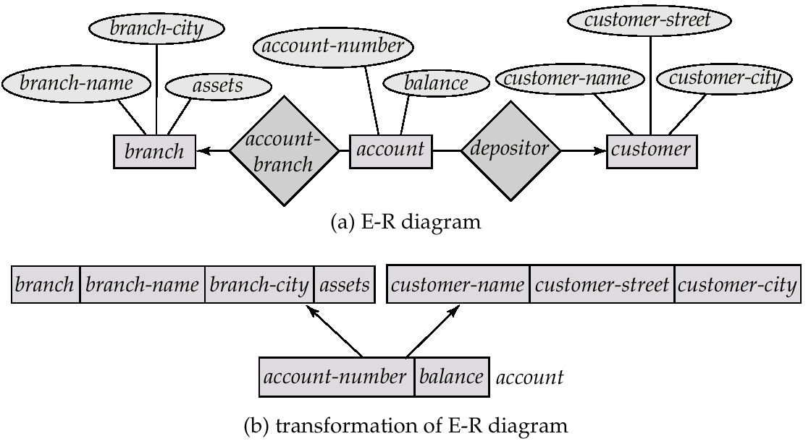
Several Relationships (Cont.)

Slide 26
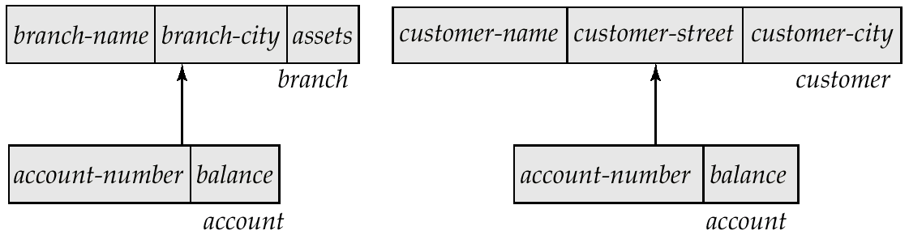
Several Relationships (Cont.)
Corresponding diagrams in the form of rooted trees.

Slide 27
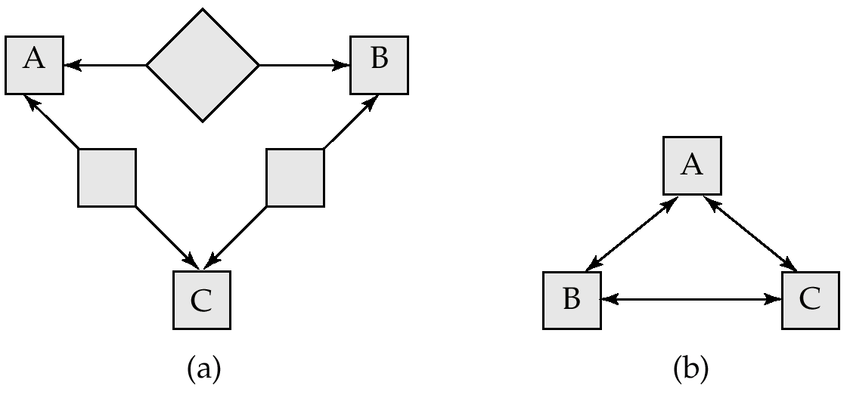
Several Relationships (2nd Example)
Diagram (b) contains a cycle.
Replicate all three record types, and create two separate diagrams.

Slide 28
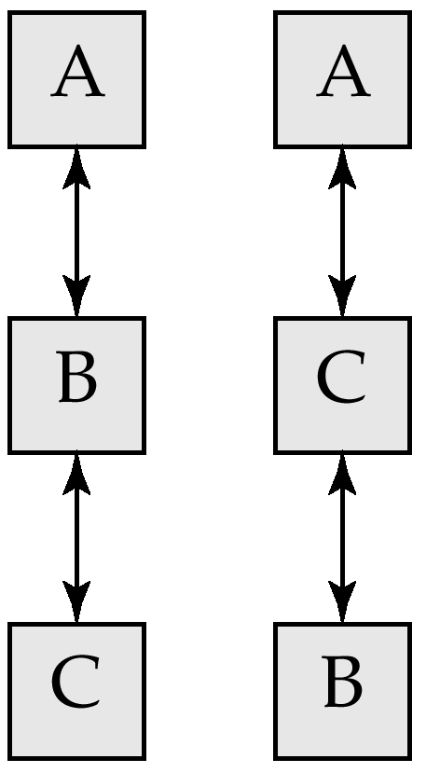
Several Relationships (2nd Example)
Each diagram is now a rooted tree.

Slide 29
Appendix-B: Hierarchical Model
Basic Concepts
Tree-Structure Diagrams
Data-Retrieval Facility
Update Facility
Virtual Records
Mapping of Hierarchies to Files
The IMS Database System
Summary

Slide 30
Data Retrieval Facility
G
We present querying of hierarchical databases via a simplified version of DL/I, the data-manipulation language of IMS.
Example schema: customer-account-branch
A branch can have several customers, each of which can have several accounts.
An account may belong to only one customer, and a customer can belong to only one branch.

Slide 31
Program Work Area
A buffer storage area that contains these variables
  Record templates
  Currency pointers
  Status flag
A particular program work area is associated with precisely one application program.
Example program work area:
  Templates for three record types: customer, account, and branch.
  Currency pointer to the most recently accessed record of branch, customer, or account type.
  One status variable.

Slide 32
The get Command
Data items are retrieved through the get command
  locates a record in the database and sets the currency pointer to point to it
  copies that record from the database to the appropriate program work-area template
The get command must specify which of the database trees is to be searched.
State of the program work area after executing get command to locate the customer record belonging to Freeman
  The currency pointer points now to the record of Freeman.
  The information pertaining to Freeman is copied into the customer record work-area template.
  DB-status is set to the value 0.

Slide 33
The get Command (Cont.)
To scan all records in a consistent manner, we must impose an ordering on the records.
Preorder search starts at the root, and then searches the subtrees of the root from left to right, recursively.
  Starts at the root, visits the leftmost child, visits its leftmost child, and so on, until a leaf (childless) node is reached.
  Move back to the parent of the leaf and visit the leftmost unvisited child.
  Proceed in this manner until the entire three is visited.
Preordered listing of the records in the example database three:
Parkview, Fleming, A-522, A-561, Freeman, A533,
Seashore, Boyd, A-409, A-622

Slide 34
Access Within A Database Tree
Locates the first record (in preorder), of type <record type> that satisfies the <condition> of the where clause.
The where clause is optional <condition> is a predicate that involves either an ancestor of <record type> or the <record type> itself.
If where is omitted, locate the first record of type
<record-type>
  Set currency pointer to that record
  Copy its contents into the appropriate work-area template.
If no such record exists in the tree, then the search fails, and
DB-status is set to an appropriate error message.

Slide 35
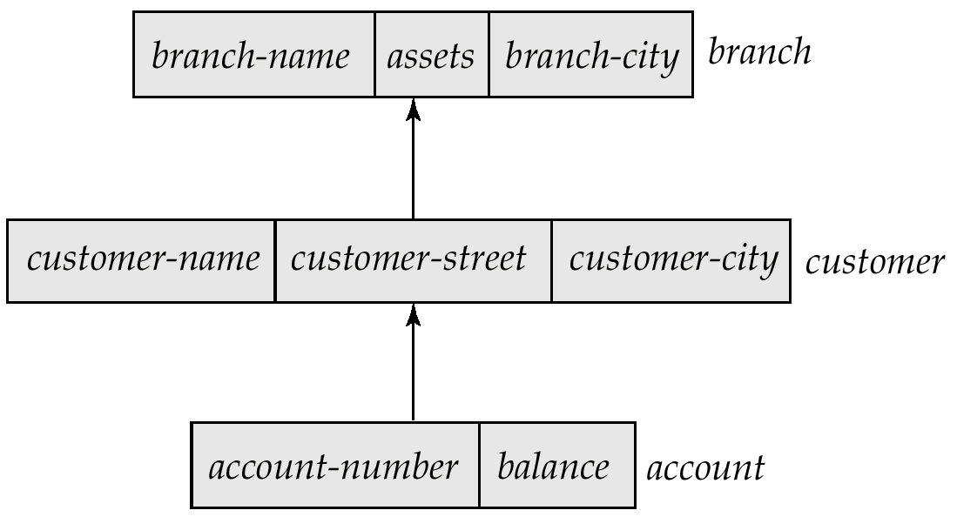
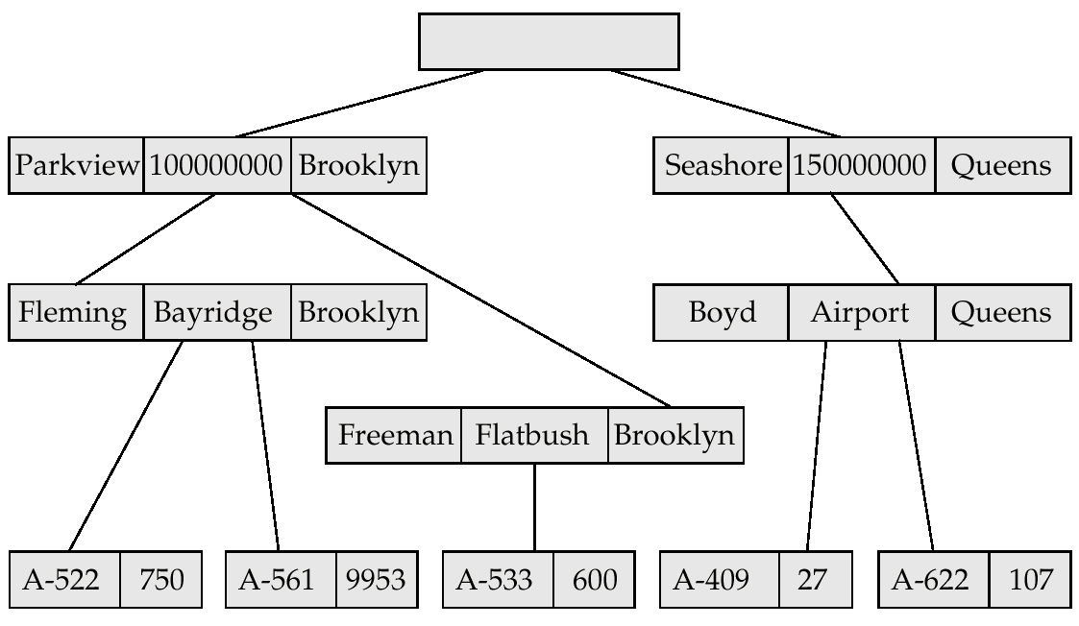
Example Schema
G

Slide 36
Example Queries
G
Print the address of customer Fleming:
get first customer
where customer.customer-name = “Fleming”;
print (customer.customer-address);
Print an account belonging to Fleming that has a balance greater than $10,000.
get first account
where customer.customer-name = “Fleming”;
and account.balance > 10000;
if DB-status = 0 then print (account.account-number);

Slide 37
Access Within a Database Tree (Cont.)
get next <record type>
where <condition>
Locates the next record (in preorder) that satisfies
<condition>.
If the where clause is omitted, then the next record of type
<record type> is located.
The currency pointer is used by the system to determine where to resume the search.
As before, the currency pointer, the work-area template of type <record-type>, and DB-status are affected.

Slide 38
Example Query
Print the account number of all the accounts that have a balance greater than $500
get first account
where account.balance > 500;
while DB-status = 0 do
begin
print (account.account-number);
get next account
where account.balance > 500;
end
When while loop returns DB-status ≠ 0, we exhausted all account records with account.balance > 500.

Slide 39
Access Within a Database Tree (Cont.)
get next within parent <record type>
where <condition>
Searches only the specific subtree whose root is the most recent record that was located with either get first or get next.
Locates the next record (in preorder) that satisfies <condition> in the subtree whose root is the parent of current of <record type>.
If the where clause is omitted, then the next record of type <record type> within the designated subtree to resume search.
Use currency pointer to determine where to resume search.
DB-status is set to a nonzero value if no such record exists in the designated subtree (rather than if none exists in the entire tree).

Slide 40
Example Schema
G

Slide 41
Example Query
G
Print the total balance of all accounts belonging to Boyd:
sum := 0;
get first customer
where customer.customer-name = “Boyd”;
get next within parent account;
while DB-status = 0 do
begin
sum = sum + account.balance;
get next within parent account;
end
print (sum);
We exit from the while loop and print out the value of sum only when the DB-status is set to a value not equal to 0. This value exists after the get next within parent operation fails.

Slide 42
Appendix-B: Hierarchical Model
Basic Concepts
Tree-Structure Diagrams
Data-Retrieval Facility
Update Facility
Virtual Records
Mapping of Hierarchies to Files
The IMS Database System
Summary

Slide 43
Update Facility
Various mechanisms are available for updating information in the database.
Creation and deletion of records (via the insert and delete operations).
Modification (via the replace operation) of the content of existing records.

Slide 44
Creation of New Records
To insert <record type> into the database, first set the appropriate values in the corresponding <record type> work-area template. Then execute
insert <record type>
where <condition>
If the where clause is included, the system searches the database three (in preorder) for a record that satisfies the <condition> in the where clause.
Once such a record — say, X — is found, the newly created record is inserted in the tree as the leftmost child of X.
If where is omitted, the record is inserted in the first position (in preorder) in the tree where <record type> can be inserted in accordance with the specified schema.

Slide 45
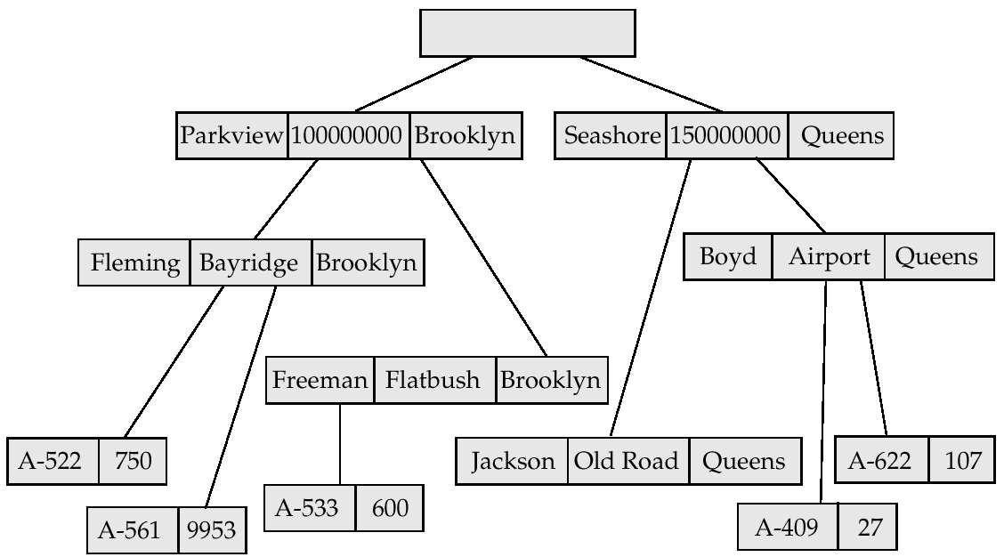
New Database Tree

Slide 46
Example Queries
Add a new customer, Jackson, to the Seashore branch:
customer.customer-name := “Jackson”;
customer.customer-street := “Old Road”;
customer.customer-city := “Queens”;
insert customer
where branch.branch-name = “Seashore”;
Create a new account numbered A-655 that belongs to customer “Jackson”;
account.account-number := “A-655”;
account.balance := 100;
insert account
where customer.customer-name = “Jackson”;

Slide 47
Modification of an Existing Record
To modify an existing record of type <record type>, we must get that record into the work-area template for <record type>, and change the desired fields in that template.
Reflect the changes in the database by executing
replace
replace dies not have <record type> as an argument; the record that is affected is the one to which the currency pointer points.
DL/I requires that, prior to a record being modified, the get command must have the additional clause hold, so that the system is aware that a record is to be modified.

Slide 48
Example Query
Change the street address of Boyd to Northview:
get hold first customer
where customer.customer-name = “Boyd”;
customer.customer-street := “Northview”;
replace;
If there were more than one record containing Boyd’s address, the program would have included a loop to search all Boyd records.

Slide 49
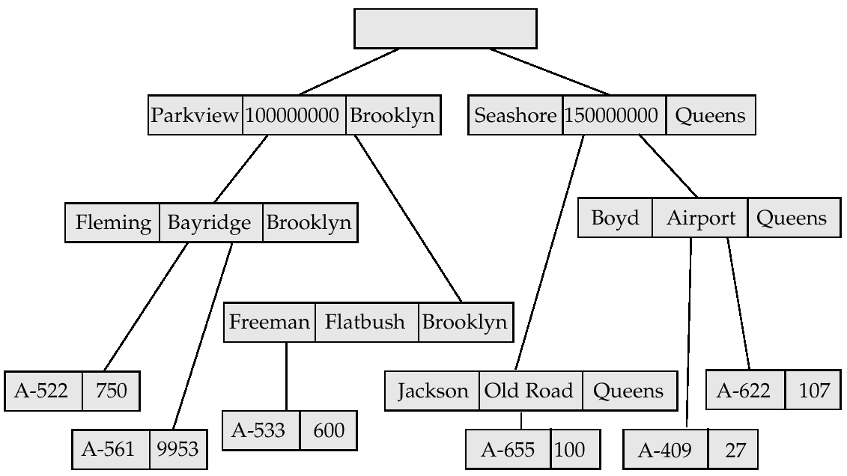
New Database Tree

Slide 50
Deletion of a Record
To delete a record of type <record type>, set the currency pointer to point to that record and execute delete.
As a record modification, the get command must have the attribute hold attached to it. Example: Delete account A-561:
get hold first account
where account.account-number = “A-561”;
delete;
A delete operation deletes not only the record in question, but also the entire subtree rooted by that record. Thus, to delete customer Boyd and all his accounts, we write
get gold first customer
where customer.customer-name = “Boyd”;
delete;

Slide 51
Appendix-B: Hierarchical Model
Basic Concepts
Tree-Structure Diagrams
Data-Retrieval Facility
Update Facility
Virtual Records
Mapping of Hierarchies to Files
The IMS Database System
Summary

Slide 52
Virtual Records
G
For many-to-many relationships, record replication is necessary to preserve the tree-structure organization of the database.
  Data inconsistency may result when updating takes place
  Waste of space is unavoidable
Virtual record — contains no data value, only a logical pointer to a particular physical record.
When a record is to be replicated in several database trees, a single copy of that record is kept in one of the trees and all other records are replaced with a virtual record.
Let R be a record type that is replicated in T₁, T₂, . . ., T_{n}. Create a new virtual record type virtual-R and replace R in each of the
n – 1 trees with a record of type virtual-R.

Slide 53
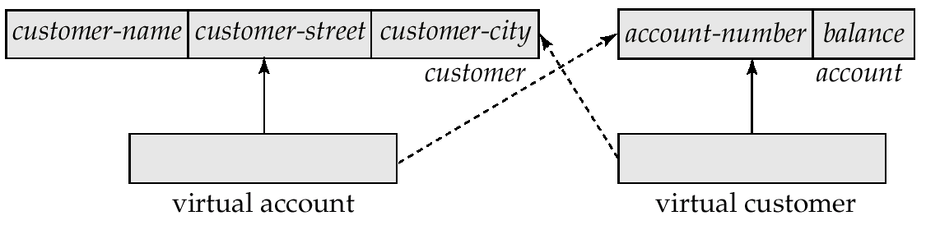
Virtual Records (Cont.)
G
Eliminate data replication in the diagram shown on page B.11; create virtual-customer and virtual-account.
Replace account with virtual-account in the first tree, and replace customer with virtual-customer in the second tree.
Add a dashed line from virtual-customer to customer, and from virtual-account to account, to specify the association between a virtual record and its corresponding physical record.

Slide 54
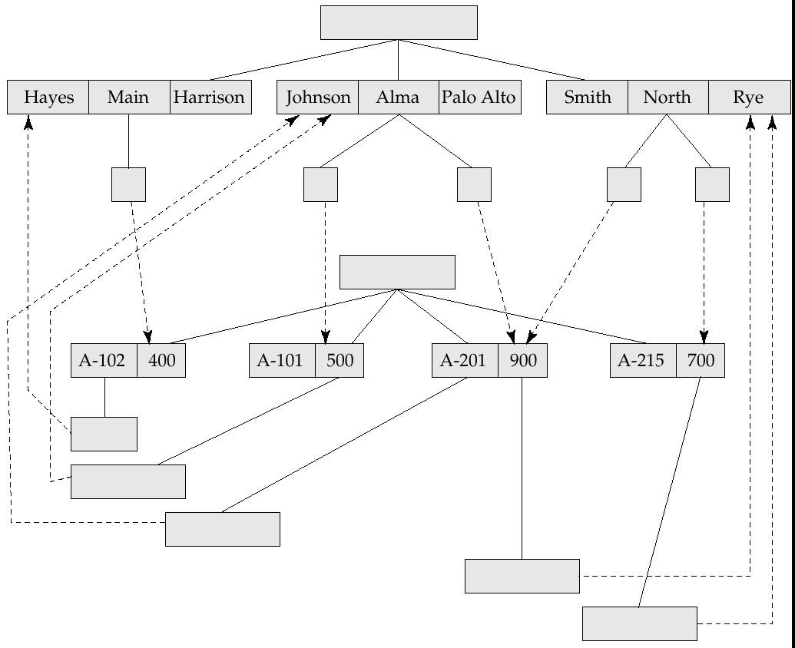
Sample Database
G

Slide 55
Appendix-B: Hierarchical Model
Basic Concepts
Tree-Structure Diagrams
Data-Retrieval Facility
Update Facility
Virtual Records
Mapping of Hierarchies to Files
The IMS Database System
Summary

Slide 56
Mapping Hierarchies to Files
Implementations of hierarchical databases do not use
parent-to-child pointers, since these would require the use of variable-length records.
Can use leftmost-child and next-sibling pointers which allow each record to contain exactly two pointers.
  The leftmost-child pointer points to one child.
  The next-sibling pointer points to another child of the same parent.

Slide 57
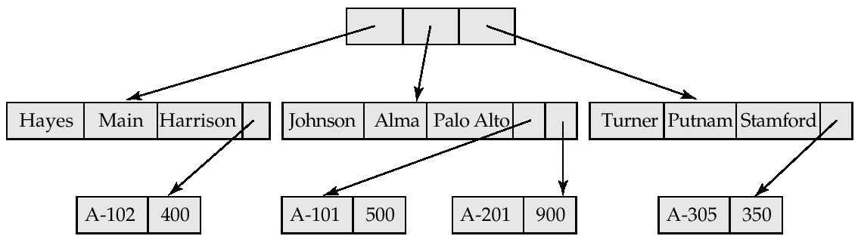
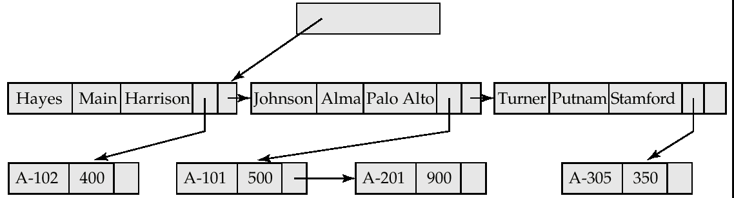
Mapping Hierarchies to Files (Cont.)
Implementation with parent-child pointers.
Implementation with leftmost child and next-sibling pointers.

Slide 58
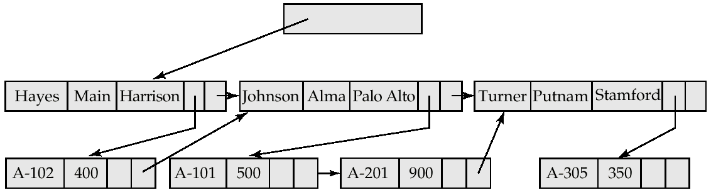
Mapping Hierarchies to Files (Cont.)
In general, the final child of a parent has no next sibling; rather than setting the next-sibling filed to null, place a pointer (or preorder thread) that points to the next record in preorder.
Using preorder threads allows us to process a tree instance in preorder simply by following pointers.

Slide 59
Mapping Hierarchies to Files (Cont.)
May add a third child-to-parent pointer which facilitates the processing of queries that give a value for a child record and request a value from the corresponding parent record.
the parent-child relationship within a hierarchy is analogous to the owner-member relationship within a DBTG set.
  A one-to-many relationship is being represented.
  Store together the members and the owners of a set occurrence.
  Store physically close on disk the child records and their parent.
  Such storage allows a sequence of get first, get next, and
  get next within parent statements to e executed with a minimal number of block accesses.

Slide 60
Appendix-B: Hierarchical Model
Basic Concepts
Tree-Structure Diagrams
Data-Retrieval Facility
Update Facility
Virtual Records
Mapping of Hierarchies to Files
The IMS Database System
Summary

Slide 61
The IMS Database System
IBM Information Management System — first developed in the late 1960s; historically among the largest databases.
Issue queries through embedded calls which are part of the IMS database language DL/I.
Allows the database designer a broad number of options in the data-definition language.
  Designer defines a physically hierarchy as the database schema.
  Can define several subschemas (or view) by constructing a logical hierarchy from the record types constituting the schema.
  Options such as block sizes, special pointer fields, and so on, allow the database administrator to tune the system.

Slide 62
Record Access Schemes
Hierarchical sequential-access method (HSAM) — used for physically sequential files (such as tape files). Records are stored physically in preorder.
Hierarchical indexed-sequential-access method (HISAM) — an index-sequential organization at the root level of the hierarchy.
Hierarchical indexed-direct-access method (HIDAM) — index organization at the root level with pointers to child records.
Hierarchical direct-access method (HDAM) — similar to HIDAM, but with hashed access at the root level.

Slide 63
IMS Concurrency Control
Early versions handled concurrency control by permitting only one update application program to run at a time. Read-only applications could run concurrent with updates.
Later versions included a program-isolation feature
  Allowed for improved concurrency control
  Offered more sophisticated transaction-recovery techniques (such as logging); important to online transactions.
The need for high-performance transaction processing led to the introduction of IMS Fast Path.

Slide 64
IMS Fast Path
Uses an alternative physical data organization that allows the most active parts of the database to reside in main memory.
Instead of updates to disk being forced at the end of a transaction, update is deferred until a checkpoint or synchronization point.
In the event of a crash, the recovery subsystem must redo all committed transactions whose updates were not forced to disk.
Allows for extremely high rates of transaction throughput.
Forerunner of main-memory database systems.

Slide 65
Appendix-B: Hierarchical Model
Basic Concepts
Tree-Structure Diagrams
Data-Retrieval Facility
Update Facility
Virtual Records
Mapping of Hierarchies to Files
The IMS Database System
Summary

Slide 66
Appendix-B Summary (1)
A hierarchical database consists of a collection of records that are connected to each other through links.
A record is a collection of fields, each of which contains only one data value.
A link is an association between precisely two records.
The hierarchical model is thus similar to the network model in the sense that data and relationships between data are also represented by records and links, respectively.
The hierarchical model differs from the network model in that the record types are organized as collections of trees, rather than as arbitrary graphs.

Slide 67
Appendix-B Summary (2)
A tree-structure diagram is a schema for a hierarchical database.
Such a diagram consists of two basic components: boxes,which correspond to record types, and lines, which correspond to links.
A tree-structure diagram serves the same purpose as an E-R diagram; it specifies the overall logical structure of the database.
A tree-structure diagram is similar to a data-structure diagram in the network model.
The main difference is that, in the former, record types are organized in the form of an arbitrary graph, whereas in the latter, record types are organized in the form of a rooted tree.
For every E-R diagram, there is a corresponding tree-structure diagram.

Slide 68
Appendix-B Summary (3)
The database schema is thus represented as a collection of tree-structure diagrams.
For each such diagram, there exists a single instance of a database tree.
The root of this tree is a dummy node.
The children of the dummy node are instances of the root record type in the tree structure diagram.
Each record instance may, in turn, have several children, which are instances of various record types, as specified in the corresponding tree-structure diagram.

Slide 69
Appendix-B Summary (4)
The data-manipulation language discussed in this appendix consists of commands that are embedded in a host language.
These commands access and manipulate database items, as well as locally declared variables.
For each application program, the system maintains a program work area that contains record templates, currency pointers, and a status flag.
Data items are retrieved through the get command, which locates a record in the database, sets the currency pointer to point to that record, and then copies the record from the database to the appropriate program work-area template.
There are various forms of the get command.
The main distinction among them is where in the database tree the search starts and whether the search continues until the end of the entire database tree or restricts itself to a particular subtree.

Slide 70
Appendix-B Summary (5)
Various mechanisms are available for updating information in the database.
They allow the creation and deletion of records (via the insert and delete operations), and the modification (via the replace operation) of the content of existing records.
In the case of many-to-many relationships, record replication is necessary to preserve the tree-structure organization of the database.
Record replication has two major drawbacks: (1) data inconsistency may result when updating takes place and (2) waste of space is unavoidable.
The solution is to introduce the concept of a virtual record.

Slide 71
Appendix-B Summary (6)
Such a record contains no data value; it does contains a logical pointer to a particular physical record.
When a record needs to be replicated, a single copy of the actual record is retained, and all other records are replaced with a virtual record containing a pointer to that physical record.
The data-manipulation language for this new configuration remains the same as in the case where record replication is allowed.
Thus, a user does not need to be aware of these changes. Only the internal implementation is affected.
Implementations of hierarchical databases do not use parent-to-child pointers, since that would require the use of variable-length records.
Instead, they use preorder threads.
This technique allows each record to contain exactly two pointers.
Optionally, a third child-to-parent pointer may be added.

Slide 72
Bibliographical Notes (1)
Two influential database systems that rely on the hierarchical model are IBM’s Information Management System (IMS) [IBM 1978a, McGee 1977] and MRI’s System 2000 [MRI 1974, 1979].
The first IMS version was developed in the late 1960s by IBM and by North American Aviation (Rockwell International) for the Apollo moon-landing program.
A survey paper on the hierarchical data model is presented by Tsichritzis and Lochovsky [1976].
The simplified version of DL/I used in this appendix is similar to the one presented by Ullman [1988].

Slide 73
Bibliographical Notes (2)
With the current dominance of relational database systems, there is often a need to query data in legacy hierarchical databases by using a relational language.
Meng et al. [1995] discusses translation of relational queries into hierarchical queries.
Obermarck [1980] discusses the IMS program-isolation feature and gives a brief history of the concurrency-control component of IMS.
Bjorner and Lovengren [1982] presents a formal definition of IMS.

Slide 74
Appendix-B: Hierarchical Model
G
Basic Concepts
Tree-Structure Diagrams
Data-Retrieval Facility
Update Facility
Virtual Records
Mapping of Hierarchies to Files
The IMS Database System
Summary

Slide 75
End of Chapter

Slide 76
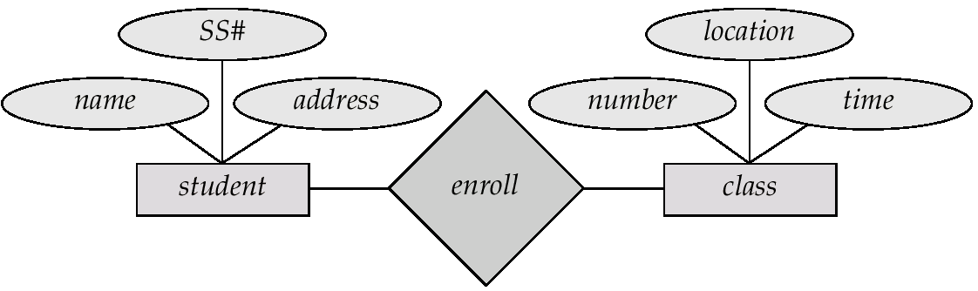
Class-enrollment E-R Diagram

Slide 77
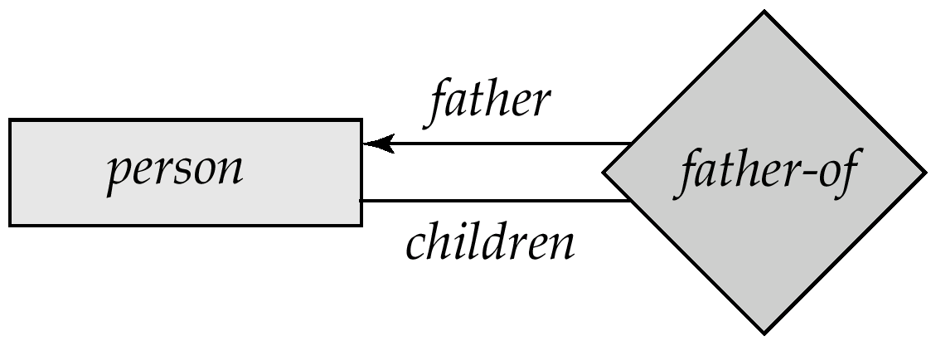
Parent–Child E-R Diagram

Slide 78
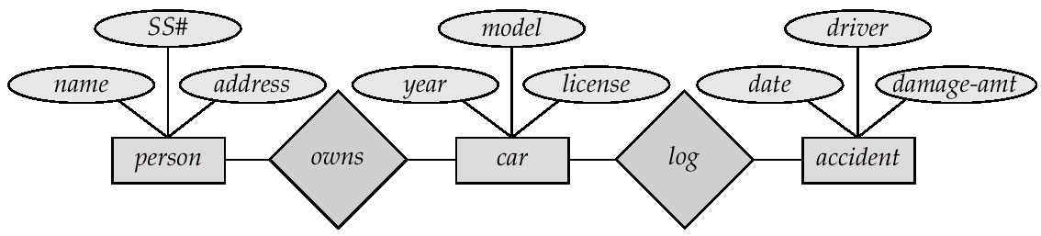
Car-insurance E-R Diagram

