Slide 1
Data Intensive Query Processing for Large RDF Graphs Using Cloud Computing Tools
Mohammad Farhan Husain et al.
University of Texas at Dallas
Cloud Computing 2011
29 March 2013
SNU IDB Lab.
Min Sup Lee

Slide 2
Outline
Introduction
Proposed Architecture
MapReduce Framework
Results
Conclusion
Discussion

Slide 3
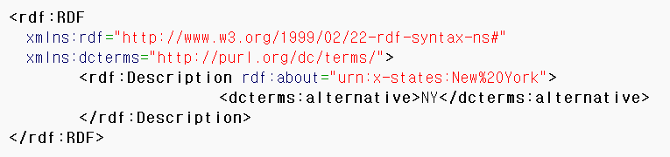
Introduction
Semantic Web
Enabling users to find, share, and combine information more easily
The inclusion of semantic content in web pages
RDF (Resource Description Framework)
The most prominent standards
Storing and representing data
SPARQL
Query language to retrieve data from an RDF store
[The Postal abbreviation for New York]
<RDF/XML>
<N-triples>
New York has the postal abbreviation NY

Slide 4
Introduction
RDF Query Processing
S | P | O
민섭 | type | Student
혜성 | type | Student
길동 | type | Student
민섭 | worksFor | IDB
혜성 | worksFor | IDB
길동 | worksFor | OS
IDB | subOrganizationOf | SNU
OS | subOrganizationOf | MIT
IDB | type | Lab.
OS | type | Lab.
SNU | type | Univ.
MIT | type | Univ.
SELECT ?X WHERE{
?X rdf : type ub : Student
?X ub : worksFor ?Y
?Y ub : subOrganizationOf SNU }
민섭 | worksFor | IDB
혜성 | worksFor | IDB
길동 | worksFor | OS
IDB | subOrganizationOf | SNU
민섭
혜성

Slide 5

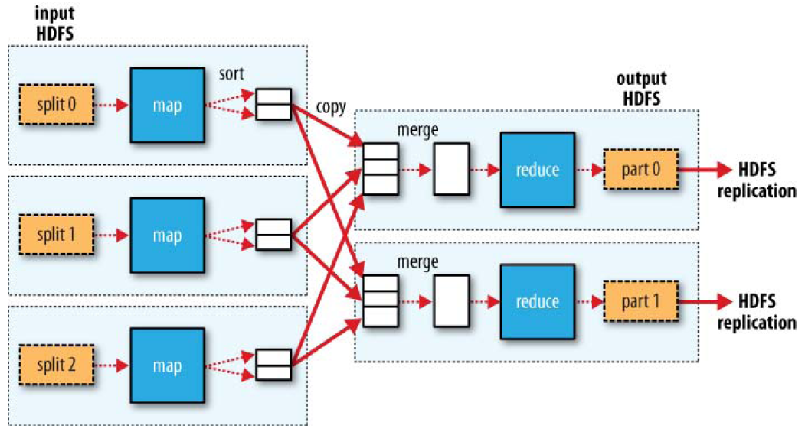

Introduction
MapReduce
Suitable for processing large amount of data in parallel
Many Join operations are performed in a MapReduce job
Hadoop
High fault tolerance and reliability
Provide an implementation of MapReduce programming model

Slide 6
Introduction
MapReduce Join
SELECT ?X WHERE{
?X ub:worksFor ?Y
?Y ub:belongTo C.S.}
Map
Subject | Predicate | Object
꺽정 | Type | Student
춘삼 | Type | Student
영철 | worksFor | IDS
IDB | belongTo | C.S.
길동 | worksFor | OS
IDB | Type | Lab.
IDS | Type | Lab.
길동 | Type | Student
IDS | belongTo | C.S.
OS | belongTo | E.E.
꺽정 | worksFor | IDB
영철 | Type | Student
OS | Type | Lab.
춘삼 | worksFor | IDB
[Machine 1]
꺽정 | Type | Student
춘삼 | Type | Student
영철 | worksFor | IDS
IDB | belongTo | C.S.
길동 | worksFor | OS
Reduce
[Machine 1]
영철 | worksFor | IDS
[Machine 2]
IDS | belongTo | C.S.
IDB | Type | Lab.
IDS | Type | Lab.
길동 | Type | Student
IDS | belongTo | C.S.
OS | belongTo | E.E.
영철
꺽정
춘삼
[Machine 2]
길동 | worksFor | OS
[Machine 3]
[Machine 3]
꺽정 | worksFor | IDB
영철 | Type | Student
OS | Type | Lab.
춘삼 | worksFor | IDB
꺽정 | worksFor | IDB
춘삼 | worksFor | IDB
IDB | belongTo | C.S.

Slide 7
Introduction
Design a schema to store RDF data in Hadoop
Devise an algorithm
Based on a cost model
Determine the best query plan
Minimize the amount of space
Reduce the execution time of a SPARQL query

Slide 8
Outline
Introduction
Proposed Architecture
MapReduce Framework
Result
Conclusion
Discussion

Slide 9
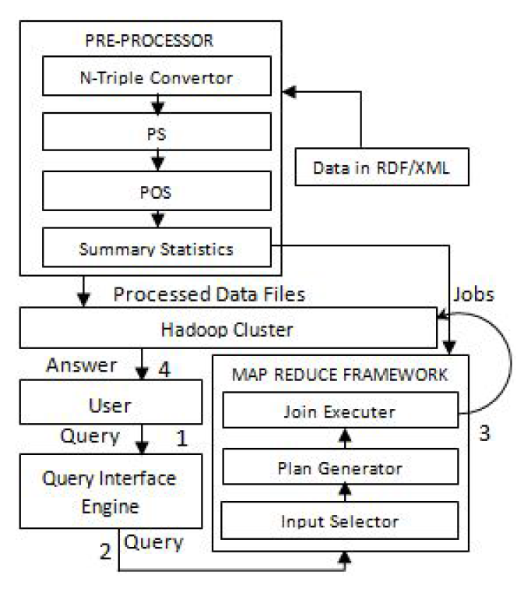
Proposed Architecture Data Generation and Storage
The System Architecture
The LUBM data generator generates data in RDF/XML format
Not suitable for MapReduce framework
Need to parse the entire file
Convert the data to N-Triples
Convenient to use with MapReduce jobs
Notes:
실제 논문에서는 LUBM dataset 사용

Slide 10
Proposed Architecture File Organization
N-Triples
Subject | Predicate | Object
꺽정 | Type | Student
꺽정 | worksFor | IDB
IDB | subOrganizationOf | SNU
IDB | Type | Lab.
SNU | Type | Univ.
꺽정 | belongTo | C.S.
C.S. | Type | Dept.
길동 | worksFor | IDB
영희 | worksFor | IDB
철수 | worksFor | IDB
길동 | Type | Student
영희 | Type | Professor
철수 | Type | Professor
. | . | .
. | . | .
Do not store the data in a single file
A file is the smallest unit of input to a MapReduce job
The splitting is done in two steps
Predicate Split, Predicate Object Split
Notes:
실제 논문에서는 LUBM dataset 사용

Slide 11
Proposed Architecture File Organization
p-worksFor
꺽정 | IDB
길동 | IDS
영희 | IDB
철수 | IDB
Predicate Split (PS)
Divide the data according to the predicates
S | P | O
꺽정 | type | Student
꺽정 | worksFor | IDB
IDB | subOrganizationOf | SNU
IDB | type | Lab.
SNU | type | Univ.
꺽정 | belongTo | C.S.
C.S. | type | Dept.
길동 | worksFor | IDS
영희 | worksFor | IDB
철수 | worksFor | IDB
길동 | type | Student
영희 | type | Professor
철수 | type | Professor
. | . | .
. | . | .
p-subOrganizationOf
IDB | SNU
into four files
p-belongTo
꺽정 | SNU
p-type
꺽정 | Stuent
IDB | Lab.
SNU | Univ.
C.S. | Dept.
길동 | Student
영희 | Professor
철수 | Professor

Slide 12
Proposed Architecture File Organization
Predicate Object Split (POS)
p1-worksFor
꺽정 | IDB
길동 | IDS
영희 | IDB
철수 | IDB
Divided into as the number of distinct objects
Easily retrieved from the file name
type_Student
꺽정
길동
p2-subOrganizationOf
IDB | SNU
type_Lab
IDB
p3-belongTo
꺽정 | SNU
type_Univ.
SNU
p4-type
꺽정 | Stuent
IDB | Lab.
SNU | Univ.
C.S. | Dept.
길동 | Student
영희 | Professor
철수 | Professor
type_Dept.
C.S.
type_Professor
영희
철수

Slide 13
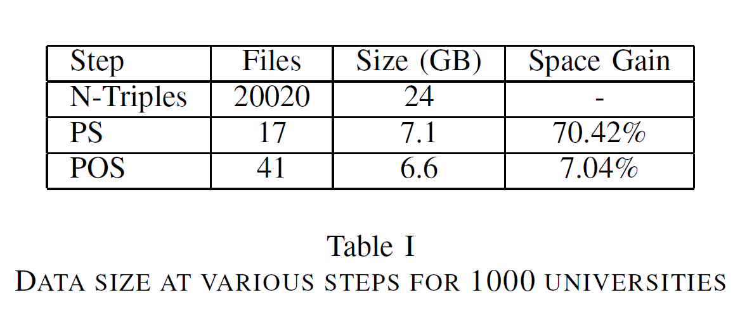
Proposed Architecture File Organization
Reduce the execution time
Reduce the amount of space
70.42% space gain after PS step
According to predicate size
24GB → 7.1GB
7.04% space gain after POS step
According to the type of the object

Slide 14
Outline
Introduction
Proposed Architecture
MapReduce Framework
Result
Conclusion
Discussion

Slide 15
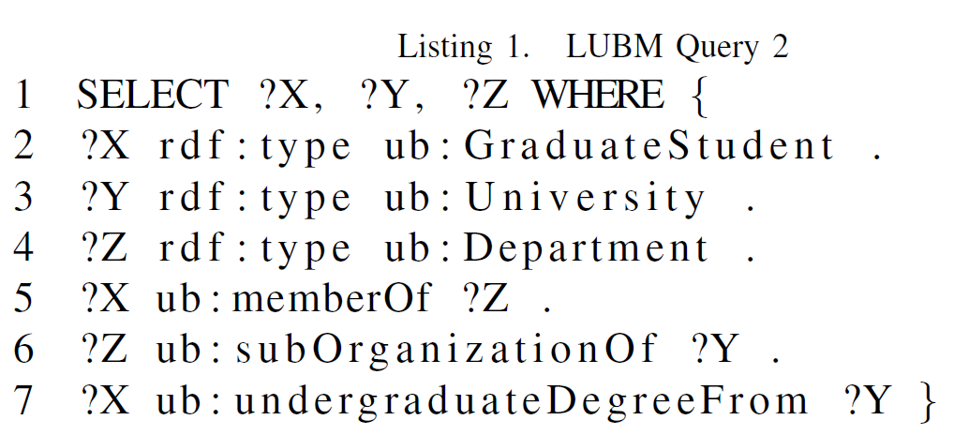
MapReduce Framework Input Files Selection
Select the files
Before determining the jobs
p-subOrganization
IDB | SNU
IDS | SNU
OS | MIT
. | .
. | .
type_GraduateStudent
꺽정
춘삼
길동
영철
p-memberOf
꺽정 | IDB
춘삼 | IDB
길동 | IDS
영철 | OS
. | .
. | .
p-undergraduateDegreeFrom
꺽정 | SNU
춘삼 | SNU
길동 | IDS
영철 | OS
. | .
. | .
type_University
SNU
MIT
type_Department
C.S.
E.E.
Notes:
LUBM Query 2

Slide 16
MapReduce Framework The DetermineJobs Algorithm
MapReduce Join
SELECT ?X WHERE{
?Y rdf:type ub:Lab.
?X ub:worksFor ?Y
?Y ub:belongTo C.S.}
Map
p-worksFor
길동 | OS
꺽정 | IDB
춘삼 | IDB
영철 | IDS
[Machine1]
p-worksFor
길동 | OS
꺽정 | IDB
춘삼 | IDB
영철 | IDS
Reduce
[Machine1]
IDB | 꺽정
IDB | 춘삼
type_Student
길동
꺽정
춘삼
영철
IDB
IDB | C.S.
꺽정
춘삼
영철
[Machine2]
type-Lab.
IDB
IDS
OS
type-Lab.
IDB
IDS
OS
[Machine2]
OS | 길동
OS
[Machine3]
[Machine3]
p-belongTo
IDB | C.S.
IDS | C.S.
OS | E.E.
p-belongTo
IDB | C.S.
IDS | C.S.
OS | E.E.
IDS | 영철
IDS
IDS | C.S.

Slide 17
Outline
Introduction
Proposed Architecture
MapReduce Framework
Result
Conclusion
Discussion

Slide 18
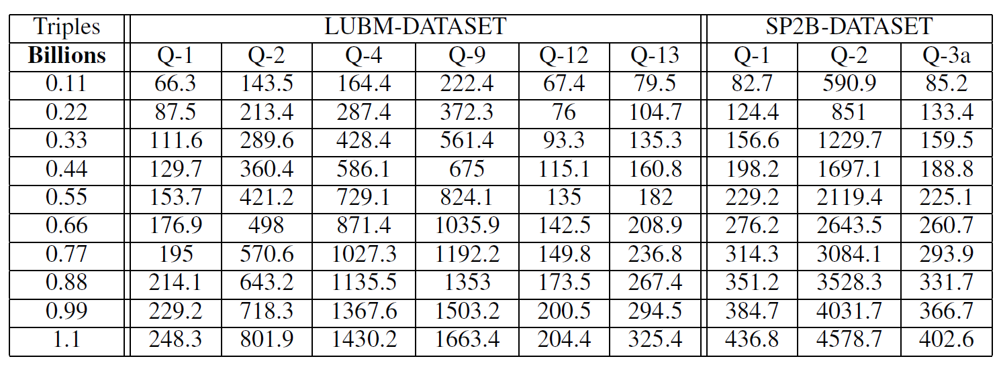
Result
Tested on cluster of 10 nodes with POS schema
Pentium 4 2.8GHz processor
4GB main memory
640GB disk space
Time to answer a query does not grow proportionately

Slide 19
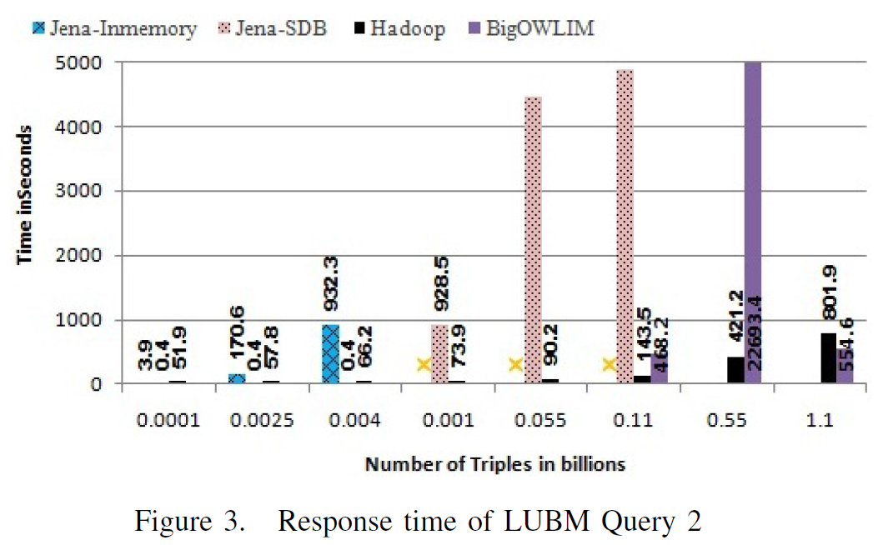
Result
As the size of the dataset grew Jena In-Memory model ran out of memory
Our framework does not have any indexing or tripe cache
Whereas BigOWLIM exploits indexing

Slide 20
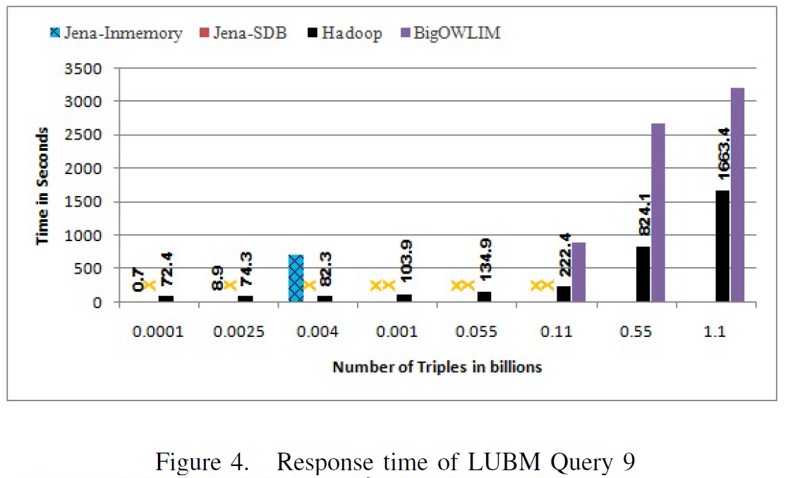
Result
Jena-SDB model could not finish answering
Jena In-Memory Model became slower than Hadoop implementation

Slide 21
Outline
Introduction
Proposed Architecture
MapReduce Framework
Result
Conclusion
Discussion

Slide 22
Conclusion
Devised efficient file organization
Reduced the amount of space
Possible to make synergy between semantic web and cloud computing (Big data)

Slide 23
Outline
Introduction
Proposed Architecture
MapReduce Framework
Result
Conclusion
Discussion

Slide 24
Discussion
Strong points
A signficant approach for Large RDF graph at using the Hadoop
Weak points
Incomplete description of Query plan generation

Slide 25
Thank you

