Slide 1
Modeling the Web as a Hypergraph to Compute Page Reputation
Klessius Berlt et al.
Department of Computer Science, Federal University of Amazonas, Manaus, Brazil
Journal of Information Systems 2010
Nov 29, 2012
Hee-gook Jun

Slide 2
Outline
Introduction
Related Work
The Hypergraph Model
Implementation of the Algorithms using the Hypergraph Model
Experimental Setup
Experimental Results
The Influence of Spam in the Methods
Conclusions and Future Work

Slide 3
Outline
Background
Our Approach
Experiments
Conclusion

Slide 4
Link-based Ranking Method
InDegree vs. PageRank
A
B
C
D
Notes:
Indegree는 단순히 page의 inlink 개수로 평가
PageRank는 전체 웹 구조에서 inlink기반한 pagerank점수 를 건네주며 특정값에 수렴할 때 까지 반복 계산

Slide 5


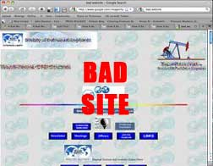
Limitation of PageRank
Equally distribution of PageRank value
20
25
60
20
A
25
20
10
Notes:
Indegree는 단순히 page의 inlink 개수로 평가
PageRank는 전체 웹 구조에서 inlink기반한 pagerank점수 를 건네주며 특정값에 수렴할 때 까지 반복 계산

Slide 6
Another Aspects of the Limitations (1/2)
Computing a page’s reputation
Linking = voting
A

Slide 7



Another Aspects of the Limitations (2/2)
Computing a page’s reputation
main
sitemap
info
A

Slide 8
Related Work: Link Weight
Giving weights to the edges
Query dependent
(processing on result sets)
main
1/3
sitemap
1/3
info
1/3
A
1
1
Notes:
쿼리에 대해 얻은 결과, 즉 local link structure만 가지고 weight 계산을 했다.
그러나 우리의 관심은 Global 링크 분석이다.

Slide 9
Related Work: High-level Entity
However, it is a exclusive representation
main
sitemap
info
A
Notes:
그러나 큰 개체로 묶는 순간 내부 페이지 간의 정보는 없어진다. (우리 방법은 페이지간 정보, high-level entity 정보 모두 함께 표현 가능!)

Slide 10
Outline
Background
Our Approach
Experiments
Conclusion

Slide 11
Hypergraph
Graph
Edge: link two vertices
Hypergraph
Edge: link n vertices

Slide 12
The Hypergraph Model
Page-based partition
A block is composed of a single web page
Host-based partition
All pages of a block belong to the same web host
Domain-based partition
All pages of a block belong to the same web domain

Slide 13
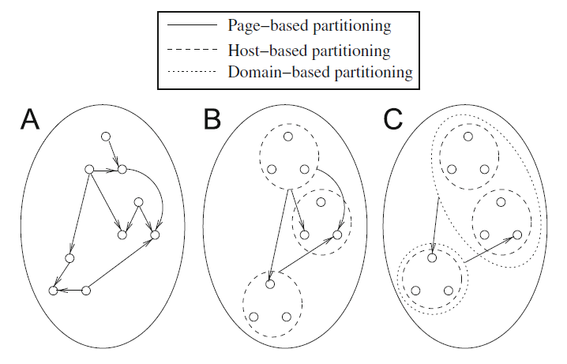
Partitioning
Page
http://www.yahoo.com/index.html
http://www.yahoo.com/help.html
http://www.yahoo.com/sitemap.html
http://dir.yahoo.com/
http://mail.yahoo.com/
http://shop.yahoo.com/
http://cafe.yahoo.com/
Host
www.yahoo.com
dir.yahoo.com
mail.yahoo.com
shop.yahoo.com
cafe.yahoo.com
Domain
Yahoo.com

Slide 14
Host/Domain-based PageRank
PRHost, PRDom

Slide 15
Hypergraph version of Host/Domain-based PR
HyPRHost, HyPRDom
Hyperarc ε = (B, v)

Slide 16
Hypergraph version of Host/Domain-based PR
HyPRHost, HyPRDom
Hyperarc ε = (B, v)

Slide 17
Outline
Background
Our Approach
Experiments
Conclusion

Slide 18
Experimental Setup
The WBR03 collection
A real search engine database of the search engine TodoBR
12,020,513 web pages
130,717,004 links
For realistic testbed
The WT10g collection
1,692,096 web pages
2,530,920 links
Sparse link structure

Slide 19
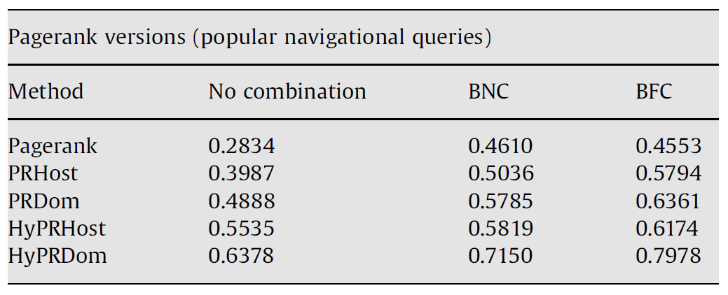
Experiments with the WBR03 collection
MRR (mean reciprocal rank)
The most common metric for evaluating the quality of results
Adopted on the TREC Conference
Combined Link Analysis Method
BNC (PR + Bayesian Belief Network)
BFC (PR + Brute Force Training)

Slide 20
Partitioning
Domain
Yahoo.com
Host
Host
Host
www.yahoo.com
dir.yahoo.com
shop.yahoo.com

Slide 21
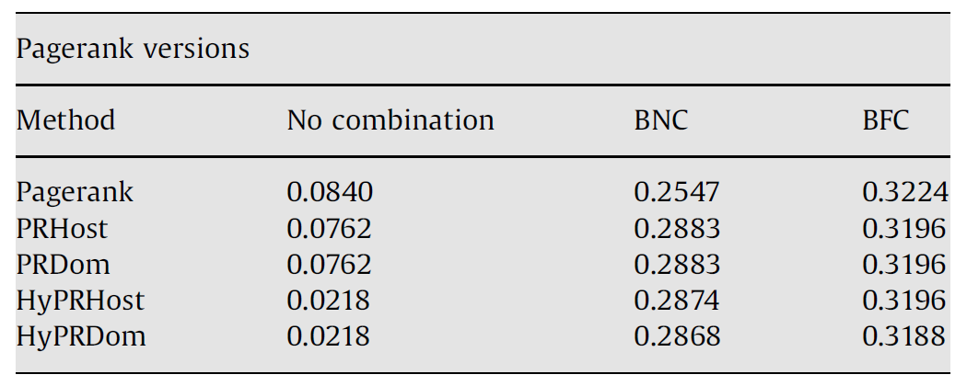
Experiments with the WT10g collection

Slide 22
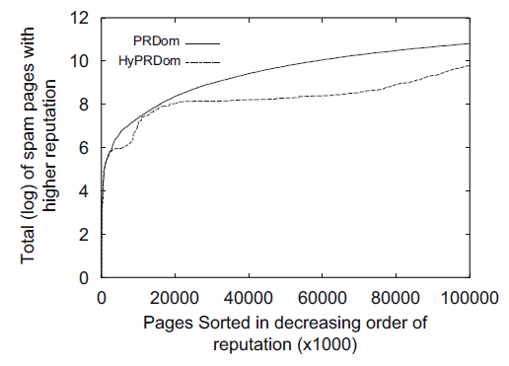
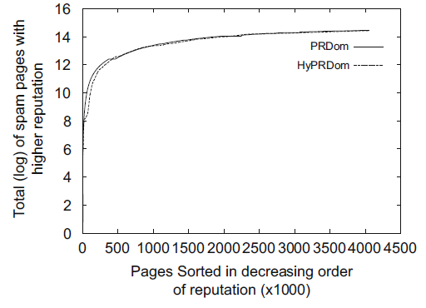
The Influence of Spam
For the first 100,000 pages
For all pages

Slide 23
Conclusion
Compute page reputation
Using a hypergraph model
Control the quality of web connections
Using hyperarcs
Between block and page
Host-based partition
Domain-based partition

Slide 24
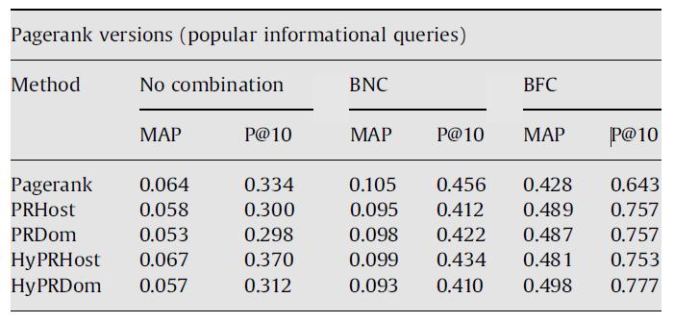
Discussion
Other type of clustering
Goal: getting information

