Slide 1
Graphs in Statistical Analysis
F. J. Anscombe
Dept. of Statistics, Yale Univ
The American Statistician, 1973
Dec 19, 2013
Hee-gook Jun

Slide 2
Outline
Introduction
Regression Analysis Model
Graphs in Statistical Analysis
Conclusion

Slide 3
Both Calculations and Graphs
Should be made and studied
Each will contribute to understanding

Slide 4
Stereotype of Graph
Calculations are exact, but graphs are rough
Intricate calculations are virtuous, whereas looking at the data is cheating
Some data fits specific statistical calculations

Slide 5
Purpose of Graph
Perceive broad features of the data
Look behind those broad features
Check if the assumptions of statistical calculation are correct

Slide 6
Good Statistical Analysis is
Not a simple routine way
More than one pass through the computer
Sensitive to specific features in the data
Sensitive to general background information about data

Slide 7
Outline
Introduction
Regression Analysis Model
Graphs in Statistical Analysis
Conclusion

Slide 8


Regression Analysis
Explain data
Estimate new data
$$y=a+bx$$
y
y
$$a$$
x
x

Slide 9



Regression Analysis Model
data
$$y=a+bx$$
Model
( x , y )
(1.0, 1.5)
(2.0, 2.0)
(3.0, 2.5)
(4.0, 3.0)
…
$$f:X →Y$$
$$f\left(x\right)=1+1.5X$$
1
2
3
4
5
..
1.5
2.0
2.5
3.0
2.9
..
new instance (x=10, y=?) → f(10) = 1 + 1.5 * 10 = 16

Slide 10



Residual Value [1/3]
$$perfectly fitted model$$
$$f(x)=a+bx$$
y
y
x
x
$$unexplained variation$$

Slide 11


Residual Value [2/3]
$$\hat{y}=f(x)=a+bx$$
y
(x, y)
error
(x, $\hat{y}$)
x

Slide 12





Residual Value [3/3]
y
(x, y)
$${\hat{y}}_{i}= β_{0}+β_{1}x_{i}$$
error
(x, $\hat{y}$)
$$y_{i}= {\hat{y}}_{i}+ε_{i}$$
$$y_{i}= β_{0}+ β_{1}x_{i}+ε_{i}$$
$$sum of errors?$$
x

Slide 13
Outline
Introduction
Regression Analysis Model
Graphs in Statistical Analysis
Conclusion

Slide 14
Numerical Calculations
Data set 1
x y
Data set 2
x y
Data set 3
x y
Data set 4
x y
10.0
8.0
13.0
9.0
11.0
14.0
6.0
4.0
12.0
7.0
5.0
8.04
6.95
7.58
8.81
8.33
9.96
7.24
4.26
10.84
4.82
5.68
10.0
8.0
13.0
9.0
11.0
14.0
6.0
4.0
12.0
7.0
5.0
9.14
8.14
8.74
8.77
9.26
8.10
6.13
3.10
9.13
7.26
4.74
10.0
8.0
13.0
9.0
11.0
14.0
6.0
4.0
12.0
7.0
5.0
7.46
6.77
12.74
7.11
7.81
8.84
6.08
5.39
8.15
6.42
5.73
8.0
8.0
8.0
8.0
8.0
8.0
8.0
19.0
8.0
8.0
8.0
6.58
5.76
7.71
8.84
8.47
7.04
5.25
12.50
5.56
7.91
6.89
N | 11 | 11 | 11 | 11
Mean(x) | 9.0 | 9.0 | 9.0 | 9.0
Mean(y) | 7.5 | 7.5 | 7.5 | 7.5
Regression line | y = 3 + 0.5x | y = 3 + 0.5x | y = 3 + 0.5x | y = 3 + 0.5x

Slide 15
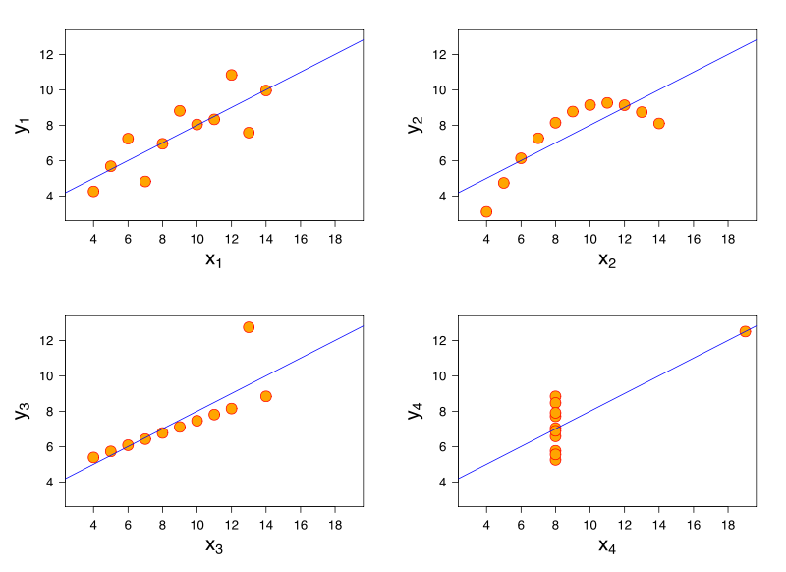
Data set 1
The kind of thing most people would see in their mind’s eye

Slide 16
Data set 2
Does not conform with the theoretical description

Slide 17
Data set 3
One of the observation is far from this line

Slide 18
Data set 4
There was something unsatisfactory about the data set

Slide 19
Conclusion
Both Calculations and Graphs contribute to understanding
Thought and ingenuity devoted to devising good graphs are likely to pay off

