Slide 1
Weighted PageRank Algorithm
Wenpu Xing and Ali Ghorbani
Faculty of Computer Science University of New Brunswick, Canada
Proceedings of the second annual conference on Communication Networks and Services Research, IEEE, 2004
Jul 4, 2012
Heegook Jun

Slide 2
Web Mining Categories
Web mining is used to discover the content of the Web*
Web Mining
Web Content Mining
Web Structure Mining
Web Usage Mining
* R. Kosala and H. Blockeel. Web mining research: A survey. ACM SIGKDD Explorations, 2(1):1-15, 2000

Slide 3
Web Mining Categories
Web Content Mining
Discovery of useful information from web content
Web Structure Mining
Discovers relationships between web pages by analyzing web structures
Web Usage Mining
Ascertains user profiles and the users’ behavior recorded inside the web logfile
profile

Slide 4
Outline
Introduction
Background
Weighted PageRank
Evaluation
Conclusion

Slide 5
HITS
Hypertext Induced Topic Selection
Rank webpages by analyzing their inlinks and outlinks
Authority Hub
a(p) = Σ h(q)
q: (q, p)∈E
h(p) = Σ a(q)
q: (p, q)∈E
P

Slide 6
HITS: Difficulties
HITS frequently returns more general webpages
Topic drift occurs while the hub has multiple topics (equivalent weight)
Some popular sites that are not highly relevant to the given query gain overhead weight values

Slide 7
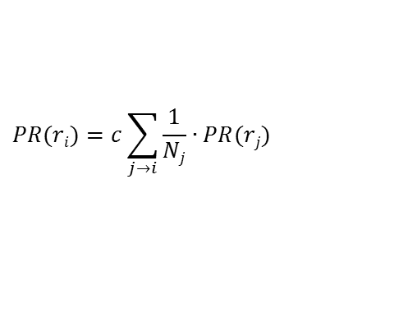
Simplified PageRank
PageRank
S. Brin and L. Page., “The anatomy of a large-scale hypertextual web search engine”, Computer networks and ISDN systems, 1998
Compute PageRank of pages linking to a page
30
10
a
10
$$PR(ri)=c\sum_{j→i}{\frac{1}{Nj}∙PR(rj)}$$
40
10
r
b
20
$$PR\left(r\right)=10+20=30$$
20
Notes:
일반 PageRank의 계산방법
한 페이지에서 다음 페이지로 연결된 Outlink들은 Uniformly Distribution을 이룬다.
예를 들어 페이지 b는 자신의 페이지랭크 값 0.6을 페이지 a, c, d 각각에 모두 동일한 확률 1/3로 나누어서 보내준다.

Slide 8
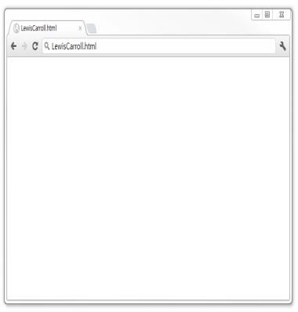
PageRank: Damping Factor
15%
D
A
B
Go to D
Link to B
Link to C
85%
C

Slide 9

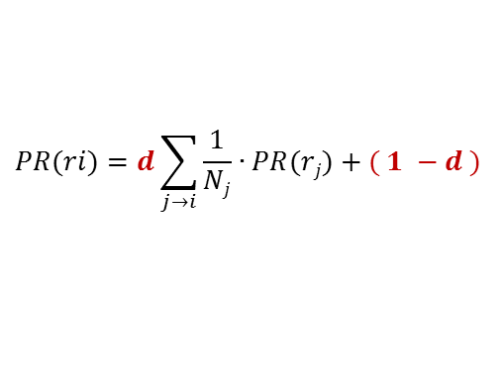
PageRank
To solve the rank sink problem
use damping factor d (usually set to 0.85)
One problem still exists
Some link may be more important than are the others
$$PR(ri)=d\sum_{j→i}{\frac{1}{Nj}∙PR(rj)}+( 1 −d )$$
$$\frac{1}{2}$$
x
a
$$\frac{1}{2}$$
y

Slide 10
Outline
Introduction
Background
Weighted PageRank
Evaluation
Conclusion

Slide 11

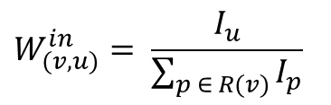


Weighted PageRank (WPR)
Assigns larger rank values to more important pages
$$\frac{1}{2}$$
$$\frac{3}{4}$$
60
v
u
30
$$\frac{1}{2}$$
b
$$\frac{1}{4}$$
y
30
c
z
$$W_{(v, u)}^{in}= \frac{I_{u}}{\sum_{p ∈ R(v)}{I_{p}}}$$

Slide 12

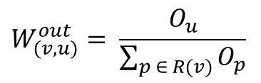

Weighted PageRank (WPR)
Assigns larger rank values to more important pages
r
$$\frac{2}{5}$$
v
u
s
$$\frac{3}{5}$$
y
t
w
z
$$W_{(v, u)}^{out}= \frac{O_{u}}{\sum_{p ∈ R(v)}{O_{p}}}$$

Slide 13

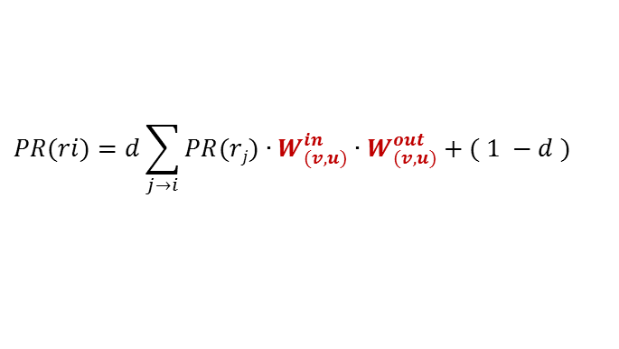

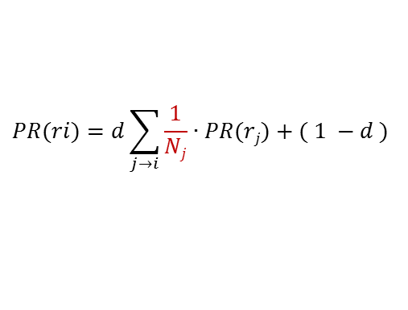


Weighted PageRank (WPR)
Original PageRank
Weighted PageRank
$$\frac{1}{2}$$
x
$$PR(ri)=d\sum_{j→i}{\frac{1}{Nj}∙PR(rj)}+( 1 −d )$$
a
y
$$\frac{1}{2}$$
Win
Wout
$$\frac{3}{4}$$
$$\frac{2}{5}$$
$$PR(ri)=d\sum_{j→i}{PR(rj)∙W_{(v, u)}^{in}∙W_{(v, u)}^{out}}+( 1 −d )$$
x
a
y
$$\frac{1}{4}$$
$$\frac{3}{5}$$

Slide 14
Outline
Introduction
Background
Weighted PageRank
Evaluation
Conclusion

Slide 15
Evaluation
Dataset
Website of Saint Thomas University
Query topics
Travel agent (non-focused topic)
Scholarship (focused topic)

Slide 16
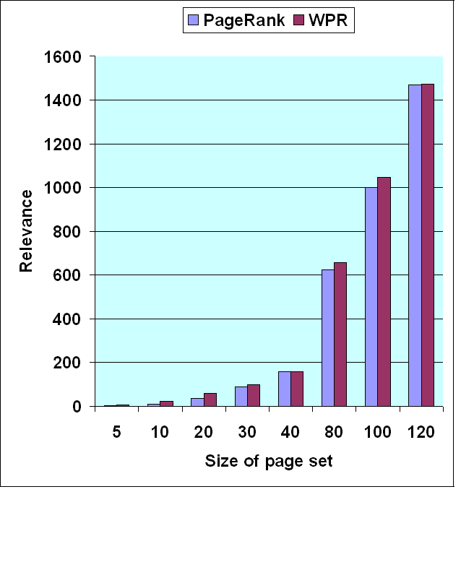
Evaluation
Travel agent (non-focused topic)
 | Num of relevant pages |  | Relevancy Value
Page set | PageRank | WPR | PageRank | WPR
10 | 0 | 1 | 0.1 | 0.5
20 | 4 | 3 | 13.1 | 16.8
30 | 4 | 4 | 47.1 | 49.8
40 | 4 | 4 | 82.1 | 84.8
50 | 4 | 4 | 117.1 | 119.8
60 | 5 | 5 | 159.6 | 162.3
70 | 7 | 7 | 211.7 | 214.4

Slide 17
Evaluation
Scholarship (focused topic)
 | Num of relevant pages |  | Relevancy Value
Page set | PageRank | WPR | PageRank | WPR
5 | 2 | 3 | 2 | 5.5
10 | 2 | 4 | 9.5 | 22
20 | 4 | 4 | 34.5 | 57
30 | 8 | 5 | 87.5 | 99
40 | 10 | 8 | 158.5 | 159.3
80 | 16 | 15 | 624.8 | 655.3
100 | 22 | 19 | 999.2 | 1045.3
120 | 25 | 20 | 1470.4 | 1473.3

Slide 18
Conclusion
Importance of both the inlinks and the outlinks of the pages
Distributes rank scores based on the popularity of the pages
Weighted PageRank can identify a larger number of relevant pages to a given query

Slide 19
Discussion
Strong points
Equally distribution of PageRank score → Distribution based on link weight
Importance is measured by in-links and out-links
Weak points
algorithm is still based on number of links

Slide 20
Thank you

