Slide 1
Join-Based SPARQL Query Processing Using Filters in MapReduce
30 Aug 2013
SNU IDB Lab.
Min Sup Lee
Notes:
기존의 MapReduce Framework에 filtering기법으로 성능을 향상.
성능이 향상된 MapReduce를 대용량 RDF graph에 적용하여 기존의 approach보다 더 나은 성능을 확인.
Filtering된 MapReduce에서 가능한 Join strategy를 제시.

Slide 2
Outline
Introduction
Semantic Web and RDF
RDF Query Processing
MapReduce Framework
Applying Filters to MapReduce
The Difference Between Naïve HadoopRDF And Our Approach
Contribution
Related Work
Our Approach

Slide 3

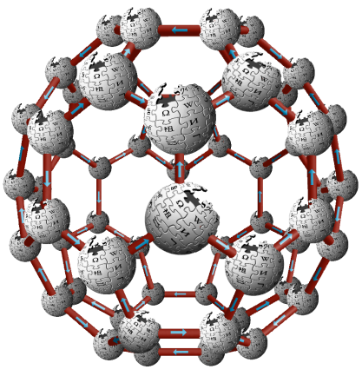
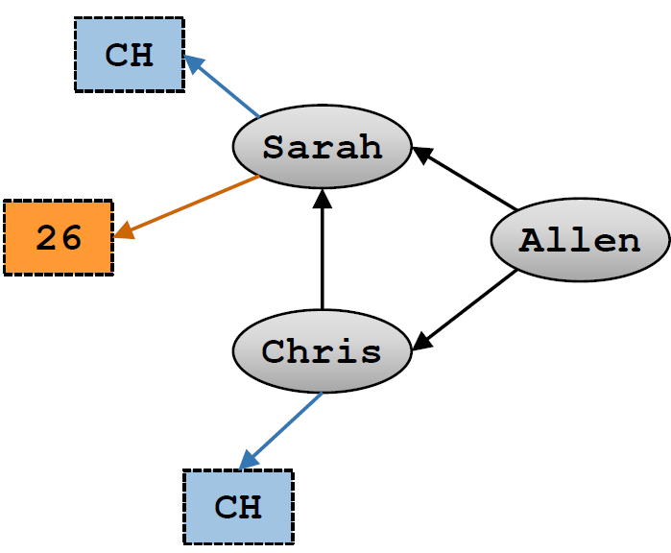
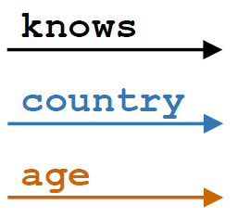
Introduction Semantic Web and RDF
Semantic web
Enabling users to find, share, and combine information more easily
The inclusion of semantic content in web pages
RDF (Resource Description Framework)
The most prominent standards by W3C
A set of triples(subject, predicate, object)
Subject | Predicate | Object
Allen | Knows | Chirs
Allen | Knows | Sarah
Sarah | Country | CH
Sarah | Age | 26
Chris | Country | CH
Chirs | Knows | Sarah
<RDF Triples>
<RDF Graph>

Slide 4
Introduction RDF Query Processing
SPARQL (Sparql Protocol And RDF Query Language)
Standard query language for RDF
Query Processing with SPARQL
Subject | Predicate | Object
Allen | Type | Student
Sarah | Type | Prof.
Chris | Type | Student
Jacob | Type | Student
Emily | Type | Prof.
Ben | Type | Student
Julia | Type | Student
Allen | Knows | Jacob
Allen | Knows | Chris
Allen | Knows | Sarah
Sarah | Country | CH
Sarah | Age | 26
Chris | Country | CH
Chris | Knows | Sarah
Jacob | Country | DE
Jacob | Age | 42
Jacob | Knows | Emily
Emily | Country | CH
Julia | Country | CH
Sarah | Knows | Julia
SELECT ?X WHERE{
?X Type Student
?X Country CH }
Chris
Julia
Join
Scan
?X Type Student
Scan
?X Country CH
Allen | Type | Student
Chris | Type | Student
Jacob | Type | Student
Ben | Type | Student
Julia | Type | Student
Sarah | Country | CH
Chris | Country | CH
Emily | Country | CH
Julia | Country | CH

Slide 5
Introduction The Limit of Query Processing with Large RDF Data
Current semantic web frameworks do not scale well
Jena, Sesame, BigOWLIM
Challenging and important problem
Storing a large number of RDF triples
Efficiently querying RDF triples

Slide 6

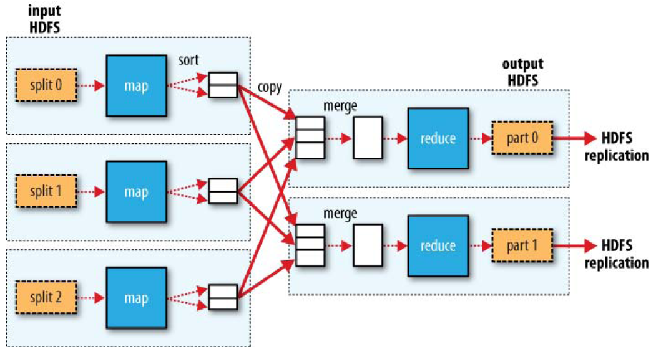

Introduction MapReduce Framework [Dean and Ghemawat, OSDI ’04]
MapReduce
A programming model for large-scale data processing
Shows desirable scaling properties and fault tolerance
Hadoop
Open-source software framework of MapReduce programming model

Slide 7
Introduction RDF Query Processing with MapReduce
Using MapReduce Join
SELECT ?X WHERE{
?X Type Student
?X Country CH }
Map Phase
Subject | Predicate | Object
Allen | Type | Student
Sarah | Type | Prof.
Chris | Type | Student
Jacob | Type | Student
Emily | Type | Prof.
Ben | Type | Student
Julia | Type | Student
Allen | Knows | Jacob
Allen | Knows | Chris
Allen | Knows | Sarah
Sarah | Country | CH
Sarah | Age | 26
Chris | Country | CH
Chris | Knows | Sarah
Jacob | Country | DE
Jacob | Age | 42
Jacob | Knows | Emily
Emily | Country | CH
Julia | Country | CH
Sarah | Knows | Julia
[Map 1]
Allen | Type | Student
Sarah | Type | Prof.
Chris | Type | Student
Jacob | Type | Student
Emily | Type | Prof.
Ben | Type | Student
Julia | Type | Student
Allen | Knows | Jacob
Allen | Knows | Chris
Allen | Knows | Sarah
Reduce Phase
[Reduce 1]
Allen | Type | Student
Jacob | Type | Student
Emily | Country | CH
Sarah | Country | CH
[Reduce 2]
Julia
Chris
[Map 2]
Ben | Type | Student
Julia | Type | Student
Sarah | Country | CH
Sarah | Age | 26
Chris | Country | CH
Chris | Knows | Sarah
Jacob | Country | DE
Jacob | Age | 42
Jacob | Knows | Emily
Emily | Country | CH
Julia | Country | CH
Sarah | Knows | Julia
Julia | Country | CH
[Reduce 3]
Chris | Type | Student
Chris | Country | CH

Slide 8
Introduction Applying Filters to MapReduce [Taewhi Lee et al., RACS’12]
Address the main drawback of join processing in MapReduce
Reduce redundant intermediate (map output) records
Key ideas
Sequential processing of input data sets in Map tasks
Dynamic construction of Bloom filter on the first dataset
Global Bloom filter
Master
R
Local Bloom filter
Mappers
Reducers
BF
Map 1
Reducer 1
S
BF
Map 2
Reducer 2
Notes:
Our key idea is to construct Bloom filters on the first input dataset like this and to process the second dataset with the filters.
To make this possible, we assign map tasks so that input datasets are sequentially processed.
I’ll explain more details later.

Slide 9
Introduction The Difference Between Naïve HadoopRDF and Our Approach
SELECT ?X WHERE{
?X Type Student
?X Country CH }
MapReduce Join
Jobtracker
Subject | Predicate | Object
Allen | Type | Student
Sarah | Type | Prof.
Chris | Type | Student
Jacob | Type | Student
Emily | Type | Prof.
Ben | Type | Student
Julia | Type | Student
Allen | Knows | Jacob
Allen | Knows | Chris
Allen | Knows | Sarah
Sarah | Country | CH
Sarah | Age | 26
Chris | Country | CH
Chris | Knows | Sarah
Jacob | Country | DE
Jacob | Age | 42
Jacob | Knows | Emily
Emily | Country | CH
Julia | Country | CH
Sarah | Knows | Julia
Map Phase
Reduce Phase
[Map 1]
[Reduce 1]
Allen | Type | Student
Chris | Type | Student
Ben | Type | Student
Allen | Type | Student
Jacob | Type | Student
[Reduce 2]
Sarah | Country | CH
Emily | Country | CH
Chris | Type | Student
Chris | Country | CH
Chris
Julia
[Map 2]
[Reduce 3]
Jacob | Type | Student
Julia | Type | Student
Ben | Type | Student
Julia | Type | Student
Julia | Country | CH
Chris | Country | CH
Julia | Country | CH
Chris | Country | CH
Julia | Country | CH

Slide 10
Introduction Contribution
Using filters to RDF query processing ➔ Reduce the map output size
Which dataset have to be chosen for building filters?
Make query plan generator that fits in with filtering techniques
Determine the join order
Does applying filters affect the join order?
Join with X
SELECT ?X WHERE{
?X Type Student
?X Country CH }
1
1
Subject | Predicate | Object
Allen | Type | Student
Chris | Type | Student
Jacob | Type | Student
Ben | Type | Student
Julia | Type | Student
2
Statistics information for choosing the dataset
Chris
Julia
The number of record
The number of variables
File format
2
Subject | Predicate | Object
Sarah | Country | CH
Chris | Country | CH
Emily | Country | CH
Julia | Country | CH

Slide 11
Outline
Introduction
Related Work
HadoopRDF
MapReduce with Fiters
Join Algorithms in MapReduce
Our Approach

Slide 12
Related Work Naïve Query Processing
advisor
A MapReduce job with a join key
Ryan
Ullman
type
worksFor
authorOf
type
Query
SELECT ?X ?Y WHERE{
?X type Professor .
?X worksFor CS .
?Y advisor ?X .
?Y type Student }
Data
Student
CS
DB system
Professor
type
year
Dept.
2008
Execution Plan
Join Y
Join X
<?Y type Student>
Join X
<?Y advisor ?X>
Need 3 MR jobs
<?X type Professor>
<?X worksFor CS>
DFS
DFS
DFS
DFS
MR Job 1
MR Job 2
MR Job 3

Slide 13
Related Work HadoopRDF [Husain et al., TKDE’11]
Conflicting Joins (CJ)
A pair of joins on different variables sharing a triple
NonConflicting Joins (NCJ)
Just need a join
Not sharing any triple pattern
Sharing a triple pattern and the joins are on same variable
Query
SELECT ?X ?Y WHERE{
?X type Professor .
?X worksFor CS .
?Y advisor ?X .
?Y type Student }
Execution Plan
Need 2 MR jobs
Professor
type
?X
advisor
type
Join X
?Y
Student
CS
worksFor
Join on X
Join on Y

Slide 14
Related Work Join Processing Using Filters in MapReduce [Taewhi Lee et al., RACS’12]
Execution Overview
Reducing redundant intermediate (map output) records
(1) Job submission
Jobtracker
Job client
R
(4) Global filter
merging
(2) First map phase
Split 0
Split 1
Map
Split 2
(6) Reduce phase
Output
(3) Local filter
construction
…
Reduce 1
Part 0
Map
S
Split 0
Reduce 2
Part 1
Split 1
Map
Split 2
…
(5) Second map phase
Notes:
We modified Hadoop and I’ll present the overall execution flow of our implementation.
First, job client submits a job to JobTracker, then map and reduce tasks are created.
JobTracker is the master or coordinator node in Hadoop, and the rest nodes are called TaskTrackers and may run multiple mappers or reducers.
Next, JobTracker assigns map tasks for the first input R, and each mapper runs map function on its input split and creates the local Bloom filters on the intermediate records. When all map tasks for R are complete, mappers send their local filters to Jobtracker, and then Jobtracker creates global Bloom filters by merging them and sends them back.
Now, JobTracker assigns map tasks for S and mappers run map function with the global filters.
Reducers run reduce functions and produce final join results like Hadoop.

Slide 15
Related Work Join Processing Using Filters in MapReduce [Taewhi Lee et al., RACS’12]
Map Task Scheduling
Hadoop
Scheduling in the order of input split size
➔ Processing order of the input datasets cannot be controlled
Our approach
Keeps the order of the input datasets
Pros: DB techniques such as filtering and join ordering can be applied
Cons: All Mappers must wait during the global filter construction
S
R
S
R
S
R
S
S
R
S
R
S
S
R
R
S
S
S
R
S
Notes:
We made two changes to Hadoop.
First, we changed its map task scheduling policy.
Hadoop basically assigns map tasks in the order of the input split size.
Then, input splits are processed in mixed order like this, then we can’t apply Bloom filter.
So, we keeps the order of the input dataset and assigns map tasks like this.
Now we can apply Bloom filter.
Instead, all mappers must wait for a while after first map phase during the global filter construction.
but it will be efficient when many records are filtered out.

Slide 16
Related Work Join Algorithms and Query Processing in MapReduce
Map-side join: can be used only in particular circumstances
Map-Merge join: input datasets should be partitioned and sorted on the join keys in advance [KH Lee et al., SIGMOD Record ’11]
Broadcast join: efficient only when the size of one dataset is small [Blanas et al., SIGMOD ’10]
Reduce-side join
Repartition join: the whole input records have to be sent to reducers
Semijoin [Blanas et al., SIGMOD ’10], Bloomjoin [Palla, MS Thesis ’09] : 3 MR jobs are required → input records are processed multiple times
SPARQL query processing in MapReduce
Basic graph pattern processing [Myung et al., MDAC ’10]
Duplication-based and non-Conflicting joins on MapReduce [Kim et al., KIISE ’12]

Slide 17
Outline
Introduction
Related Work
Our Approach
Query Plan Generation
Execution Overview

Slide 18
Our Approach Query Plan Generation
The process to make query plans
1
2
3
4
SPARQL Query
Query Graph
Job Plan Object
Filtering
Run
Make filters with a dataset
Which dataset have to be chosen for building filters?
The number of record
The type of Triple pattern
File format

Slide 19
Our Approach Query Plan Generation
SELECT ?X WHERE{
?Y Type Student
?Y Knows ?X
?X Country CH
?X Type Student }
Build a graph for the query
Add variables for the job plan
According to the number of joins
1
2
3
4
[Job Plan]
Variable | Nodes | Joins | ||Joins||
Y | 1, 2 | 1-2 | 1
Variable | Nodes | Joins | ||Joins||
Y | 1, 2 | 1-2 | 1
X | 2, 3, 4 | 2-3, 3-4, 4-2 | 3
Variable | Nodes | Joins | ||Joins||
X | 2, 3, 4 | 2-3, 3-4, 4-2 | 3
Y | 1, 2 | 1-2 | 1
1
Y
1
Y
2
X, Y
1, 2, 3, 4
2, 3, 4
X, Y
3
X
4
X
X, Y

Slide 20
Our Approach Filtering Method (1) – The Number of Records
[Map Phase]
Jobtracker
[Reduce Phase]
SELECT ?X WHERE{
?X Type Student
?X Country CH }
Type_Student
Type_Student
Type_Student
Consider the number of records
Choose the dataset with little records
Smaller map output ➔Lower overhead
Subject
Allen
Ben
Chris
Jacob
Julia
Subject
Allen
Ben
Chris
Jacob
Julia
Subject
Allen
Ben
Chris
Jacob
Julia
Chris
Country_CH
Transfer 6 records
Subject
Sarah
Chris
Emily
Country_CH
Country_CH
Subject
Chris
Subject
Chris
[Map Phase]
Jobtracker
[Reduce Phase]
Type_Student
Type_Student
Subject
Allen
Ben
Chris
Jacob
Julia
Subject
Chris
Type_Student
Subject
Chris
Chris
Country_CH
Country_CH
Country_CH
Subject
Sarah
Chris
Emily
Subject
Sarah
Chris
Emily
Transfer 4 records
Subject
Sarah
Chris
Emily

Slide 21
Our Approach Filtering Method (2) – The Number of Variables
Tripple patterns have one or two variable
Make the different number of record after Map job
?X Works_for ABC
?X Works_for ?Y
[Map Phase]
?X Works_for ABC
Works_for
Subject | Object
Allen | Apple
Chris | Samsung
Jacob | Google
Julia | ABC
Sarah | ABC
Works_for
Subject | Object
Julia | ABC
Sarah | ABC
Possible to make filters with smaller dataset
Lead to reduce map output size
?X Works_for ?Y
Works_for
Works_for
Subject | Object
Allen | Apple
Chris | Samsung
Jacob | Google
Julia | ABC
Sarah | ABC
Subject | Object
Allen | Apple
Chris | Samsung
Jacob | Google
Julia | ABC
Sarah | ABC

Slide 22
Our Approach Pre-condition: Input File Organization in HadoopRDF
<Predicate Split>
<Predicate Object Split>
<N-Triples>
Type
Subject | Predicate | Object
Allen | Type | Student
Sarah | Type | Prof.
Chris | Type | Student
Jacob | Type | Student
Emily | Type | Prof.
Allen | Knows | Jacob
Allen | Knows | Chris
Allen | Knows | Sarah
Sarah | Country | CH
Sarah | Age | 26
Chris | Country | CH
Chris | Knows | Sarah
Jacob | Country | DE
Jacob | Age | 42
Jacob | Knows | Emily
Emily | Country | CH
Subject | Object
Allen | Student
Sarah | Prof.
Chris | Student
Jacob | Student
Emily | Prof.
Type_Prof.
Knows_Student
Knows
Subject
Sarah
Emily
Subject | Object
Allen | Jacob
Allen | Chris
Subject | Object
Allen | Jacob
Allen | Chris
Allen | Sarah
Chris | Sarah
Jacob | Emily
Type_Student
Knows_Prof.
Subject
Allen
Chris
Jacob
Country
Subject | Object
Allen | Sarah
Chris | Sarah
Jacob | Emily
Subject | Object
Sarah | CH
Chris | CH
Jacob | DE
Emily | CH
Age
Subject | Object
Sarah | 26
Jacob | 42
Country_CH
Subject
Sarah
Chris
Emily
Country_DE
Subject
Jacob
Easily retrieved from the file name
Split using type information of object
Divide the data according to the predicates

Slide 23
Our Approach Filtering Method (3) – File Format
File format
PS data has bigger size than POS data
If both of thme have the same number of records
[Map Phase]
[Reduce Phase]
?X Age 26
Need expensive operations
Disk IO
Network transfer
Make filters with POS data
Less data is more efficient
Age
Age
Subject | Object
Allen | 26
Chris | 26
Jacob | 26
Julia | 26
Subject | Object
Allen | 26
Chris | 26
Jacob | 26
Julia | 26
?X Country CH
Country_CH
Country_CH
Subject
Allen
Chris
Jacob
Julia
Subject
Allen
Chris
Jacob
Julia

Slide 24
Thank you

