Slide 1
ScalaGiST: Scalable Generalized Search Trees for MapReduce Systems[Innovative Systems Paper]
Peng Lu, Gang Chen, Beng Chin Ooi, Hoang Tam Vo, Sai Wu
VLDB, October 2014
DongHyo Kim

Slide 2
ABSTRACT
MapReduce
State-of-the-art for data parallel processing
Hadoop : open-source equivalent of MapReduce
Problem
Sub-optimal performance
(operate on raw data without utilizing any type of indexes)
Solution
Present ScalaGiST
(scalable generalized search tree)
★ScalaGiST
Seamlessly integrated with Hadoop
cost-based data access optimizer
Support unconventional queries
Providing efficient write and read performance
(comparisions with SpatialHadoop, Data Mapping, and RT-CAN)

Slide 3
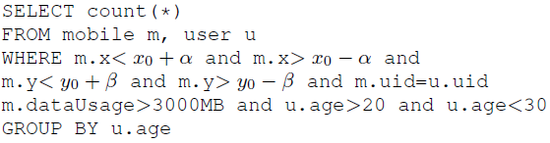
Introduction
Map Reduce Strategy : two types of mappers unnecessary I/O overheads (We can be effectively avoided by using indexes)
Challenge : we need to build various types of indexes to support the query
R-tree index can be employed to locate mobile phones
B+ tree index can be built for dataUsage, data consumption
SpatialHadoop : support several types of spatial indexes(i.e, R-tree)
These index schems are specialized in a certain type of index
High index maintenance overheads, and lacks code and interface reuse
Requires users to define a data mapping function for each specific index

Slide 4
Introduction
ScalaGiST
General indexing framework to build all popular indexes
Non-intrusive component for existing systems(MapReduce)
Efficiency, Reliability, Scalability
Advantages
Enables users to define indexes for new type of data
Providing built-in functions without the need of data mapping
Providing data access optimizer ♦ choosing the better plan (index scan or full table scan)

Slide 5
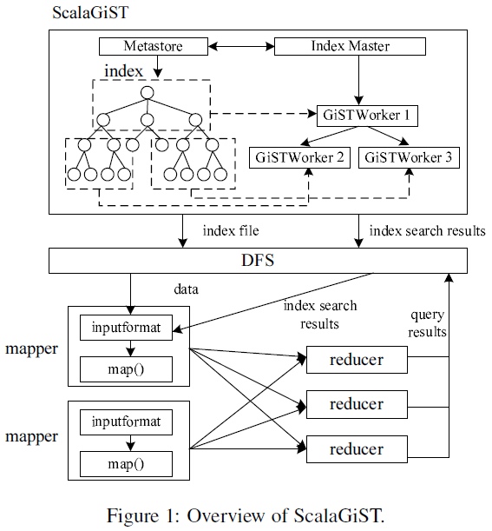
Architecture Overview

Slide 6
System Implementation
Interface of ScalaGiST
ScalaGiST’s keys are instances of a user-defined class overrides the abstraction key class
Ex)
ScalaGiST can be instantiated as a distributed B+-tree-like index structure by defining keys as ranges of numbers
ScalaGiST can be instantiated as a distributed R-tree-like index structure by defining keys as bounding boxes
★ Only thing that users are required to do is
Define what presents a key
Override abstracted methods in the key class
♦ Consistent(N.p, q) : Returns true if both p and q are satisfied for a given data key
♦ Penalty(e, N) : Path that has the least penalty in the tree is chosen for inserting new entry
♦ Union(S) : Defines how to merge a set S of index nodes
♦ PickSplit(N) : Node split upon the insertion of a new index entry
♦ Parse(InputStream) : Reads the binary data from DFS and parses it into a user-defined tree node
♦ Store(N, OutputStream) : Serializes node N into its binary data and flushes it back to DFS

Slide 7
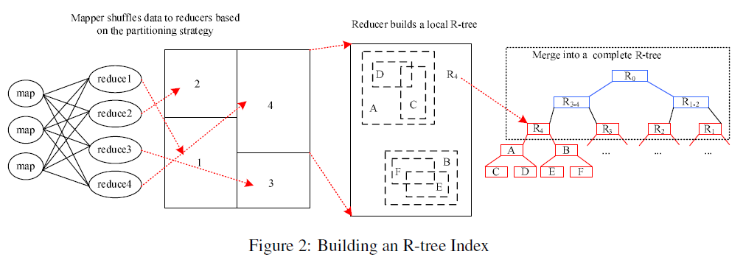
System Implementation : Tree Methods
Index Construction

Slide 8
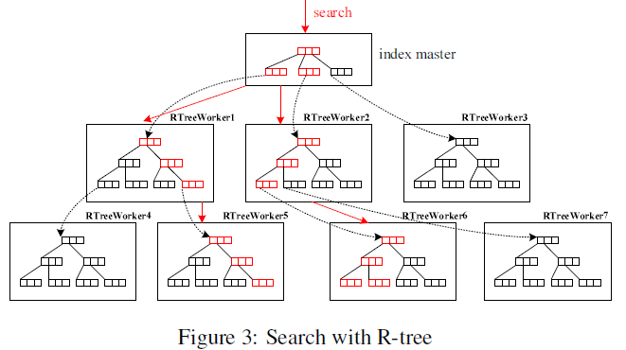
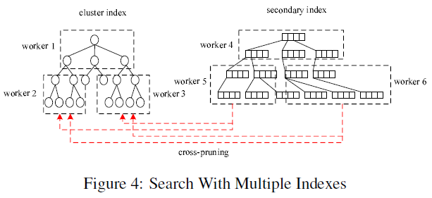
System Implementation : Tree Methods
Search
Search with Multiple Indexes

Slide 9




Data Access Optimization Algorithm
♣ Selection of Optimal Data Access Plan (Full Scan vs Index Scan)
Full Scan
Index Scan - primary index
Index Scan - secondary index
Index lookup cost

Slide 10
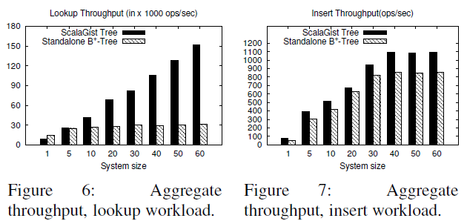
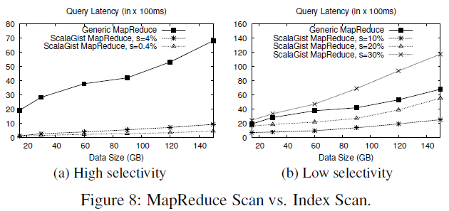
Performance Evaluation
♣ ScalaGiST Tree vs. Standalone B+ tree
♣ MapReduce Scan vs. Index Scan

Slide 11
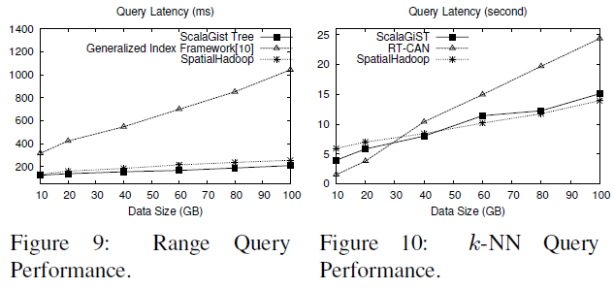
Performance Evaluation
♣ Generalized Search Tree vs. Data Mapping, Spatial Hadoop, RT-CAN

Slide 12
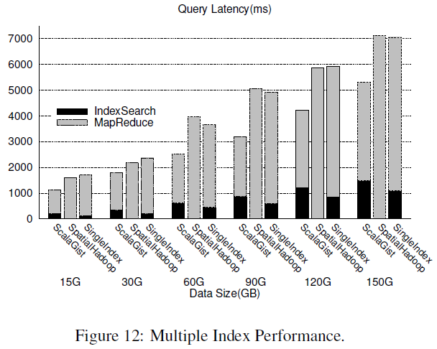
Performance Evaluation
♣ Multiple Indexes Performance

