Slide 1
Ch. 2: XSLT
Seoul National University, Internet Database Laboratory
July, 2011
Jee-bum Park

Slide 2
Contents
XSLT
Transforming XML with XSLT
Outputting Values
Looping Over Nodes
Processing Nodes Conditionally
Adding Conditional Choices
Sorting Nodes Before Processing
Generating Output Attributes
Creating and Applying Templates

Slide 3
XSLT
XSLT: eXtensible Style Language for Transformations
Describes the rules of the transformation
Used to
Format XML documents
Reorder the output according to specific criteria
Display only certain pieces of information
...

Slide 4
Transforming XML with XSLT
XML
XSLT
HTML

Slide 5
Transforming XML with XSLT
Linking XML document to XSLT style sheet
Using xml-stylesheet processing instruction
<?xml version="1.0"?>
<?xml-stylesheet type="text/xsl" href="02-03.xsl"?>
<ancient_wonders>
<wonder>
<name language="English">Colossus of Rhodes</name>
<location>Rhodes, Greece</location>
</wonder>
</ancient_wonders>

Slide 6
Transforming XML with XSLT
Assessing the XSLT style sheet
Set the output method to HTML
Root template
Namespace & prefix
<?xml version="1.0"?>
<xsl:stylesheet xmlns:xsl="http://www.w3.org/1999/XSL/Transform" version="1.0">
<xsl:output method="html"/>
<xsl:template match="/">
<html><head><title>Wonders of the World</title></head><body>
<h1>Wonders of the World</h1>
The <xsl:value-of select="ancient_wonders/wonder/name"/>
is located in <xsl:value-of select="ancient_wonders/wonder/location"/>.
</body></html>
</xsl:template>
</xsl:stylesheet>

Slide 7
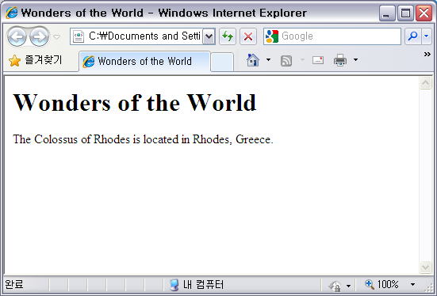
Transforming XML with XSLT
The final transformed HTML

Slide 8
Outputting Values
Using <xsl:value-of> element
XPath Expression
<?xml version="1.0"?>
<xsl:stylesheet xmlns:xsl="http://www.w3.org/1999/XSL/Transform" version="1.0">
<xsl:output method="html"/>
<xsl:template match="/">
<html><head><title>Wonders of the World</title></head><body>
<h1>Wonders of the World</h1>
The <xsl:value-of select="ancient_wonders/wonder/name"/>
is located in <xsl:value-of select="ancient_wonders/wonder/location"/>.
</body></html>
</xsl:template>
</xsl:stylesheet>

Slide 9
Looping Over Nodes
<xsl:for-each> element
Processes all the nodes matched by its select attribute
XPath Expression
...
<xsl:template match="/">
...
<table border="1">
<tr><th>Wonder Name</th><th>Location</th><th>Height</th></tr>
<xsl:for-each select="ancient_wonders/wonder">
<tr><td>
<strong><xsl:value-of select="name[@language='English']"/></strong><br/>
(<em><xsl:value-of select="name[@language!='English']"/></em>)
</td><td><xsl:value-of select="location"/>
</td><td><xsl:value-of select="height"/>
</td></tr>
</xsl:for-each>
</table>
...
</xsl:template>

Slide 10
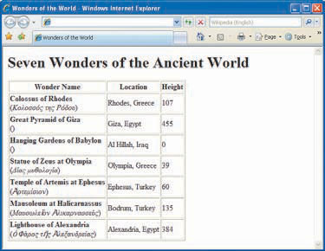
Looping Over Nodes
Transformed HTML
...
<table border="1">
<tr><th>Wonder Name</th><th>Location
</th><th>Height</th></tr>
<tr><td><strong>Colossus of
Rhodes</strong><br/>(<em>Κολοσσός
της Ρόδου</em>)</td>
<td>Rhodes, Greece</td>
<td>107</td></tr>
<tr><td><strong>Great Pyramid of
Giza</strong><br/>(<em/>)</td>
<td>Giza, Egypt</td>
<td>455</td></tr>
<tr><td><strong>Hanging Gardens of
Babylon</strong><br/>(<em/>)</td>
<td>Al Hillah, Iraq</td>
<td><td/></tr>
...
</table>
...

Slide 11
Processing Nodes Conditionally
<xsl:if> element
XPath Expression
...
<xsl:for-each select="ancient_wonders/wonder">
<tr><td><strong><xsl:value-of select="name[@language='English']"/></strong>
<xsl:if test="name[@language!='English']">
<br/>(<em><xsl:value-of select="name[@language!='English']"/></em>)
</xsl:if>
</td>
...

Slide 12
Adding Conditional Choices
<xsl:choose> element
XPath Expression
...
<xsl:choose>
<xsl:when test="height != 0">
<xsl:value-of select="height"/>
</xsl:when>
<xsl:otherwise>
unknown
</xsl:otherwise>
</xsl:choose>
...

Slide 13
Sorting Nodes Before Processing
<xsl:sort> element
Criteria
Sorting order
text or number
...
<table border="1"><tr>
<th>Wonder Name</th><th>Location</th><th>Height</th></tr>
<xsl:for-each select="ancient_wonders/wonder">
<xsl:sort select="height" order="descending" data-type="number" />
...

Slide 14
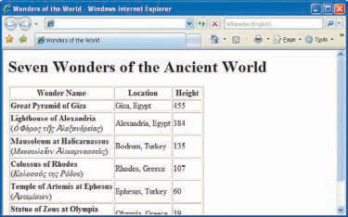
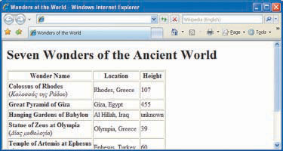
Sorting Nodes Before Processing
<xsl:sort> element

Slide 15
Generating Output Attributes
<xsl:attribute> element
Attribute name
Attribute value
...
<tr><td>
<a>
<xsl:attribute name="href">
#<xsl:value-of select="name[@language='English']"/>
</xsl:attribute>
<strong><xsl:value-of select="name[@language='English']"/></strong>
</a>
...

Slide 16
Creating and Applying Templates
<xsl:template> and <xsl:apply-templates> element
Functions in most programming languages
Root template (main function)
Creating template
...
<xsl:template match="/">
...
</xsl:template>
<xsl:template match="name[@language!='English']">
(<em><xsl:value-of select="."/></em>)
</xsl:template>
...
<xsl:apply-templates select="name[@language!='English']"/>
...
Applying template

