Slide 1
Design Patterns for Efficient Graph Algorithms in MapReduce
Jimmy Lin and Michael Schatz
University of Maryland
MLG, 2010
23 January, 2014
Jaehwan Lee

Slide 2
Outline
Introduction
Graph Algorithms
Graph
PageRank using MapReduce
Algorithm Optimizations
In-Mapper Combining
Range Partitioning
Schimmy
Experiments
Results
Conclusions

Slide 3
Introduction
Graphs are everywhere :
e.g., hyperlink structure of the web, social networks, etc.
Graph problems are everywhere :
e.g., random walks, shortest paths, clustering, etc.
Contents from Jimmy Lin and Michael Schatz at Hadoop Summit 2010 - Research Track

Slide 4
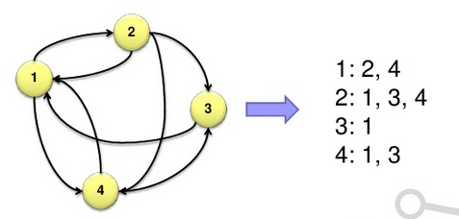
Graph Representation
G = (V, E)
Typically represented as adjacency lists :
Each node is associated with its neighbors (via outgoing edges)
Contents from Jimmy Lin and Michael Schatz at Hadoop Summit 2010 - Research Track

Slide 5
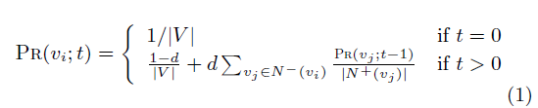

PageRank
PageRank
a well-known algorithm for computing the importance of vertices in a graph based on its topology.
$PR(v_{i})$ representing the likelihood that a random walk of the graph will arrive at vertex $v_{i}$.
t : timesteps
d : damping factor
Contents from Jimmy Lin and Michael Schatz at Hadoop Summit 2010 - Research Track
Notes:
timesteps t
damping factor d which allows for periodic random jumps to any other node in the graph

Slide 6
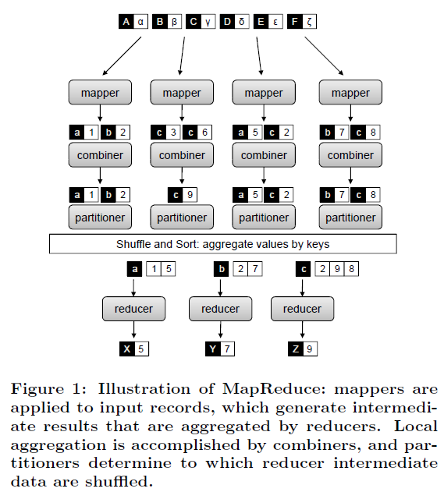
MapReduce

Slide 7
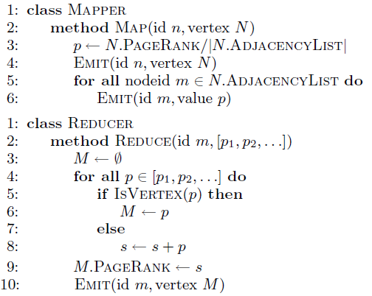
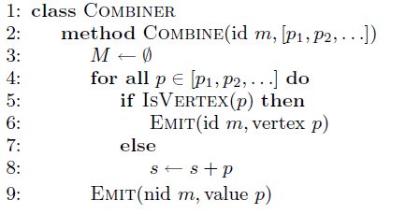
PageRank using MapReduce [1/4]
1
2
3

Slide 8


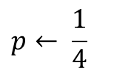
PageRank using MapReduce [2/4]
at Iteration 0 where id = 1
$$p← \frac{1}{4}$$
Graph Structure itself
Key | Value
1 | V(2), V(4)
$$EMIT$$
…
Key | Value
2 | 1/8
$$EMIT$$
messages
Key | Value
4 | 1/8

Slide 9



PageRank using MapReduce [3/4]
Key | Value
3 | V(1)
Key | Value
3 | V(1)
$$EMIT$$
Key | Value
3 | 1/8
$$s ← \frac{1}{8}+ \frac{1}{8}$$
Key | Value
3 | 1/8
$$V(3).PageRank← \frac{1}{4}$$

Slide 10
PageRank using MapReduce [4/4]

Slide 11
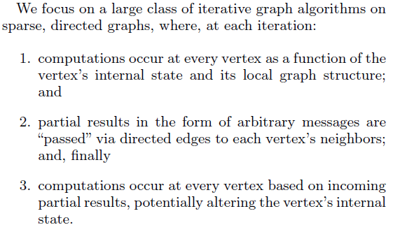
Algorithm Optimizations
Three Design Patterns
In-Mapper combining : efficient local aggregation
Smarter Partitioning : create more opportunities
Schimmy : avoid shuffling the graph
Contents from Jimmy Lin and Michael Schatz at Hadoop Summit 2010 - Research Track

Slide 12
In-Mapper Combining [1/3]

Slide 13
In-Mapper Combining [2/3]
Use Combiners
Perform local aggregation on map output
Downside : intermediate data is still materialized
Better : in-mapper combining
Preserve state across multiple map calls, aggregate messages in buffer, emit buffer contents at end
Downside : requires memory management
Contents from Jimmy Lin and Michael Schatz at Hadoop Summit 2010 - Research Track

Slide 14
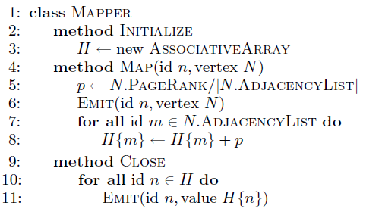
In-Mapper Combining [3/3]

Slide 15
Smarter Partitioning [1/2]

Slide 16
Smarter Partitioning [2/2]
Default : hash partitioning
Randomly assign nodes to partitions
Observation : many graphs exhibit local structure
e.g., communities in social networks
Smarter partitioning creates more opportunities for local aggregation
Unfortunately, partitioning is hard!
Sometimes, chick-and-egg
But in some domains (e.g., webgraphs) take advantage of cheap heuristics
For webgraphs : range partition on domain-sorted URLs
Contents from Jimmy Lin and Michael Schatz at Hadoop Summit 2010 - Research Track

Slide 17
Schimmy Design Pattern [1/3]
Basic implementation contains two dataflows:
1) Messages (actual computations)
2) Graph structure (“bookkeeping”)
Schimmy : separate the two data flows, shuffle only the messages
Basic idea : merge join between graph structure and messages
Contents from Jimmy Lin and Michael Schatz at Hadoop Summit 2010 - Research Track

Slide 18
Schimmy Design Pattern [2/3]
Schimmy = reduce side parallel merge join between graph structure and messages
Consistent partitioning between input and intermediate data
Mappers emit only messages (actual computation)
Reducers read graph structure directly from HDFS
Contents from Jimmy Lin and Michael Schatz at Hadoop Summit 2010 - Research Track

Slide 19
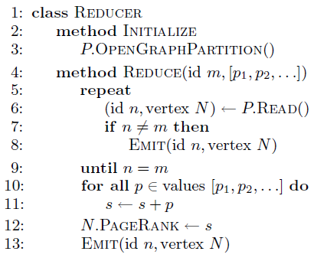
Schimmy Design Pattern [3/3]
load graph structure from HDFS

Slide 20
Experiments
Cluster setup :
10 workers, each 2 cores (3.2 GHz Xeon), 4GB RAM, 367 GB disk
Hadoop 0.20.0 on RHELS 5.3
Dataset :
First English segment of ClueWeb09 collection
50.2m web pages (1.53 TB uncompressed, 247 GB compressed)
Extracted webgraph : 1.4 billion links, 7.0 GB
Dataset arranged in crawl order
Setup :
Measured per-iteration running time (5 iterations)
100 partitions
Contents from Jimmy Lin and Michael Schatz at Hadoop Summit 2010 - Research Track

Slide 21
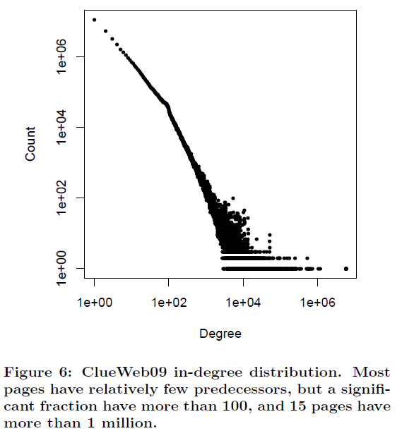
Dataset : ClueWeb09

Slide 22
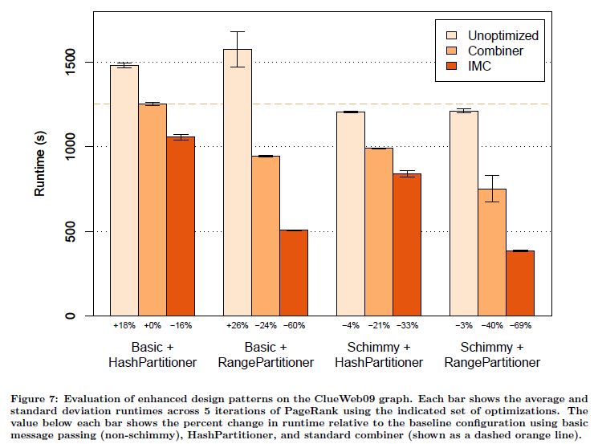
Results
Notes:
by computing 5 iterations of PageRank with different sets of optimization enabled.

Slide 23
Conclusion
Lots of interesting graph problems
Social network analysis
Bioinformatics
Reducing intermediate data is key
Local aggregation
Smarter partitioning
Less bookkeeping
Contents from Jimmy Lin and Michael Schatz at Hadoop Summit 2010 - Research Track

