Slide 1
TensorFlow: Large-Scale Machine Learning on Heterogeneous Distributed Systems
Martin Abadi, Ashish Agarwal, Paul Barham, et al.
Preliminary White Paper, November 9, 2015
Dongjun Lee
11 Feburary 2016

Slide 2
Abstract
Interface for expressing machine learning algorithms, and an implementation for executing such algorithms.
Can be executed on variety of heterogeneous systems.
mobile devices ~ large scale distributed systems
GPU cards
Open Source Software Library
http://github.com/tensorflow/tensorflow
released in November, 2015

Slide 3
Introduction
Google Brain project’s second-generation system for large scale machine learning
more flexible
significantly better performance
broader range of models
support heterogeneous hardware platforms
Expressed as stateful dataflow graph
flexible for quickly experimenting with new models
high performance
robust for production
Notes:
Tensorflow Computations are expressed as stateful dataflow graph
datastructure

Slide 4
Programming Model and Basic Concepts
Basic Concepts
computations are expressed as a directed graph
represents a dataflow computation
extensions for structures
C++ / Python
graphs mapped onto variety of hardware platforms
Nodes
has zero or more inputs and outputs
represent the instantiation of an operation
Notes:
Tensorflow Computations are expressed as stateful dataflow graph
User constructs computational graph with C++ or Python

Slide 5
Programming Model and Basic Concepts (cont.)
Programming Model
Tensor
values that flow along normal edges
type specified at graph-construction time
Control dependencies
special edge with no data flows
source node must finish before the destination node
Operation
represents an abstract computation
matrix multipy, add
can have attributes
handle different tensor element types
Notes:
Tensorflow Computations are expressed as stateful dataflow graph
User constructs computational graph with C++ or Python

Slide 6
Programming Model and Basic Concepts (cont.)
Programming Model (cont.)
Kernel
particular implementation of an operation that can be run on a particular type of device (e,g., CPU or GPU)
Variables
most tensors do not survive past a single execution of the graph
maintain state across executions of the graph
Sessions
Client programs interact with the Tensorflow system by a Session
places the graph operations onto Devices
provides methods to execute them
Notes:
Tensroflow set up a session with a graph once, and then execute the full graph or subgraphs mllions of times via Run calls.
Session : context

Slide 7
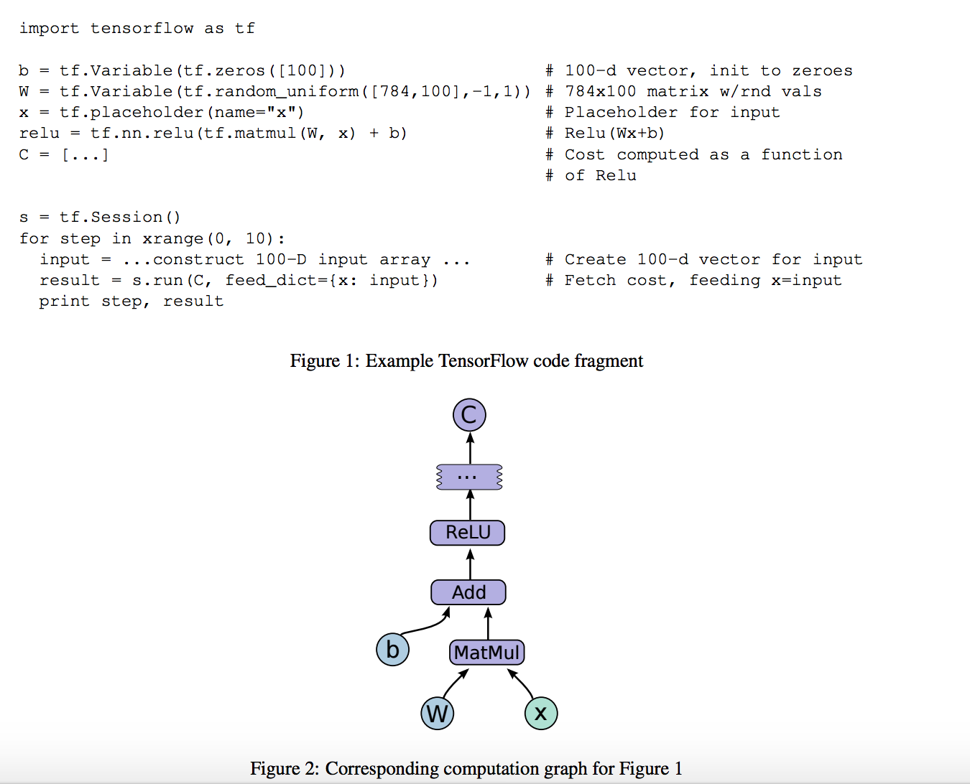
Programming Model and Basic Concepts (cont.)
Notes:
relu -> activation function

Slide 8
Programming Model and Basic Concepts (cont.)
Basic Usage
Represents computations as graphs.
Executes graphs in the context of Sessions.
Represents data as tensors.
Maintains state with Variables.
http://tensorflow.org

Slide 9
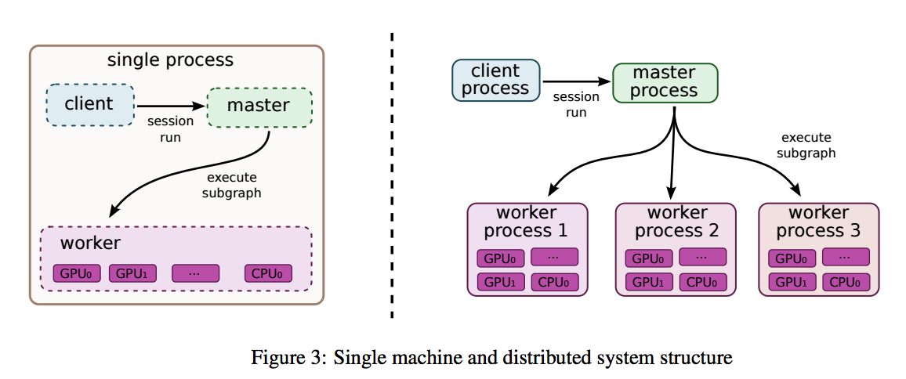
Implementation
Client
uses the Session interface to communicate with master, and one or more worker processes
each worker process access to one or more devices
local implementation
run on a single machine
distributed implementation
shares most of the code with the local implementation
extends with support for an environment

Slide 10
Implementation (cont.)
Multi-Device or Distributed Execution
Two main complications
deciding which device to place the computation for each node
managing the communication of data across device boundaries
Node Placement
Map the computation onto the set of available devices
Placement Algorithm
cost model : size of input and output tensors, estimates of the computation time for each node
uses greedy heuristic for node placing on possible devices.
Notes:
Cost model is either statically estimated based on heuristics associated with different operation types,
Or is measured based on an acutual set of placement decisions for earlier executions of the graph

Slide 11
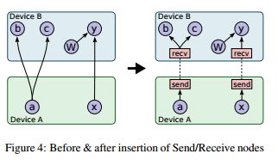
Implementation (cont.)
Cross-Device Communication

Slide 12
Implementation (cont.)
Cross-Device Communication (cont.)
cross-device edge is removed
Replaced by a new Send node and Receive node
Send and Receive nodes coordinate to transfer data across devices at Runtime
Isolate all communication inside Send and Receive node.
Allow the scheduling of nodes on different devices to be decentralized
Master only needs to issue a single Run request to each worker

Slide 13
Implementation (cont.)
Fault Tolerance
Two main failures
Error in a communication between send and receive node
Periodic health-checks from the master to every workers
Abort entire graph execution and restarted from scratch
Support consistent checkpointing and recovery
Each variable node is connected to a Save node
Save nodes are executed periodically
Notes:
Save

Slide 14
Optimizations
Common Subexpression Elimination
Computation graphs easily end up with redundant copies of the same computation
Common subexpression path algorithm
Runs over the computation graph
Canonicalizes multiple copies of operations to a single one
Controlling Data Communication and Memory Usage
Careful scheduling result better performance
Reduce the time window during which intermediate results are needed
Orchestrating the communication of data
➔ Scheduling of Receive nodes for reading remote values
Notes:
In particular with respect to data transfers and memory usage
This reduction is particularly important for GPU devices where memory is scarce.
Start these nodes until just before their results are needed

Slide 15
Optimizations (cont.)
Asynchronous Kernels
Synchronous kernel: complete execution at the end of the compute method
Asynchronous kernel: continuation passed
Reduce active threads
Receive kernel
Optimized Libraries for Kernel Implementations
Lossy Compression
For higher precision internal representation
When sending data between devices
Notes:
Having many active threads is relatively expensive in terms of memory usage or other resources

Slide 16
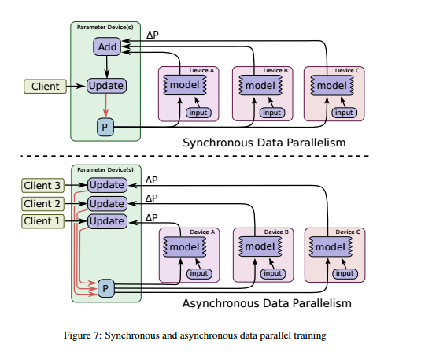
Common Programming Idioms
Data Parallel Training

Slide 17
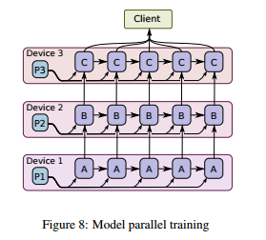
Common Programming Idioms
Model Parallel Training
Different portions of the model computation on different devices simultaneously

Slide 18
Performance
A future version of this white paper will have a comprehensive performance evaluation section of both the single machine and distributed implementations

Slide 19
Tools
TensorBoard
Visualization of Computation Graphs
Visulaization of Summary Data
Performance Tracing

Slide 20
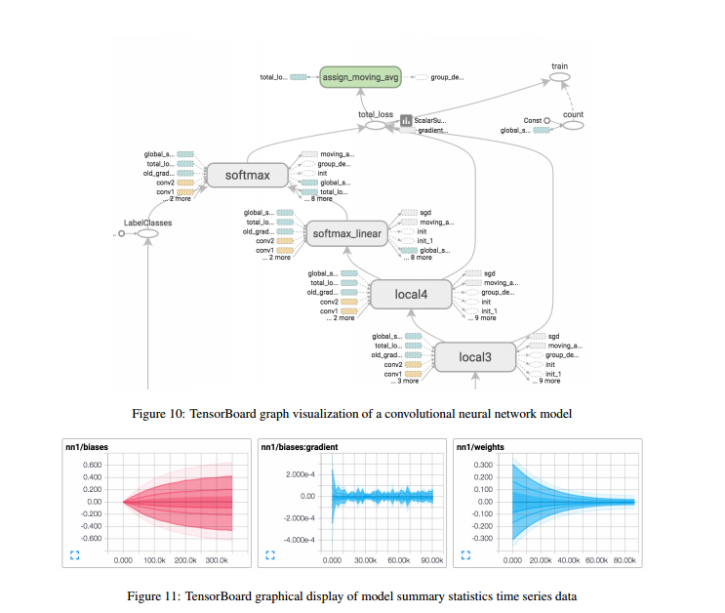
Tools (cont.)
TesnorBoard

Slide 21
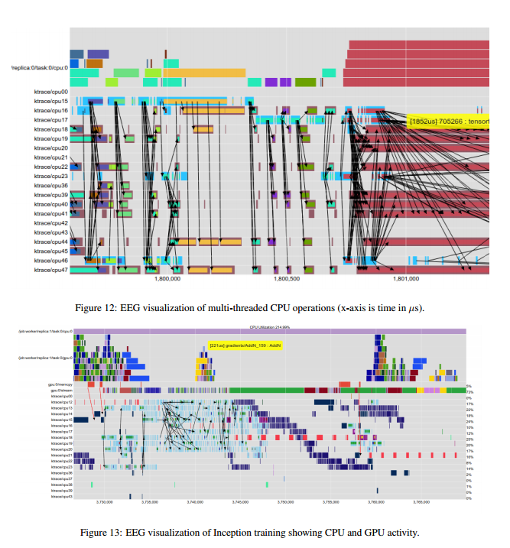
Tools (cont.)
Performance Tracing

Slide 22
Future Work
Extend basic programming model
Function mechanism
An entire subgraph to be a reusable component
Imporve performance
Just-in-time compiler
Improving the placement and node scheduling algorithms

