Slide 1
Digital Systems Design Term Project: CNN Accelerator Electrical and Computer Engineering Seoul National University

Slide 2
Table of Contents
Introduction & project goals
Background
Convolution / FC / Pooling / ReLU
Model configuration
Module-wise description
APB, AXI-stream / Computation layers (FC, Conv, Pool)
VDMA
System overview
Project materials
Submission
Miscellaneous

Slide 3
Introduction & Project Goal

Slide 4
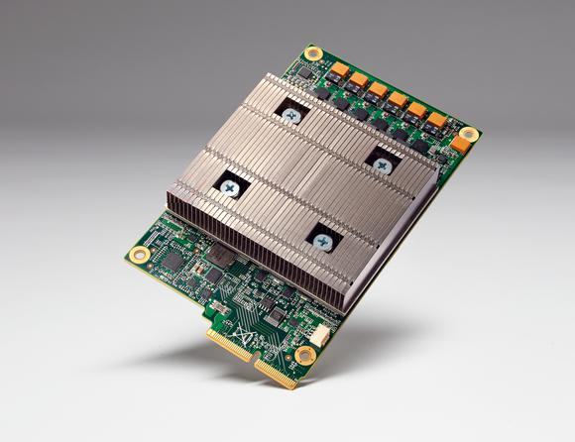
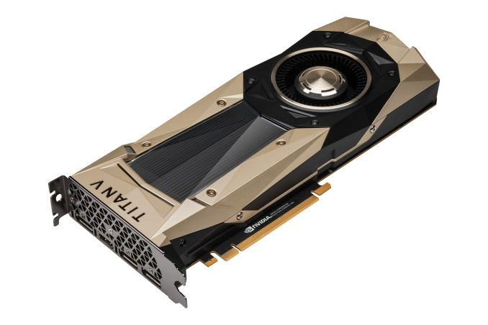

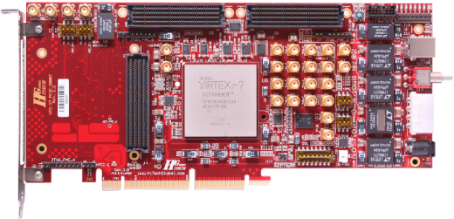
Introduction
Deep Learning Hardware
Google TPU
NVIDIA GPU (Titan V)
Intel CPU (Xeon)
NPU, etc…
FPGA (Xilinx Virtex-7)

Slide 5
Project Goal
Make a CNN accelerator on the FPGA board
Only for inference; not training
Reconfigurable (You can not change bitstream file)
Everything will be given
Model structure
Datasets
Interfaces between computer and FPGA boards
Network parameters!
Only things to do!
Make RTL code of 3-layers
Check functionality using the provided test dataset

Slide 6
Project Steps
1st : Write RTL code and implement the functionality
Make HW work!!!
2nd : Find “the optimal point” of design (by revision)
Speed = images / second
For step 2, you need to make design decisions
Everything is trade-off
Resource reuse / pipelining / parallel
HW complexity
Etc.
RTL implementation of the 3-layers are your only concerns

Slide 7
Provided Materials
Dataset
CIFAR-10 dataset
CNN python codes
Naïve python code for your understanding on CNN
Verilog skeleton codes
Testbench & UART ipynb file
For each module (Conv, FC, Pool)
For the entire project

Slide 8
NOTE
This is not a Deep Learning course
You need to understand the algorithm first
There are too many answer for implementation
DO NOT COPY!

Slide 9
Background

Slide 10
Overview of CNN Model
Convolution Neural Network
Convolution + ReLU (activation function)
Pooling
FC

Slide 11
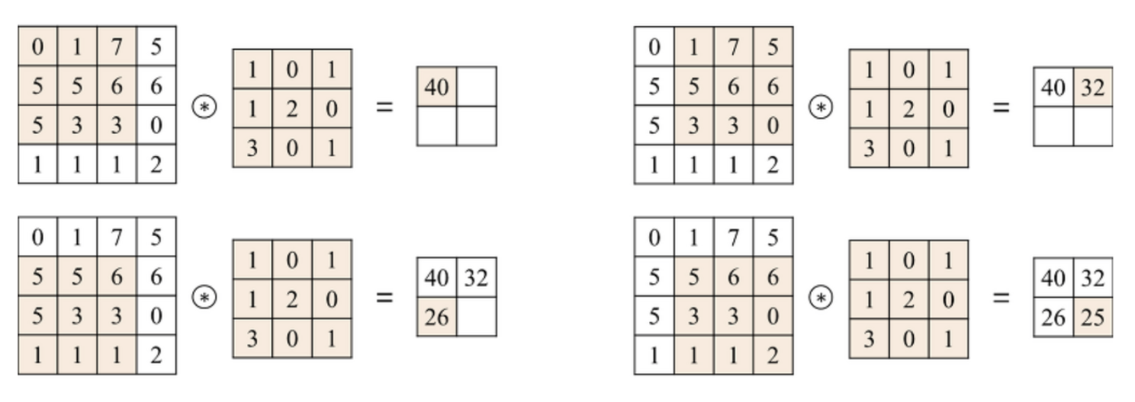
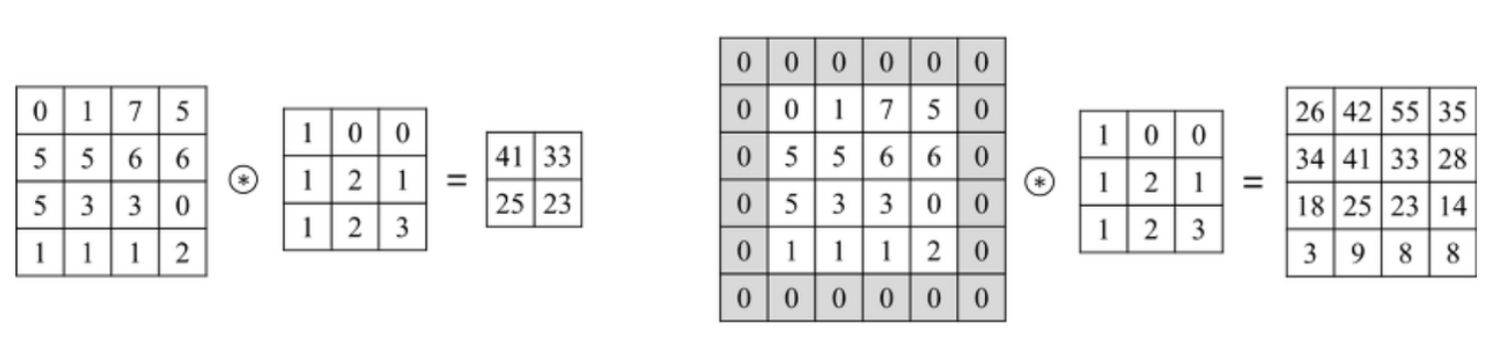
Convolution Layer
Convolution layers extract the features of input data
Filter
Weight matrix to multiply with feature matrix
Stride
Stride size: How many elements for filter to jump?
Padding
Padding is used for making the size of input and output similar or the same
After convolution, do ReLU operation, which filters out negative values
Example of convolution computation
(stride_size=1, padding=0)
The effect of padding
(left: no padding, right: zero padding)

Slide 12
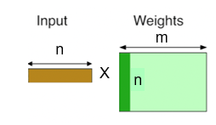
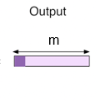

Fully-Connected (FC) Layer
FC layers classify the data
FC = Matrix-Vector multiplication
The output of the last conv(+pool) layer is a matrix form, so it is unrolled as a vector form
After FC, do ReLU operation same as the convolution layer
[
Input
Weight
]
Bias
Output
m
$$+$$
=
Structure of FC layer ¹⁾
Operation of FC layer²⁾
1) http://needjarvis.tistory.com/182
2) https://petewarden.com/2015/04/20/why-gemm-is-at-the-heart-of-deep-learning/

Slide 13
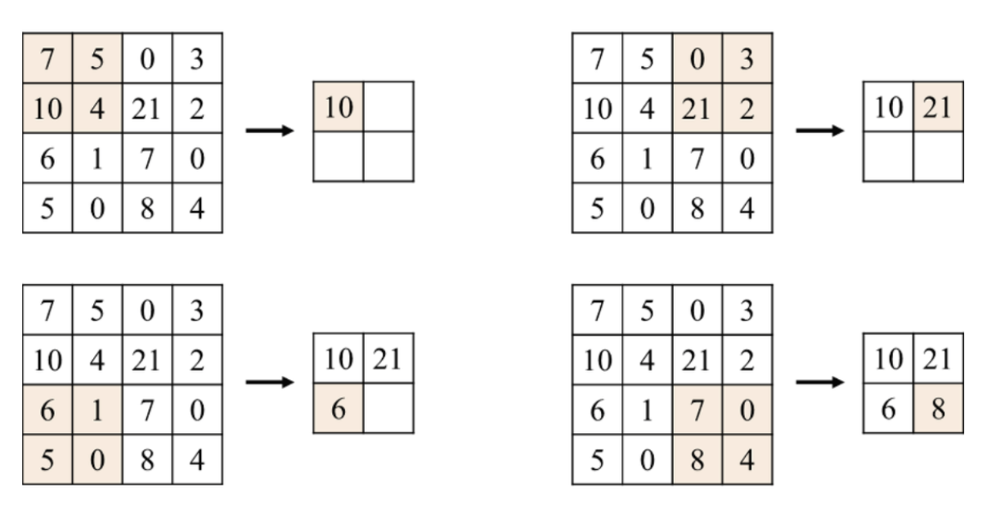
Pooling Layer
Option: Max pooling, min pooling, average pooling(no comp.)
Used for preventing overfitting
Window size
Similar to filter of conv. layer (almost 2x2)
Stride size
How many elements for window to jump?
Example of pooling computation
(window_size=2x2, stride_size=2)

Slide 14
Appendix
What is Deep Learning?
https://www.nature.com/articles/nature14539
For convolutional layer,
Refer http://cs231n.github.io/convolutional-networks/#conv
For fully-connected layer,
Refer to Lab 06 notes
Or refer http://cs231n.github.io/convolutional-networks/#fc
For pooling layer,
Also refer http://cs231n.github.io/convolutional-networks/#pool

Slide 15
Model Configuration

Slide 16
Experiment Setup
Dataset: CIFAR-10
Model architecture: revised VGG
# of convolutional layers = 6
# of pooling layers = 4
# of FC layers = 3
Trained with PyTorch framework
The default feature/weight representation in PyTorch is (out-channel, in-channel, rows, cols)
E.g. weight matrix: (out-channel, in-channel, rows, cols)

Slide 17
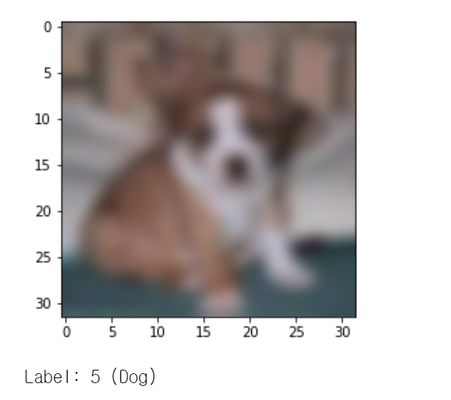
Model Structure
Input size per img
3x32x32
Label
CONV1 (32, 3, 3, 3)
FC1 (256, 1024)
FC2 (64, 256)
MAXPOOL1
FC3 (10, 64)
CONV2 (64, 32, 3, 3)
MAXPOOL2
CONV3 (128, 64, 3, 3)
CONV4 (128, 128, 3, 3)
MAXPOOL3
CONV5 (256, 128, 3, 3)
CONV6 (256, 256, 3, 3)
MAXPOOL4
(Out-ch, In-ch, Row, Col)
(Out, In)

Slide 18
Module-wise Description

Slide 19
APB
Abbreviation of Advanced Peripheral Bus, which is a kind of AMBA (Advanced Microcontroller Bus Architecture) protocol
We will use this protocol on our control path
If you want to know more about the APB protocol, refer to: https://www.eecs.umich.edu/courses/eecs373/labs/lab3/IHI0024C_amba_apb_protocol_spec.pdf

Slide 20
APB
It takes part of control flow
top_<ex>_module
PC
apb_<ex>_module
APB (control flow)

Slide 21
APB
You can read and write values to modules from the CPU
From the CPU, you can send start signals & receive end signals
You can set certain parameters to your module
You can read certain values from your module from the CPU
This might be very useful for debugging!

Slide 22
APB
APB port list
APB input/output
Input |  | Output
Name | Size | Name | Size
PCLK | 1-bit | PRDATA | 32-bit
PRESETB | 1-bit
PADDR | 32-bit
PSEL | 1-bit
PENABLE | 1-bit
PWRITE | 1-bit
PWDATA | 32-bit

Slide 23
AXI-Stream
There are three kinds of AXI
AXI (full)
Basic version
Uses 5 channels for data transaction between master and slave
(Write address/control, Write data, Write response, Read address and Read data)
AXI-Lite (already learn in the lab session)
Light version of AXI
Uses 5 channels for data transaction between master and slave
But do not use burst mode or other modes
AXI-Stream
We will use this in the project
Used for sending and receiving data streams
Uses only one channel (Write data channel) for data transaction between master and slave

Slide 24
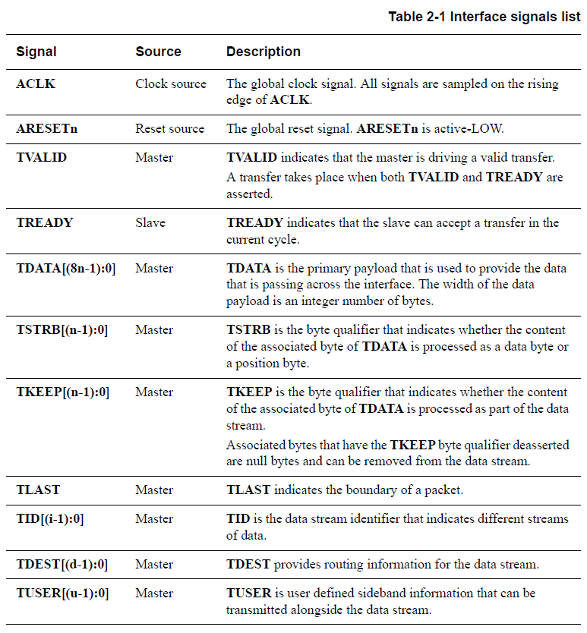
AXI-Stream
You have to implement below signals
Both AXI-Stream Master and Slave interface
ACLK and ARESETn are shared with master and slave
Other signals exist respectively (master and slave)
For master interface, TKEEP and TUSER is used for output and it should be set to {4{1’b1}}, 1’b0

Slide 25
AXI-Stream
AXI port list
AXI-Stream input/output
Input |  | Output
Name | Size | Name | Size
M_AXIS_TREADY | 1-bit | S_AXIS_TREADY | 1-bit
S_AXIS_TDATA | 32-bit | M_AXIS_TDATA | 32-bit
S_AXIS_TVALID | 1-bit | M_AXIS_TVALID | 1-bit
S_AXIS_TLAST | 1-bit | M_AXIS_TLAST | 1-bit
S_AXIS_TKEEP | 4-bit | M_AXIS_TKEEP | 4-bit
S_AXIS_TUSER | 1-bit | M_AXIS_TUSER | 1-bit
AXIS_ACLK | 1-bit
AXIS_ARESETN | 1-bit

Slide 26
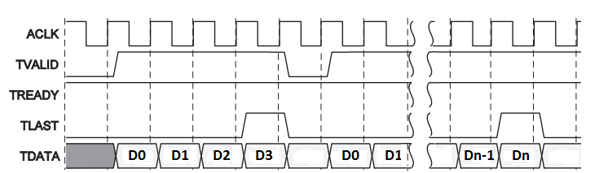
AXI-Stream
When Slave is ready for get data, TREADY <= HIGH

Slide 27
AXI-Stream
When master sends TDATA, TVALID <= HIGH

Slide 28
AXI-Stream
Send D0
When TREDAY AND TVALID are both HIGH, data are sent

Slide 29
AXI-Stream
Send D3 (Last)
When the last data is sent, the TLAST goes high

Slide 30
AXI-Stream
After the last data is sent, TVALID and TLAST goes LOW

Slide 31
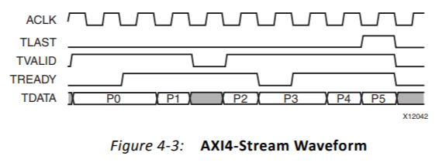
AXI-Stream
TVALID (0) && TREADY (1) : No data sent from master
TVALID (1) && TREADY (0) : No data received from slave, master holds current data value

Slide 32
AXI-Stream
If you want to know more information, you can make AXI-stream example file with the way you make the AXI-Lite example file. (Please refer the Lab 09)
Or you can refer the following site: https://www.xilinx.com/support/documentation/ip_documentation/ug761_axi_reference_guide.pdf

Slide 33
VDMA
AXI VDMA (Video Direct Memory Access)
Provides a high bandwidth solution for video applications
Provides high performance direct memory access btw system memory and AXI4-Stream type target peripherals
DMA? (Direct Memory Access)
A feature of computer systems that allows certain hardware subsystems to access main system memory independent of the CPU (Central Processing Unit) <-> (PIO)

Slide 34
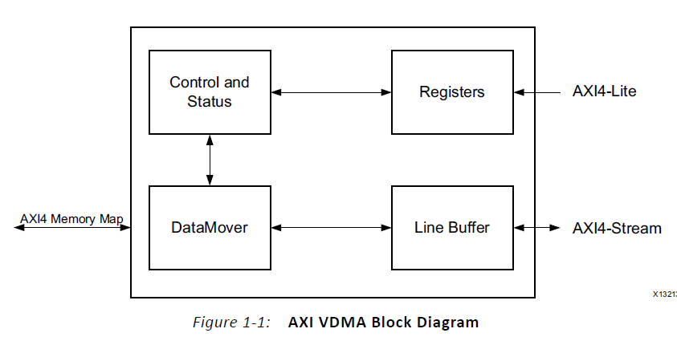
VDMA
After registers are programmed through the AXI4-Lite interfaces, the Control/Status logic block generates appropriate commands to the DataMover to initiate Write and Read commands on the AXI4 Master interface
S
Memory
FC module
AXI VDMA Block Diagram

Slide 35
VDMA
A configurable asynchronous Line Buffer is used to temporarily hold the pixel data prior to writing it out to the AXI4-Memory Map interface or the AXI4-Stream interface.
S
Memory
FC module
AXI VDMA Block Diagram

Slide 36
VDMA
In the Write path, the AXI VDMA accepts frames on the AXI4 Stream slave interface and writes it to system memory using the AXI4 Master interface (S2MM)
Memory
FC module
Memory Map to Stream (MM2S)
M
S
M
S
M
Stream to Memory Map (S2MM)
AXI VDMA Block Diagram

Slide 37
VDMA
In the Read path, the AXI VDMA uses the AXI4 Master interface for reading frames from system memory and outputs it on the AXI4 Stream Master interface (MM2S)
Memory
FC module
Memory Map to Stream (MM2S)
M
S
M
S
M
Stream to Memory Map (S2MM)
AXI VDMA Block Diagram

Slide 38
VDMA
Within the VDMA, there are registers responsible for setting the control, start address, class, hsize and vsize by data transfer direction (MM2S and S2MM)
To send data over VDMA, the values must be written to VDMA internal registers via the AXI4-Lite interface
Because it is Video DMA, default transfer unit is frame
The frame consists of lines, and you can send data by setting the hsize (line size) and vsize (# of lines)

Slide 39
VDMA
To operate the VDMA, write the values on the registers in the order as below
VDMACR (control) register: Setting the control (MM2S or S2MM)
START_ADDRESS register: Setting the memory address to start send or receive data
FRMDLY_STRIDE register: Setting the stride (if there is no need for using stride, set same as HSIZE
HSIZE register: Setting the HSIZE (line size in Bytes)
VSIZE register: Setting the VSIZE (# of lines)
After setting the VSIZE, data transfer will be start on VDMA

Slide 40
VDMA
Register address offset:
You should only send the address value in 9-bits (b/c port width is 9-bit)
Register type | Address Offset
 | MM2S | S2MM
VDMACR (control) | 0x00 | 0x30
START_ADDRESS | 0x5C | 0xAC
FRMDLY_STRIDE | 0x58 | 0xA8
HSIZE | 0x54 | 0xA4
VSIZE | 0x50 | 0xA0

Slide 41
FC Module
Module
Control
MAC (input format: 8-bit 2’s fixed-point)
AXI-stream
Ports
APB signal
AXI-stream

Slide 42
FC Module
AXI-Stream
I/O ports are given
Unnecessary pins are fixed to default
S_AXI: receive the data
M_AXI: send the data
The AXIS protocol ports for sending data
m_axis_tdata, m_axis_tlast, m_axis_tvalid
The AXIS protocol port for receiving data:
s_axis_tready

Slide 43
FC Module
APB I/O Ports
fc_start
PC to FPGA, Use APB protocol
Trigger the start of operation of module’s
When PC receive fc_done, PC set fc_start to zero
max_index
Check whether this fc module is last or not
If it is last, it sends the maximum score’s index (0 to 9, =class number)
It reduces the communication overhead of inference
fc_done
The port indicating that the operation of the fc layer has ended
PC reads this value and then progresses
fc_done flag must remain zero during processing and be HIGH when processing is over
You have to add these ports!!

Slide 44
FC Module
Testbench structure
top_simulation
tb
fc_module
AXI-Stream (Data flow)
wire (control flow)

Slide 45
FC Module
Hardware structure
fc_top
MEM
PC
fc_module
fc_apb
AXI-Stream (Data flow)
APB (Control flow)

Slide 46
Conv Module
Module
Control
Systolic Array
PE (=MAC) (input format: 8-bit 2’s fixed point)
AXI-stream
Port
APB signal
AXI-stream

Slide 47
Conv Module
AXI-Stream
I/O ports are given
Unnecessary pins are fixed to default
S_AXI: receive the data
M_AXI: send the data
The AXIS protocol ports for sending data
m_axis_tdata, m_axis_tlast, m_axis_tvalid
The AXIS protocol port for receiving data:
s_axis_tready

Slide 48
Conv Module
APB I/O Ports
conv_start
PC to FPGA, Use APB protocol
Trigger the start of operation of module’s
When PC receive the conv_done, PC set conv_start to zero
conv_done
The port indicating that the operation of the conv layer has ended
PC reads this value and then progresses.
conv_done flag must remain zero during processing and be HIGH when processing is over

Slide 49
Conv Module
Testbench structure
top_simulation
tb
conv_module
AXI-Stream (Data flow)
wire (control flow)

Slide 50
Conv Module
Hardware structure
top_conv
DRAM
PC
conv_module
conv_apb
AXI-Stream (Data flow)
APB (control flow)

Slide 51
Pooling Module
Algorithm
max-out
Max pooling - should store each pooling’s coverage
Should store the previous row’s data

Slide 52
Pooling Module
AXI-Stream
I/O ports are given
Unnecessary pins are fixed to default
S_AXI: receive the data
M_AXI: send the data
The AXIS protocol ports for sending data
m_axis_tdata, m_axis_tlast, m_axis_tvalid
The AXIS protocol port for receiving data:
s_axis_tready

Slide 53
Pooling Module
APB I/O Ports
pool_start
PC to FPGA, Use APB protocol
Trigger the start of operation of module’s
When PC receives the pool_done, PC sets pool_start to zero
pool_done
The port indicating that the operation of the pool layer has ended
PC reads this value and then progresses.
pool_done flag must remain zero during processing and be HIGH when processing is over

Slide 54
Pooling Module
Testbench structure
top_simulation
tb
pool_module
AXI-Stream (Data flow)
wire (control flow)

Slide 55
Pooling Module
Hardware structure
pool_top
DRAM
PC
pool_module
pool_apb
AXI-Stream (Data flow)
APB (control flow)

Slide 56
ReLU Module
Activation layer (ReLU)
It is so simple
ReLU computation is done at the last step of conv / FC module
There is no separate module for ReLU

Slide 57
System Overview

Slide 58
System Overview
CNN accel. system overview
FPGA Board
PC
UART
AXI Stream
FC Layer
UART
Module
Interconnect
AXI-Lite
AXI Stream
CONV Layer
AXI Full
POOL Layer
AXI Stream
MIG(Memory Interface Generator)
DRAM

Slide 59
System Overview
CNN accel. system overview
FPGA Board
PC
UART
APB
FC Layer
Decoder
Interconnect
AXI-Lite
APB
CONV Layer
APB
POOL Layer
MIG(Memory Interface Generator)
DRAM

Slide 60
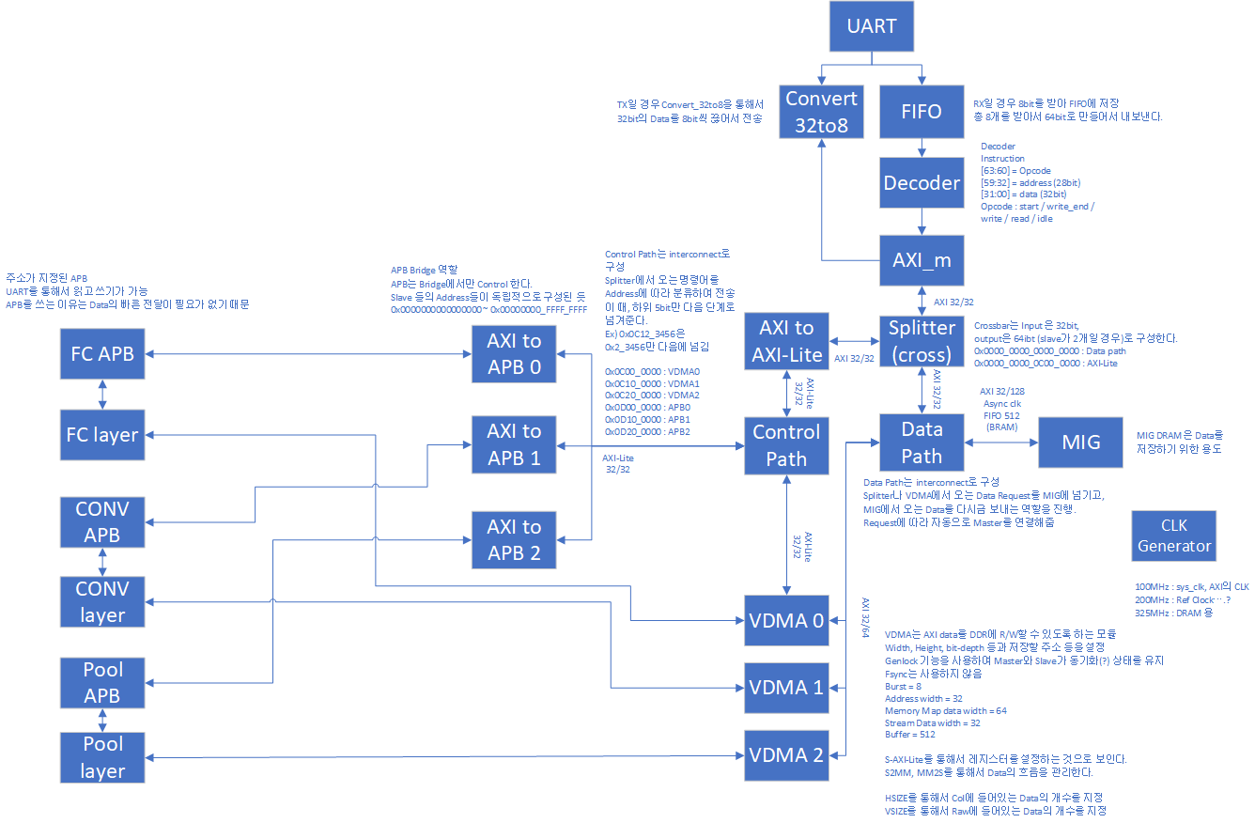
System Overview

Slide 61
Memory Map
Major modules are assigned to a memory address
DRAM : 0x0000_0000 ~ 0x0800_0000
VDMA0 : 0x0C00_0000 ~ 0x0C10_0000
VDMA1 : 0x0C10_0000 ~ 0x0C20_0000
VDMA2 : 0x0C20_0000 ~ 0x0C30_0000
APB0 : 0x0D00_0000 ~ 0x0D10_0000
APB1 : 0x0D10_0000 ~ 0x0D20_0000
APB2 : 0x0D20_0000 ~ 0x0D30_0000
Instructions sent from PC via UART are decoded by the decoder
[63:60] = opcode (read: 5, write: 4)
[59:32] = address
[31:00] = data
Intermediate interconnects send data to the proper address
Splitter
Control path
Data path

Slide 62
Data Save
e.g., Instruction 1
Opcode = 0x04 (write)
Address = 0x0200_0000
Data = save weight or bias, etc,..
Send data to data because address is smaller than 0x0C00_0000

Slide 63
Result Read
e.g., Instruction 2
Opcode = 0x05 (read)
Address = 0x0600_0000
Data = 0x0000_0000
Redirected to datapath and data read because the address is smaller than 0x0C00_0000

Slide 64
PC to VDMA0
e.g., Instruction 3
Opcode = 0x04 (write)
Address = 0x0C00_0054
Data = HSIZE
Data sent to control path because the address is larger than
0x0C00_0000
Addr redirected to 0x54
Save HSIZE to VMDA’s reg

Slide 65
VDMA0 to FC Layer
Instruction
Opcode = 0x04 (write)
Address = 0x0D00_0001
Data = apb_command
Data sent to control path because the address is larger than
0x0C00_0000
Data sent to APB0 because the address is larger than
0x0D00_0000

Slide 66
Project Materials

Slide 67
Provided Materials
Verilog source code
Vivado project directories referencing the above verilog source codes
Python scripts
Documentation about this project (this PPT)
Extra explanations about each materials is in the README.md file in the github repository

Slide 68
Recommendations
You should understand how the python code works
Look closely into scale_uart.py
The python code interacts with the APB module (which is the control for your modules)
Read the code & comments carefully
You should understand how to control the module
Look closely into APB module and protocol
You should implement your own APB module for each layer
You should understand the specifications of each layer
Look closely what conv, fc, and pool layer does
You should implement your own modules for each layer
Look closely into the input/output specification of each modules

Slide 69
Desired Roadmap
1st Week (Nov. 21th ~ Nov. 25th)
Read the project description/code
Share your idea with teammates
Design the module (roughly)
2nd Week (Nov. 26th ~ Dec. 2nd)
Implement each part
3rd Week (Dec. 3rd ~ Dec. 9th)
Debug each part
4th Week (Dec. 10th ~ Dec. 16th)
Extra implement and debugging (final)

Slide 70
Submission

Slide 71
Submission Deadline
Submission deadline:
TBA
Checkpoint:
Your functionality (demo)
Evaluation time

Slide 72
Submission Deadline
Submit to github
Bitstream file
Your python code (which may be revised for your design)
Your code
Push everything in the “main” branch of the github repository
The final commit before the deadline will be assessed

Slide 73
Submission Deadline
Submit to etl
One report for each team
One demo video for each team
Video of running the ipynb files
Less than 500MB
One member should upload all the materials
We will re-check your project demo after class for rechecking and evaluating the latency criteria

Slide 74
Report
Report deadline:
TBA
In the report, you must include:
Summary of the code that your team implemented
If you haven’t finished the project, explain what your team implemented and to what level did your team succeed
E.g., We implemented the FC layer and it passes the simulation & single_layer_test.ipynb
Diagram of your team’s overall design
Each members contribution (which layers did each of you designed)
Please submit on time
“Delayed submission will be not accepted!”

Slide 75
Miscellaneous

Slide 76
Tips for Design
Debugging Verilog is very difficult
It is time consuming
Synthesis and Implementation is time consuming
Maybe…… = 1-hours in most notebook
So, maybe most of your time is consumed in this progress

Slide 77
Tips for Design
First, design roughly for focusing on functionality (CNN)
Implementation can be difficult enough.
Then optimize!
Almost everything we need to do in the project has already been covered in class and lab session.
UART
AXI
FC (Advanced Compute units)
But you also need to revise and implement existing/new things
Convolutional layer
Max-pool
Memory-mapped

Slide 78
Tips for Design
Before writing code of modules, plan the algorithms
Bit operations, convolving sequences, what to store and reuse (weights or input features)
There is few designs achieving both efficiency and easiness
So, work hard and design thoroughly!
Debugging Verilog code is very and more difficult than SW
Everyone knows that debugging is twice as hard as writing a program in the first place. So, if you're as clever as you can be when you write it, how will you ever debug it?
"The Elements of Programming Style", By Brian Karnighan

Slide 79
Python API
You will use PC <-> FPGA board communication via UART
We will provide python API for you
You do not have to modify any python codes for this project, unless if you want to modify the python codes for debugging
And reuse the environment setting in Lab08
Use Conda to install packages!!
Package requirements (jupyter, pyserial, numpy, matplotlib, torch, glob2)
$ conda install pip
$ pip install -r requirements.txt

Slide 80
Python API
Here is the python APIs list and specifications
There are implementation details on project *.py code
First, we recommend you run the cifar_pytorch.ipynb jupyter-notebook to understand how each layer works

Slide 81
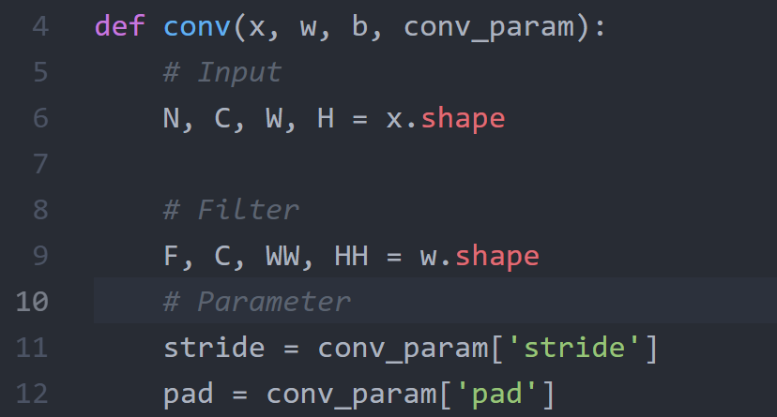
Python API
layers_cifar10.py

Slide 82
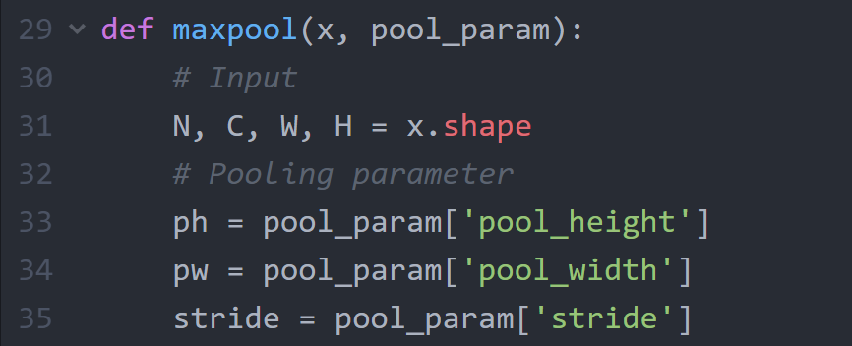
Python API
layers_cifar10.py

Slide 83
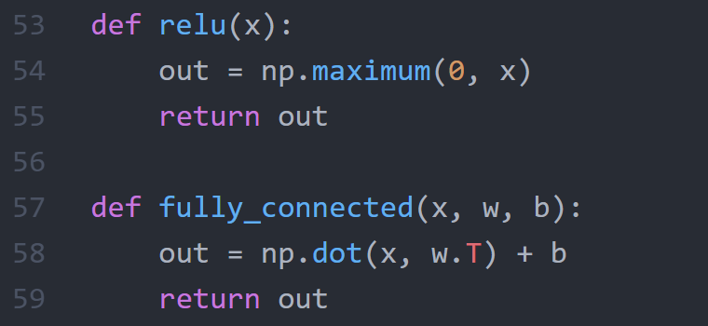
Python API
layers_cifar10.py

Slide 84
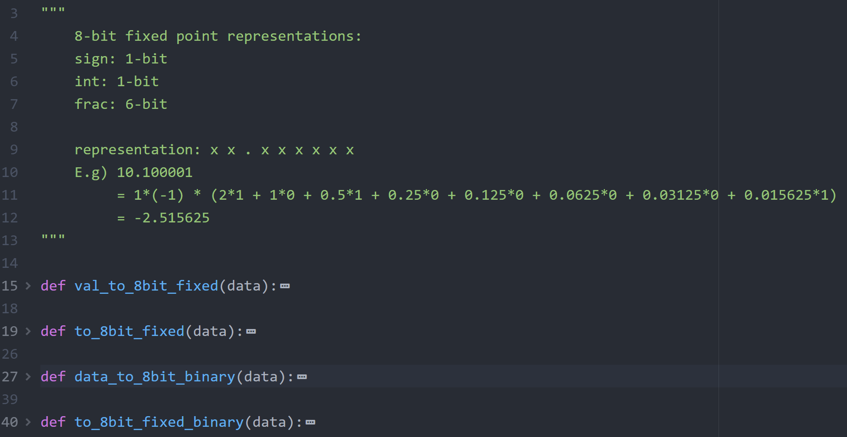
Python API
bit_operation.py

Slide 85
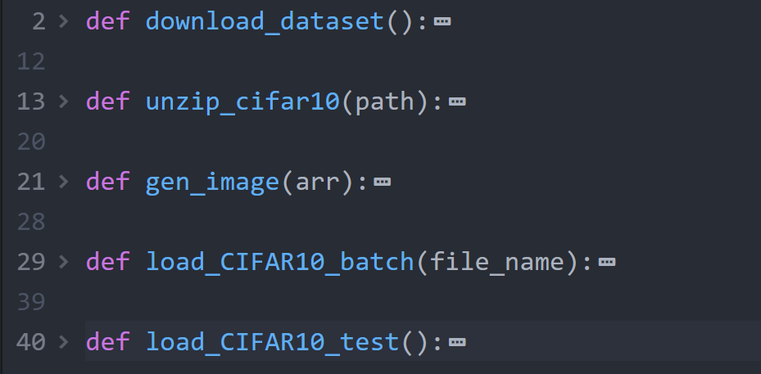
Python API
setup_cifar10.py

Slide 86
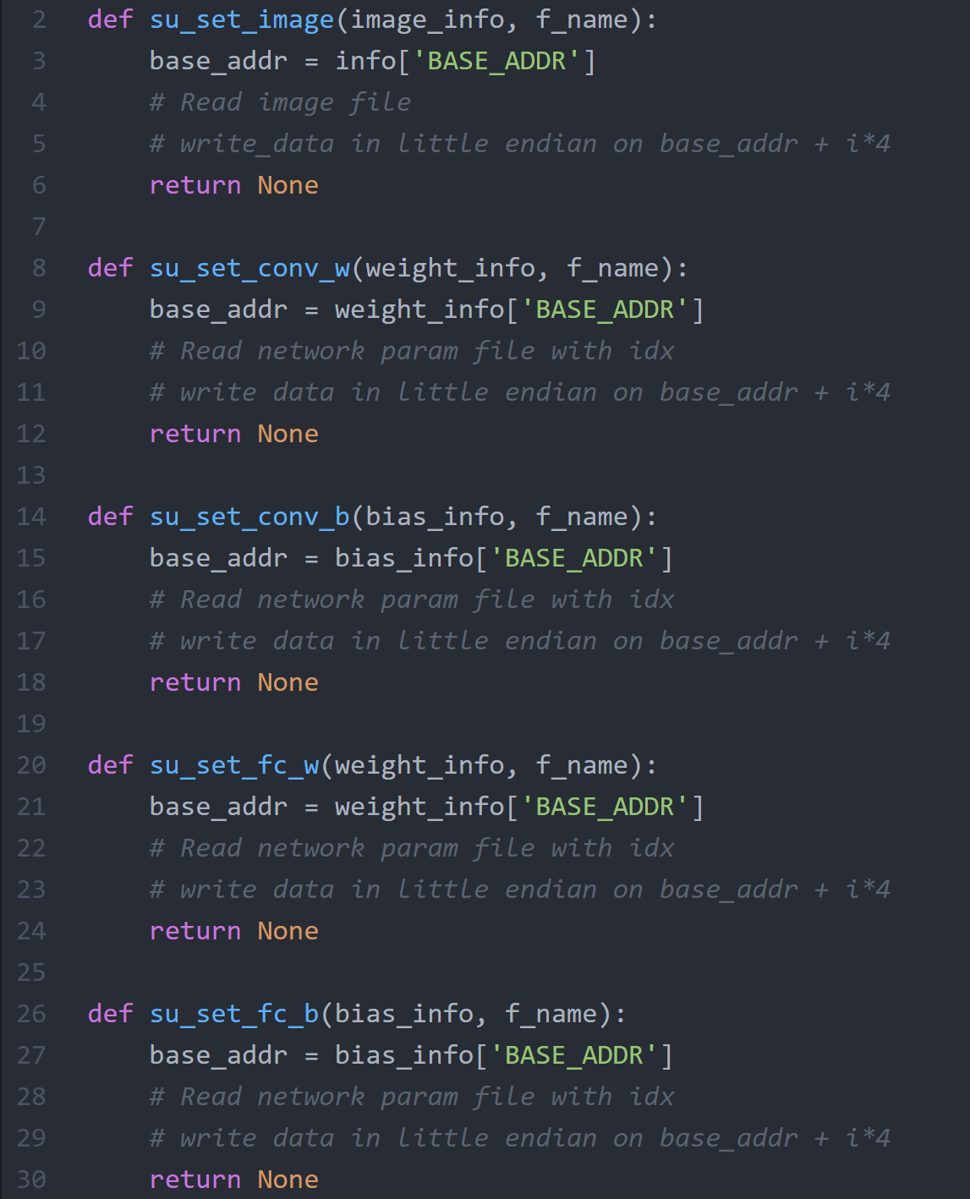
Python API
scale_uart.py
su_set_*() functions:
Read from file
Write to DRAM with base address
See the scale_uart.py and all_layer_test.ipynb

Slide 87
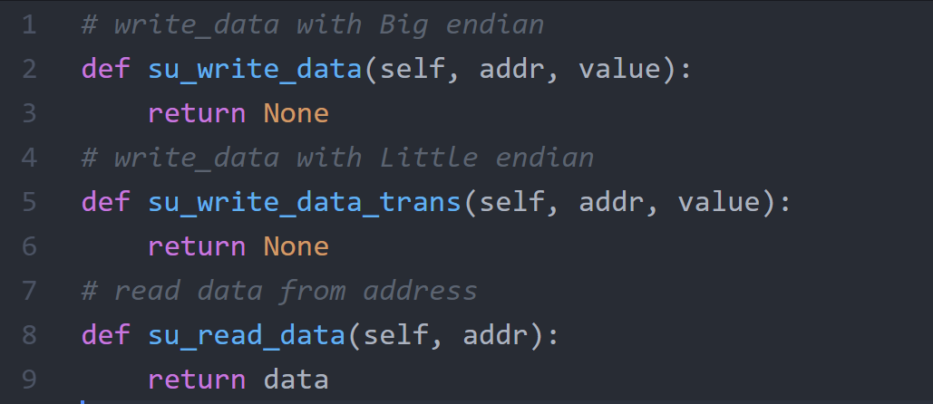
Python API
scale_uart.py
You can check the address or send the val to address by this function

Slide 88
Q&A

