Slide 1
ENERGY PRODUCTION FOR COMBINED CYCLE POWER PLANT
Mentor Name- Karthik Muskula
Start Date- 29 Aug 2023
Group no- 5

Slide 2
Presented By:
Mr. Prashant Payghan
Mr. Rajratna Dubdube
Ms. Priti Deshmukh
Mr. Girish Rayte
Mr. Mohammed

Slide 3
Business Objective:
A combined- cycle power plant comprises gas turbines, steam turbines, and heat recovery steam generators. In this type of plant, the electricity is generated by gas and steam turbines combined in one cycle. Then, it is transferred from one turbine to another.
We have to model the energy generated as a function of exhaust vacuum and ambient variables and use that model to improve the plants performance

Slide 4
Project Architecture:
Understanding Business Problem
EDA Process
Feature Engineering
Model Building
Deployment
Feedback

Slide 5
Data Set Details:
In given dataset the data file contains 9568 observations with 5 variables.
The variables are the following-
temperature, in degree Celcius.
exhaust_vacuum, in cm Hg. Independent Variable
amb_pressure, in milibar. (Ambient Pressure)
R_humidity, in percentage.(Relative Humidity)
Energy_production, in MW, Dependent Variable

Slide 6
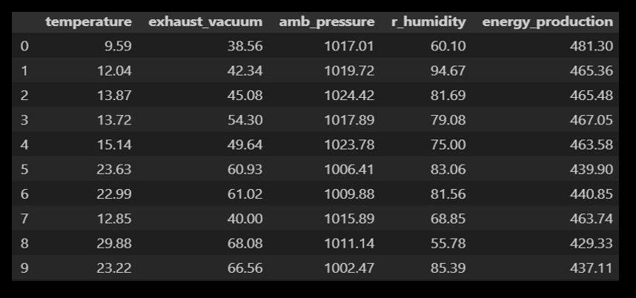
Data Set:
First 10

Slide 7
EXPLORATORY DATA ANALYSIS (EDA):
The given dataset has 9568 rows and 5 column.
Upon checking the given dataset has no null values.
We get 41 duplicate values in given dataset and we clean them.
After cleaning we have 9527 rows and 5 column.
We visualize the data and check the data distribution with histplot of temperature.
We also get outliners in ambient pressure and r_humidity and we clean that.

Slide 8
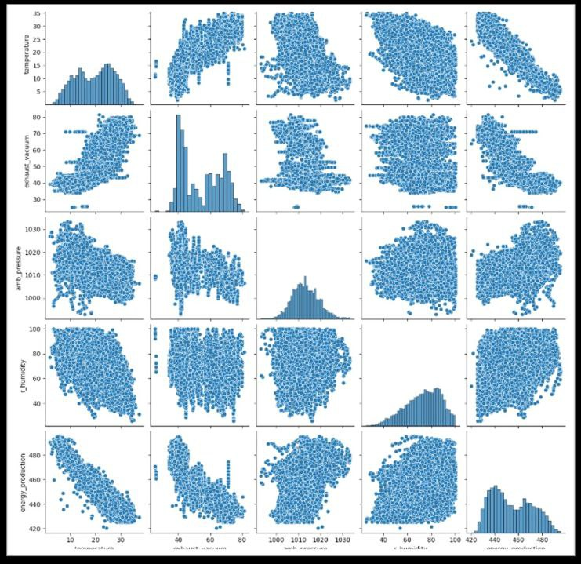
Correlation with variables:
From the scatter plot Temperature have strongest relationship which is -ve with the output.
Ambient pressure have a +ve correlation with the output.
Exhaust vacuum have –ve and Relative humidity have +ve impact on output.

Slide 9
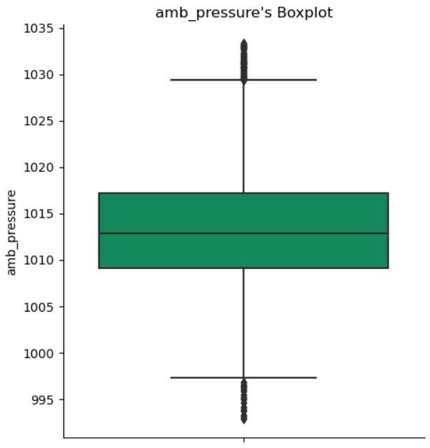
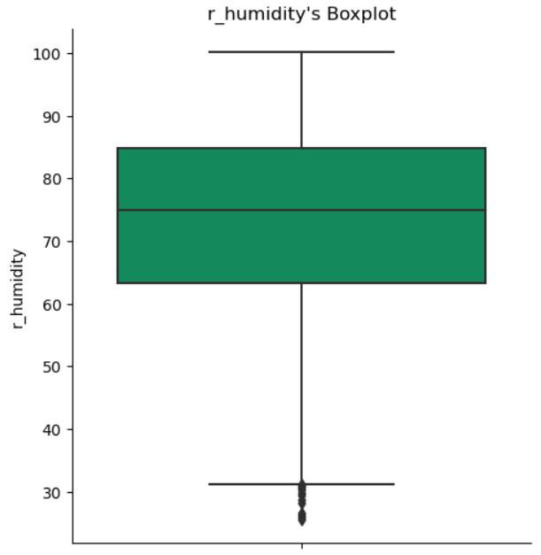
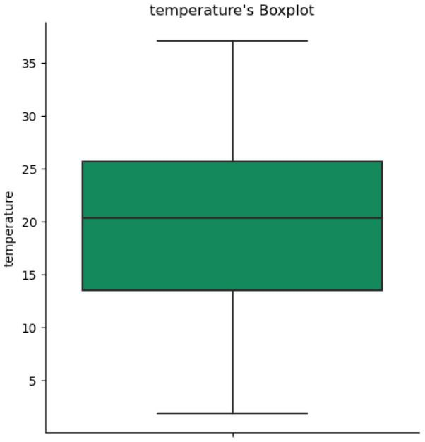
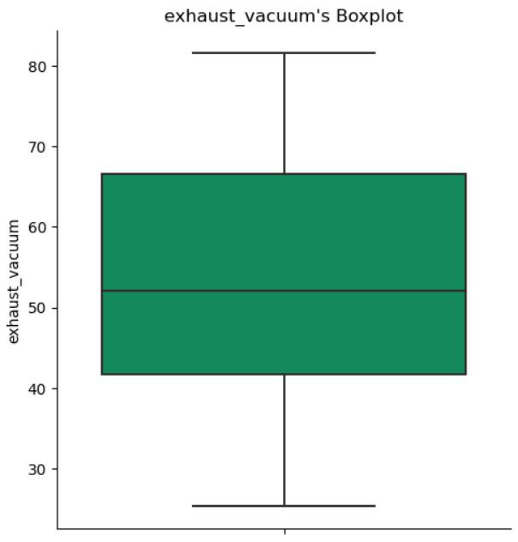
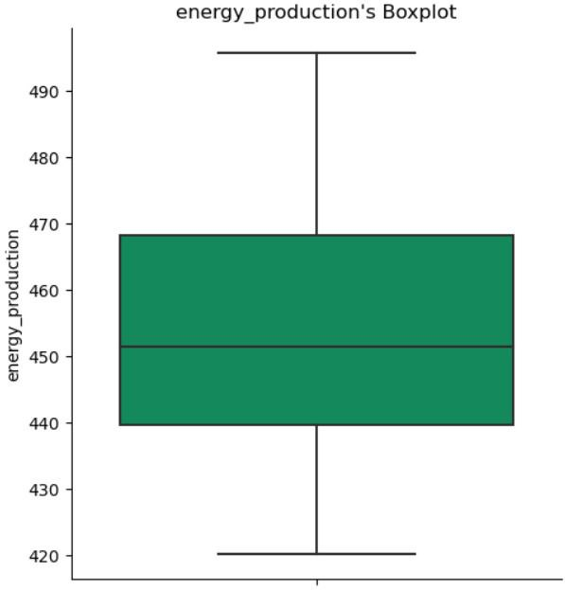
Outliers:
We get outliers in ambient pressure at upper extreme(above 1030) and lower extreme(below 997).
We can see outliers in relative humidity at lower extreme(below 32).

Slide 10
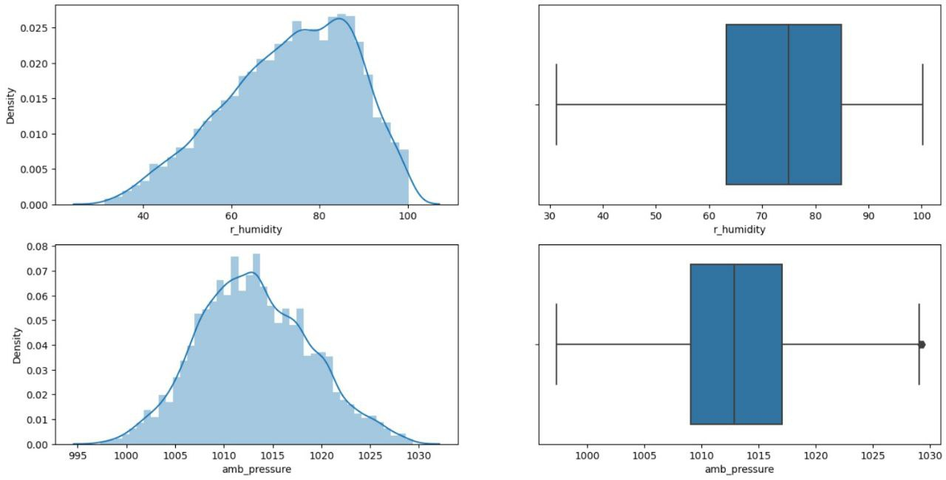
REMOVING OUTLIERS:
We used the IQR method to remove the outliers from our both features that is r_humidity and amb_pressure.
We compare the plots to check if our features still consist of any outliers and check the skewness.

Slide 11
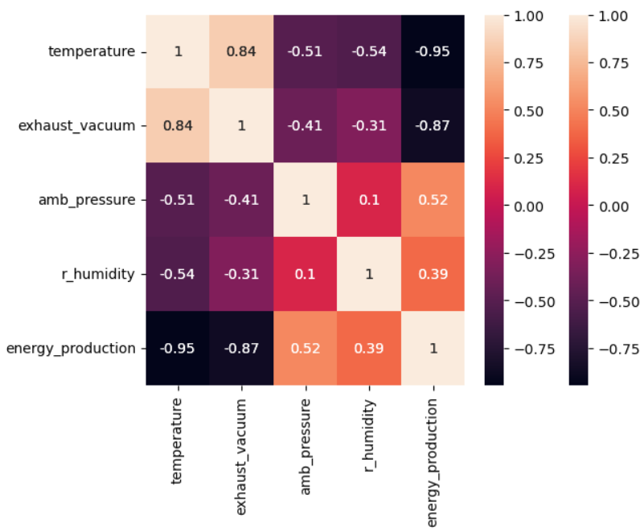
Heatmap:
In heatmap we can see the correlation between the features and the labels.
We can clearly see that temperature is having the highest correlation with the target variable (-0.95).
Exhaust vacuum also has strong correlation with energy production(-0.87).
Both temperature and exhaust vacuum have a negative correlation with the energy production which indicates that if one increases the other decreases.
Temperature and the exhaust vacuum is also having strong correlation with each other which might be a problem.

Slide 12
Skewness, Correlation & Outliers:
Exhaust vacuum and ambient pressure are right skewed or positive skewed.
Temperature and r_humidity are left skewed or negative skewed.
Temperature and exhaust vaccum are highly correlated.
After normalize data we take X is independent variable and Y is dependent variable.
The correlation between the features itself can cause a problem in our model building so we might have to use regularization techniques to solve this.

Slide 13
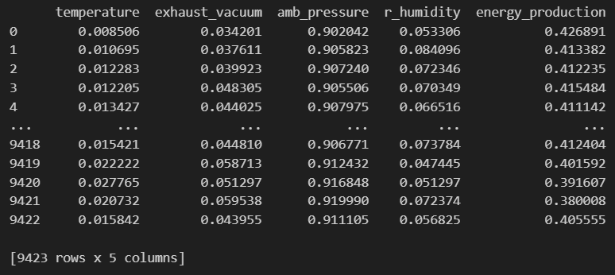
Normalization:
Data set after the normalization.
Normalization can help to improve the performance of machine learning models by making the data more consistent and easier for the model to learn.
Normalization can help to reduce the impact of outliers on the mode.
Normalization can make it easier to interpret the results of a machine learning model.

Slide 14
Model : Multi Linear Regression
Data Splitting
Algorithm
Data was split into train and test with a ratio of 70 to 30. And We train our model on 70% of the data.
Linear regression was used as the regressor here.
Data set Details
Accuracy
Train dataset was consisting of 6596 values and test set was left with 2827 values.
R square is used to get the accuracy of this model ~(0.9268).

Slide 15
Model : Decision Tree Regression
Data Splitting
Algorithm
Data was split into train and test with a ratio of 70 to 30. And We train our model on 70% of the data.
Decision Tree regressor was used as the regressor here.
Data set Details
Accuracy
Train dataset was consisting of 6596 values and test set was left with 2827 values.
R square is used to get the accuracy of this model ~(0.9311).

Slide 16
Model : Polynomial Regression
Data Splitting
Algorithm
Data was split into train and test with a ratio of 70 to 30. And We train our model on 70% of the data.
Linear regression was used as the regressor here.
Data set Details
Accuracy
Train dataset was consisting of 6596 values and test set was left with 2827 values.
R square is used to get the accuracy of this model ~(0.9401).

Slide 17
Model : KNN
Data Splitting
Algorithm
Data was split into train and test with a ratio of 70 to 30. And We train our model on 70% of the data.
Linear regression was used as the regressor here.
Data set Details
Accuracy
Train dataset was consisting of 6596 values and test set was left with 2827 values.
R square is used to get the accuracy of this model ~(0.9478).

Slide 18
Model : Random Forest Regression
Data Splitting
Algorithm
Data was split into train and test with a ratio of 70 to 30. And We train our model on 70% of the data.
Random forest regressor was used as the regressor here.
Data set Details
Accuracy
Train dataset was consisting of 6596 values and test set was left with 2827 values.
R square is used to get the accuracy of this model ~(0.9546).

Slide 19
Final Model Selection:
The Final model that would be used for the future predictions is Random forest Regression Model as it has shown the highest r square value among all the 4 model we had tested our data on.
Polynomial regression can often be more accurate than linear regression for modeling.
Further this model will be used for the deployment.

Slide 20
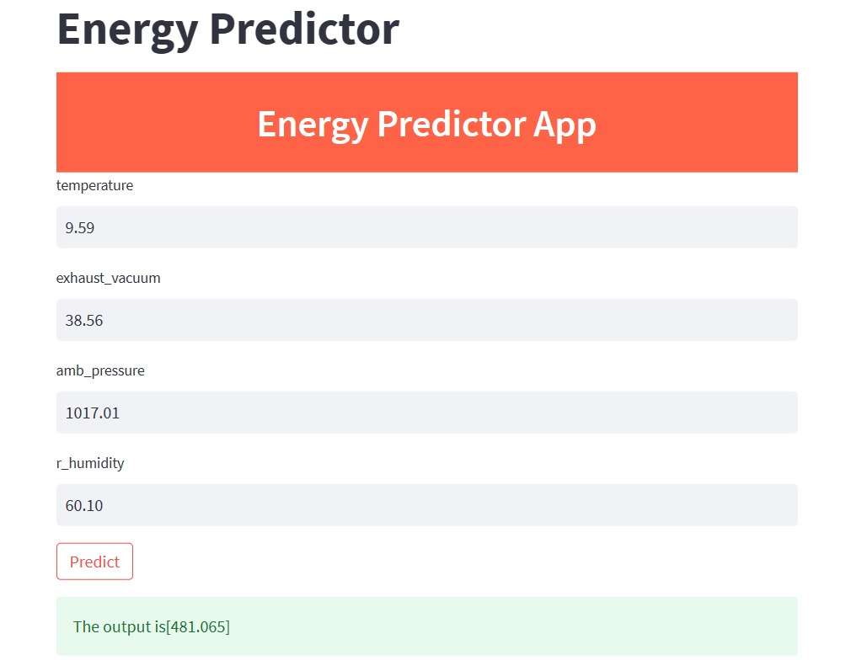
Challenges:
The data had outliers which can cause errors in getting the final results so we try remove them from our data.
To select the best model we had to train our data on different models. And select the model having the best accuracy on basis of the max rsquare and least mse value to predict our future data.
The data itself had multicollinearity between the independent variables, which creates challenges in the regression analysis because it becomes difficult to determine the individual effect of each independent variable on the dependent variable accurately.
The deployment is also a big challenge in itself so we tried to learn about it on youtube, skitlearn, and some other sites.

Slide 21
Thank You!
23-sept-23

