Slide 1


SNUwagon
Progress report
Group4

Slide 2
SNUwagon
Information trading platform

Slide 3
Settings
Backend
Python 3.5.2
Django 2.0.4
Django Rest Framework 3.8.2
PostgreSQL 9.5
Frontend
Node.js 8.5
React 15.4
Redux 3.6

Slide 4
Main goal of iteration 1, 2
Building right structure for cooperation
Continuous integration
Code coverage
Coding convention
Testing
API documentation

Slide 5
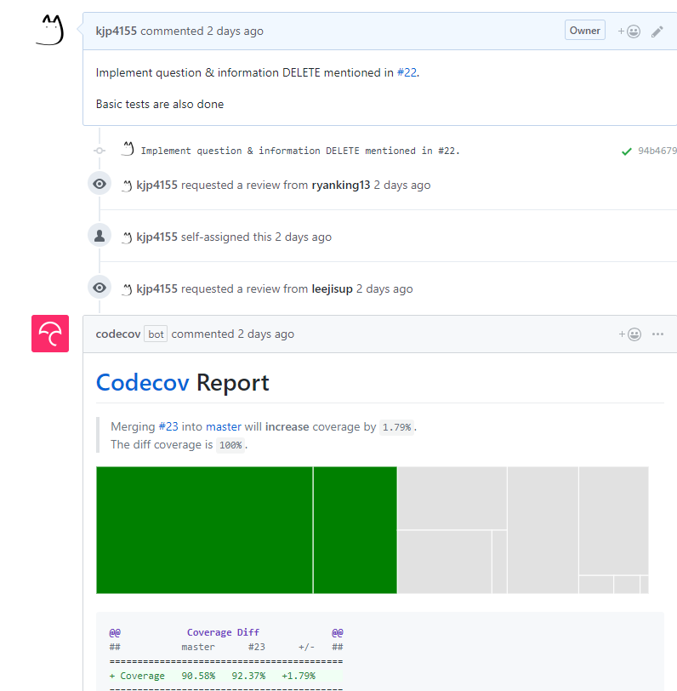
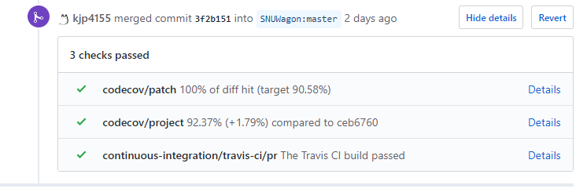
Continuous integration
Travis CI
PR are rejected if build fails.
Codecov
PR can be rejected if code coverage decreases.

Slide 6
Coding convention
Python – PEP8 (flake8)
Javascript – Airbnb javascript style guide (eslint)

Slide 7
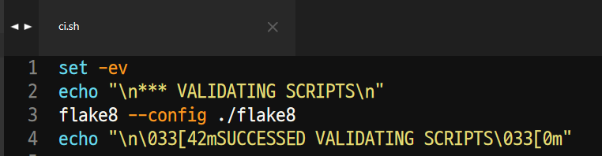
Forced Coding convention
Travis CI build setting
Git pre commit hook

Slide 8
API documentation
drf-yasg module
django-rest-swagger has compatibility issue with DRF > 3.6

Slide 9
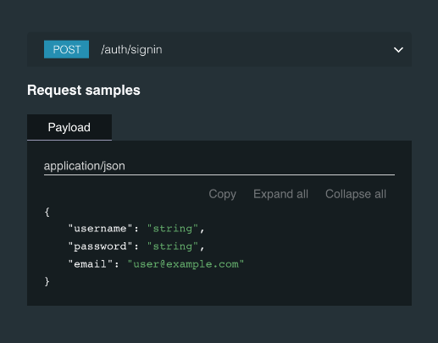
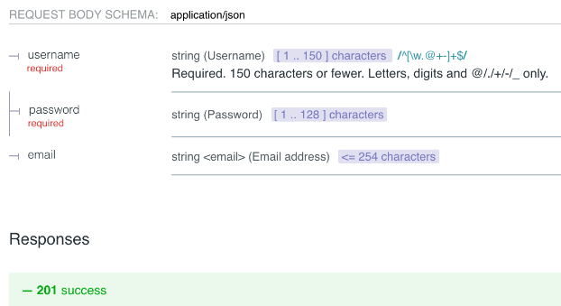
API documentation

Slide 10
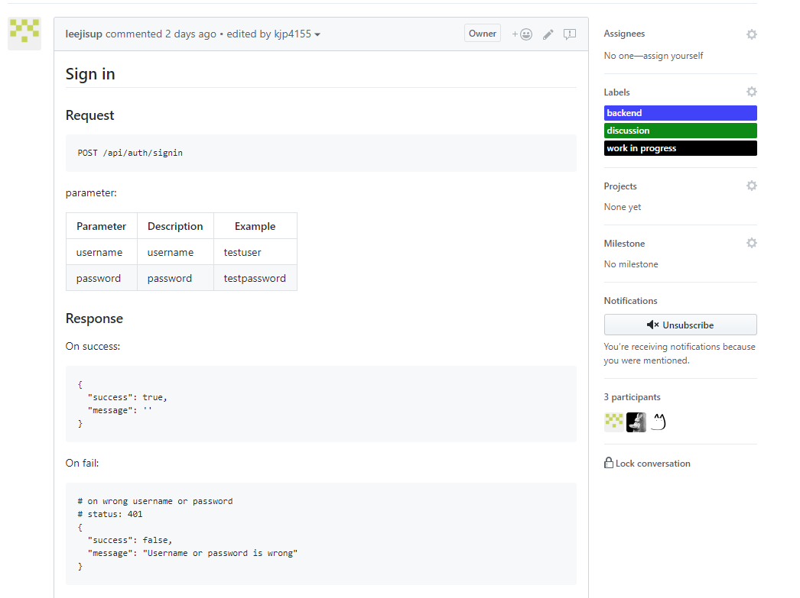
API documentation (informal)
Also using github issue
Due to implementation load

Slide 11
Implementation
Sign up
Sign in
Question write
Question read
View Question list

Slide 12
Division of work
Management: 최경재
Backend: 김진표, 이지섭
Frontend: 김도윤, 최경재

Slide 13
Demo

