Slide 1

Reusable layouts · Based on Ch1_SI.pdf
Simple Academic
Presentation
1 Text and explanation
2 Figures and supporting notes
3 Tables and equations
Notes:
Template cover. Replace title, context line, outline, and optional APL logo. Source: user-supplied Ch1_SI.pdf, p. 1. Use 16:9, 13.333 × 7.5 inches by default. These are example layouts, not a required deck sequence. Default body 22 pt; do not reduce essential content below 20 pt.

Slide 2
Text and explanation
Use one broad text area for the slide’s main explanation.
Keep the body at 22 pt. Use short paragraphs or four to five bullets when they fit naturally.
Let each point explain a complete idea. Avoid turning every phrase into a separate box.
Split a crowded slide before reducing the text size.
Leave unused space white once the content is readable.
2
Notes:
Based on Ch1_SI.pdf, pp. 2–5, 9–13, 20–21. Title 28 pt navy, body 22 pt near-black, 0.6-inch side margins. Original body is predominantly 18–20 pt; this template raises its default to 22 pt for readability. One body placeholder contains native PowerPoint bullets; wrapped lines align with the text. Usually 3–5 points and approximately 70–100 English words; line count and visual fit control, not a rigid bullet count.

Slide 3
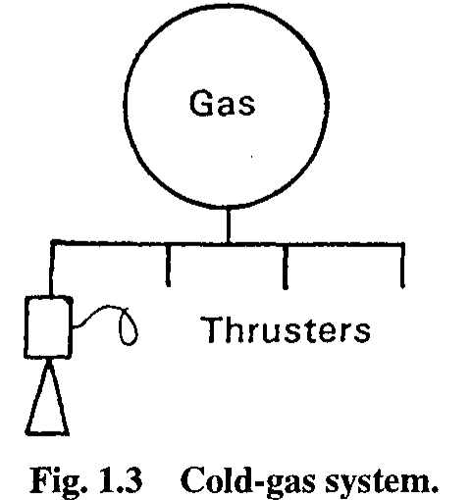
Text with one supporting figure
Use a figure only when it helps explain the subject.
Give the text and figure enough room to remain readable.
Keep labels close to the feature they describe.
Move the figure to its own slide if either area becomes crowded.
Example from the supplied PDF
3
Notes:
Based on Ch1_SI.pdf, pp. 6 and 14–16. Source image: p. 14, Fig. 1.3; retained as supplied, not a new engineering diagram. Replace the image with the new topic’s evidence. Widescreen layout: approximately 58% text, 5% gap, and 37% figure area. Preserve image aspect ratios. No panel background or decorative frame. Key figure labels should be ≥18 pt where editable; redraw from data or split the visual if source labels are too small. The figure object is an image, not an editable schematic.

Slide 4
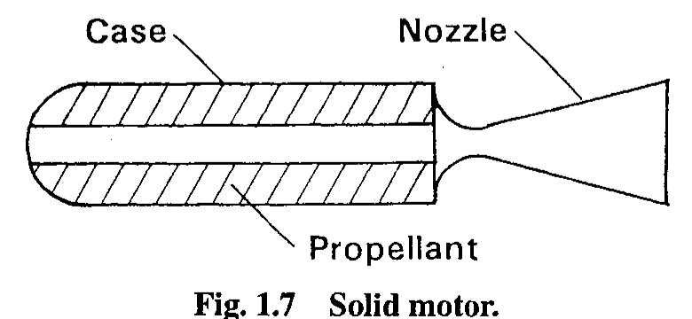
A figure with a short explanation
Use most of the slide for the evidence the audience needs to inspect.
Add one or two observations below it. Put detailed derivations and full references in the notes.
4
Notes:
Based on source figure-dominant slides Ch1_SI.pdf pp. 8, 17 and 19. Source image here: p. 18, Fig. 1.7. The historical drawing is a sample image only. Keep the full original figure without distortion. The source has 13–15 pt figure explanations on some slides; this template uses 22 pt observations instead and limits their number.

Slide 5
Typography settings
Element | Reference | Template
Slide title | 28 pt | 28 pt
Main body | Mostly 18–20 pt | 22 pt
Essential labels | Varies | 18–20 pt
Page number | 11 pt | 11 pt
Use a small native table with readable cells.
Split large tables across slides.
5
Notes:
A native, editable table, extending the source’s plain table layout (Ch1_SI.pdf p. 19). Typography measurements are from PDF text spans. White cells, minimal neutral rules, no zebra striping or colored blocks. Default 20 pt cells; maximum around 5–6 data rows and 3–4 columns only if content fits. The original PDF embeds its table as an image.

Slide 6
An equation with its assumptions
Δv = Isp g₀ ln(m₀ / mf)
Define each symbol immediately below the equation.
State the assumptions needed to interpret the result.
Use a short worked example when the numbers clarify the method.
Put a long derivation on a separate slide or in an appendix.
6
Notes:
An added technical layout using the same source typography and chrome; not a layout copied from the source PDF. The rocket equation is editable text with Unicode symbols, not a native Office Math equation. Replace it with an editable equation suited to the new content; keep symbols and indices readable. Example symbols: Δv ideal velocity increment; Isp specific impulse; g₀ reference gravity; m₀ initial mass; mf final mass. Equation is illustrative template content, not a mission result.

