Slide 1
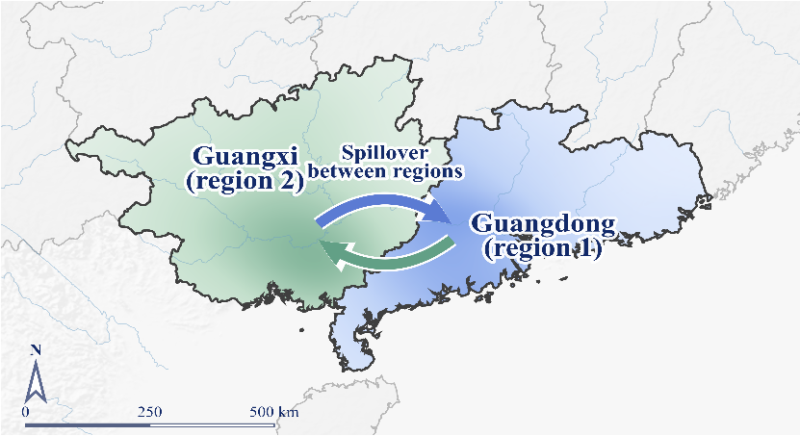

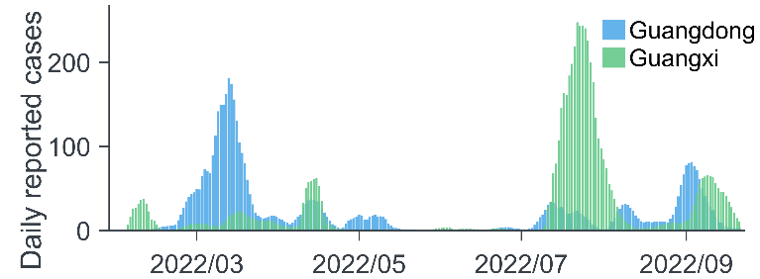
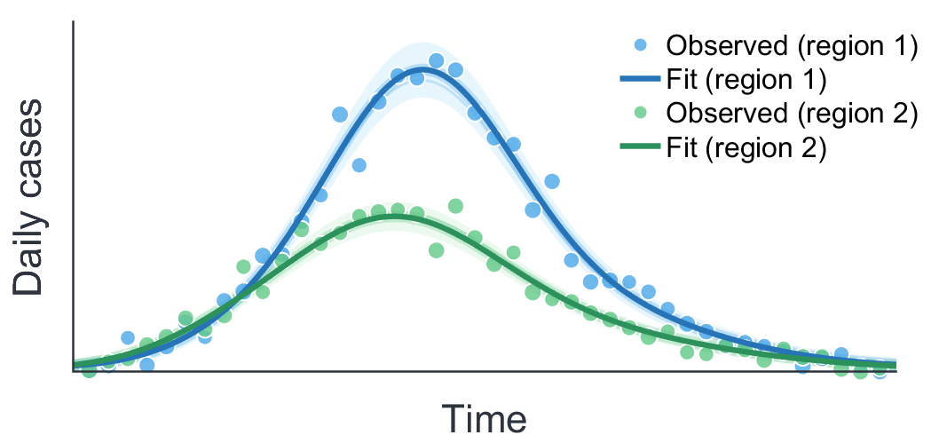

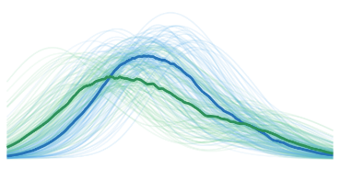

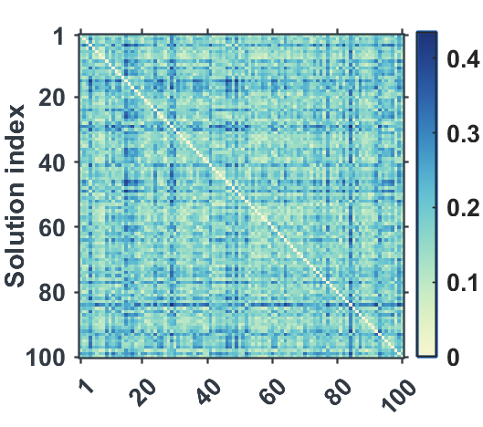





















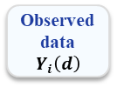







a
b
c
Study setting and epidemic data
Two-region mechanistic model
UDE-based inference
Two neighboring provinces in South China
Coupled epidemic system with bidirectional spillover
Neural time-varying functions with differentiable RK4 integration
Guangdong ($i = 1$)
Guangxi ($i = 2$)
Region-specific neural networks (time-varying functions)
Differentiable
RK4 ODE solver
Model states
x(t)
$$Sᵢ$$
$$λ_{i}\left(t\right)$$
$$Iᵢ$$
$$γ$$
$$Rᵢ$$
$$Φ_{1→2} (t)$$
$$Sᵢ$$
$$λ_{i}\left(t\right)$$
$$Iᵢ$$
$$γ$$
$$Rᵢ$$
$$c1\left(t\right)$$
$$q1\left(t\right)$$
$$m1\left(t\right)$$
$$d1\left(t\right)$$
$$dx/dt = f(x(t), θ(t))$$
$$q_{i}\left(t\right)$$
$$μ$$
$$γ$$
$$q_{i}\left(t\right)$$
$$q_{i}\left(t\right)$$
$$γ$$
$$q_{i}\left(t\right)$$
Time t
$$q_{i}\left(t\right)$$
$$Φ_{2→1} (t)$$
$$μ$$
RK4
(integrable &
differentiable)
...
$$S_{qi}$$
$$I_{qi}$$
$$Cᵢ$$
$$S_{qi}$$
$$I_{qi}$$
$$Cᵢ$$
$$c2(t)$$
$$q2\left(t\right)$$
$$m2(t)$$
$$d2(t)$$
(reported cases)
(reported cases)
Predicted daily cases $Ŷ_{i}\left(d\right)$
Cross-regional spillover: $Φ_{i→j}\left(t\right)= m_{i}\left(t\right)\left(1−q_{i}\left(t\right)\right)·β·c_{i}\left(t\right)·S_{i}\left(t\right)·\frac{I_{i}\left(t\right)}{N_{i}}+d_{i}\left(t\right)·I_{i}\left(t\right)$
Eight time-varying outputs
Within-region transmission hazard (i) : $λ_{i\left(t\right)}= β·c_{i}\left(t\right)·\frac{I_{i}\left(t\right)}{N_{i}}$
Shared parameter $β$
Reported cumulative cases: $\frac{dC_{i}\left(t\right)}{dt}= q_{i}\left(t\right)·β·c_{i}\left(t\right)·S_{i}\left(t\right)·\frac{I_{i}\left(t\right)}{N_{i}}$
Loss
(versus observed)
Observed data
$$Y_{i}\left(d\right)$$
Fixed constants
$$γ = μ =\frac{1}{7}$$
Daily reported cases: $Y_{i}\left(d\right)= C_{i}\left(d+1\right)− C_{i}\left(d\right)$
d
e
Fixed constants: $γ = μ =\frac{1}{7}$
f
Baseline admissible reconstruction
Diverse admissible solution ensemble
Counterfactual strategy analysis and robustness
One ODE-exact admissible solution
Constructing many data-compatible mechanistic solutions
3 × 3 timing strategies across solutions
Baseline solution
(1 example)
Many admissible
Solutions
N = 100 main ensemble
N = 30, 50 sensitivity
Admissible
solutions
(N = 100)
3 × 3 timing strategies
Policy evaluation
across solutions
Region 1 (Guangdong)
Region 2 (Guangxi)
N
H
L
Outcomes across
admissible solutions
N
NN
NH
NL
H
HN
HH
HL
Pairwise distance matrix
Diverse but data-compatible
trajectories
Multiple admissible solutions fit the data
Substantial heterogeneity across solutions
Used for counterfactual analysis
L
LN
LH
LL
Compare strategies
(e.g. cumulative cases,
peak size, timing)
N: normal H: high risk L: low risk
• Most rankings are solution-dependent.
• HH vs LL remains robust across admissible solutions.
8 learned
time-varying
functions
ODE-exact
trajectory
Baseline
reference
solution

