Slide 1




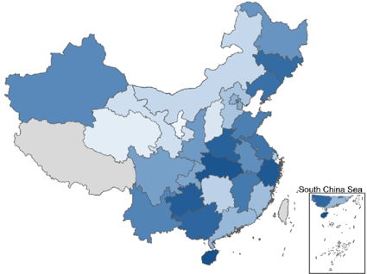



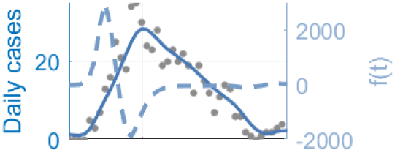



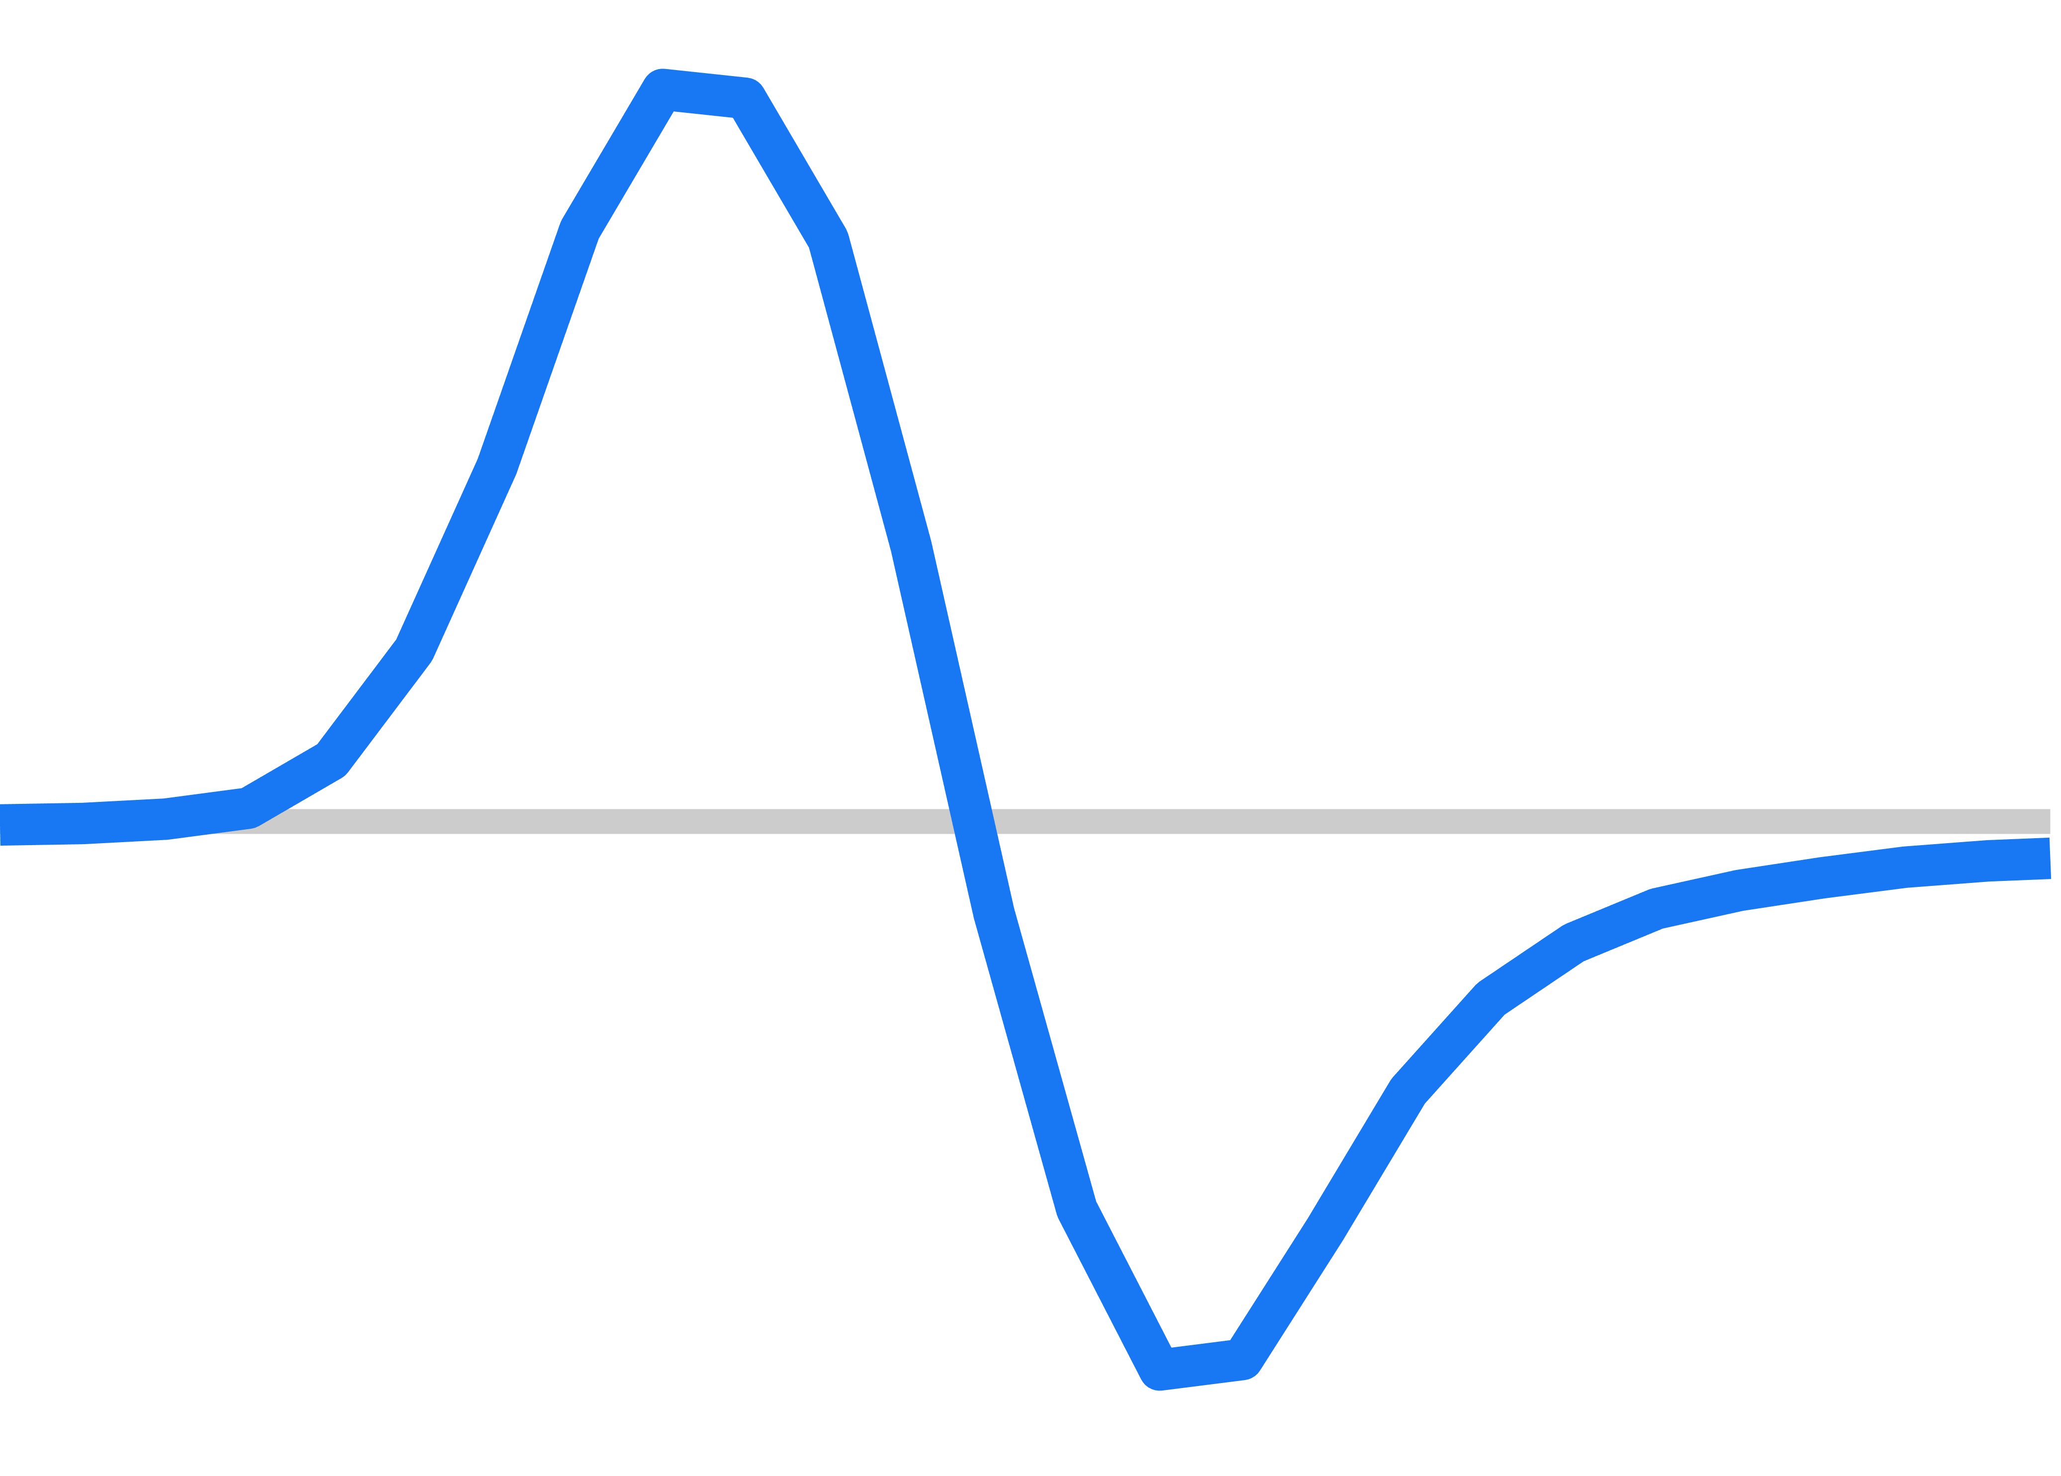
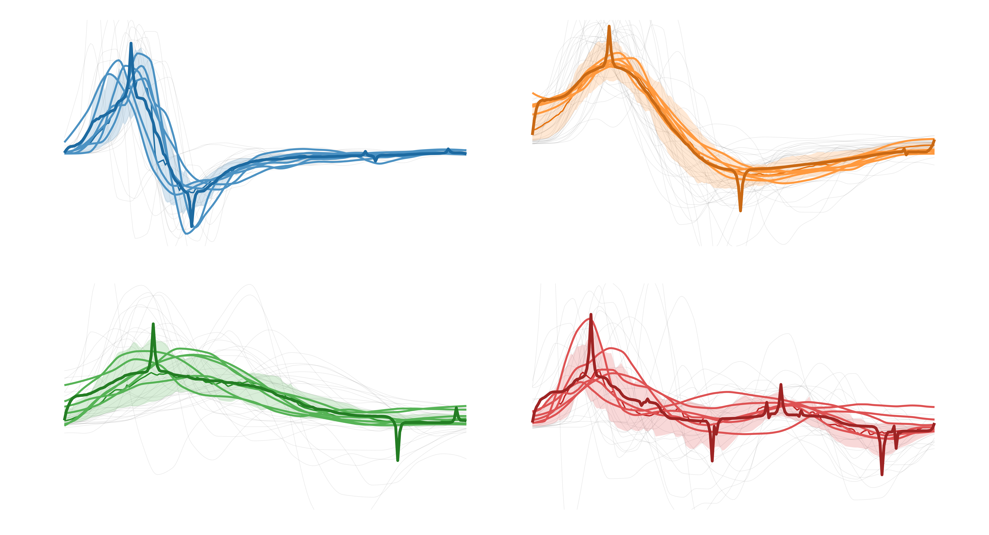

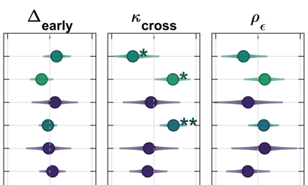
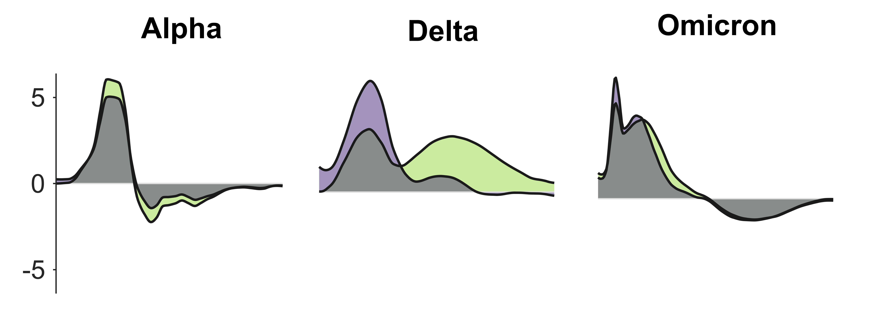
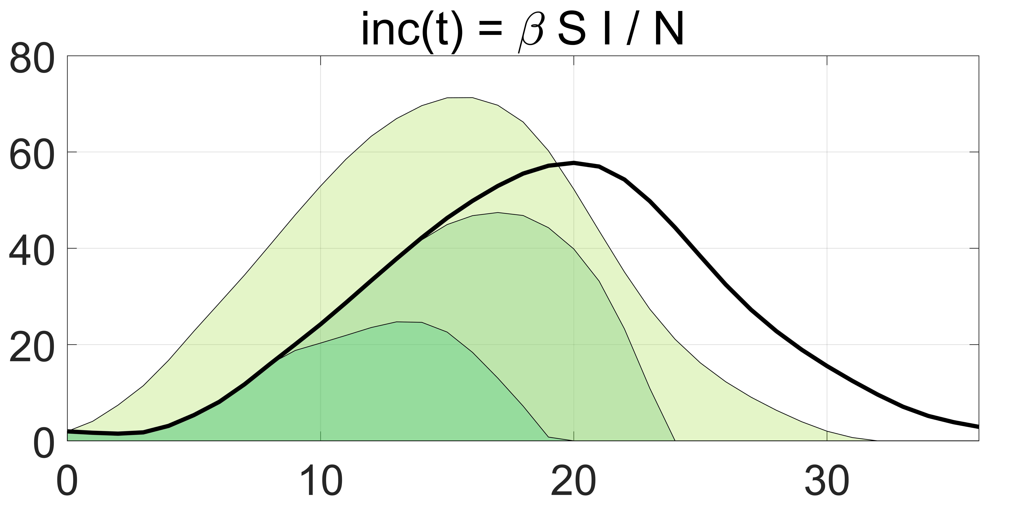
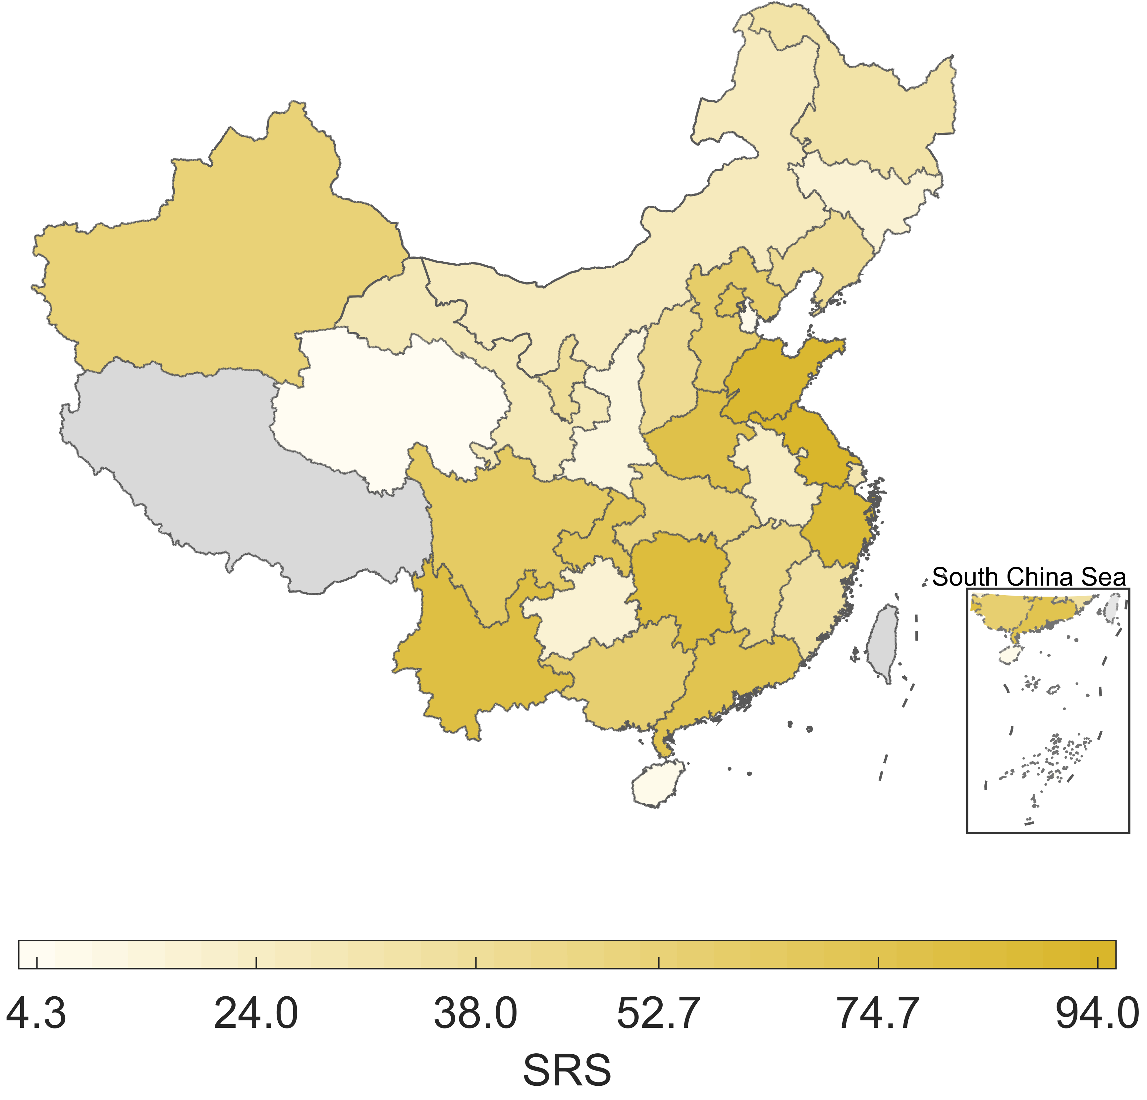
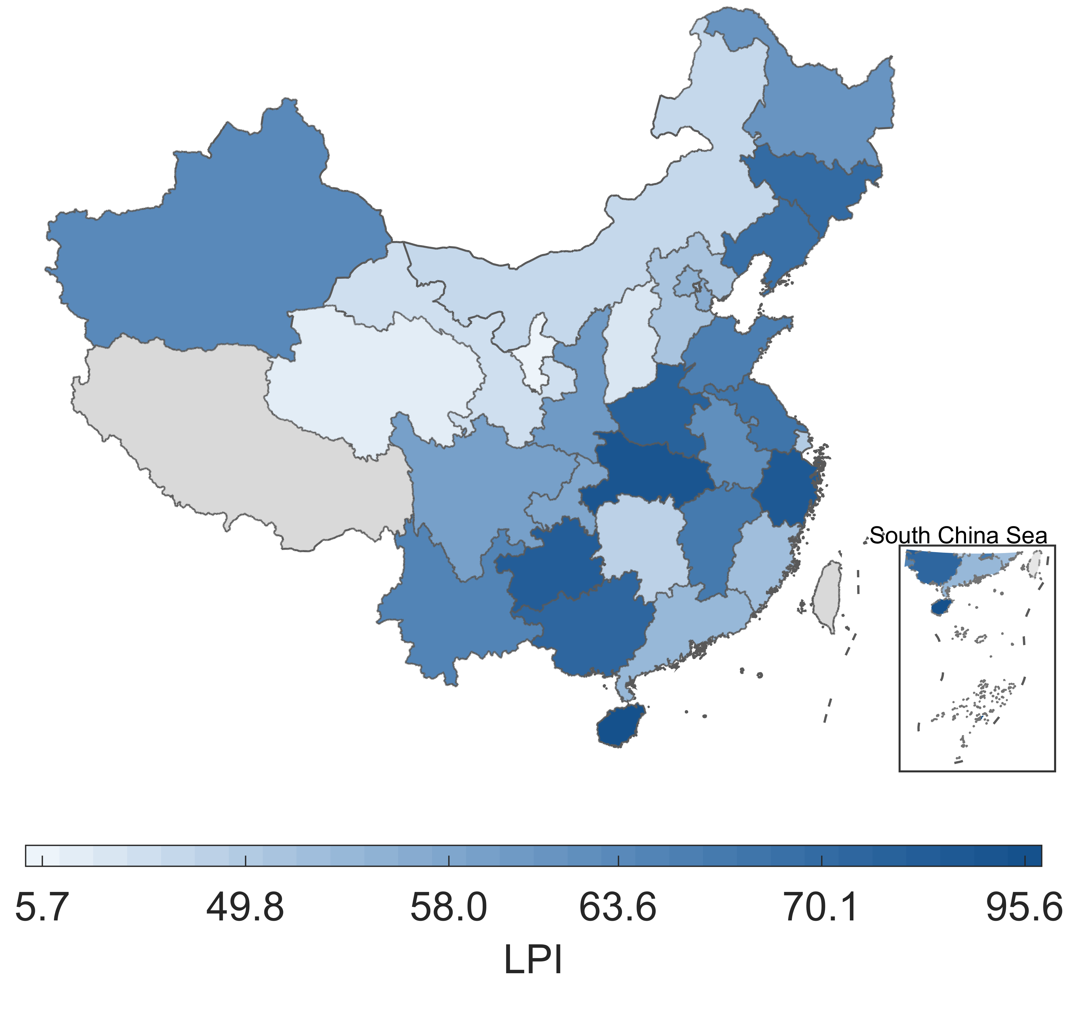



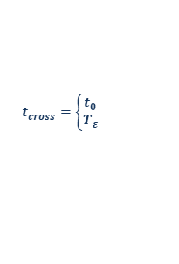







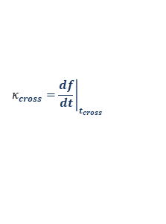



1. Data & problem setup
Learn an interpretable susceptibility mobilization function, $f(t)$, for each wave that bends the epidemic curve
210 province-level waves ｜ 30 provinces
Original/Alpha → Delta → Omicron
Tourism
Urbanicity
Healthcare
Economy
2021.6 2022.1
Climate
Mobility
Population
Domains will be used for alignment (HBM)
2. PINN learning of SMF
$$S_{e}$$
$$f(t)$$
$$I$$
$$R$$
$$S$$
Physics-informed
covariate-free
Output
$f\left(t\right)$ and fitted curve
for 210 waves
3. Morphology & shape landscape
SMF -- $f(t)$
$∆_{early}=t_{cross}$- $t_{inc−slope}$
FPCA and prototype clustering
fast-rise/fast-decay
steady/steady
$$κ_{cross}={\left.\frac{df}{dt}\right|}_{t_{cross}}$$
$$t_{cross}=\left\{\begin{matrix}t_{0} \\ T_{ε}\end{matrix}\right.$$
$$t_{f,max}$$
$$\text{near}\text{-}\text{zero} \text{threshold}$$
slow/slow
multi-wave rebound
$$t_{inc−slope}$$
$$t_{f,min}$$
4. Alignment with societal context & period sensitivity
Morphology targets
Urbanicity
Population
Hierarchical
Bayesian
alignment
Mobility
Economy
Climate
Healthcare
Delta, high-context settings exhibit later, broader mobilization
Tourism
Fix effect across targets
5. Context-aware action guidance
Level ≠ Progress
East-high/west-low with exceptions
Different winners for LPI
Timing beats intensity

Slide 2











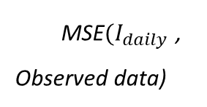
$$f(t)$$
$κ$ kernel: $\frac{d}{dt}x\left(t\right)≈\frac{x_{t+Δt}−x_{t−Δt}}{2Δt}$
$$9×128$$
$$S_{e}$$
$$S$$
$$\frac{d}{dt}$$
$$physic loss$$
$$Loss$$
$$R$$
$$I$$
MSE${(I}_{daily}$ ,
Observed data)
Input
t

Slide 3
