Slide 1
Portrait Optimization Via Deep Learning Networks:
A Framework for Context-Aware Photography Recommendations
Shriya Nair & Bucky Hayes
Institute for Computing in Research Summer 2025

Slide 2
Motivation
Photo-aid

Slide 3
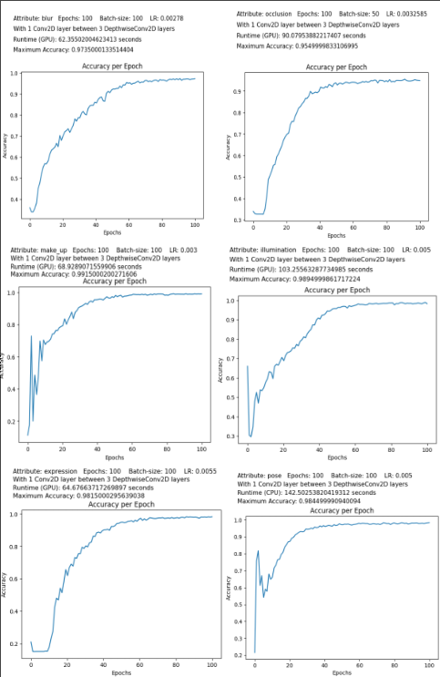
Motivation
Photo-aid

Slide 4

What Is a Neural Network?
P., Petru. “What Is a Neural Network & How Does It Work? Ai Guide.” Roboflow Blog, Roboflow Blog, 14 Jan. 2025, blog.roboflow.com/what-is-a-neural-network/.

Slide 5
What Is a Neural Network?
Neurons
Activation

Slide 6
What Is a Neural Network?
Neurons
Activation
Normalization
Weights
Bias
Loss

Slide 7
What Is a Neural Network?
Neurons
Back-propagation
Activation
Normalization
Weights
Hyper-parameters:
Bias
Epochs
Loss
Learning Rate
Batch-size

Slide 8
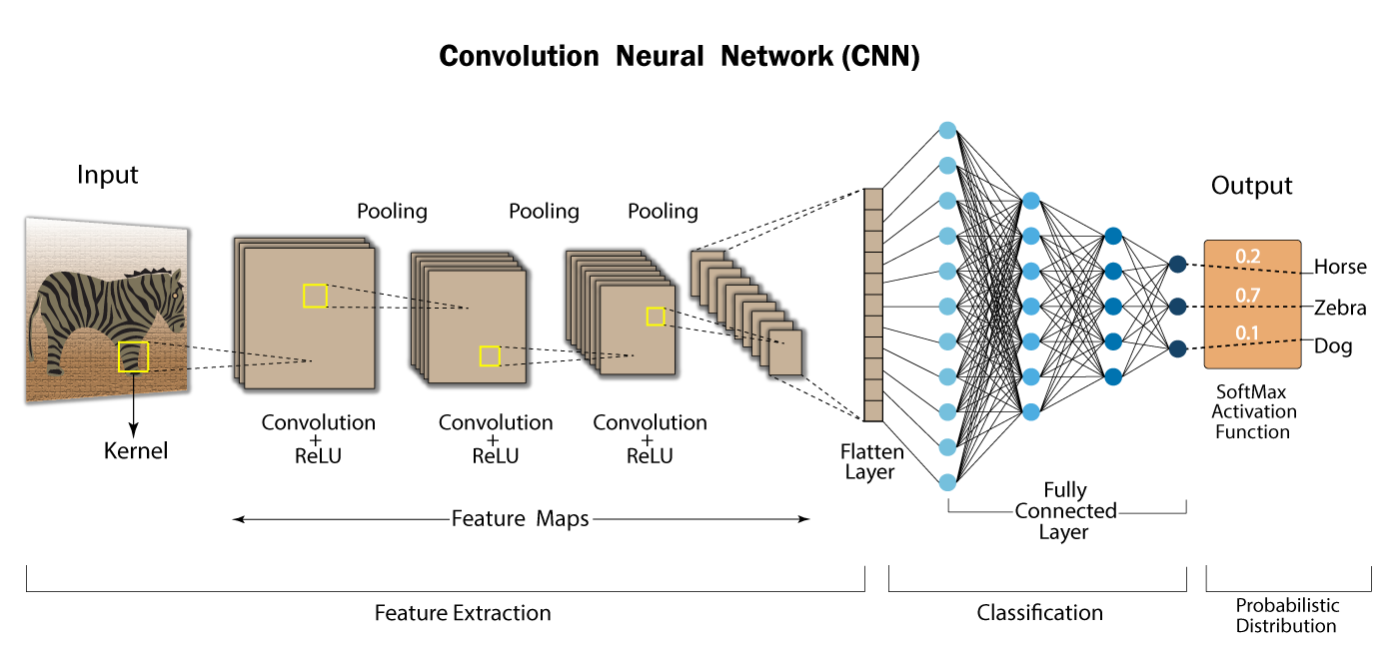
What Is a Neural Network?
Swapna, & Sulthandudekula. (2025, February 8). Convolutional Neural Network: Deep learning. Developers Breach. https://developersbreach.com/convolution-neural-network-deep-learning/

Slide 9
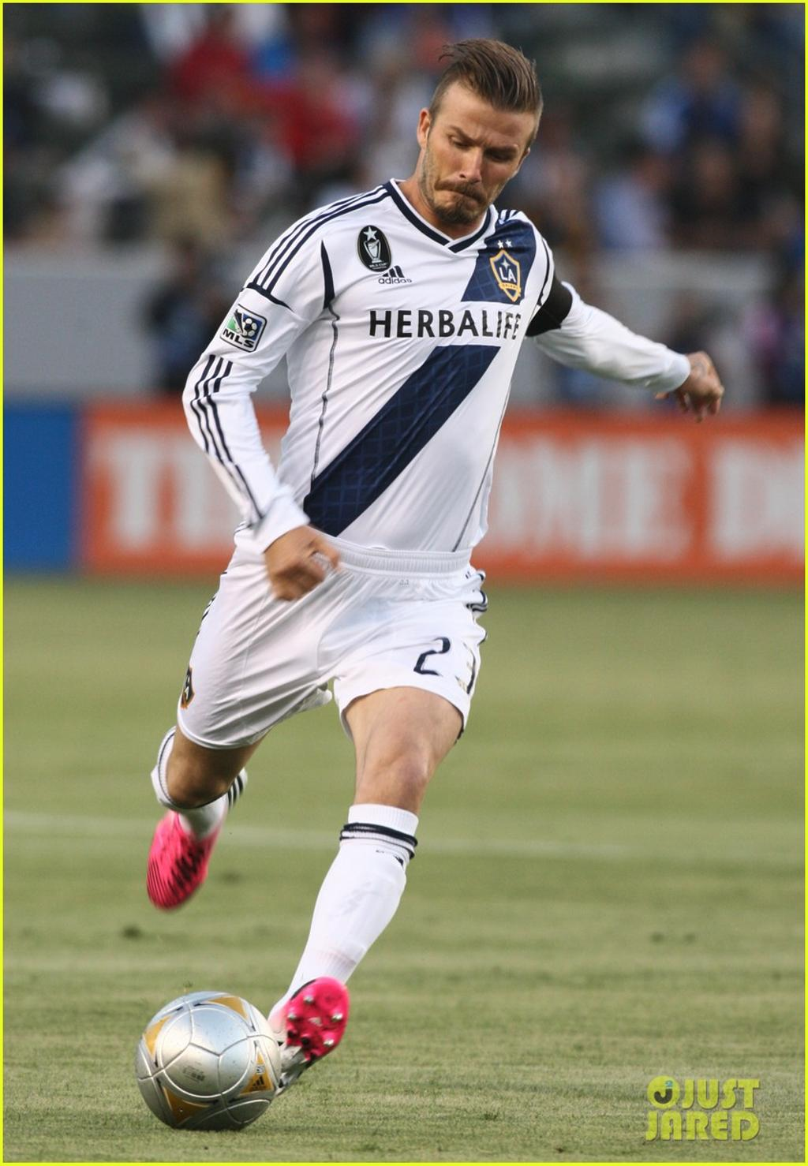
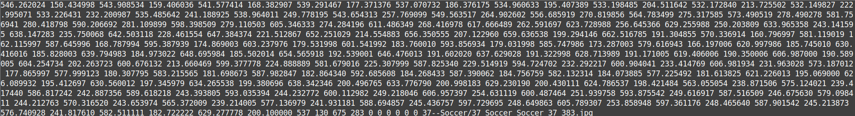
Wider Facial Landmarks in the Wild (WFLW)
Dataset
< image1, label1>

Slide 10
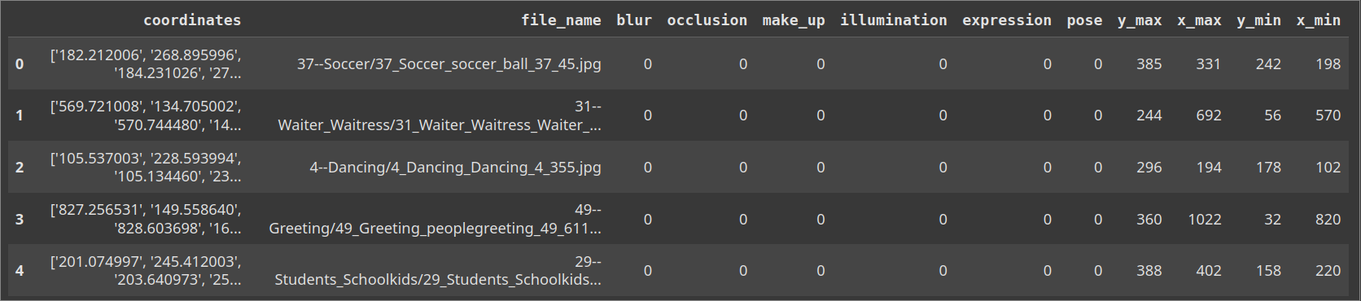
Wider Facial Landmarks in the Wild (WFLW)
Dataset

Slide 11
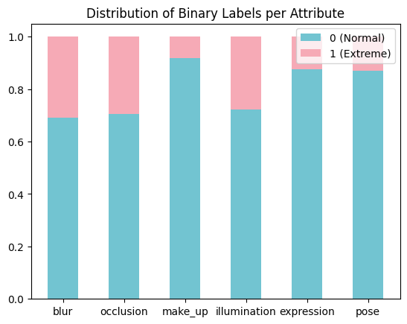

Slide 12
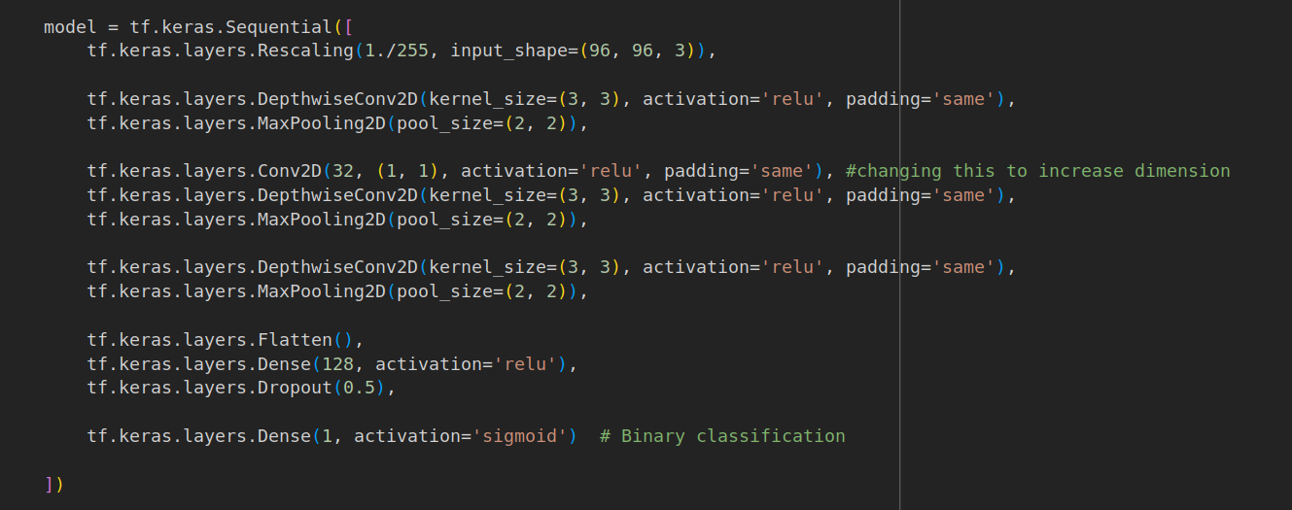

Slide 13
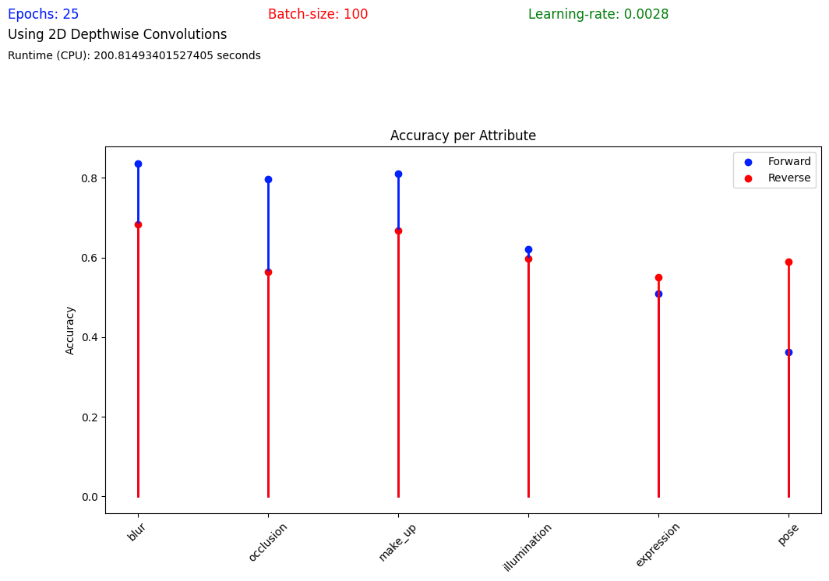

Slide 14
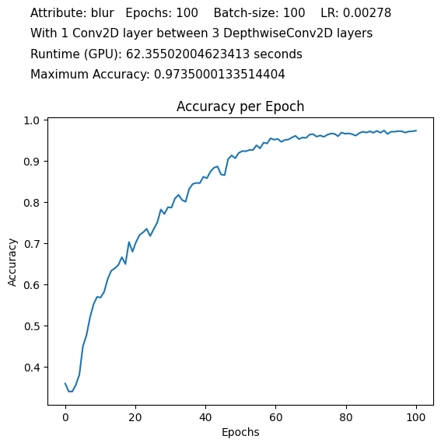
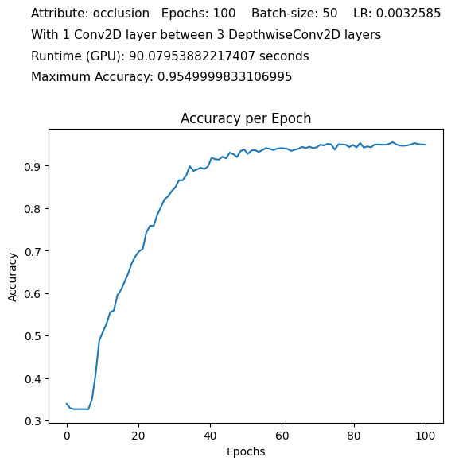
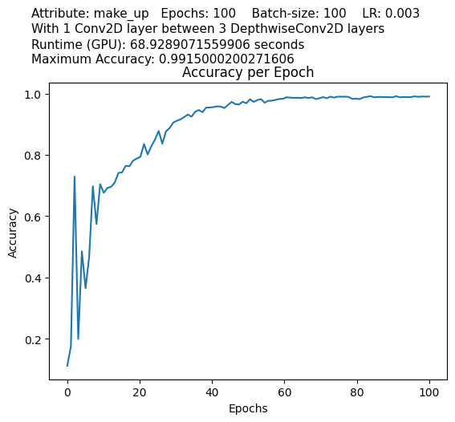
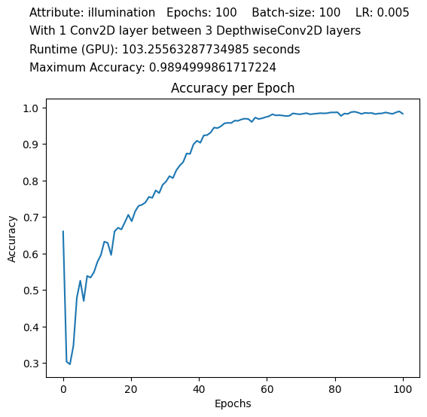
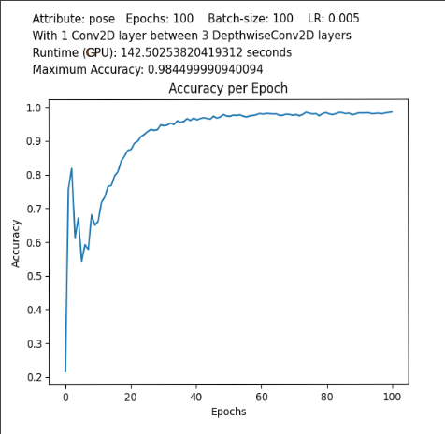
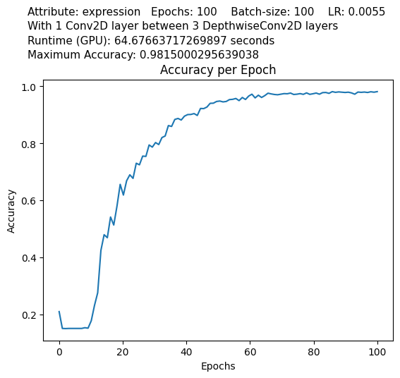
Accuracy per Epoch graph for each Attribute

Slide 15
Training Results
 | Blur | Occlusion | Make Up | Expression | Illumination | Pose
Accuracy | 97.3% | 95.5% | 99.1% | 98.2% | 98.9% | 98.4%
Learning Rate | 0.00278 | 0.003285 | 0.003 | 0.0055 | 0.005 | 0.005
Batch-size | 100 | 50 | 100 | 100 | 100 | 100

Slide 16
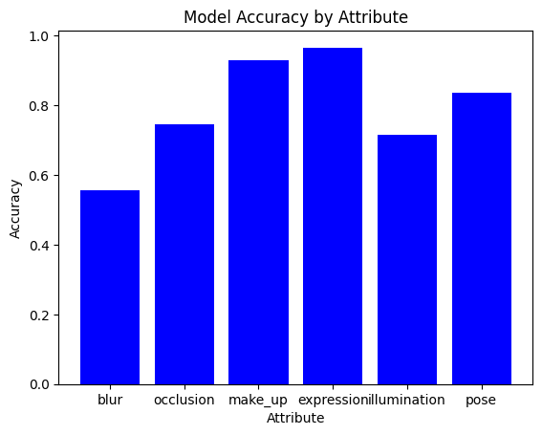
Testing Results

Slide 17
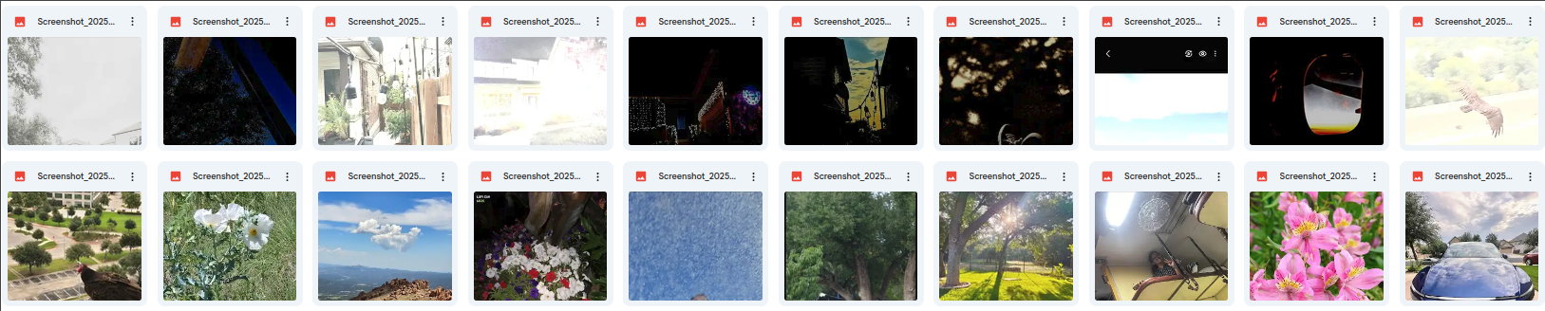
Testing Results
Extreme Illumination:
“Normal” Illumination:

Slide 18
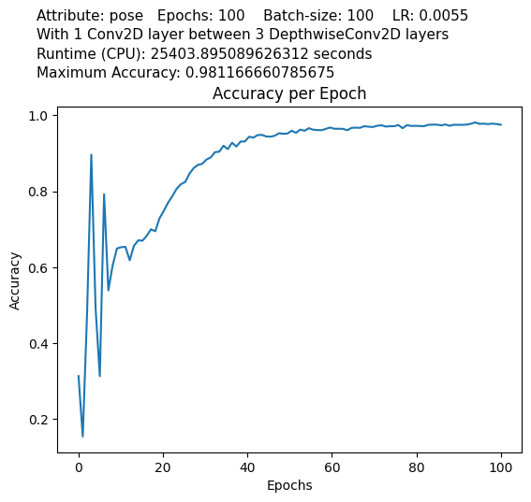
CPU vs GPU
C
G

Slide 19
Outcomes
- Used Tensorflow, Keras, Open-CV Libraries through Google Colab
- Created Neural Networks to classify blur, occlusion, make up, illumination, expression, and pose into binary categories
- Experimented with different training conditions
- Tested using WFLW data and personal data

Slide 20
What’s Next?
Photo-Aid Application
- Manipulate structure of models
- Diverse models
- CPU time complexity reduction
Similar Applications
- Deep Fake Recognition
- Modular AI vision system

Slide 21
Thank you!

Slide 22
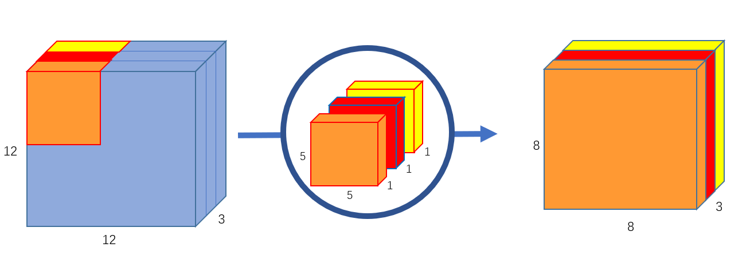
Depthwise Convolution Visual

